Slide 1
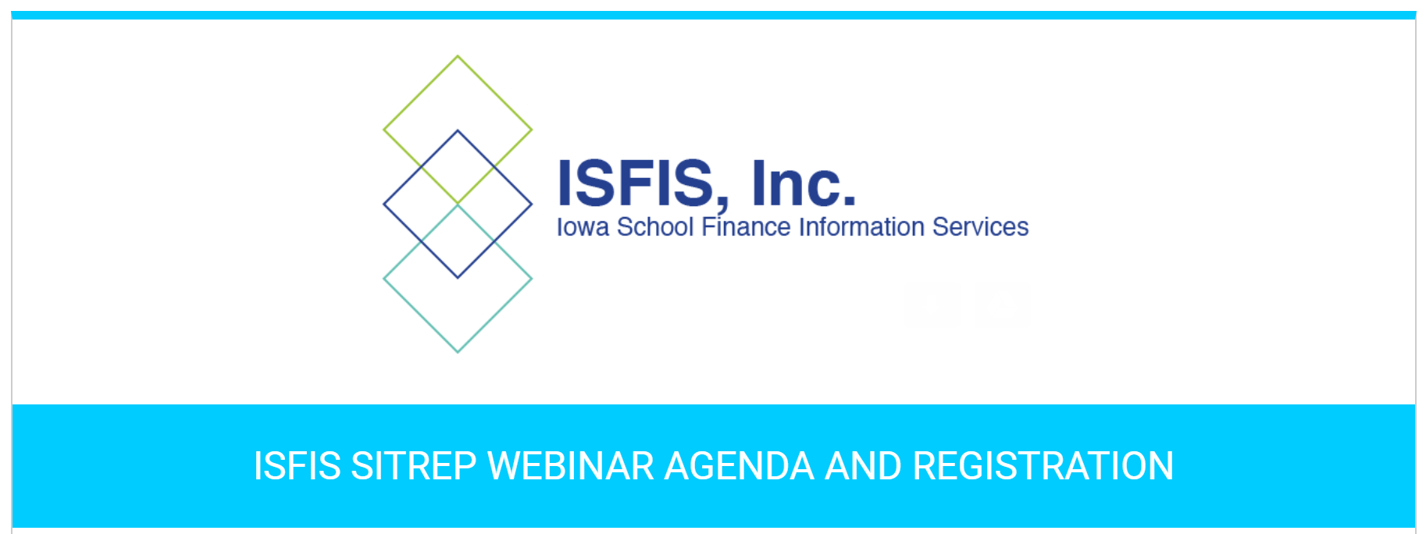
September 21, 2018 Special Education Finance
Margaret Buckton, Partner, ISFIS

Slide 2
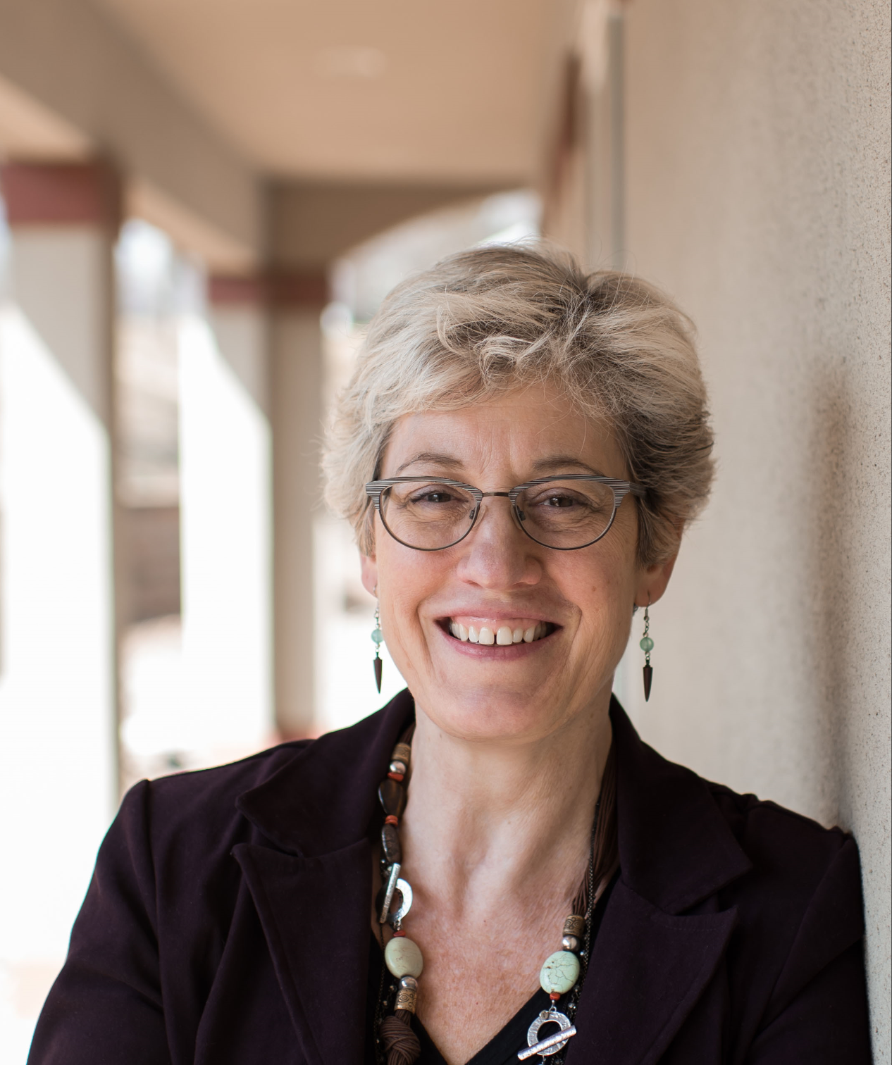
Your Presenter
Margaret Buckton
Partner at ISFIS, Inc.
Professional Advocate for Rural School Advocates of Iowa
Lobbyist for Urban Education Network
Financial member, Drake Head Start Advisory Committee
Instructor at IASBO Academy, Iowa Principal Leadership Academy, Drake, UNI, Iowa State, and Viterbo Universities for administrator programs, and Heartland AEA
Former Assoc. Executive Director of Public Policy, IASB and member of the Lighthouse Study Team
Former Des Moines Public Schools School Board Member
Mother of four graduates of Des Moines Public Schools and Graduate of Hoover High School, Des Moines, and Northwestern University, Evanston, IL.

Slide 3
Iowa School Finance Information Services
In addition to the advocacy and lobbying services for UEN and RSAI;
Our mission is to help schools electronically organize and use data; educate school leaders on school finance issues and other issues affecting their work; and empower school leaders with information and communications tools to connect with staff, parents, community and state level decision-makers to the benefit of students.
Subscription-based model of tools, consulting, expertise on tax policy, school finance, school board processes, communications, and public policy to which school districts subscribe annually.

Slide 4
ISFIS Board Building Blocks
Understanding Special Education Funding

Slide 5
Big Picture
Understand Special Education Funding
Weightings: What they are and how they work
Revenues
Expenditures
Deficit/Surplus
Medicaid match
Impact on financial health of the district

Slide 6
Weightings
Each student that is identified as Special Ed eligible receives one of three weightings based on the services in their Individualized Education Plan (IEP):
Level I 0.72, Level II 1.21, Level III 2.74
This is in addition to the 1.0 weighting
The weighting is multiplied by the District Cost per Pupil
So for example lets take a Level III student:

Slide 7
Weightings
These weightings are set by the SBRC based on experience of school districts statewide
Since they are averages, local costs to deliver special ed services are expected to vary.
Special ed services are labor intensive, ie., staff cost. Actual expenditures by district vary based on experience and advanced degree status of the teacher or years of experience of a paraprofessional.

Slide 8
Revenues
Federal:
In addition to the revenues generated by the formula, districts also receive federal funds
When the IDEA has a “goal” of providing 40% of the funding, the federal government is a long way from that – effectively funding about 14% of the cost
Primary funding is IDEA Part B (approximately $24 million statewide in current fiscal year)

Slide 9
Revenues
Other school districts
Special Education students can open enroll
They can receive services in another district
The receiving district bills the sending district back for the full cost of the services provided
Nonpublic schools
Special Education students are also served in Iowa’s nonpublic schools
The local public school district and/or the AEA provide services to the student in the nonpublic school setting

Slide 10
Revenues
The 1.0 weighting does not all remain in the Regular Program
The General Program Percentage is the amount that stays with the General Education portion, the remainder goes with special ed
Varies by level of student
Level I – varies by district, from 70% to 100%
Level II – 32%
Level III – 27%

Slide 11
Expenditures
Iowa is a “full funding” state
Districts are obligated to provide any service mandated by a student’s IEP (Individualized Educational Plan)
The IEP is created by AEA/District and Parents

Slide 12
Expenditures
Direct cost of providing special ed instruction
Including specialized Phys Ed; training, travel or accommodations to extra curricular activities
Special accommodations to fulfill the IEP
Licensed staff (including para’s providing direct support to eligible students)
Staff development and travel for special education staff (or general staff if the topic is special ed)
Health services included in IEP
Specialized supplies and equipment
Transportation costs (if required in IEP)
Special vehicle costs (only if used by SE)
Open enroll out costs

Slide 13
Non Allowable Expenditures
Operations and Maintenance (overhead)
Capital expenditures
General education program costs (except what is generated by the GPP)
General education student instruction
Private facility or district admin costs (unless approved by SBRC)
Any cost not included in IEP (except those authorized)

Slide 14
AEA Services
There is weighting generated funding for Special Education through the AEA’s
This funds the services that they provide to local districts – eg., speech pathology, professional development, 0-age 3 services, other direct/indirect services
Largest portion of AEA expenditures
Statewide coverage – regionalized delivery model

Slide 15
So What Happens if we Spend More / Less than what the Weightings Generate in Revenue?
If you spend more than the revenues generated by the weighting, you have a Special Ed Deficit
If you spend less than the revenues generated, you have a Special Ed Surplus
Districts receive an automatic grant of spending authority for any amount of deficit (as long as all costs are allowable) if school board passes a resolution requesting the SBRC to grant the spending authority and submits application through the DE portal timely.

Slide 16
So What Happens if we Spend More / Less than what the Weightings Generate in Revenue?
So, at the end of the day, Special Education costs have NO IMPACT on SPENDING AUTHORITY.
If you overspent, you get the spending authority
If you underspent, well, you never spent the money in the first place
If you have a spending authority problem, cutting special ed will not help
If you have a spending authority problem, ensuring that everything allowable in the IEP is being coded to special education may help.

Slide 17
Special Ed Spending
Special Ed Deficits do impact property tax rates – there’s no check from the state for their share
Considerations:
First, make sure that all things required by a child’s IEP are being fulfilled
Second, is your special education population stable or changing?
Enrollment up/down
Weightings shifting
Aging of very high cost students

Slide 18
Medicaid Claiming
Because many of the services provided to special education students are also covered by Medicaid, there is the ability to do what is called Medicaid claiming for services to children eligible for Medicaid (low-income)
This reduces a deficit, because the district gets to count the federal funds received as income.
Feds cover over 60% of covered claims (a total of over $61 million in FY 2017)
School districts return the local/state required match to the Iowa Department of Human Services.
These federal funds offset what would otherwise be property taxes to cover a larger deficit
Medicaid claiming doesn’t give you more student resources: feds reimburse a part of what the IEP requires your district to provide

Slide 19
Resources
Check out the Comprehensive Financial Projection Model
Shows history of weightings and Deficit or Surplus
http://www.iowaschoolfinance.com/comprehensive_financial_projection_model

Slide 20
Board Discussion
The instructions for the activities at your board table to facilitate discussion and confirm understanding are included in your materials from the ISFIS web site.
Enjoy the conversation and let us know if you have any other questions.
Thank you for participating in this Board Building Blocks Module for Local Board Conversations!

Slide 21
Stats about Iowa Students
The number of students in Iowa’s public school districts continues to climb with six years of enrollment gain (follows a 17-year decline of enrollment). DE enrollment projections anticipate about 1,000 student growth every year for at least 5 years.
Minority students make up 23.5% of the student body. The number of minority students in Iowa’s public schools continues to increase and is at an all-time high (113,076).
The percentage of students eligible for free-or-reduced priced lunch in the 2016-17 school year to 41.3%, up from 28.3% in 2000-01. (In 2017-18, it dropped slightly to 40.5%)
The percent of students who are English language learners (ELL) increased from 2.3% in 2000-01 to 5.9% in 2016-17. It climbed further to 6.1% in 2017-18.

Slide 22
FY 2001 Free and Reduced Eligibility (percent of enrollment)
Notice darkest areas > 41%.
Notice how many are in lowest category of 3-23%

Slide 23
FY 2002 Free and Reduced

Slide 24
FY 2003 Free and Reduced

Slide 25
FY 2004 Free and Reduced

Slide 26
FY 2005 Free and Reduced

Slide 27
FY 2006 Free and Reduced

Slide 28
FY 2007 Free and Reduced

Slide 29
FY 2008 Free and Reduced

Slide 30
FY 2009 Free and Reduced

Slide 31
FY 2010 Free and Reduced

Slide 32
FY 2011 Free and Reduced

Slide 33
FY 2012 Free and Reduced

Slide 34
FY 2013 Free and Reduced

Slide 35
FY 2014 Free and Reduced

Slide 36
FY 2015 Free and Reduced

Slide 37
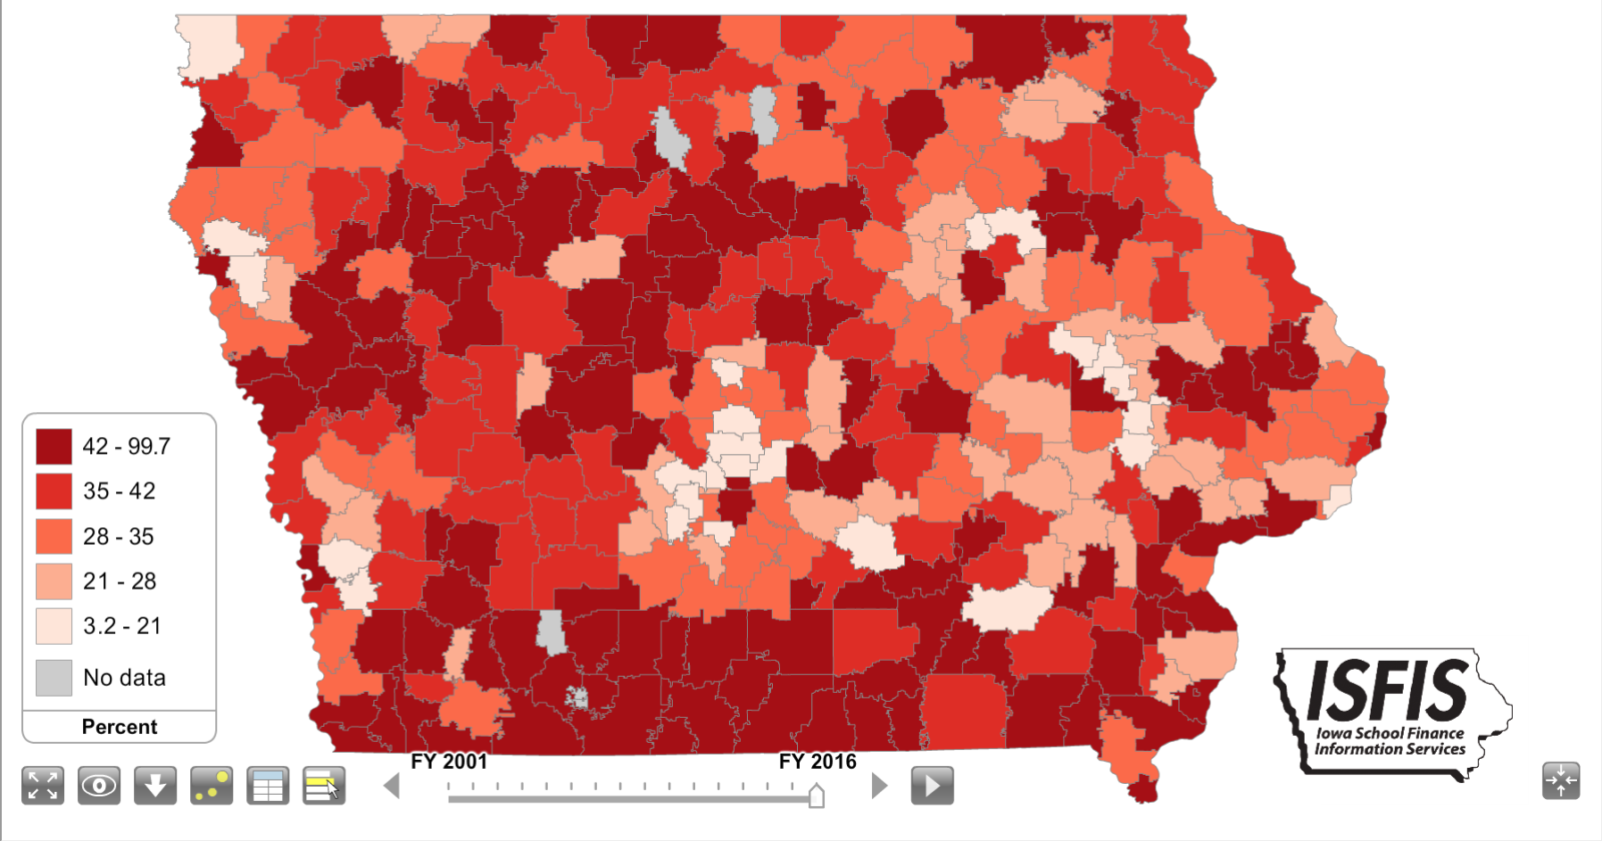
FY 2016 Free and Reduced

Slide 38
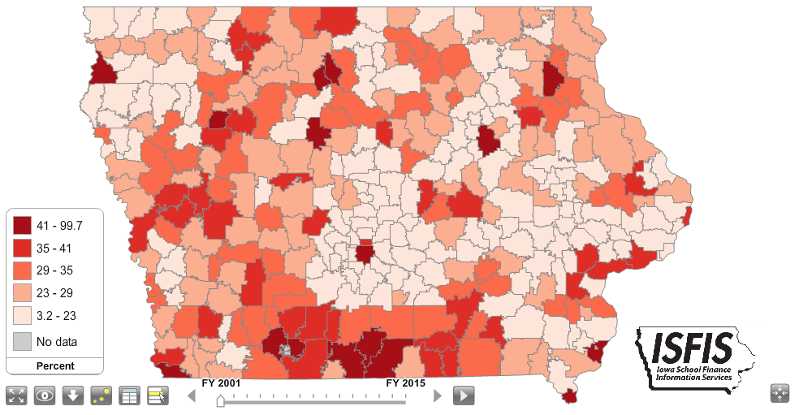
2001
2016

Slide 39
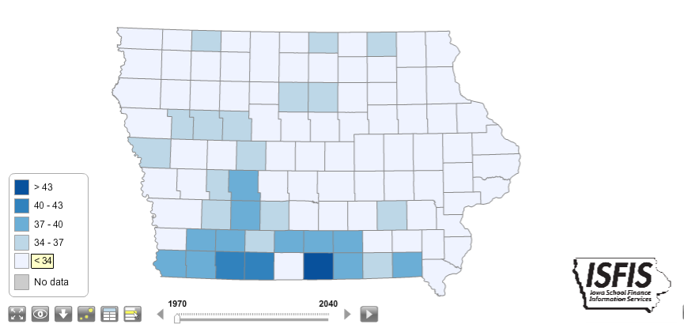
Median Age by County 1970
Notice: How many counties have a median age of over 43 years?

Slide 40
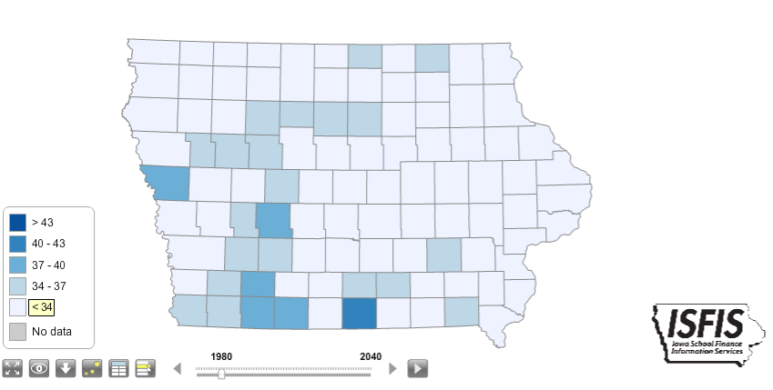
Median Age by County 1980

Slide 41
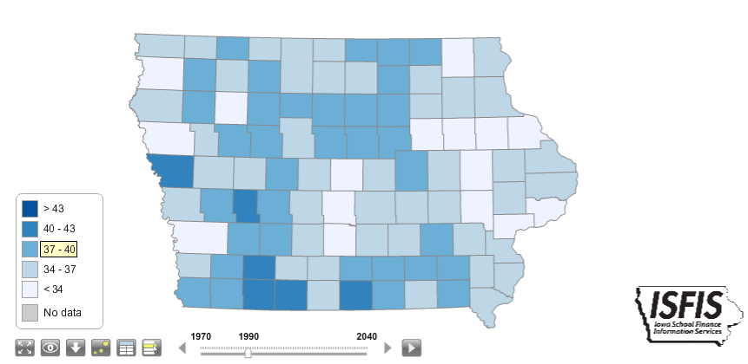
Median Age by County 1990

Slide 42
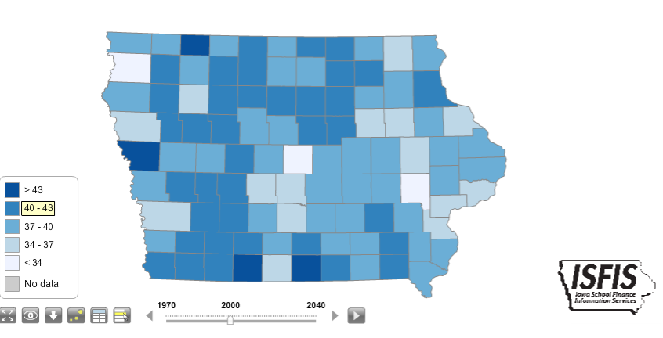
Median Age by County 2000

Slide 43
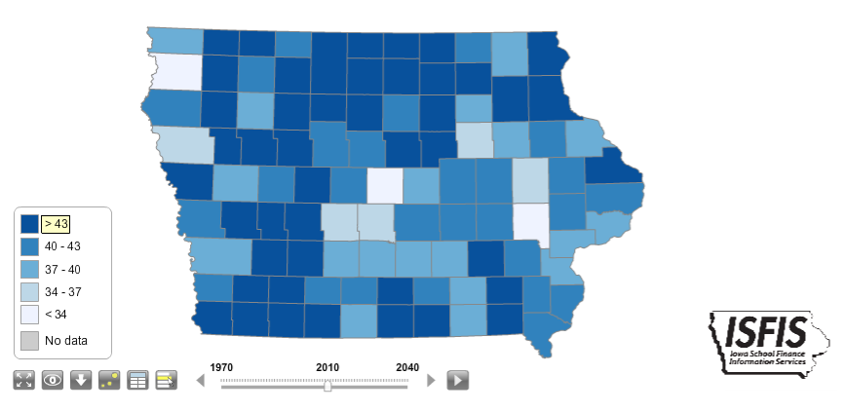
Median Age by County 2010

Slide 44
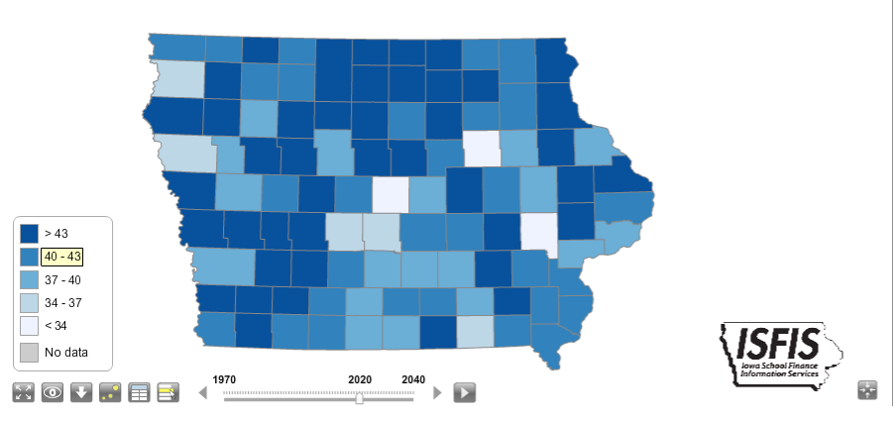
Median Age by County 2020 (est)

Slide 45
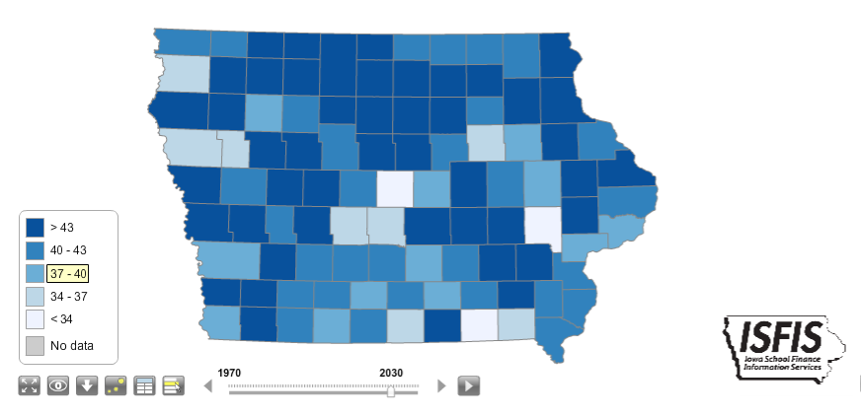
Median Age by County 2030 (est)

Slide 46
Median Age 1970 vs. 2030

Slide 47
12.54% in 1999-00
12.79% in 2011-12
12.54% in 2015-16

Slide 48
Stop, think. . . . and talk to a neighbor: How do demographic changes impact Iowa’s students and education advocates?

Slide 49
Special Education Deficit Dollars in Millions

Slide 50
Special Education Data
2017 | Deficit by Level | Identified /weighted students | Deficit per leveled enrollment
level 1 | $ 55,538,979 | 33,662 | $ 1,650
level 2 | $ 21,869,087 | 14,414 | $ 1,517
level 3 | $ 36,002,824 | 8,737 | $ 4,121
total | $ 106,470,014 | 56,813 | $ 1,874
FY 2017 Medicaid Claiming statewide of $61.9 million

Slide 52
Board Building Blocks exercises for Board Table

Slide 53
https://blog.allspiceonline.com/recipe/tomato-jam/
STEPS Core the tomatoes and chop finely (no need to peel and remove seeds). Combine all ingredients in a large stainless steel or other non-reactive pot. Bring mixture to a boil over high heat; once boiling, reduce heat to low.
Simmer jam for 1-1/2 to 2 hours, stirring the mixture regularly until it is thick with jammy goodness and a sample falls off a spoon with a slow plop. Use a canning funnel to transfer jam to hot, sterile 4 – 8 oz jars.
This recipe makes about 2-3 pints. A covered jar of jam will keep in the refrigerator for up to 6 months. For longer storage, leave about 1/2″ of “head space” as you fill the jars with the jam, seal with a sterile lid, and process in a boiling water bath as you would for other jams and jellies.

Slide 54
Internal Advocacy
Board and administrator training – share the Special Education Board Buildings blocks with them from ISFIS web site http://www.iowaschoolfinance.com/board_building_blocks
Be an advocate for your students – use the process of IEP development to include the services needed. Get the para in there if it’s needed and advocate for the district to provide it.
Relate to district and board goals – what does it take to improve reading, math, career/college readiness for special education students? What happens to our communities and our students if we aren’t successful?
Can you show early investments in special education save money later down the road? An ounce of prevention???

Slide 55
External Advocacy
Gentle persuasion applied relentlessly
Who could care??
Business (workforce issue)
Can special education parents be good advocates with state leaders on adequate funding for schools in general?
Be clear on the ask and be careful what you ask for. Increasing the weightings would cost state money otherwise available for SSA, benefiting property tax payers, but not necessarily providing more resources for special education students.

Slide 56
Questions or Comments?
Larry Sigel, ISFIS – Partner
Cell: 515-490-9951
larry@iowaschoolfinance.com
Iowa School Finance Information Services
1201 63rd Street
Des Moines, IA 50311
Office: 515-251-5970
www.iowaschoolfinance.com
Margaret Buckton , ISFIS – Partner
Cell: 515-201-3755
margaret@iowaschoolfinance.com

