Slide 1
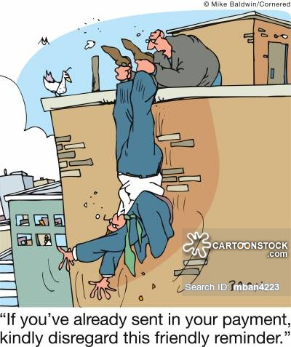
Debt Collection and Charging Policy

Slide 2
Breakdown into 2 categories.
Food Service Charging Policy.
Student Fee Debt Collection.
Must have full support of administration and school board.
Decide what your district approach will be.
Pull your own wagon or Push everyone’s wagon.
Review your policies and procedures with your board periodically so they will be prepared to answer questions from community members. “why do we have kids who go hungry?”
Remember that unfortunately your decision is as much political as it is practical. Every community is different.

Slide 3
Food Service Charging
We use Infinite Campus to assist in managing communication.
Automated Calling System starts at a balance of + $10.00
Automated daily reminders continue via phone, e-mail & text message.
Food Service department sends letter at $-10.00.
Food Service department starts personal calls weekly after letter goes out.

Slide 4
Food Service Charging
Upon reaching $-20.00 balance limit per family, the following rules will apply.
Students will not be able to purchase breakfast or lunch (PK – 12)
Letter is sent via US Mail – The letter states that they will need to provide a sack lunch for their student(s)
Principal is asked to make contact with parent.
Kitchen staff is asked to make contact with student.
If a student has “money in hand” for a meal that student can purchase a meal for that day only.
Parents may set up a payment plan but must be making consistent progress toward bringing their account current.

Slide 5
Food Service Charging
ELEMENTARY & MIDDLE SCHOOL STUDENTS
Kitchen staff will ask the teacher on a daily basis to check with that individual student to see if they brought a lunch for that day.
If the student brings nothing they are discretely escorted to the office to place a call to the parent.
If the student has “money in hand” for a meal, they may eat.
If a parent cannot be reached to bring a meal, we will feed the student a reimbursable meal and charge their account accordingly.

Slide 6
Food Service Charging
HIGH SCHOOL STUDENTS
No charging is allowed.
Student services become involved with trying to get a free and reduced meal application filled out if needed.
If student has “money in hand” for a meal they are served a reimbursable meal.

Slide 7
Food Service Charging
DISTRICT STAFF
No negative balances are allowed.
You are a responsible adult and can starve to death for all we care !

Slide 8
Food Service Charging
ENHANCED INTERROGATION STRATEGIES
Student Services will contact parents. (Will make home visits if necessary.)
Bridges / Counselors will contact parents to assist with completing free/reduced application or other community aid resources.
Partner with local service club to hold donated money to cover negative accounts. Application based.
Gray area
Contact sheet (Grandma ?)
Small town effect (Waunita)
“Lunch Shaming”

Slide 9
Food Service Charging
Gentle pressure applied relentlessly !
FY14: Negative Balance of ($9,405.33)
0.47% of total revenue
FY15: Negative Balance of ($12,296.41)
0.55% of total revenue
FY16: Negative Balance of ($11,498.79)
0.50% of total revenue

Slide 10
Food Service Charging
Refer to DE Charging Policy Templates

Slide 11
Student Fee Collection
All student fees are loaded into Infinite Campus each year so that parents can have access to the balances anytime throughout the year.
Balances are reviewed with parents at registration and included with the mailed registration packet each year. (funnel parents through cashier at registration)
Invoices are sent once during the school year for each student.
Unpaid balances roll over each year until student is a Senior.
Senior students and parents receive invoices after both the first and second trimester.
Senior High staff notify students directly through the spring of senior year.

Slide 12
Student Fee Collection
All student fees must be paid in full before students can pick up their cap and gown for graduation. (Including lunch account negative balances)
Students with unpaid balances still receive diploma but cannot walk at the ceremony.
Senior’s making payment on accounts within 30 days of graduation must pay via cash only. (Checks, credit or debit card transactions are not accepted)
Seniors with extenuating circumstances are occasionally allowed to perform service for the district equal to the monetary value of their outstanding balance.

Slide 13
Student Fee Collections
NSF Checks
We notify the originator of the check by letter.
If they are a household of a student in our district, we add the amount of the check as a Misc. fee on their Infinite Campus account.
Stop accepting checks after 2nd returned check.
No other collection efforts beyond a follow-up letter.

Slide 14
Questions ?

