Slide 1
Looming Iowa Teacher Shortage - Recruiting Challenges and Suggested Best Practices for finding and keeping great teachers in Rural and Urban schools
Margaret Buckton, Partner

Slide 2
Agenda
State of Current Teacher shortage in Iowa
Impact of Collective Bargaining Changes in WI on attracting and recruiting teachers.
Policy Brief from Rural Schools Collaborative.
Suggested strategies for finding and keeping great teachers

Slide 3
Teacher Shortage Areas
Iowa DE designates Iowa teacher shortage areas annually.
Data used to calculate the shortages include:
the numbers of Class C and Class B licenses issued,
the number and frequency of job postings on TeachIowa.gov (the statewide teacher recruitment website), and
the number of projected graduates in each teaching discipline.
Local data is important to analyze, too. How many applicants are you receiving for positions locally? Do you spot trends or shortage areas not necessarily seen at the state level? Are your shortages even greater than the state level?

Slide 4
Rural and Urban Challenges
Poverty
Inadequate resources to meet student needs
Low property tax base
Unmet facility needs
Affordable housing for young teachers
Transportation
Amenities

Slide 5
2016-17 Iowa Teacher Shortage Areas
Special Education:
Early Childhood Special Education (PK-K)
Pre K-Grade 3 Regular/Special Education (serving in Special Education or in Early Childhood inclusive classrooms only)
Instructional Strategist I Mild/Moderate
Instructional Strategist II Behavior Disorder/Learning Disabilities
Instructional Strategist II Mental Disabilities
Instructional Strategist II Physical Disabilities
Itinerant Hearing & Visually Impaired (Birth to 21)
Itinerant Visually Impaired Birth to 21
General Education:
Agriculture (5-12)
English as a Second Language (K-12)
Family and Consumer Sciences (5-12)
Foreign Language (all)
Industrial Technology (5-12)
Mathematics (5-12)
Science (all 5-12)
Biology, Chemistry, Earth Science, Physics, All Science, Basic
Professional School Counselor (K-8 and 5-12)
Talented & Gifted (K-12)
Teacher Librarian (K-8, 5-12 and K-12)
Business (5-12)

Slide 6
Resources:
Iowa Teacher Shortage coming Des Moines Register Jan. 11, 2017 http://www.desmoinesregister.com/story/news/education/2017/01/11/iowa-readies-teacher-shortage/96257920/
Wisconsin teacher shortages since Collective Bargaining Changes Des Moines Register Mar. 28, 2017 http://www.desmoinesregister.com/story/news/education/2017/03/27/collective-bargaining-iowa-lessons-wisconsin/99687046/
Rural Teacher Corps Report, Rural Schools Collaborative/Dakota Wesleyan University http://ruralschoolscollaborative.org/rural-teacher-corps
Schools face tougher task in finding teachers, ACT 10 at FIVE | A Journal Sentinel Special Report http://projects.jsonline.com/news/2016/12/21/schools-face-tougher-task-in-finding-teachers.html
Iowa Department of Education: Teacher shortage areas: http://educateiowa.gov/

Slide 7
The pool of teachers isn’t regenerating (DMR January article)
While Iowa in recent years has been insulated from a national teacher shortage that's sent other states scrambling to fill classrooms, Iowa leaders warn that it's coming. And it might already be here.
Iowa colleges are now graduating 400 fewer teachers, counselors and administrators a year, a 16 percent decline, than they did in 2013. Now, about 2,100 graduates are earning education degrees a year, according to Iowa Department of Education data.
The national data are even more concerning. Between 2009 and 2014, enrollments in teacher prep programs dropped 35 percent, from 691,000 to 451,000 students, according to the Learning Policy Institute.
"There's a lot fewer applicants," said Anne Sullivan, chief of human resources in Des Moines schools. "There's just a lot fewer people going into education.“
Teaching jobs that once drew hundreds of applicants in Creston Schools 20 years ago are now attracting only 10 or 20 applicants, said lower elementary school Principal Callie Anderson.
Need 2,115 to replace retirees and assuming 20% of new teachers quit in the first 5 years.

Slide 8
It’s harder to become a teacher (DMR January article continues)
Seeking to overhaul college education programs, in 2009 Education Secretary Arne Duncan derided their reputation as "cash cows" and "profit centers" that do a "mediocre job of preparing teachers for the realities of the 21st century classroom."
In the years since, many states, including Iowa, rewrote degree stipulations and required a national exam before completion. And while the changes are heralded as a way to better education, it could also be narrowing the "teacher pipeline."
In Iowa, educators must now earn a score in the top 25 percent nationally to pass, said Laurence Bice, an Iowa Department of Education consultant.
More coursework is also required. To become an elementary teacher, for example, students must take 12 subject courses: three each of math, science, social studies and language arts. Before, students only took four — one in each subject.
Actually, just can’t be in the bottom 25%

Slide 9
TLC Impact too
If 25% of teachers are in leadership roles statewide, that’s created a short term spike in demand for teachers. Caveat: some districts used TLC funds to keep teachers in leadership roles that would have had to be reduced due to budget constraints.
Not all are out of the classroom, but many are. If ¼ of the 8,500 teacher leaders are full time coaches, that would double the demand for teachers in each of the last three years.
Combine that with these two additional concerns:
Not every teacher graduating from an Iowa teacher college will stay in Iowa.
Not every teacher that graduates will have the certification that aligns with district/student needs.
Not every teacher graduate will stay in or even enter the field of teaching.

Slide 10
Impact of CB changes in Wisconsin on attracting and recruiting teachers

Slide 11
Collective Bargaining WI impact (DMR article March and Sentinel Report)
5 years after Wisconsin CB overhaul, teachers “are moving from district to district, creating a year-round cycle of vacancies and turnover as fewer people enter the profession.
Some 25% of school districts are reporting an “extreme shortage” of job-seekers for key positions. Teaching is “no longer considered an attractive career path” for many top students, educators warned state Superintendent of Public Instruction Tony Evers.
“Experts say root causes of the drop include tougher training and licensure requirements and tight school district budgets at a time when high student-loan debt and an improved economy are sending graduates into other fields.”

Slide 12
Collective Bargaining WI impact (DMR article March and Sentinel Report)
Act 10’s chief contribution to the continuing trend: a cloud of pessimism hanging over the much-changed profession. Indeed, many experienced teachers have become highly negative ambassadors for their own occupation, interviews with educators in 25 districts showed. Upset over Act 10 changes that reduced take-home pay and job security, they are warning potential teachers to pick a different line of work.
Bonuses of $1,000 to $15,000 are common for teachers with superior skills or in-demand specialties, especially if they are younger and have a smaller salary.

Slide 13
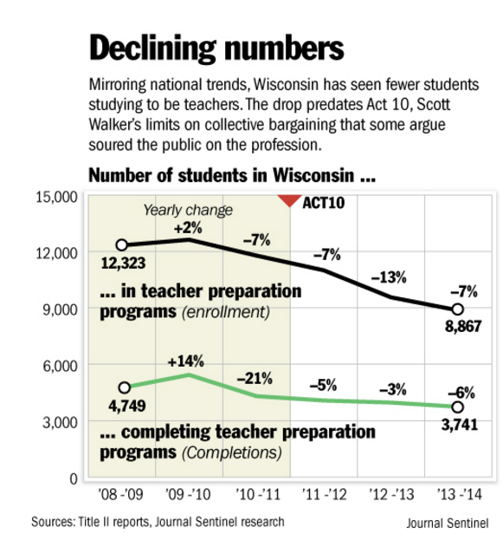
Sentinel Study Graph
Beginning of the teacher shortage predated Act 10

Slide 14
https://learningpolicyinstitute.org/product/understanding-teacher-shortages-interactive
SEP 15 2016
Understanding Teacher Shortages
A State-by-State Analysis of the Factors Influencing Teacher Supply, Demand, and Equity
This map highlights a number of key factors that reflect and influence teacher supply and attrition and signal whether states are likely to have an adequate supply of qualified teachers to fill their classrooms.
Based on these data—compensation, teacher turnover, working conditions, and qualifications—each state is assigned a “teaching attractiveness rating,” indicating how supportive it appears to be of teacher recruitment and retention and a “teacher equity rating,” indicating the extent to which students, in particular students of color, are assigned uncertified or inexperienced teachers.
Ratings are on a 1-5 scale, with 1 (the lightest color) being the least desirable and 5 (the darkest color) being the most desirable.

Slide 15
https://learningpolicyinstitute.org/product/understanding-teacher-shortages-interactive
OR 4.9
IA 3.58
WI 2.42
AZ 1.5

Slide 16
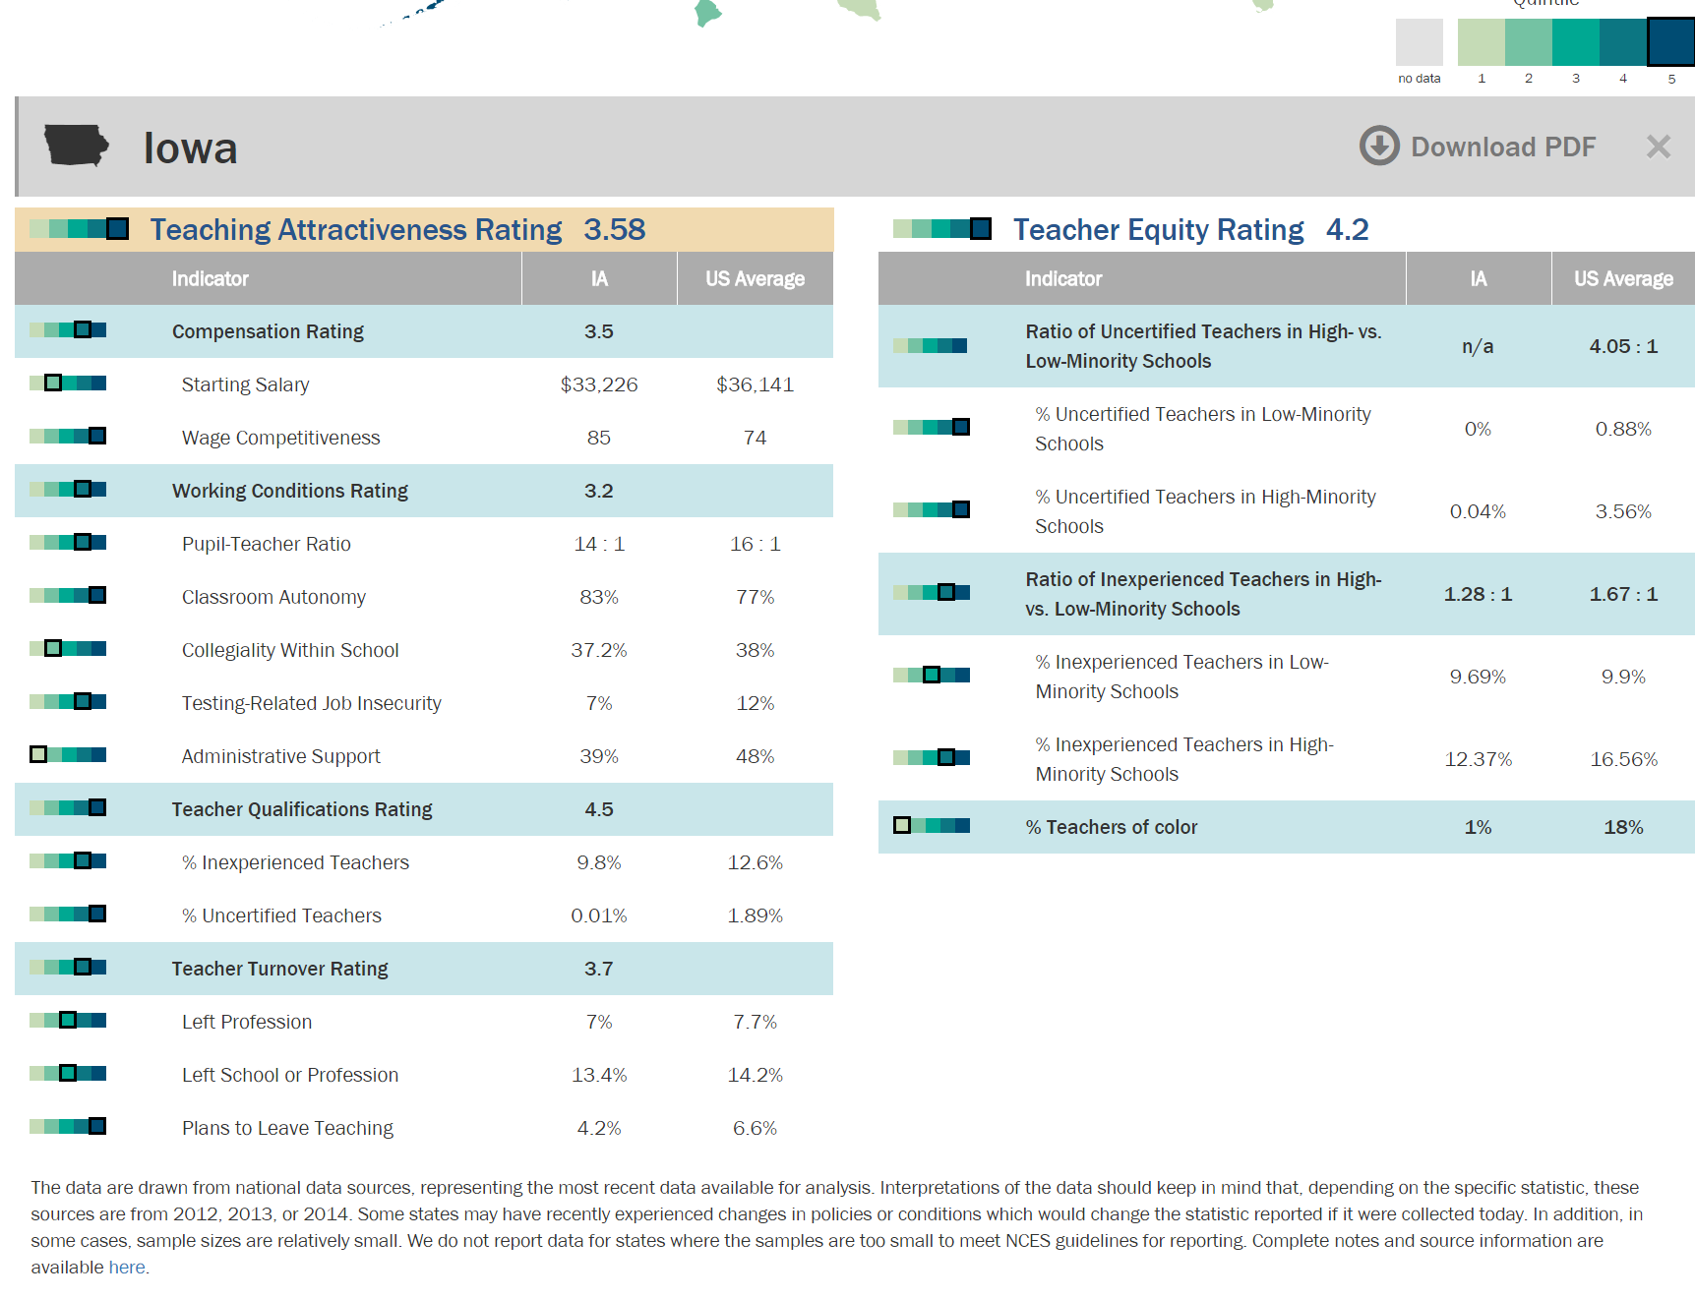

Slide 18
State and Local strategies to attract and retain teachers

Slide 19
State Policy/Strategy
Teacher Leadership and Compensation: Supports new teachers and creates a career path other than administration for educators. Also increases compensation averages relative to other states/professions.
Collective Bargaining Reform: Possibilities for differential pay to compensate for harder to staff positions. Think about rewarding teachers already committed to the community to become certified in a shortage area. What kind of bonus or reward would that take? Can the district reimburse the teacher for coursework?
Loan Forgiveness Programs: Although the district may be able to offer their own (remember Home Rule?), the state and feds also have loan forgiveness programs

Slide 20
Loan Forgiveness (AKA increasing beginning teacher salary by as much as 15%)
Teachers in shortage areas may be eligible for college student forgivable loans through both state and federal programs. Information regarding application for forgivable loans is available at the Iowa College Student Aid Commission website.
Federal Loan forgiveness or Cancellation
https://studentaid.ed.gov/sa/repay-loans/forgiveness-cancellation/teacher#forgiveness
Programs for $4000 for elementary teachers and up to $17,500 for math and science teachers.
Some loan payments may be deferred while teaching
List of 1,111 Iowa schools that qualify as low income and certain subjects regardless of income status count (math/science)

Slide 21
Teach Iowa Scholar Program
The Teach Iowa Scholar (TIS) Program provides qualified Iowa teachers with awards of up to $4,000 a year, for a maximum of five years, for teaching in Iowa schools in designated shortage areas. Qualified teachers are those currently teaching in designated shortage areas who meet all of the eligibility criteria below.
Eligibility Criteria: An applicant must:
Graduate from a teacher preparation program on/after January 1, 2013 (including undergraduate, masters or intern programs) Only teachers who complete a full teacher preparation program on/after January 1, 2013 are eligible; completing coursework to add an endorsement to your teaching license does not qualify.
Graduate in the top 25% academically of all teacher preparation program graduates during the academic year in which you graduated. ‘Top 25% academically’ is defined and certified by the college/university from which you graduated.
Secure full-time employment for the 2015-16 school year in a designated shortage area at a school district, AEA, charter school, or accredited nonpublic school recognized and approved by the DE.
Have an Iowa teaching license and the corresponding endorsement of the shortage area in which you teach.
Submit the TIS application by November 18, 2016 (likely same timeframe for Fall of 2018)
https://www.iowacollegeaid.gov/teachiowascholar

Slide 22
Substitutes
Substitutes are a pool of possible teachers (and there are not enough substitute teachers in most places, either.)
How are they treated in your schools?
Welcomed to the building?
Offered assistance by a neighboring teacher?
Principal stops by and says thanks and sees if they need anything?
Do they experience a culture that is warm, welcoming and vibrant? Or do they get through the day isolated from the teaching community?
How would your whole district treat them if you knew they were the ambassadors to all future teacher applicants in your district?

Slide 23
Creative Solutions
Grow your own: identifying students as early as middle school who might be interested and capable teachers.
Work with Community College to offer an associate’s degree program for education.
Create internships with elementary schools. Recruit students to work with younger students, individualized reading, after school supervision.
Recruit minorities (DMPS has the 3D program: Des Moines, Drake and DMACC – any minority employee interested in teaching can get their associates degree from DMACC, their teaching degree from Drake, and be guaranteed a job for 5 years once licensed.) What does this look like in rural Iowa? Maybe the shortage isn’t minority teachers, but industrial tech, agriculture, other CTE courses or math and science.
Recruit community members with content skills and support them to get hours necessary to teach.

Slide 24
Creative Solutions
Create spaces that young people want to be in:
Fort Dodge: Convert an old hotel in downtown to apartments. Include a gym. Have space for artists and a music venue. Subsidize rent in exchange for agreement to stay for five years. Require new teachers who get an apartment there to pay off the subsidy with volunteer community hours. Bonus: they get connected to community and community gets connected to them. They also meet other new teachers and may establish longer term relationships that tie them to the community.
TLC and mentors for new teachers inside the school: what happens outside of school? Who can districts partner with to make a difference in providing the kind of community that young people want to live in?

Slide 25
Creative Solutions
Real Teacher Appreciation
Does your principal or superintendent write a thank you note every day to a teacher? Do teachers feel like they are making a worthy contribution? Do teachers feel valued? Can teacher leaders play a role in this action?
Positive feedback is likely as important as salary in helping an employee feel connected to their work community.
Connect teachers to family/parents
The culture of catching someone doing something good is infectious. Imagine if teachers called parents when kids did something right? How would that practice change the way teachers feel appreciated in their everyday work?

Slide 26
Creative Solutions
Pipeline of parent volunteers:
Recruit to part time paras, so they are working when their young ones are in school.
Supports paras to get teaching degrees.
Think about flexibility: job sharing, half time or one semester. How can your district create the kind of environment that parents who want to be part of the school can be part of it without having it overtake their lives?
Pipeline of retired volunteers, too.
Do you have community members who have expertise or time/motivation to give? How can you connect them to school? If an engineer retires early at 55, if they could be certified in 2 years, would they want to teach for the next 15? Are there online program available? What would it look like in your district?

Slide 29
What are the answers to this question for Urban Schools? What attitudes and beliefs might be getting in the way of attracting and placing teacher-leaders in urban communities?

Slide 30
Rural Teacher Corps Summary: How We Work Together to Bolster the Recruitment of Future Rural Teacher-Leaders
Priority A: Develop a Network of Positive Role Models to Encourage People to become Rural Teachers
• “Equip teachers to promote teaching as a noble profession.”
• “Teachers need to become their most important “spokespeople.”
• Teachers need to think of their work with students as an act of “apprenticeship.”
Priority B: Reframe the rural narrative; emphasize the positive aspects of the rural experience.
• Find avenues to explore and share local wisdom
• “We need to learn to tell the stories of place better.”
• Use place-based learning to immerse students in the local community context.

Slide 31
What ideas do you have for attracting and retaining Teachers?
Local policy ideas
State policy ideas
Connecting with community beyond the schoolhouse walls
Write a couple down on the blank page at the end of this handout and leave them here. We’ll collect and share with you soon.

Slide 32
Questions or Comments?
LARRY SIGEL – ISFIS PARTNER
Cell: 515-490-9951
Larry.sigel@isfis.net
MARGARET BUCKTON – ISFIS PARTNER
CELL: 515-201-3755
margaret.buckton@isfis.net
Iowa School Finance Information Services
1201 63rd Street
Des Moines, IA 50311
Office: 515-251-5970
www.isfis.net

