Slide 1
Recapture Time & Money
Implementing efficient purchasing systems
Paul Tarnoff, CEO, k-Purchase
Calli Landenberger, Business Manager, North Polk CSD
Janet Hartwig, Accounts Payable, North Polk CSD

Slide 2
SLIDE 2
SLIDE 2

Slide 4
Do less
Spend less
Stress less

Slide 5
ACCOMPLISH MORE
in purchasing

Slide 6
COME ON

Slide 7
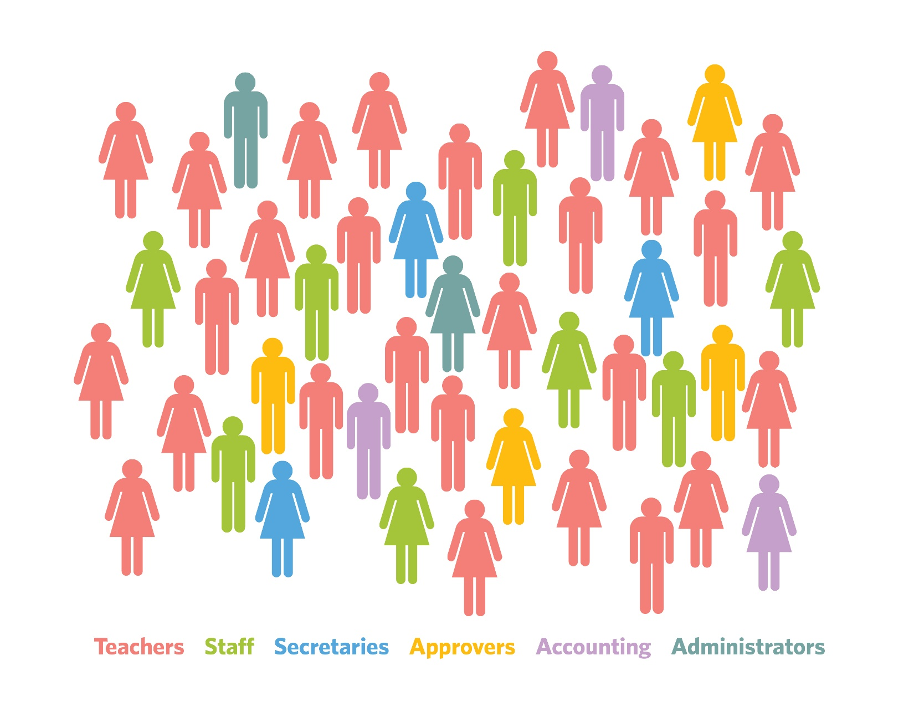
SYSTEMIC CHAOS

Slide 8
PERVASIVE MISERY
Frustrations
Distractions
Lack of controls
Complaints
Lack of accountability
Mistakes
Unknowns
Overextended

Slide 9
SAD REALITY

Slide 10
FINDING ORDER WITHIN THE CHAOS

Slide 11
2 SIDES OF PURCHASING
FIND WHAT TO BUY,
RELIABLE SERVICE,
& BEST PRICES
REQUEST,
APPROVE, ORDER
& RECEIVE
+

Slide 12
EXPOSING THE HIDDEN COSTS

Slide 13
WAYS TO RECAPTURE FOUND RESOURCES
EASY & SIMPLE
MINIMAL or NO COST
SUPPORT WORKFLOW

Slide 14
REQUEST,
APPROVE, ORDER
& RECEIVE

Slide 15
MANUAL ORDER PROCESSING

Slide 16
EACH & EVERY ORDER
115 MINUTES
$86 LABOR

Slide 17
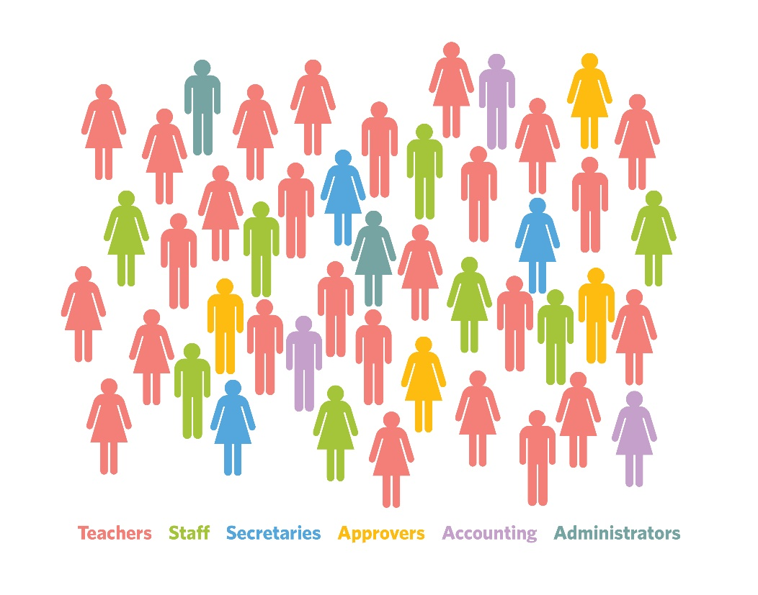
HUGE ANNUAL HIDDEN COST
per 1,000 students
4,800 HOURS
$216,000 WAGES

Slide 18
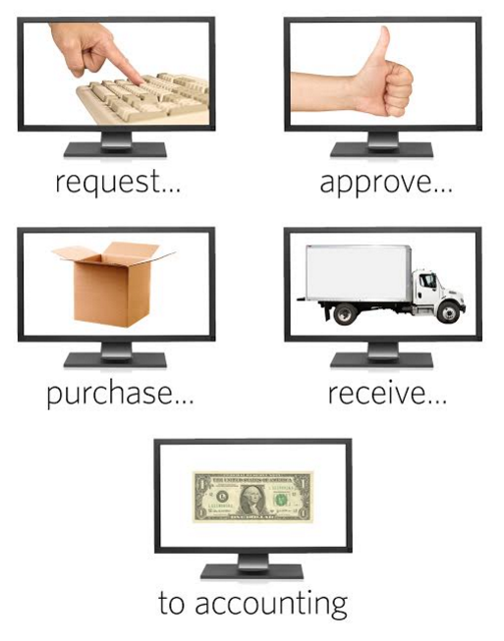
FOUND RESOURCES
Streamline & automate the process

Slide 19
RECAPTURES 70% OF HIDDEN COST
per 1,000 students
3,750 HOURS
$169,000 WAGES

Slide 20
FOUND RESOURCES
REDIRECTED TO
EDUCATING OUR STUDENTS

Slide 21
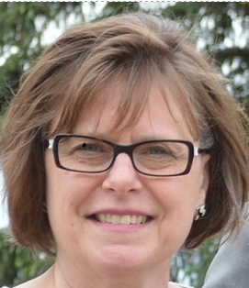
“Right away we noticed
a dramatic increase in efficiencies.
k-Purchase has
REMOVED REDUNDANT & TIME-CONSUMNG STEPS
in our former process.”
Deb Schroeder, Former Business Manager
North Polk CSD

Slide 22
“Frees up a lot of time
FOR EVERYONE EVERYDAY
to do other important things.
ESPECIALLY FOR TEACHERS
who deal with students.”
Lisa Johnson, CFO
Grinnell-Newburg CSD

Slide 23
FIND WHAT TO BUY,
RELIABLE SERVICE,
& BEST PRICES

Slide 24
FOUND RESOURCES
+
Find what to buy

Slide 25
FOUND RESOURCES
Typing

Slide 26
FOUND RESOURCES
+
Incomplete orders & payables

Slide 27
FOUND RESOURCES
Setup, training & support

Slide 28
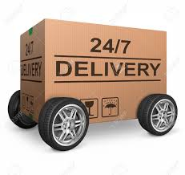
FOUND RESOURCES
Shipping

Slide 29
TOTAL FOUND RESOURCES

Slide 30
YOU GAIN
MORE TIME & MONEY TO INVEST IN THEM

