Slide 1

Free and Reduced Percent by School District
FY 2001 – FY 2024
https://www.iowaschoolfinance.com/interactive_map

Slide 2
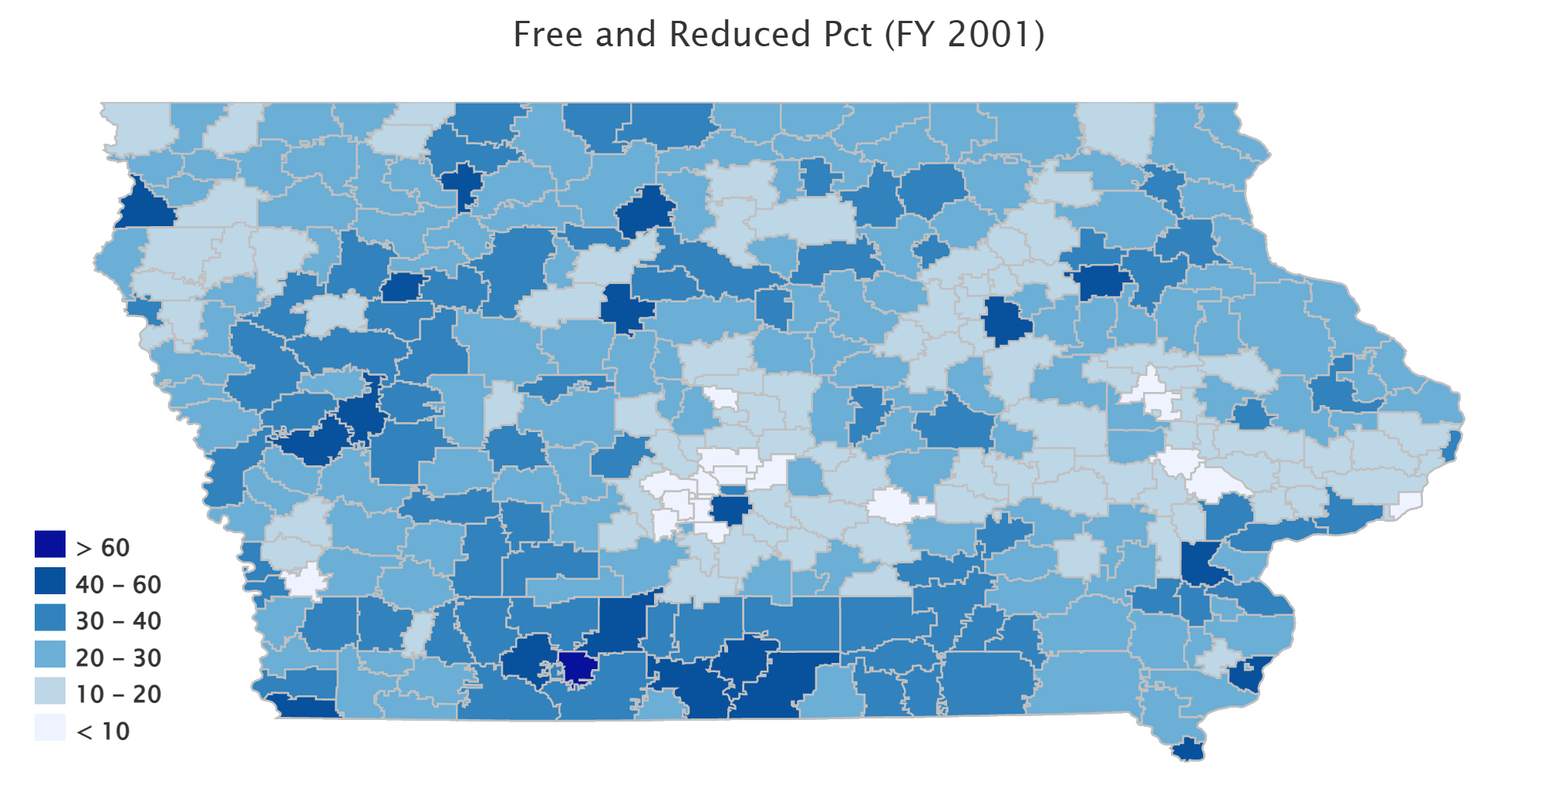

www.iowaschoolfinance.com

Slide 3
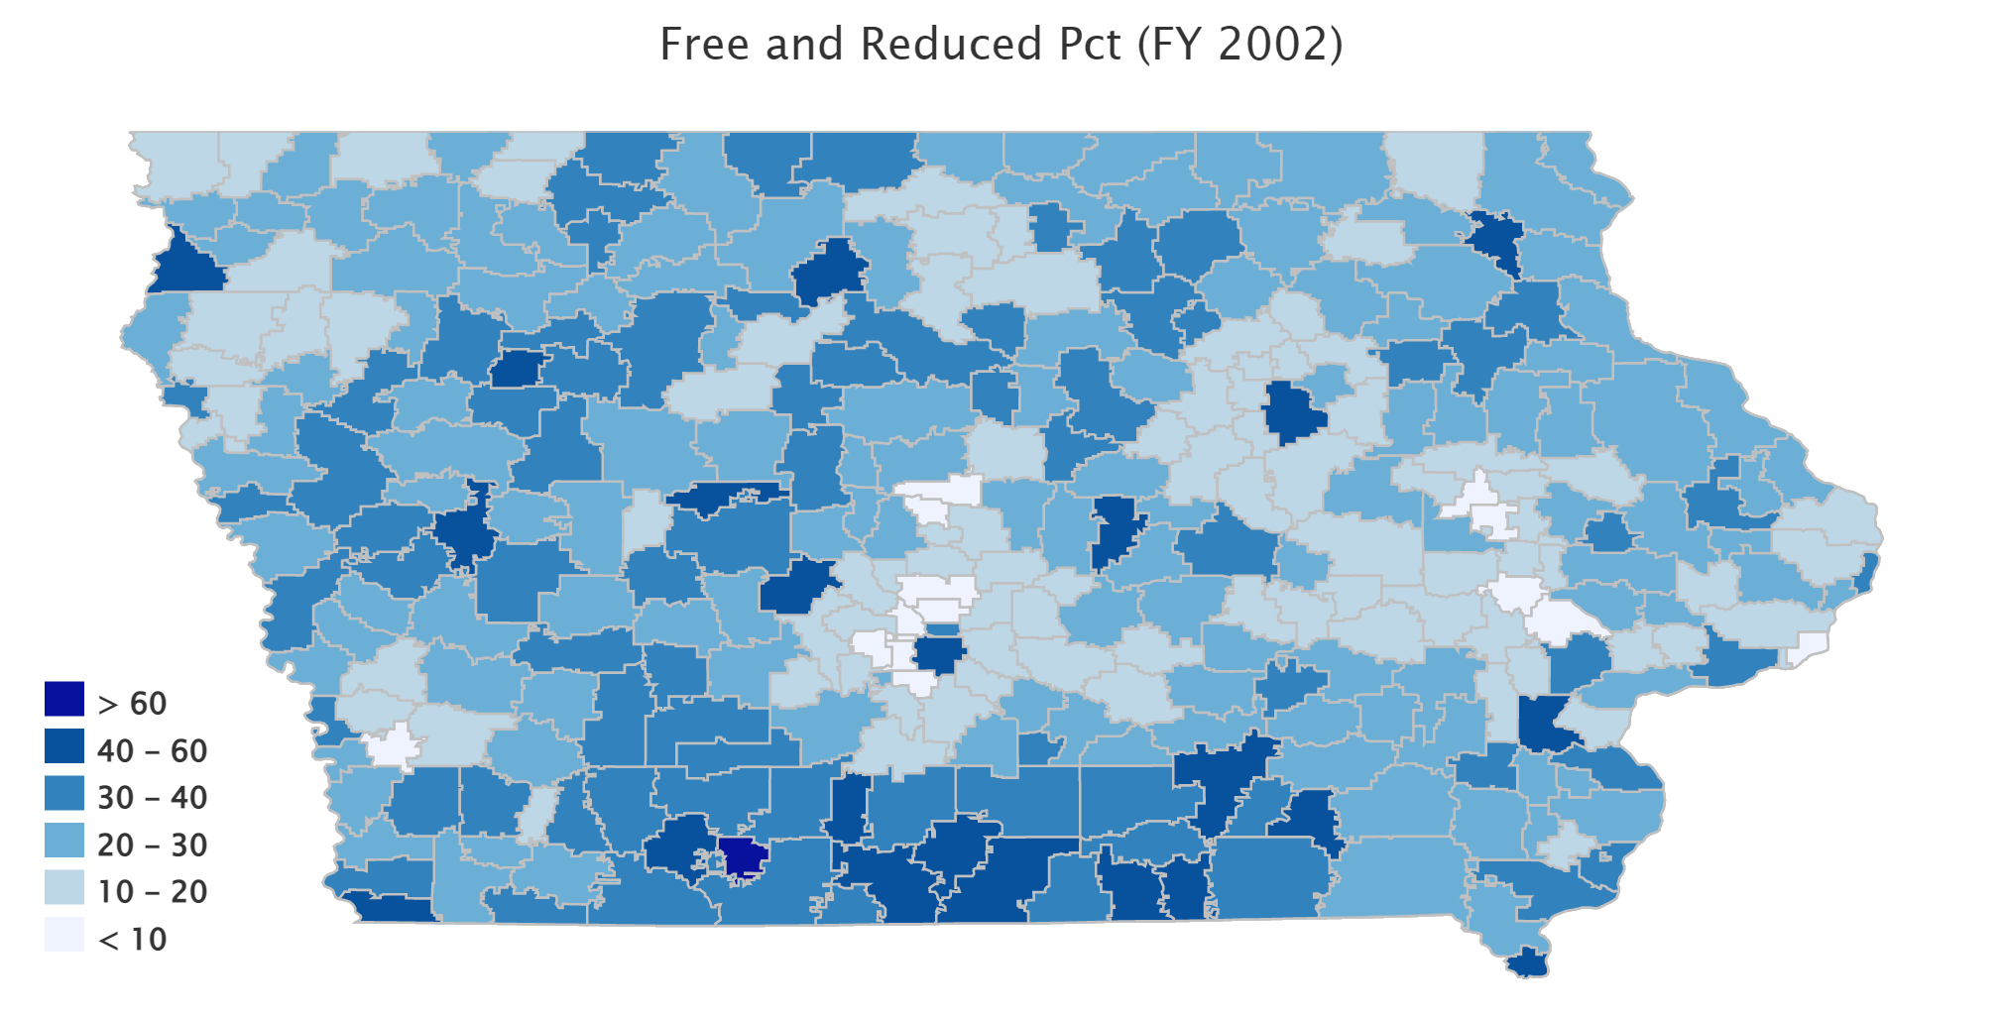
www.iowaschoolfinance.com

Slide 4
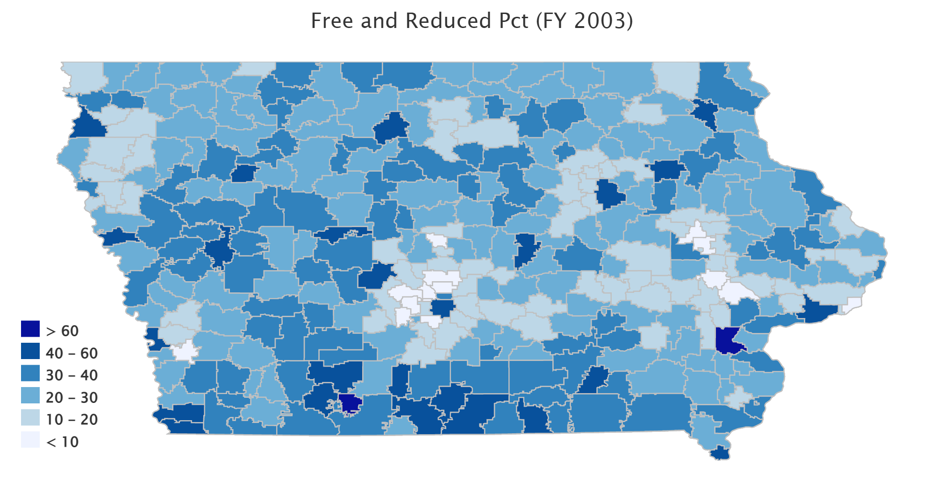
www.iowaschoolfinance.com

Slide 5
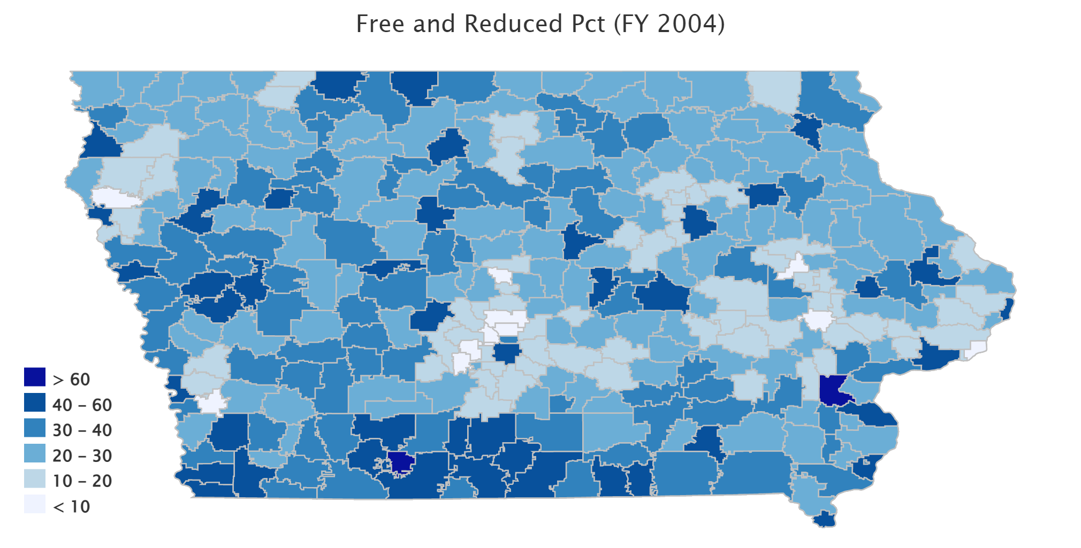
www.iowaschoolfinance.com

Slide 6
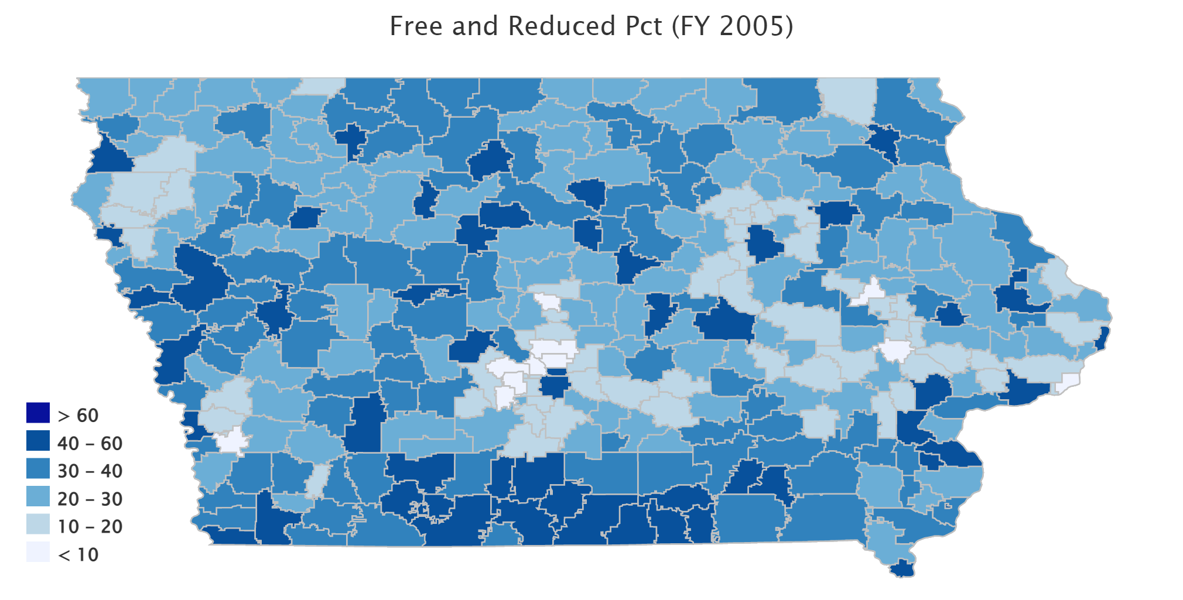
www.iowaschoolfinance.com

Slide 7
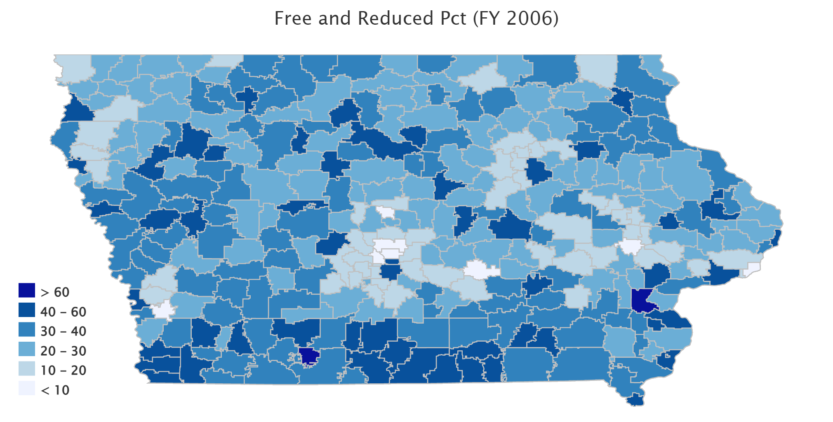
www.iowaschoolfinance.com

Slide 8
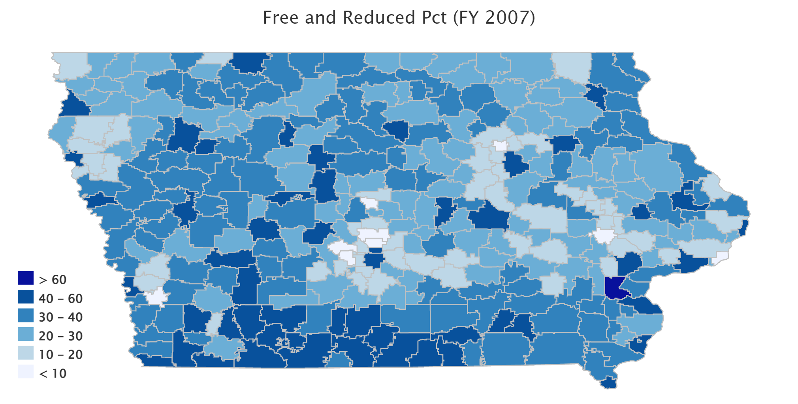
www.iowaschoolfinance.com

Slide 9
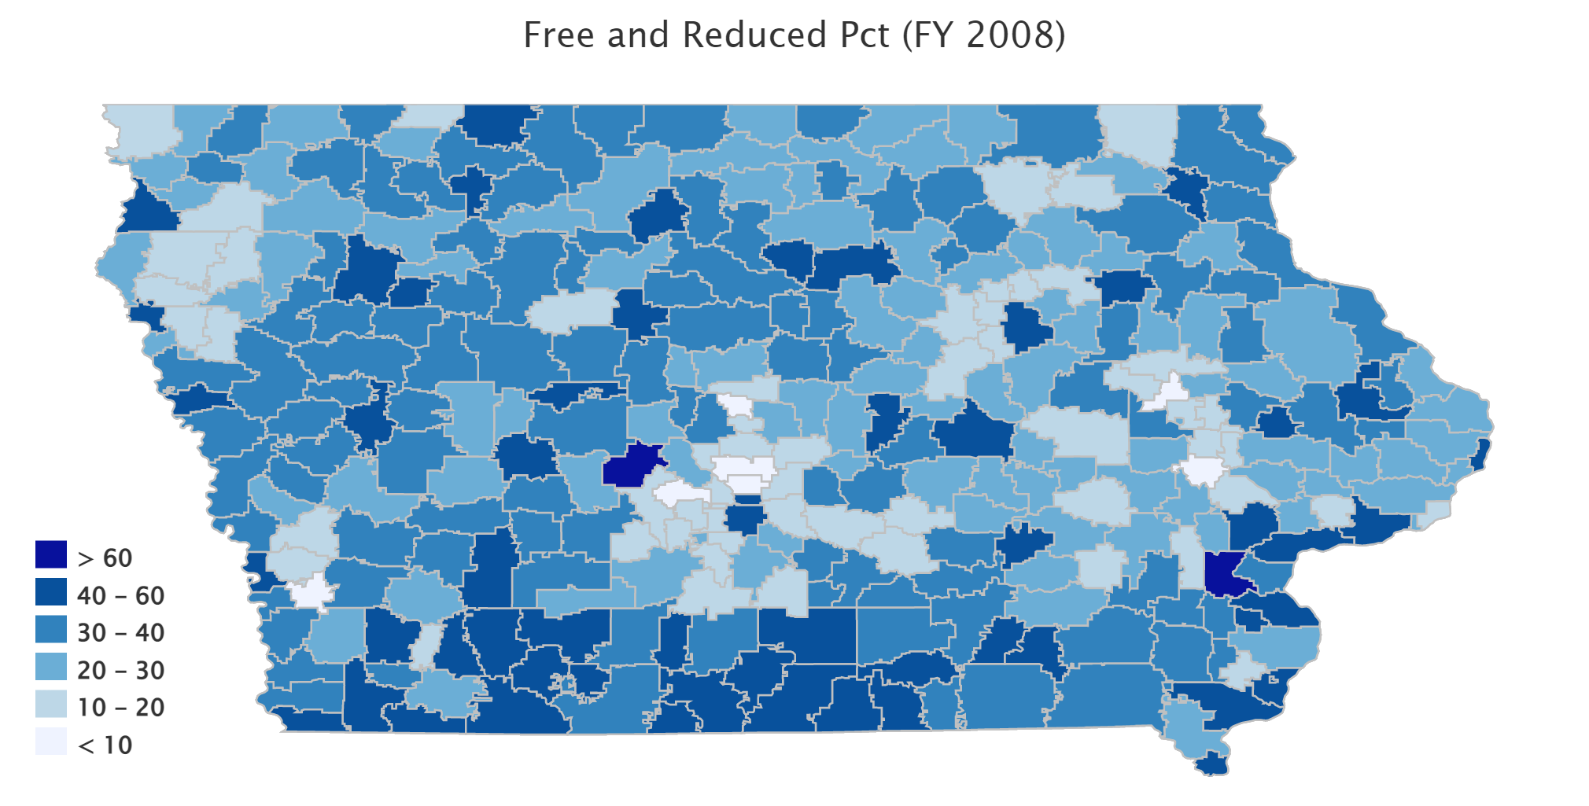
www.iowaschoolfinance.com

Slide 10
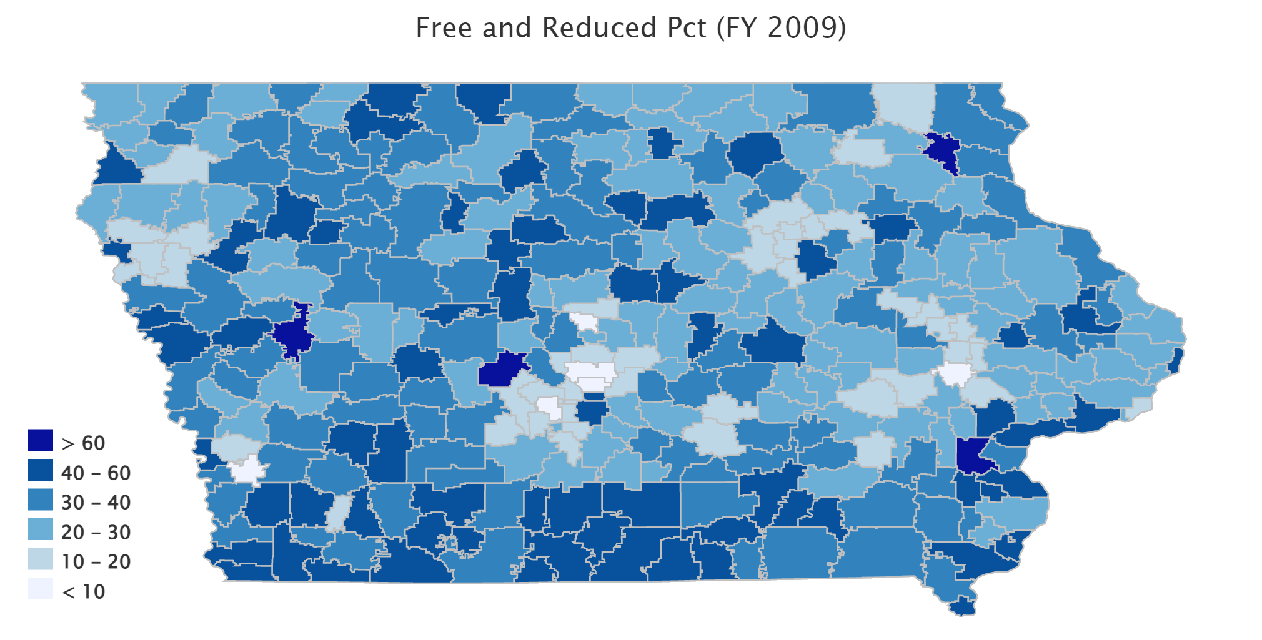
www.iowaschoolfinance.com

Slide 11
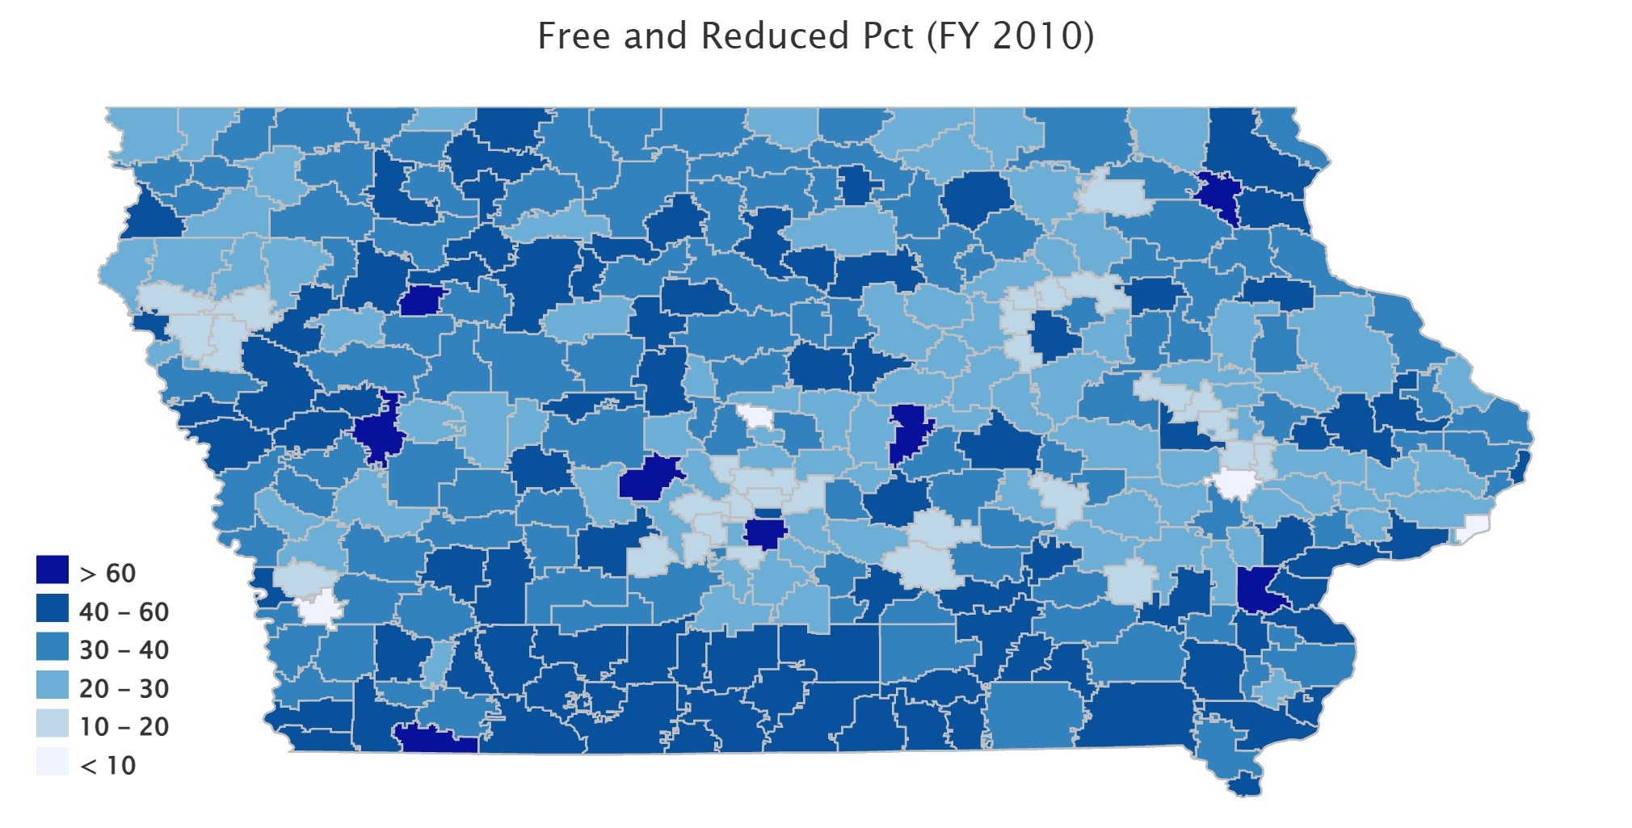
www.iowaschoolfinance.com

Slide 12
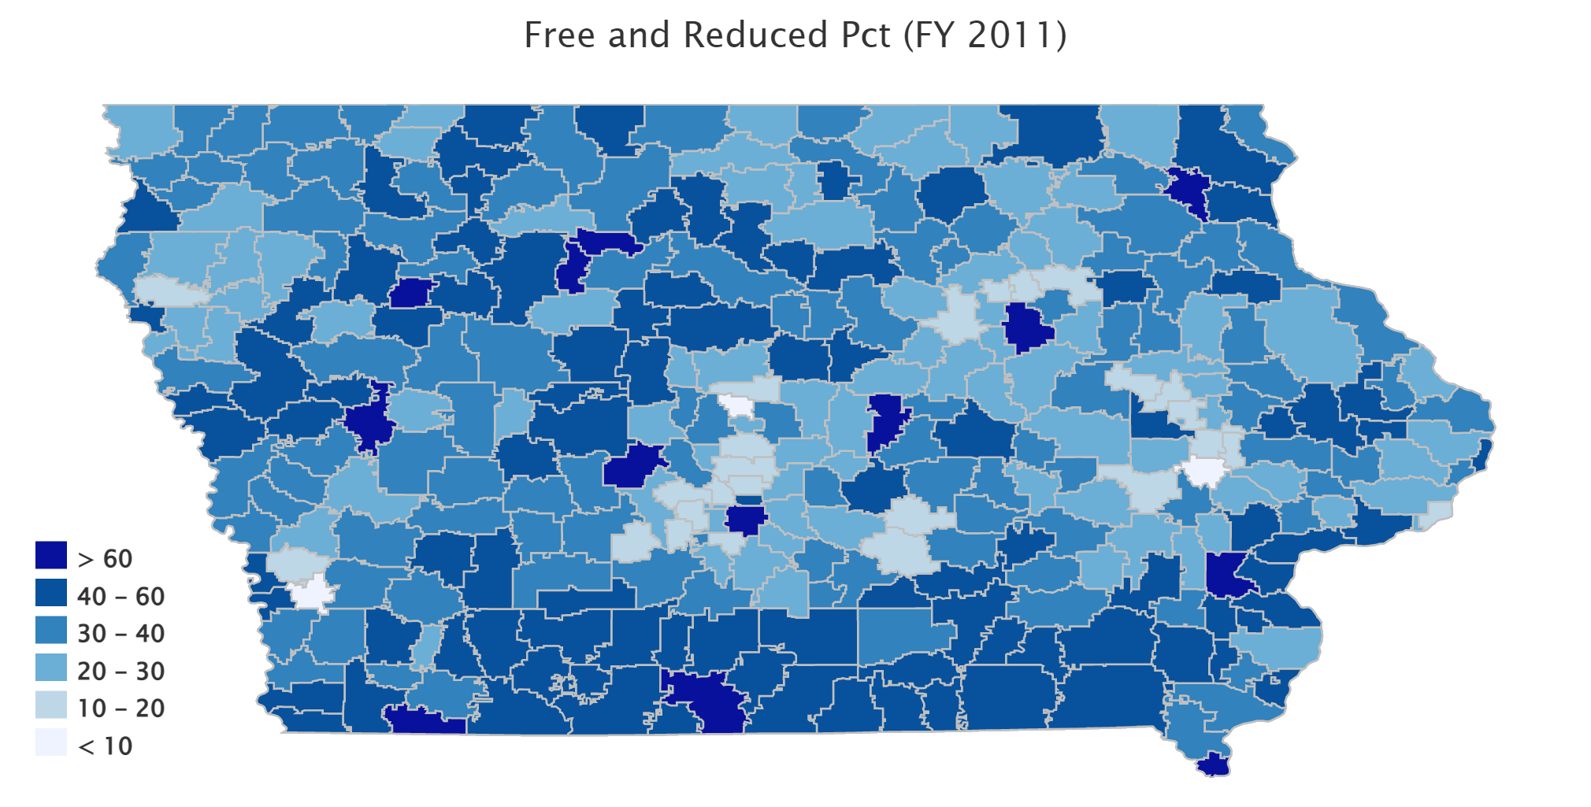
www.iowaschoolfinance.com

Slide 13
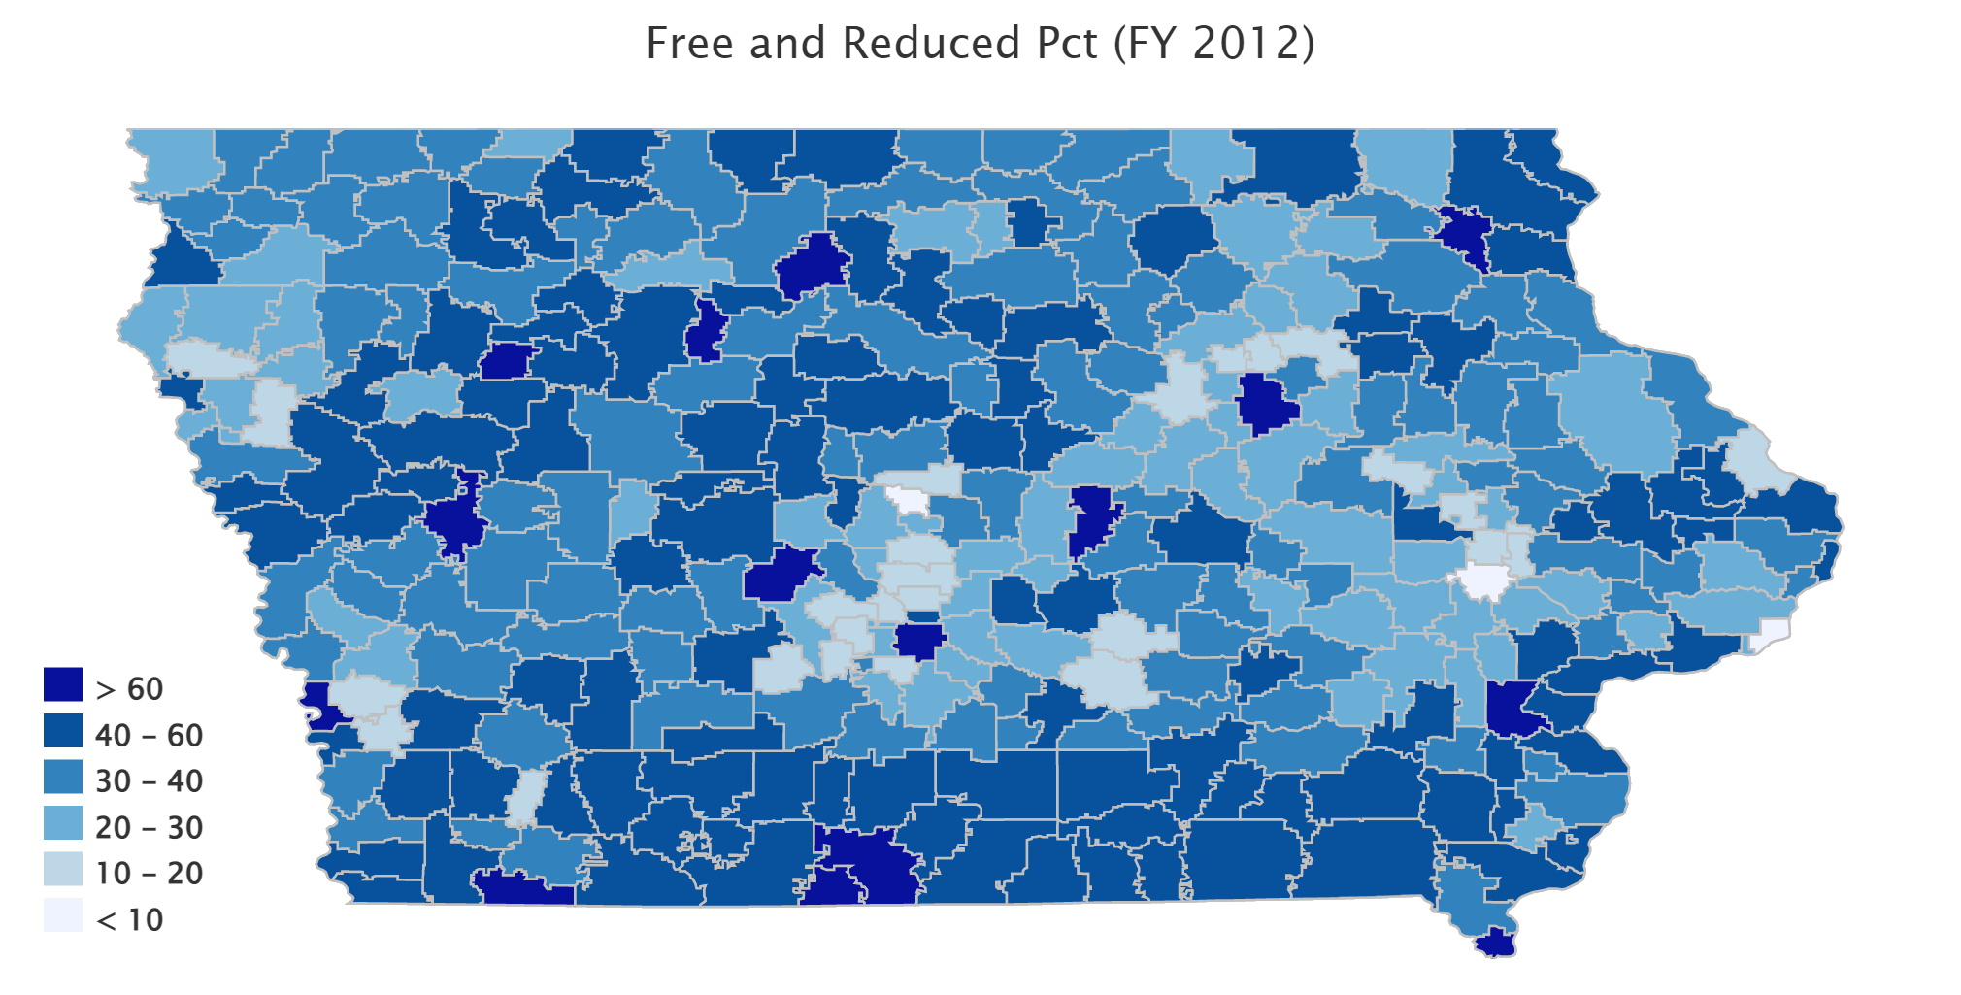
www.iowaschoolfinance.com

Slide 14
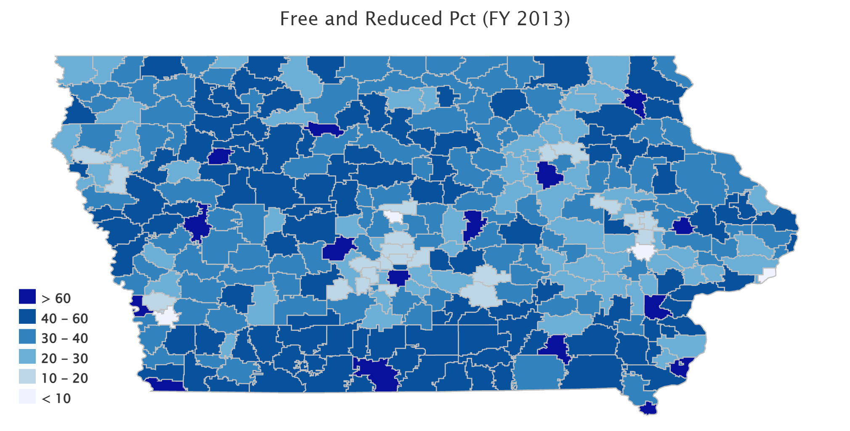
www.iowaschoolfinance.com

Slide 15
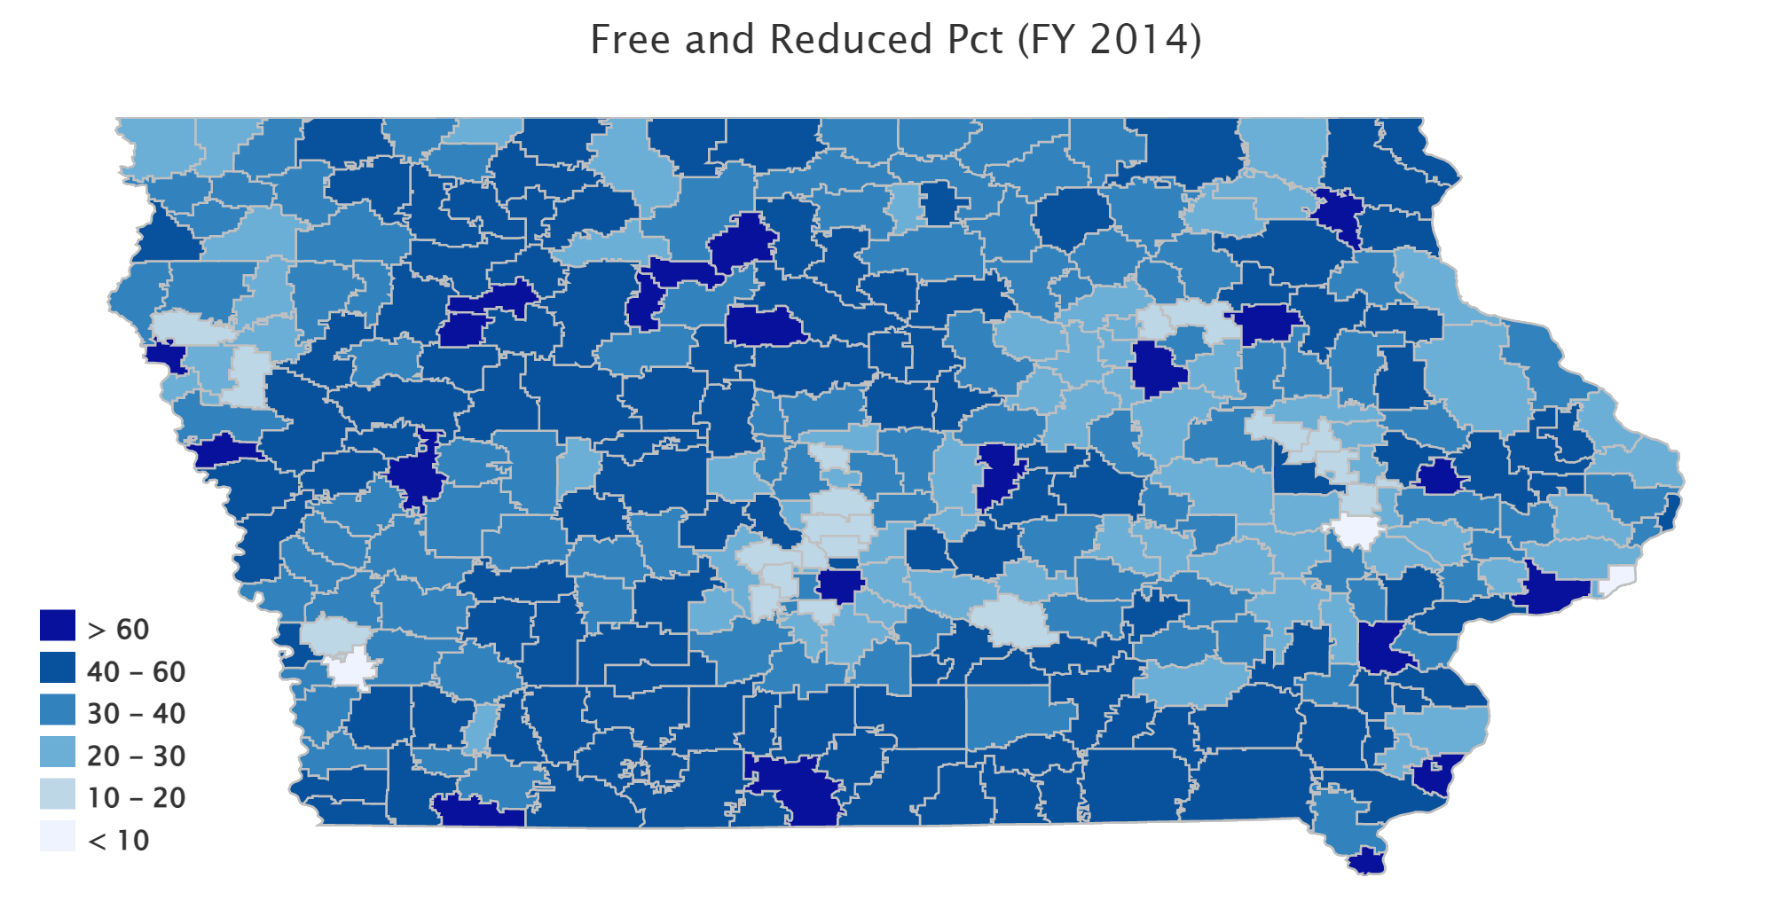
www.iowaschoolfinance.com

Slide 16
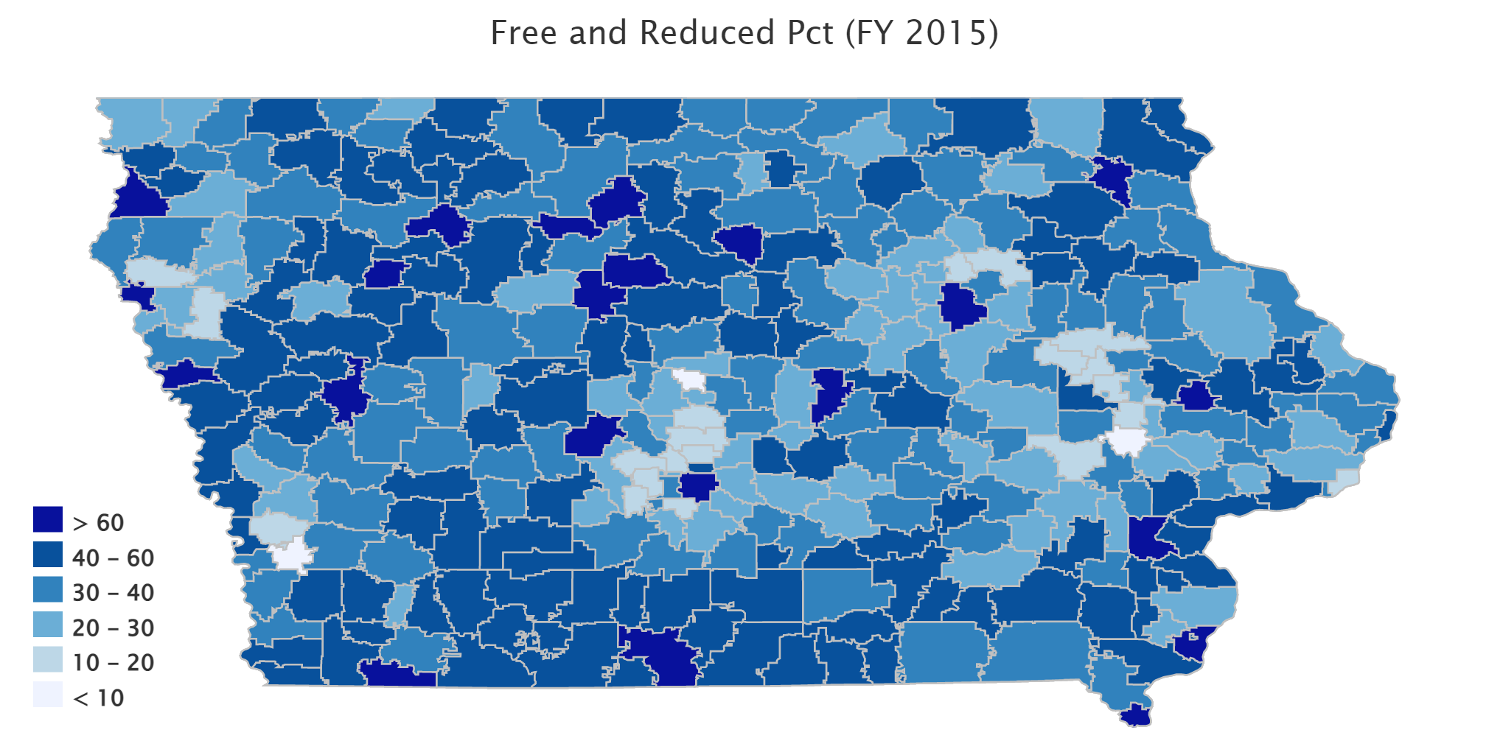
www.iowaschoolfinance.com

Slide 17
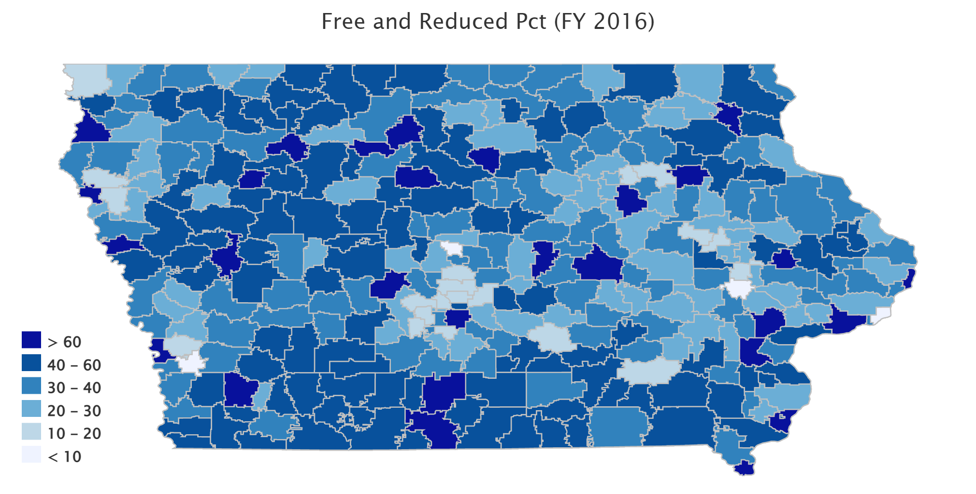
www.iowaschoolfinance.com

Slide 18
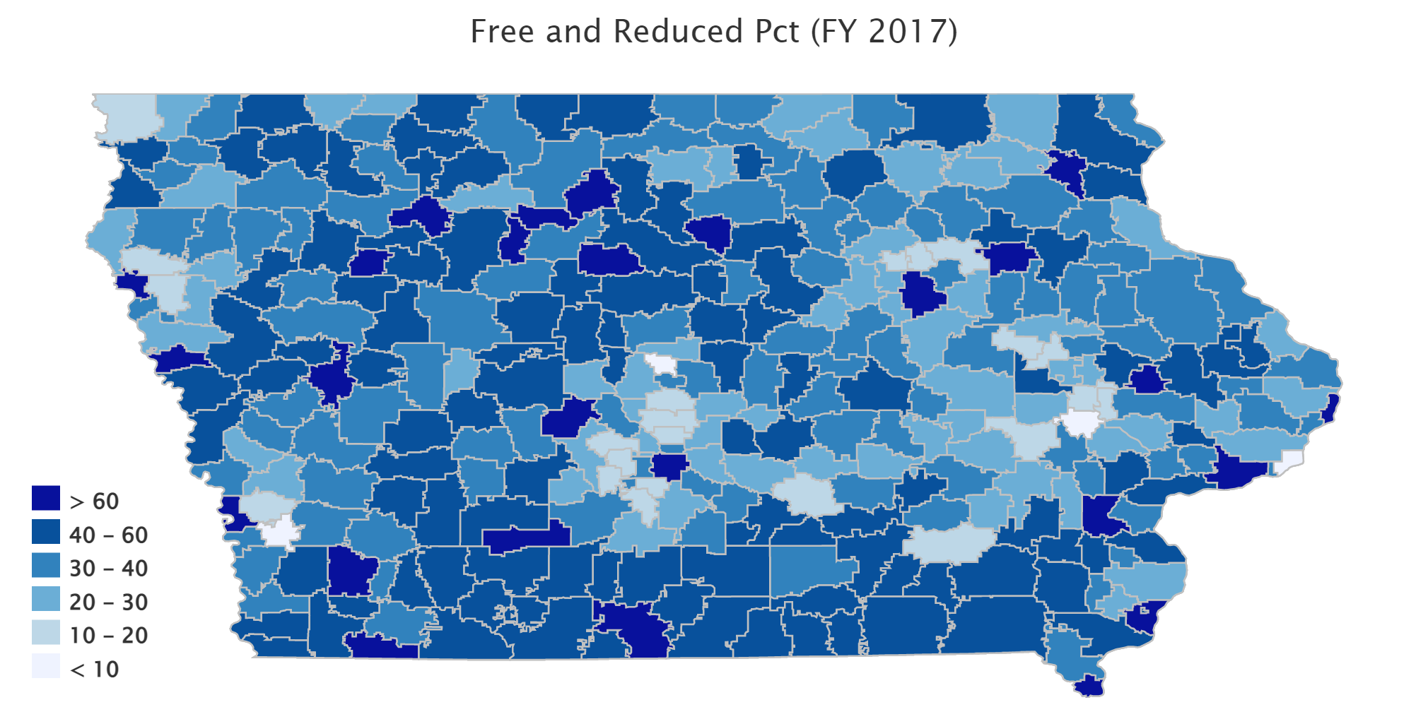
www.iowaschoolfinance.com

Slide 19
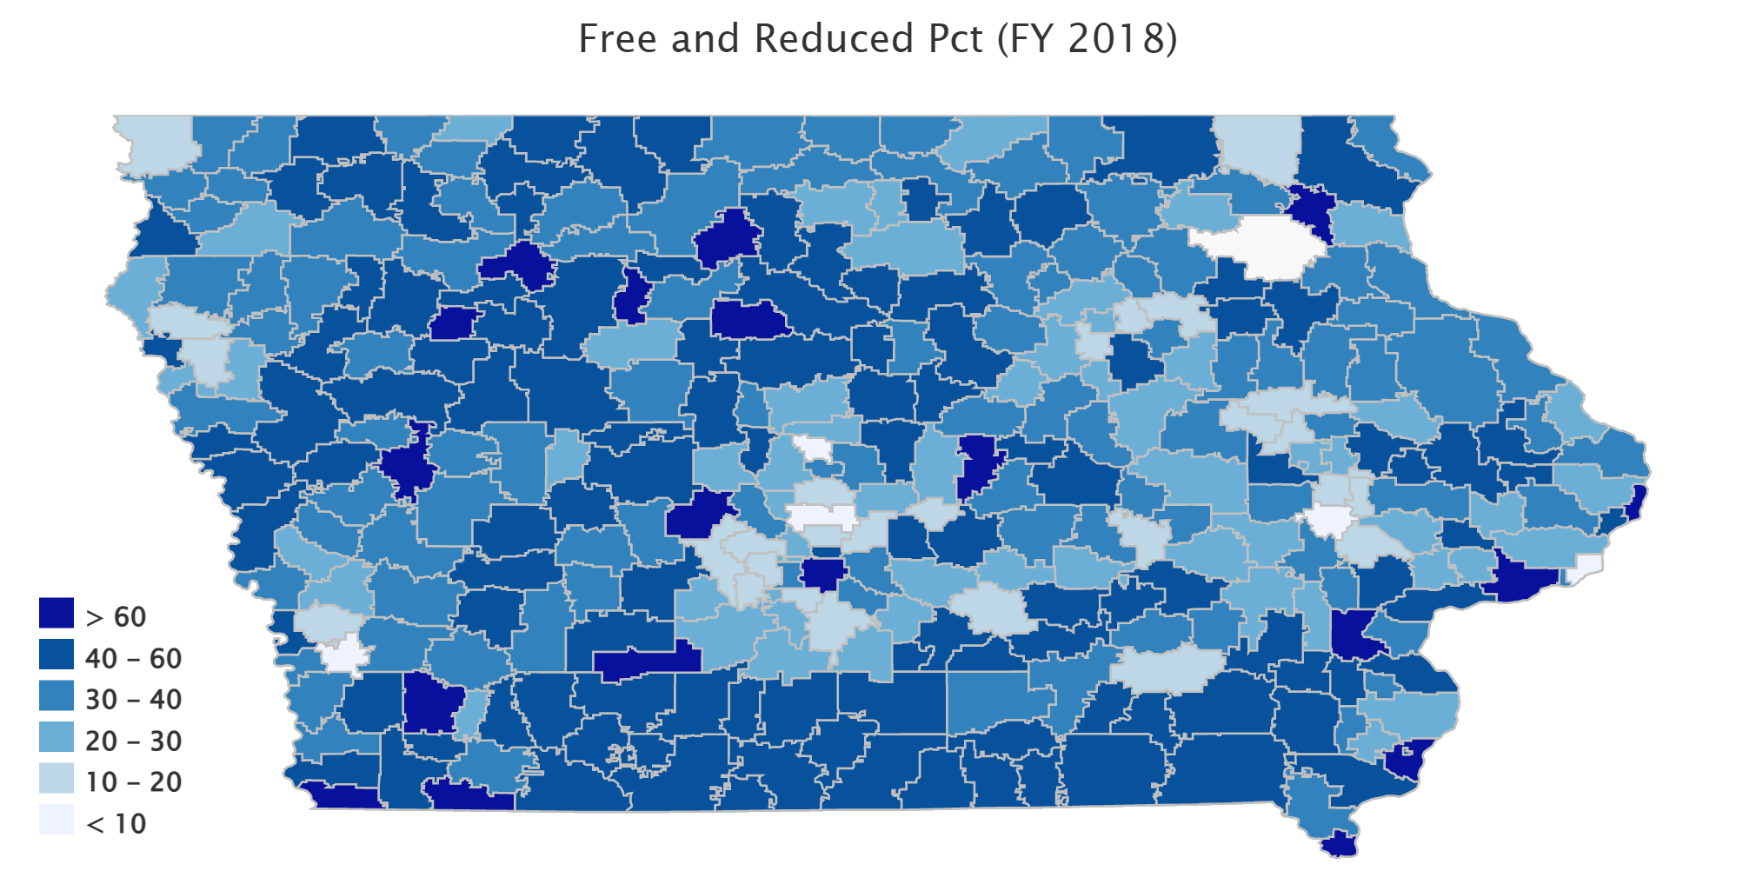
www.iowaschoolfinance.com

Slide 20
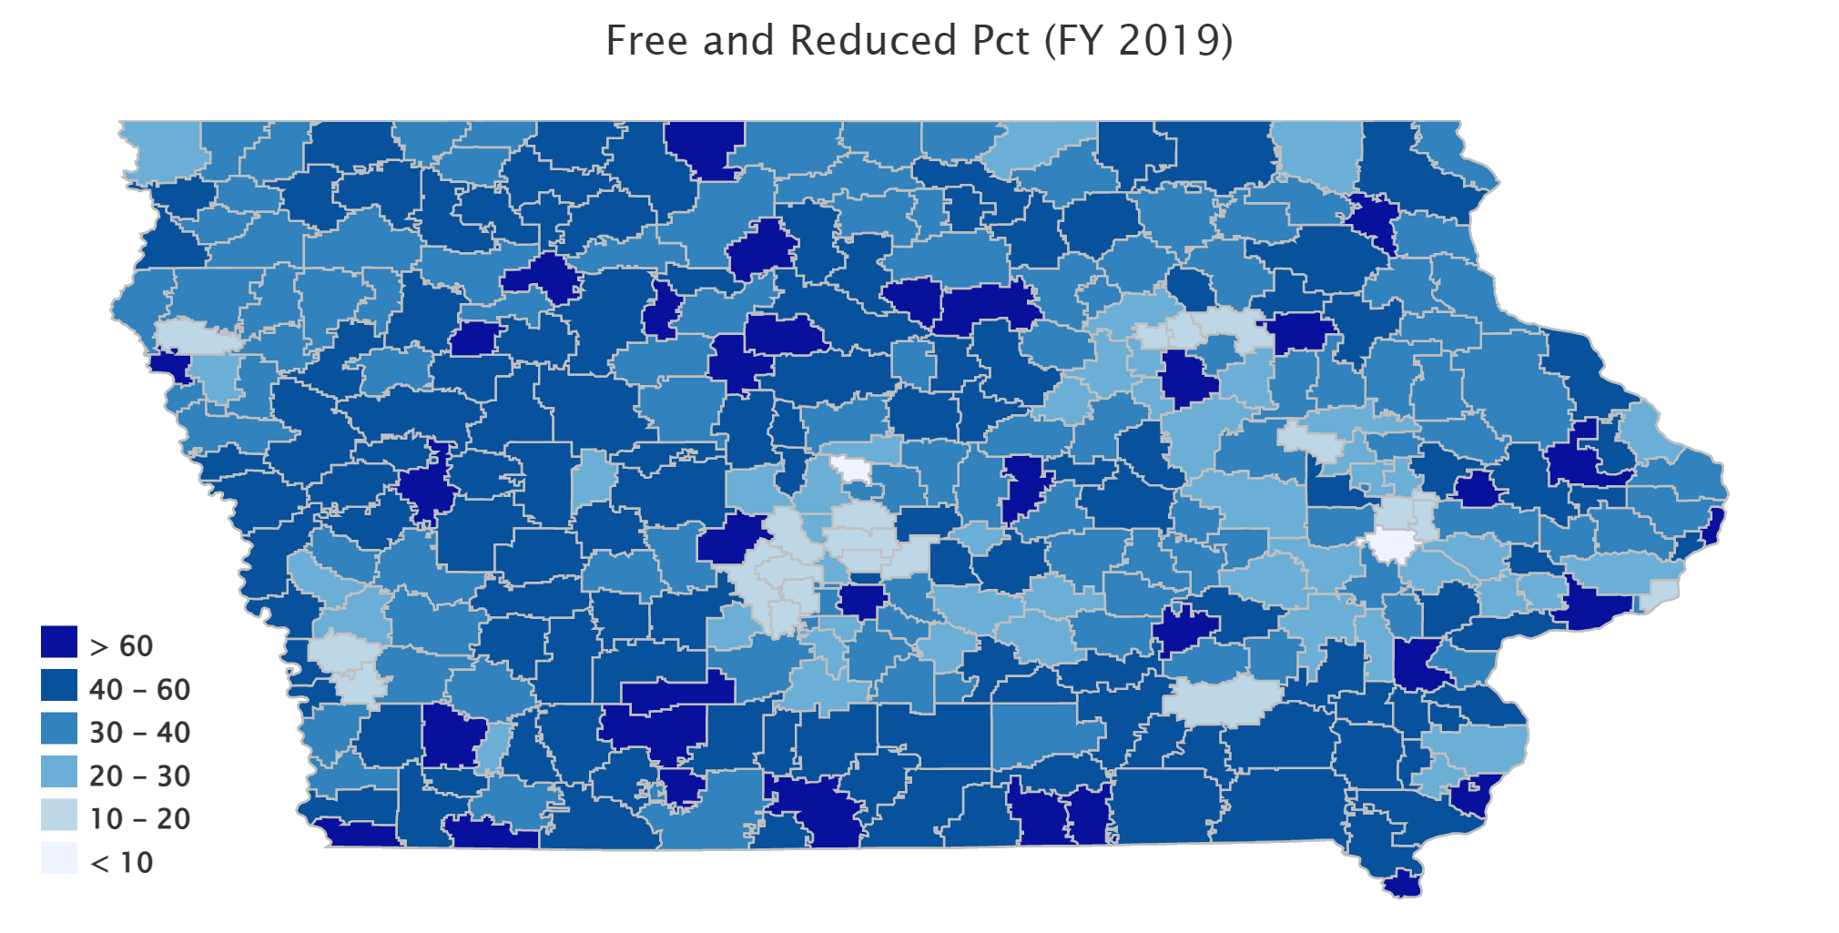
www.iowaschoolfinance.com

Slide 21
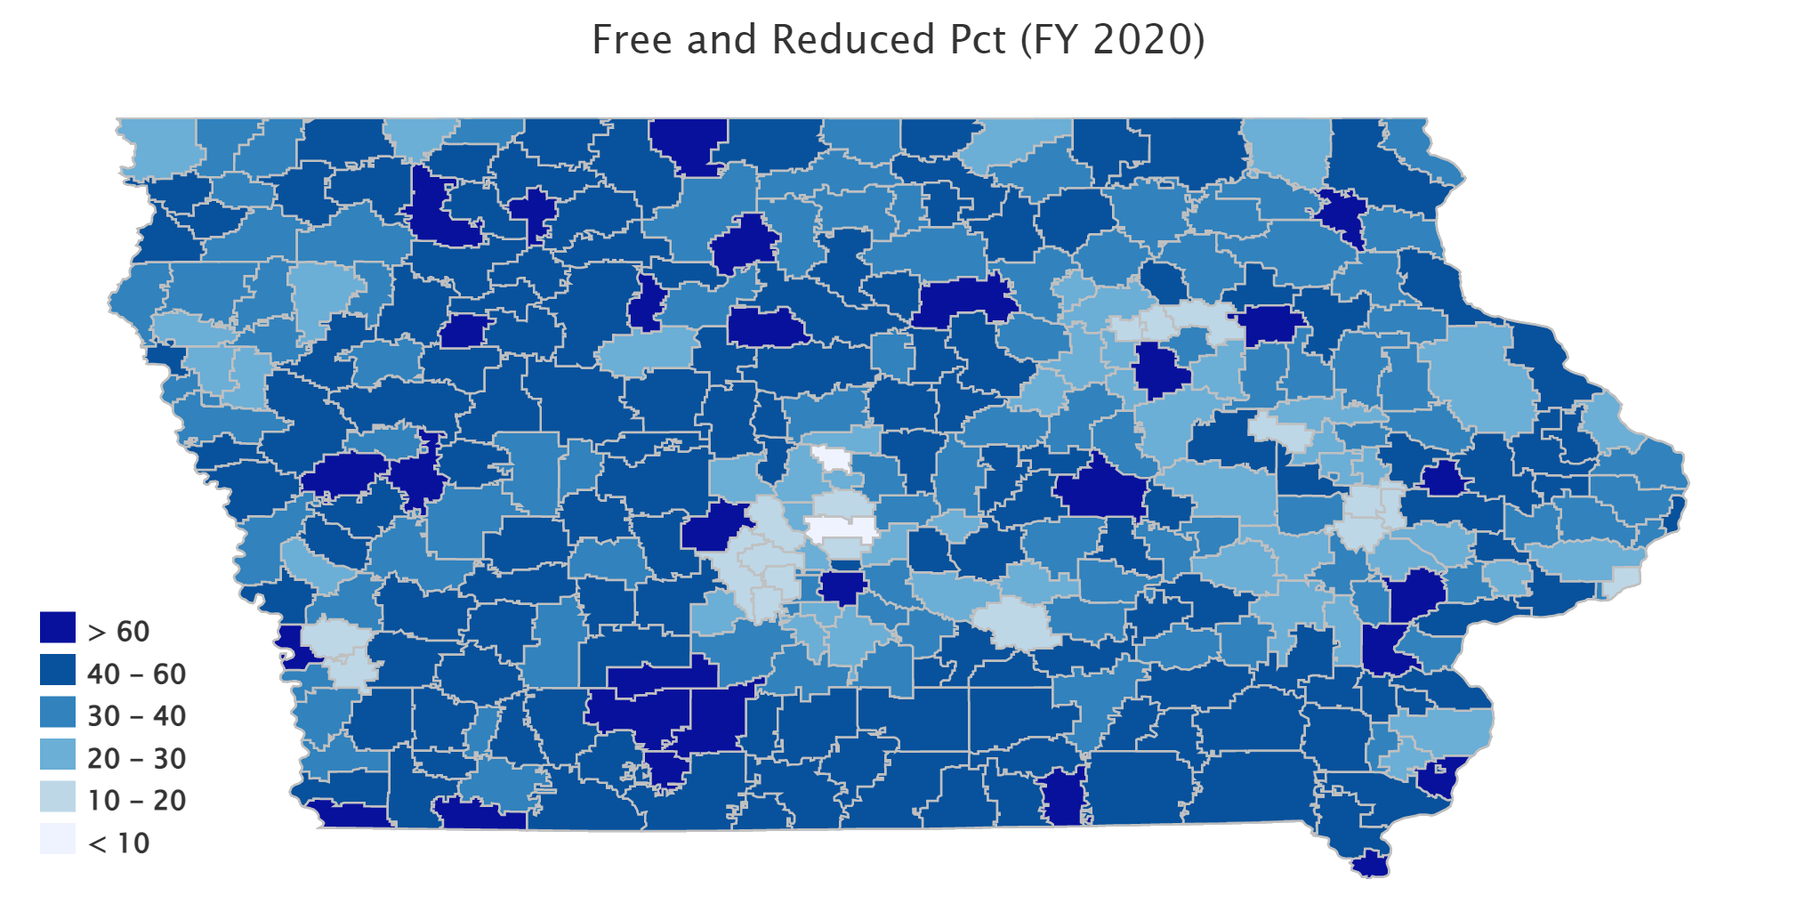
www.iowaschoolfinance.com

Slide 22
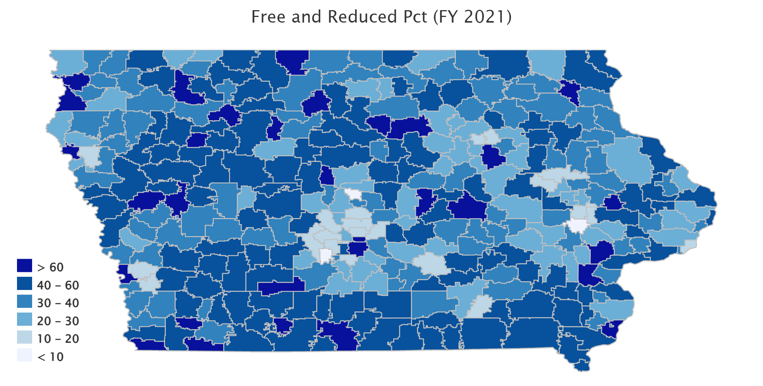
www.iowaschoolfinance.com

Slide 23
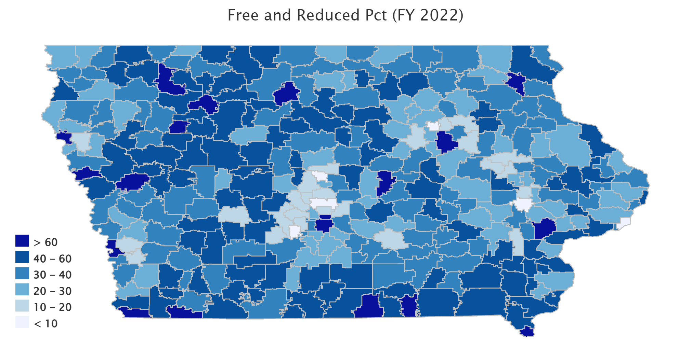
www.iowaschoolfinance.com

Slide 24
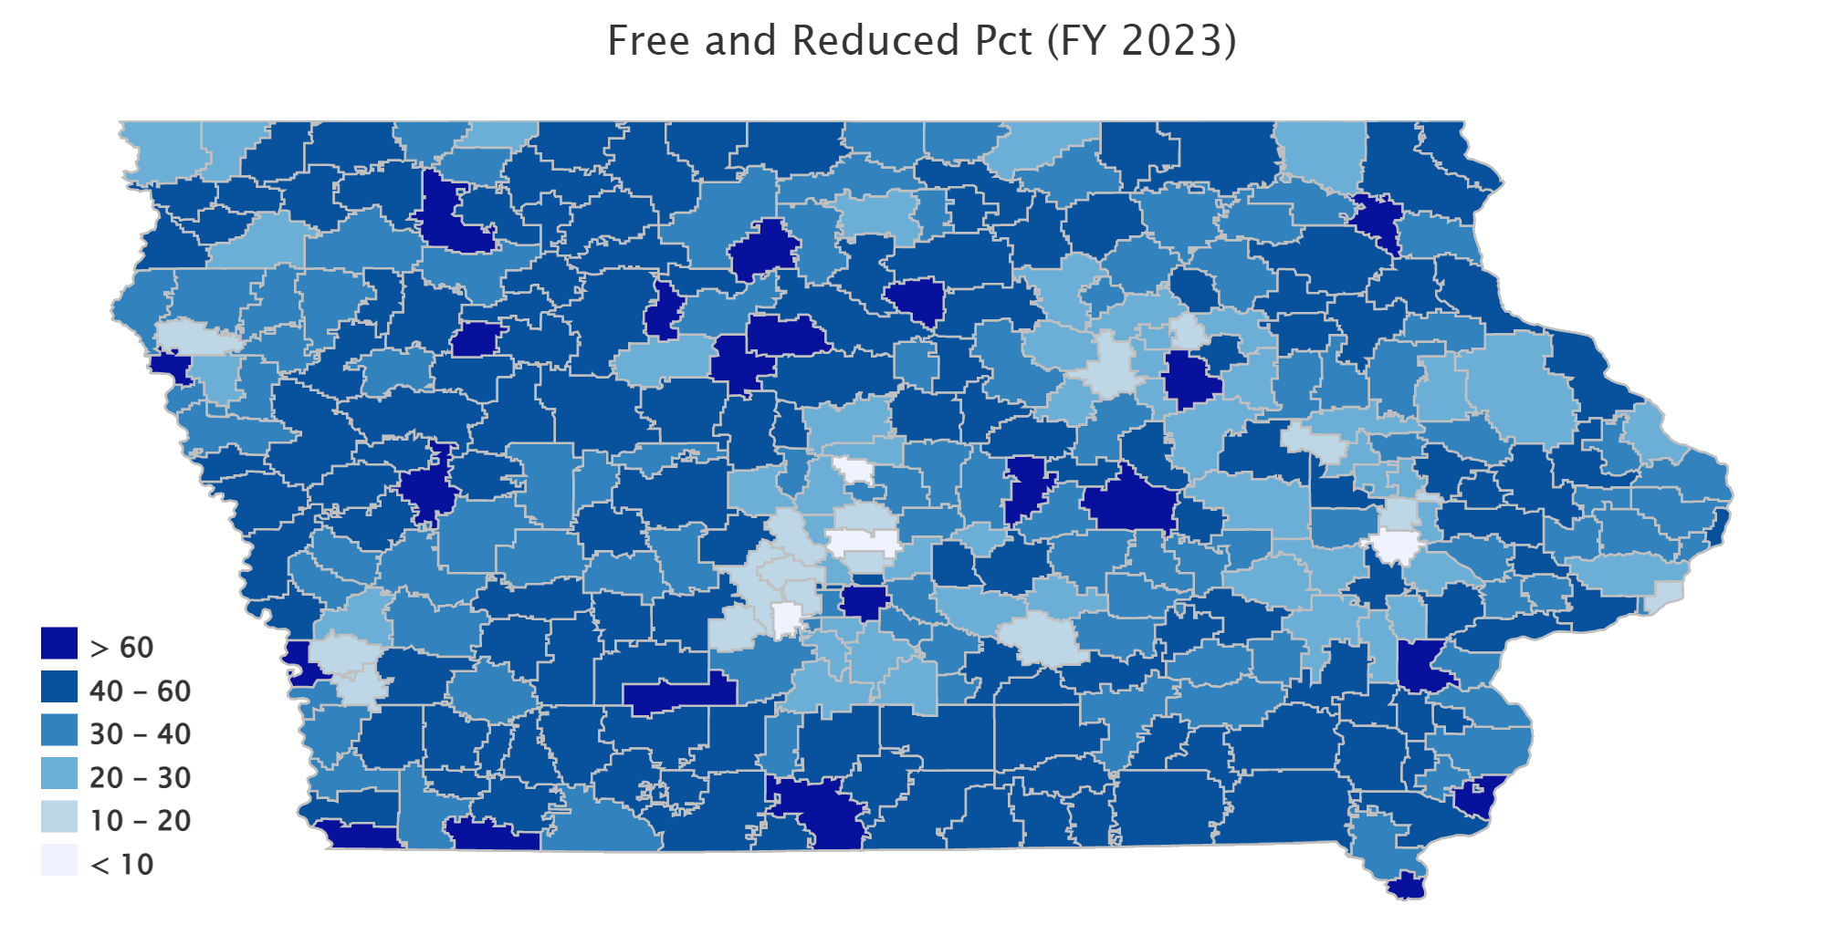
www.iowaschoolfinance.com

Slide 25
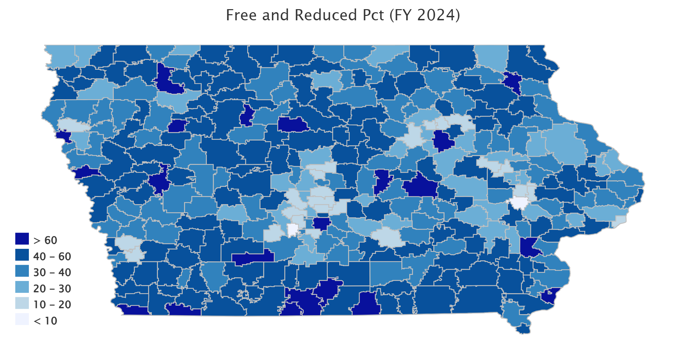
www.iowaschoolfinance.com

Slide 26
www.iowaschoolfinance.com

