Slide 1
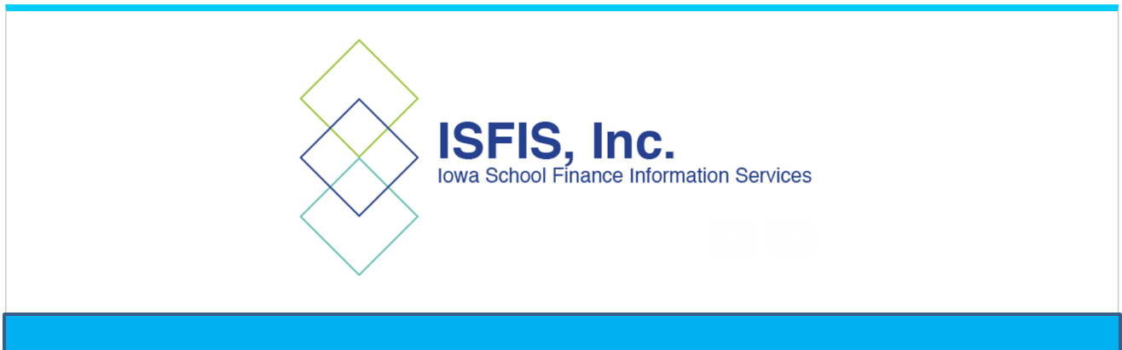
Video Conclusion:
Starting the 2023-24 School Year

Slide 2
Starting the 2023-24 School Year
Students will soon be back in your classrooms.
Do your best to ask good questions about what you don’t know.
Be patient – clarity will unfold as implementation happens. Consequences and enforcement are delayed.
Listen to directions from your administrators and school board. Defining these terms is not on you as a teacher.
Avoid any appearance of noncompliance (do not use or keep books removed from libraries in your classroom and do not post a sign that says “we read banned books”.)
Avoid politics in the classroom.
Do your best to work with parents, as we know teachers do, to inform them what they can do to help their student succeed.

Slide 3
Map of the Week
Yoga Index

Slide 4
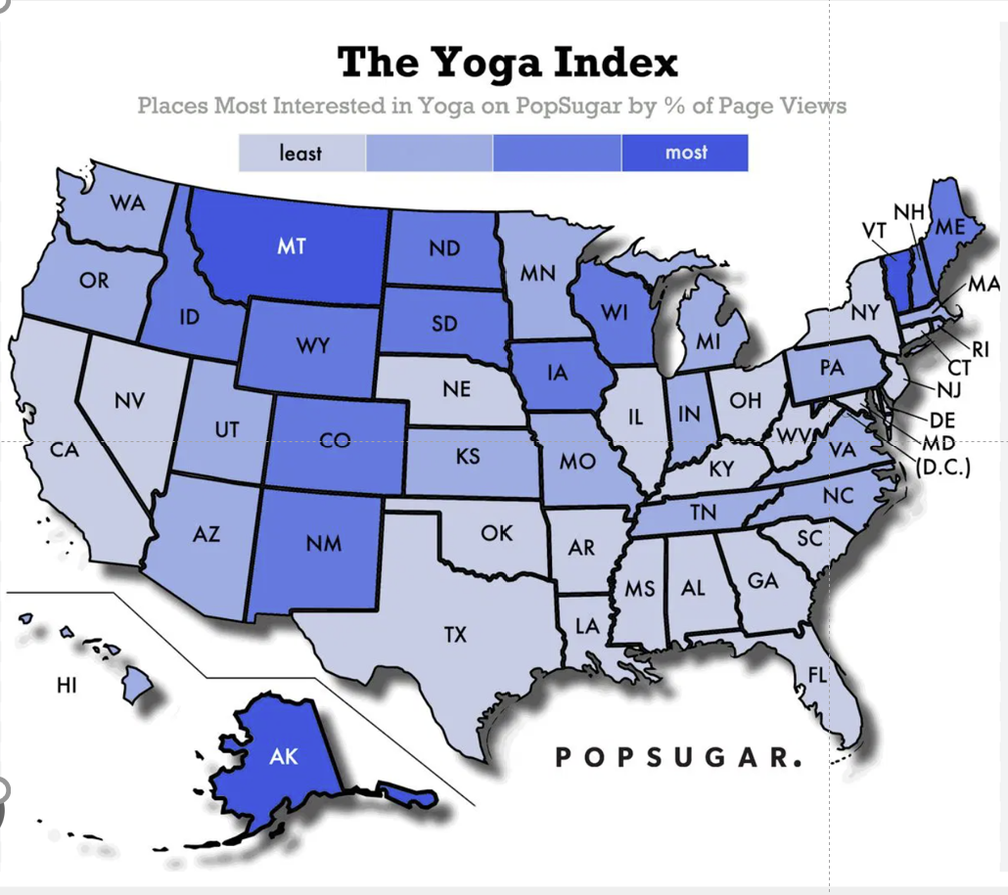

Slide 5
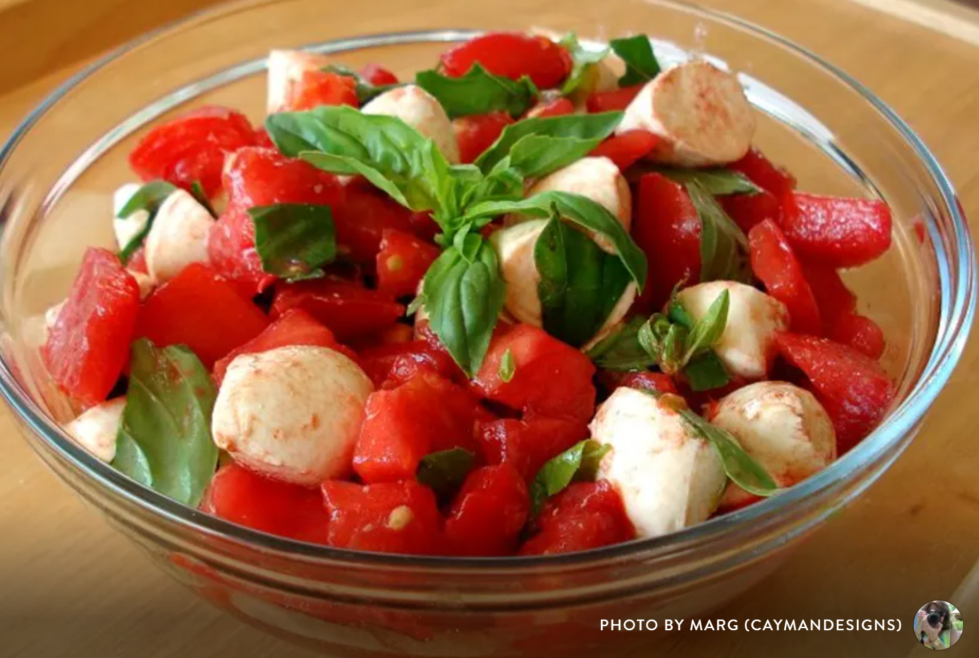
https://www.food.com/recipe/fresh-tomato-mozzarella-salad-1
FRESH TOMATO & MOZZARELLA SALAD
INGREDIENTS
3 medium tomatoes
¹⁄₂ lb. fresh mozzarella cheese (if all you can find is the tub, make sure to pat it real dry)
¹⁄₂ cup torn basil leaves
3 tablespoons olive oil
4 teaspoons balsamic vinegar
kosher salt or sea salt, to taste
DIRECTIONS
Cut up the tomatoes and mozzarella into large cubes.
Add basil leaves and drizzle w/ vinegar and olive oil.
Stir lightly.
Sprinkle with a little salt.
Chill at least one hour.
Store in refrigerator.
Ideas from Margaret:
Add a little minced garlic or finally diced red onion
Substitute peaches for tomatoes (or do half and half)
If cucumbers are ready but not tomatoes, substitute but add black pepper or cut up peppers
Make double and stir leftovers into cooked pasta the next day and add a few other cut up veggies.

Slide 6
Larry Sigel, ISFIS – Partner
Cell: 515-490-9951
larry@iowaschoolfinance.com
Margaret Buckton , ISFIS – Partner
UEN Executive Director,
RSAI Professional Advocate
Cell: 515-201-3755
margaret@iowaschoolfinance.com
We are here to help!
ISFIS, Inc., 1201 63rd Street, Des Moines, IA, 50311, (515) 251-5970, www.IowaSchoolFinance.com

