Slide 1
Mandates, Changes in Practice and Policy Requirements from the 2023 Legislative Session HF 430 Mandatory Reporter/Hiring Practices
© Iowa School Finance Information Services, 2023

Slide 2
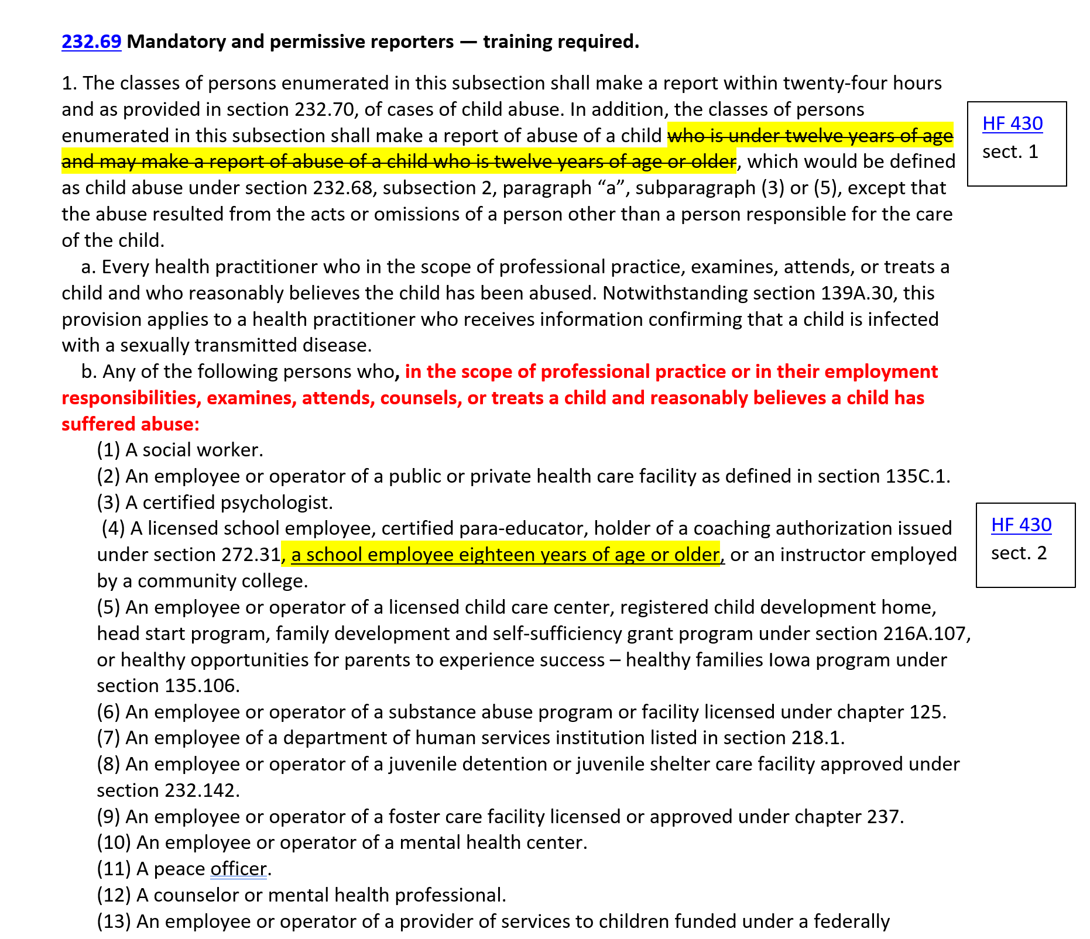
HF 430 Mandatory Reporter/Hiring Practices
Note: IC 232.69 is only specific to child abuse reporting and does not include dependent adult abuse.

Slide 3
HF 430 Mandatory Reporter/Hiring Practices
IC 232.69 (2)b. A person required to make a report under subsection 1, other than a physician whose professional practice does not regularly involve providing primary health care to children, shall complete two hours of training relating to the identification and reporting of child abuse within six months of initial employment or self-employment involving the examination, attending, counseling, or treatment of children on a regular basis. Within one month of initial employment or self-employment, the person shall obtain a statement of the abuse reporting requirements from the person’s employer or, if self-employed, from the department. The person shall complete at least two hours of additional child abuse identification and reporting training every three years. If the person completes at least one hour of additional child abuse identification and reporting training prior to the three-year expiration period, the person shall be deemed in compliance with the training requirements of this section for an additional three years.
Note: IC 232.69 is only specific to child abuse reporting and does not include dependent adult abuse.

Slide 4
HF 430 Mandatory Reporter/Hiring Practices
Requires DE to develop and implement a process for reporting and investigating an employee’s commission of a felony or violation of IC 272.15 (1) “a” regarding inappropriate relationship or contact with a student. Requires this process to:
Prohibit written or oral agreements between school districts and employees which prohibits the employer from discussing any employee behavior or incidents with officials or prospective employers as a condition of resigning or waives liability of a licensed employee related to past performance, action or allegations of wrongdoing.
Requires the school district to review an applicant’s employment history, including contacting the applicant’s previous employers listed on the application for employment and by viewing the BOEE’s public license information to determine if there is a case pending with a finding of probable cause or any licensure sanction. (This applies to all employees, regardless of contract status.)
Requires the district to keep information on forms prescribed by the DE and respond to any request from a potential employer (but not required to reveal information about unfounded, closed investigations). Gives school leaders immunity from criminal or civil liability arising from disclosure as long as the shared information is not knowingly false.

Slide 5
HF 430 Local Implementation
Even before the rules/process are completed by DE and BOEE,
Share mandatory reporter information with employees
Must report child abuse for students up to age 18
Employees age 18 and older and other classes of employees who have contact with students must have mandatory reporter training.
Train any additional employees who are now mandatory reporters ASAPP (as soon as practically possible)
Prohibit written or unwritten agreements for any resigning or terminated employees.
Review local board policies for inconsistencies or updates required by the new law
Expect to revisit these requirements when DE and BOEE rules and investigation processes are defined.

Slide 6
Larry Sigel, ISFIS – Partner
Cell: 515-490-9951
larry@iowaschoolfinance.com
Margaret Buckton , ISFIS – Partner
UEN Executive Director,
RSAI Professional Advocate
Cell: 515-201-3755
margaret@iowaschoolfinance.com
We are here to help!
ISFIS, Inc., 1201 63rd Street, Des Moines, IA, 50311, (515) 251-5970, www.IowaSchoolFinance.com

