Slide 1
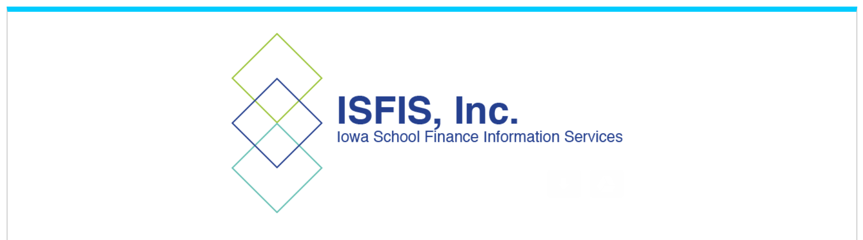
Mandates, Changes in Practice and Policy Requirements from the 2023 Legislative Session
HF 602 Licensure Renewal for Experienced MA + Teachers
© Iowa School Finance Information Services, 2023

Slide 2
HF 602 Licensure Renewal
Exempts practitioners with 10 years experience and a MA or higher degree from BOEE renewal CREDIT requirements.
Does not apply if the practitioner has an evaluator endorsement which must be renewed at least once every 10 years.
This action does not excuse practitioners from district-related PD or an individual PD plan required by IC 284.

Slide 3

Larry Sigel, ISFIS – Partner
Cell: 515-490-9951
larry@iowaschoolfinance.com
Margaret Buckton , ISFIS – Partner
UEN Executive Director,
RSAI Professional Advocate
Cell: 515-201-3755
margaret@iowaschoolfinance.com
We are here to help!
ISFIS, Inc., 1201 63rd Street, Des Moines, IA, 50311, (515) 251-5970, www.IowaSchoolFinance.com

