Slide 1
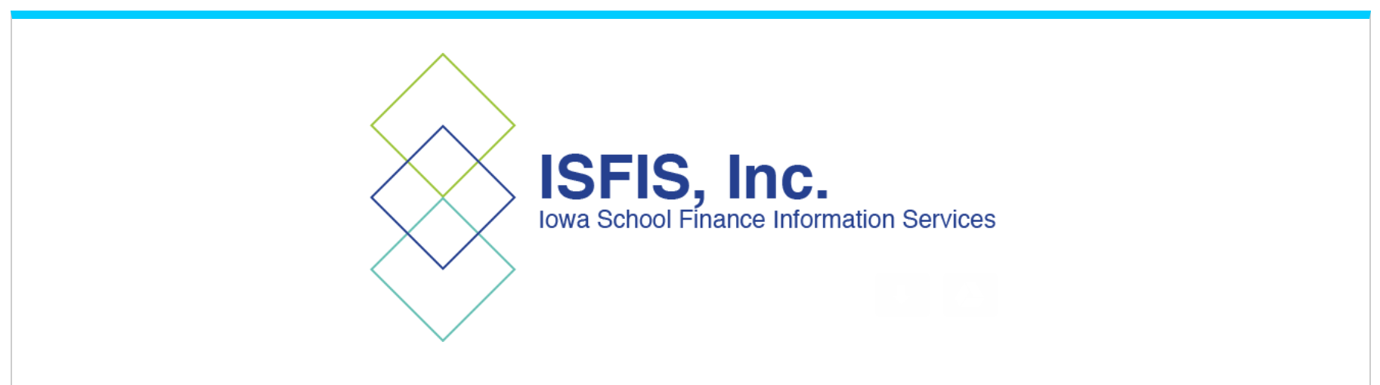
August 9, 2023
2023 Legislative Information for School Staff
Introduction
Margaret Buckton
© Iowa School Finance Information Services, 2023

Slide 2
Purpose of these Videos
Explain legislation from the 2023 Session that impacts school staff and students
Provide a heads up for when the DE or BOEE are mandated to provide a process or policy for implementation
Explain the consequences of noncompliance with state laws
Give school staff and administrators information to stay out of trouble and avoid consequences

Slide 3
Thoughts about DE Guidance
During COVID, guidance was issued under an emergency executive order, was very prescriptive and left little room for autonomy.
DE’s new Director Snow, with experience in the federal DOE, where “guidance” has a more official and transparent process than what we have experienced in Iowa.
“Guidance” doesn’t have the force of law:
Official Rules and procedures are pending, but take time

Slide 4
Starting the 2023-24 School Year
Students will soon be back in your classrooms.
Do your best to ask good questions about what you don’t know.
Be patient – clarity will unfold as implementation happens. Consequences and enforcement are delayed.
Listen to directions from your administrators and school board. Defining these terms is not on you as a teacher.
Avoid any appearance of noncompliance (do not use or keep books removed from libraries in your classroom.)
Avoid politics in the classroom.
Do your best to work with parents, as we know teachers do, to inform them what they can do to help their student succeed.

Slide 5
Larry Sigel, ISFIS – Partner
Cell: 515-490-9951
larry@iowaschoolfinance.com
Margaret Buckton , ISFIS – Partner
UEN Executive Director,
RSAI Professional Advocate
Cell: 515-201-3755
margaret@iowaschoolfinance.com
We are here to help!
ISFIS, Inc., 1201 63rd Street, Des Moines, IA, 50311, (515) 251-5970, www.IowaSchoolFinance.com

