Slide 1
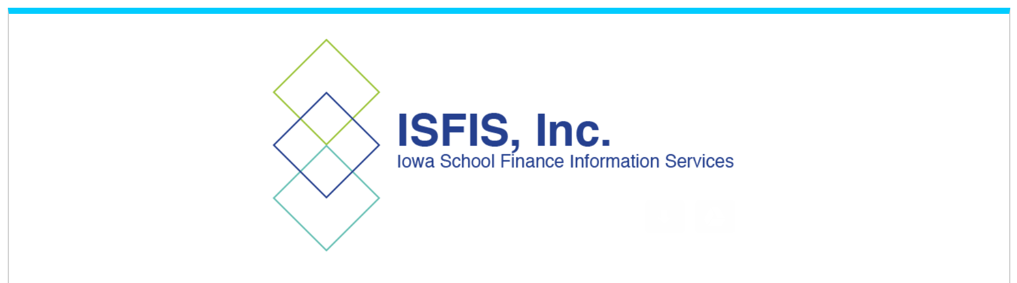
Mandates, Changes in Practice and Policy Requirements from the 2023 Legislative Session SF 496 Transparency and Parents’ Rights
© Iowa School Finance Information Services, 2023

Slide 2
SF 496 Big Concepts in the Law
Parents have the right to make decisions about their child/student.
Formal surveys and other activities that collect personal information about students and their families require parent consent (unless mandated by the state or federal government).
Schools are prohibited from teaching about gender identity and sexual orientation in Grades K-6.
Libraries and classroom educational materials are prohibited from including a depiction or description of a sex act (all grades).
Penalties for noncompliance are delayed until at least Jan. 1, 2024 and apply to knowing violations of the law.

Slide 3
Defining Terms, Rules and Guidance
SF 496 was effective July 1, 2023.
In some cases, DE or BOEE has to write new rules or provide resources.
Although there may be some FAQ documents or fact sheets, the DE staff testified at the State Board Meeting in early August that they are addressing questions on a case-by-case basis.
This is a change for schools heavily directed by the State during the COVID pandemic. Until school leaders know local authority will be respected, they are concerned that the State is just waiting for them to make a mistake. Absent additional clarity, school leaders are turning to legal counsel, which tends to focus on managing risk rather than expanding opportunity for students.
If you are uncomfortable by all of this, it’s normal. The sense of limbo is very confusing and for many individuals, operating in an unknown environment can be somewhere between uncomfortable and paralyzing. But even if we don’t like the law, we either follow it or suffer the consequences.
Don’t panic. We will all learn more as we begin to implement. Most importantly, direction from your administration and school board will be coming. Ask questions if you are concerned. But it’s as important not to over react as it is to comply with the law. We have some ideas about what legislative intent is, which I’ll share along the way.

Slide 4
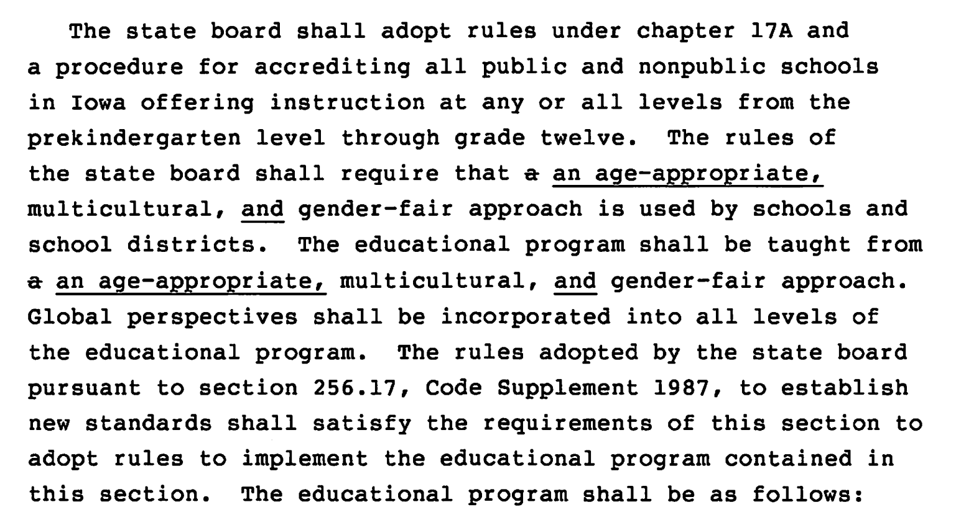
SF 496 Transparency and Parents’ Rights
Requires age-appropriate materials (defined below). This age-appropriate language goes into the education standards.

Slide 5
Sexual Orientation & Gender Identity K-6
Prohibits any program, curriculum, test, survey, questionnaire, promotion, or instruction relating to gender identity or sexual orientation to students in K-6.
“Sexual orientation”, defined in Code 216.2, means “actual or perceived heterosexuality, homosexuality, or bisexuality.”
If a book is excluded because it has a family with two moms, two dads, or even two male penguins, then every book with a mom and dad must also be excluded.
Since that action would be absurd, a reasonable interpretation of this definition means curriculum and books should not be used to persuade students to change their gender identity or to encourage any of the sexual orientation iterations, and obviously, should not include any sexual acts.
Definitions of “any program, curriculum, test, survey, questionnaire, promotion, or instruction” are unfolding and will likely be included in your school board policy.

Slide 6
SF 496 Transparency and Parents’ Rights
Defines “Age-Appropriate” to mean topics, messages, and teaching methods suitable to particular ages or age groups of children and adolescents, based on developing cognitive, emotional, and behavioral capacity typical for the age or age group. “Age-appropriate” does not include any material with descriptions or visual depictions of a sex act as defined in section 702.17.
Prior standard of obscenity allowed school reconsideration committees to review literature as a whole, allowing what alone might be considered obscene because the rest of the book has literary, social, political or artistic value. This standard no longer applies.
The bill also prohibits students from being part of a reconsideration committee.
Without any adjectives to describe description or depiction of a sex act, staff have been trying to figure out exactly what the legislation means. Let’s look at legislative intent.

Slide 7
SF 496 Legislative Intent
DMR 7.9.23 “But lawmakers who helped pass the bill, like Senate Education Committee Chair Ken Rozenboom, R-Oskaloosa, say removing school books with sex acts is “just not difficult.”
“Let's not drag Shakespeare and the Bible into this discussion, because we all know that's not what we're dealing with,” Rozenboom said. “These are books — and the list is out there — that the schools know. … Books that have very explicit, sometimes perverse, pornographic descriptions.”
Cedar Rapids Gazette 8.6.23 House Education Committee Chair Skyler Wheeler, R-Hull, in a statement provided in the newsletter, said . . .he does not believe deciding which books to remove should be hard.
“It’s unbelievable to me that some of these school districts are having such a hard time removing sexually explicit material from their library,” he said. “This is quite simple to me. Porn doesn’t belong in school libraries. Books that don’t contain porn can remain on the shelves.”
Your local board policies will likely provide additional clarification
Timing of those will depend on your district and school board implementation decisions
Listen to your district leaders in defining their approach to these definitions and terms.

Slide 8
SF 496 Transparency and Parents’ Rights
Excludes human growth and development grades (sex education classes) from the prohibition to describe a sex act (still requires instruction in human sexuality in grades 7-12).
Requires each school board to provide age-appropriate and research-based instruction in human growth and development including instruction regarding self-esteem, stress management, interpersonal relationships, and domestic abuse in grades 1-6.
Although this no longer mentions human sexuality, “domestic abuse” content could still include “good touch/bad touch” instruction for elementary students.

Slide 9
SF 496 Transparency and Parents’ Rights
Districts have until Jan. 1, 2024 before penalties regarding library provisions are effective. If a DE investigation determines the district or an employee has violated the provision prohibiting content in library books that was not age-appropriate, these consequences are laid out:
First violation results in a written warning to the school board or employee.
Second and subsequent violation, if DE finds the district knowingly violated the requirements, subjects the Superintendent to a BOEE ethics investigation.
Second and subsequent violation, if it pertains to a licensed employee which knowingly violated the requirements, subjects that employee to BOEE ethics investigation.
BOEE investigations could lead to disciplinary action.
Note: the DE’s letter to the field states that the bill gives them the authority to define a process to investigate allegations of noncompliance regarding age-appropriate materials.

Slide 10
SF 496 Transparency and Parents’ Rights
Prohibits schools from a formal examination or survey of a student designed to assess the students’ mental, emotional or physical health that is not required by state or federal law without first getting written parent consent.
Requires written notice to a student’s parent or guardian of an examination or survey of the student required by state or federal law that is designed to assess the student’s mental, emotional, or physical health
not less than seven days prior to the examination or survey
includes a copy of the examination/survey or a link to an internet site where the parent or guardian may access the examination or survey.
Does not apply to vision or hearing exams, in emergent care situations or when cooperating with a child abuse investigation.

Slide 11
SF 496 Transparency and Parents’ Rights
Requires school boards to adopt a policy describing how parents of an enrolled student or residents of the school district can review instructional materials used in classrooms. Requires that the policy be posted on the district’s website and include the process for a parent to opt their child out of material. Access to the policy must be provided to parents annually in writing or electronically.
Defines instructional materials as “printed or electronic textbooks and related core materials that are written and published primarily for use in elementary and secondary instruction and required by the state or district for use by students in the student’s classes by the teacher of record.” Excludes lesson plans.
Requires identity of a parent requesting removal of materials from the classroom or library shall be confidential.

Slide 12
SF 496 Transparency and Parents’ Rights
Requires schools to publish on the district’s website:
A detailed explanation of the procedures or policies for the parent of an enrolled student to request removal of a book, article, outline, handout, video or other education material available to students in the classroom or library. Requires the policy to be prominently displayed on the district’s website.
A detailed explanation of procedures or policies to request a review of decisions made by the school board, including the petition process for a public hearing.
A comprehensive list of books available to students in libraries. If the district does not use an e-catalog yet, the Bill allows the districts to request a waiver from the DE for school years before July 1, 2025.

Slide 13
SF 496 Transparency and Parents’ Rights
Specific Parent’s Rights
Requires DE to adopt rules to implement this section.
Prohibits the school district from knowingly giving false or misleading information to parents of a student regarding the student’s gender identity. Defines gender identity per IC 216.2, subsection 10. “Gender identity” means a gender-related identity of a person, regardless of the person’s assigned sex at birth.
If a student requests accommodation from a licensed practitioner to affirm gender identity, including use of a name or pronoun different than that on the school district’s registration forms or records, the practitioner must inform an administrator who must inform the parent.
Specifies the same enforcement mechanism for violation of any of the above that applies to the library and age-appropriate regulations.

Slide 14
SF 496 Transparency and Parents’ Rights
Legislative intent: this is about data collection and storage of information.
Protection of student rights;
requires written parent consent before requiring a student to take part in any survey, analysis, activity or evaluation that reveals personal information about the student or family
List of items that would be personal information includes: student’s or family’s political affiliations, mental problems, sexual behavior/orientation/beliefs, illegal, antisocial, self-incriminating or demeaning behavior, critical appraisals of close family relationships, privileged relationships, religion or income.
exception for income when needed for eligibility in a program.
Requires prior written notice to the parent to include detailed information about the survey, including the person who sponsors it, how the information it generates is used, and how such information is stored.
Requires prior written parent consent for an employee to answer any questions or share student information from the survey (except when developing or implementing an IEP).

Slide 15
SF 496 Transparency and Parents’ Rights
Allows a parent of a student to enroll their child in another attendance center in the district if the district determines that the student was bullied/harassed.
Allows local school boards to set capacity limitations in a school board policy that would indicate whether the attendance center requested has capacity to enroll the student.
Allows a school district, following their anti-bullying/harassment policy, to notify parents in writing or by email within 24 hours after an employee witnesses, either directly or from viewing a recording from a video surveillance system, any student enrolled in the district harassing or bullying the student. Requires charter schools to have such a policy.
Mandates that local bullying/harassment policy requires notification of parents who’s child may have been a victim of bullying within 24 hours of receiving a report.
These provisions on inter-district transfer open enrollment requests were effective on enactment. The State BOE/DE is required to write rules and provide required forms.

Slide 16
Consequences of NonCompliance
BOEE ethics investigations have possible scaled outcomes based on the facts of the case, but we do not want school staff to face that level of stress and ultimately, put you at risk of losing your license to teach (or administer).
Politics on both sides of this equation may be squeezing the middle. The “reasonable” standard is a good protection from the extremes.
In addition to individual licensure implications, failure to comply will get media coverage and legislative attention. What will next year’s legislation look like if some schools do not respect the intent of the law?

Slide 17
Larry Sigel, ISFIS – Partner
Cell: 515-490-9951
larry@iowaschoolfinance.com
Margaret Buckton , ISFIS – Partner
UEN Executive Director,
RSAI Professional Advocate
Cell: 515-201-3755
margaret@iowaschoolfinance.com
We are here to help!
ISFIS, Inc., 1201 63rd Street, Des Moines, IA, 50311, (515) 251-5970, www.IowaSchoolFinance.com

