Slide 1

June 3, 2021
ISFIS Special Topic
Webinar
2021 Legislative Session #1
Larry Sigel & Margaret Buckton
© Iowa School Finance Information Services, 2021

Slide 2
Webinar Resources
PPT is linked on the ISFIS webinar webpage
Use the slides and information as you see fit
OK to share with others in your district
Let us know if others in your district need an invite to attend the webinars

Slide 3

Connect with ISFIS
Are you connected with ISFIS on Social Media?
Follow us on Twitter: @ISFISInc
Like us on Facebook:
https://www.facebook.com/isfisinc/
Link to us on LinkedIn:
https://www.linkedin.com/company/iowa-school-finance-information-services
If you or anyone at your district needs access to the ISFIS subscriber content on the website, email jen@iowaschoolfinance.com
Please check with others at your district to make sure they’re getting our emails & invites!

Slide 4

ISFIS Renewal for 2021-22
We thank you for your 2020-21
ISFIS Subscription and ask you to consider
renewal for 2021-22.
Check out our new FY 2022 ISFIS Program & Services Guide (included in the mailing to Supts & SBOs, and on our website).
We offer a 5% discount for renewal subscriptions paid before July 15th.
If you are leaving your position at year-end, setup your replacement for success by renewing with ISFIS before your depart.
Let us know if you have any questions about our programs or services
or how ISFIS can help your district.

Slide 5
ISFIS Upcoming Webinars
Register Here | SPECIAL TOPIC WEBINAR - UNDERSTANDING FLEX FUNDS June 10, 2021 at 3pm In this Special Topic Webinar, Margaret and Larry will do a deeper dive into expanded school district funding flexibility over the last four years, including recent updates to the flexibility accounts, school board process, and short- and long-term considerations for sustainability.
Register Here | SPECIAL TOPIC WEBINAR - 2021 LEGISLATIVE SESSION RECAP - PART 2 June 17, 2021 at 3pm In this Special Topic Webinar, Margaret will continue the recap of the legislative actions that took place at the Iowa Statehouse during the 2021 legislative session. This episode will focus on school funding, preschool, tax policy and other legislation with budget implications.
Let us know if there’s an issue or content that you’d like to see us cover in a future Special Topic Webinar. Find Registration, Recordings and Links to Materials:
https://www.iowaschoolfinance.com/webinars

Slide 6
2021 Legislative Session Webinar Agenda
2021 Session Processes
Education Policy Bills School Choice
Accreditation Changes
Education Policy Bills Other

Slide 7
COVID-19 2021 Session Processes
Less stakeholder contact (fewer or no forums at home, few visits to the statehouse, no lobby days or conferences)
Lobbyist and other contact limited
  Senate Subcommittees required virtual/ZOOM
  House Subcommittee required in person to comment, but virtual observation
  New process for written comments prior to the subcommittee
Leadership negotiations when Senate/House/Governor were stuck. Once agreement was achieved, typically one amendment with changes and both chambers approved the bill.

Slide 8
Governor’s Timeline
Sine Die May 19 12:45 AM
June 20 is the 30 day deadline for Governor to sign, veto or line item veto
Most bills are effective July 1, 2021 unless the language in the bill states otherwise

Slide 9
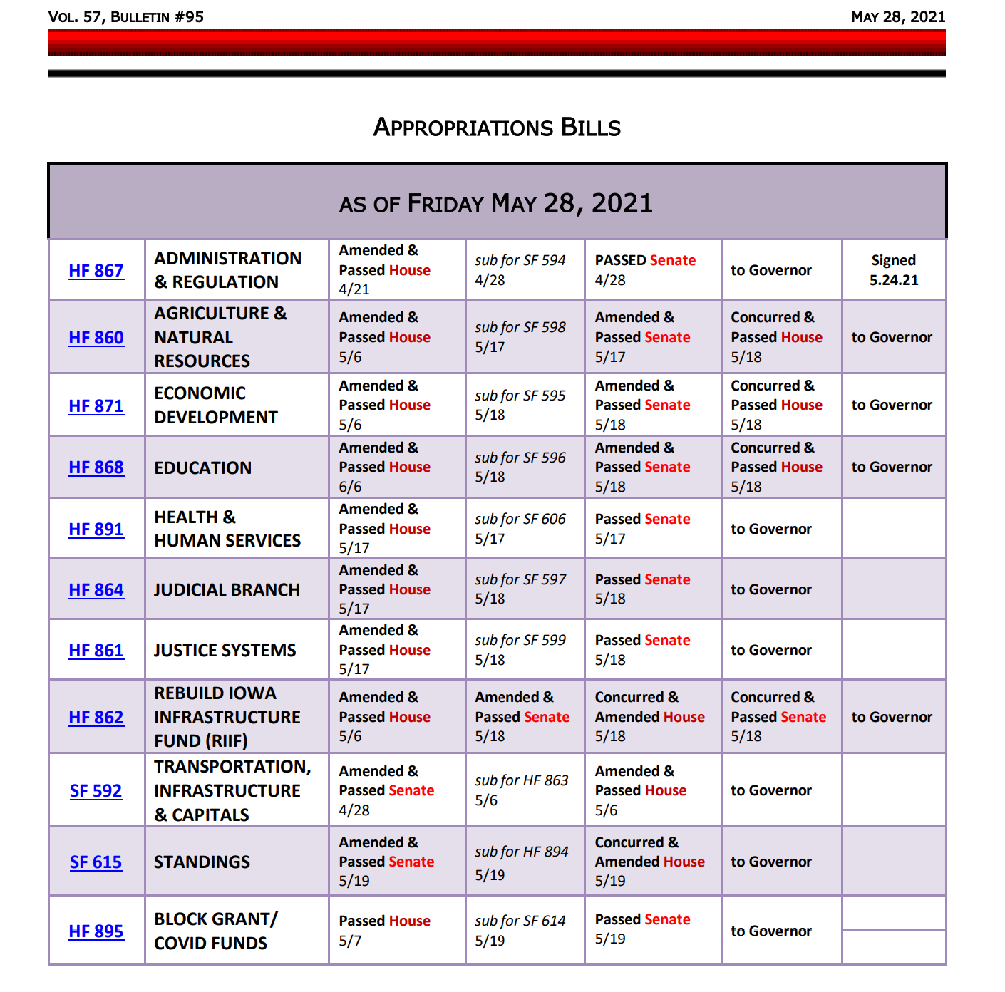
9 of the 11 big budget bills were amended and approved in the last 72 hours of the Session . . . (May 17-19)

Slide 10

School Choice Bills

Slide 11
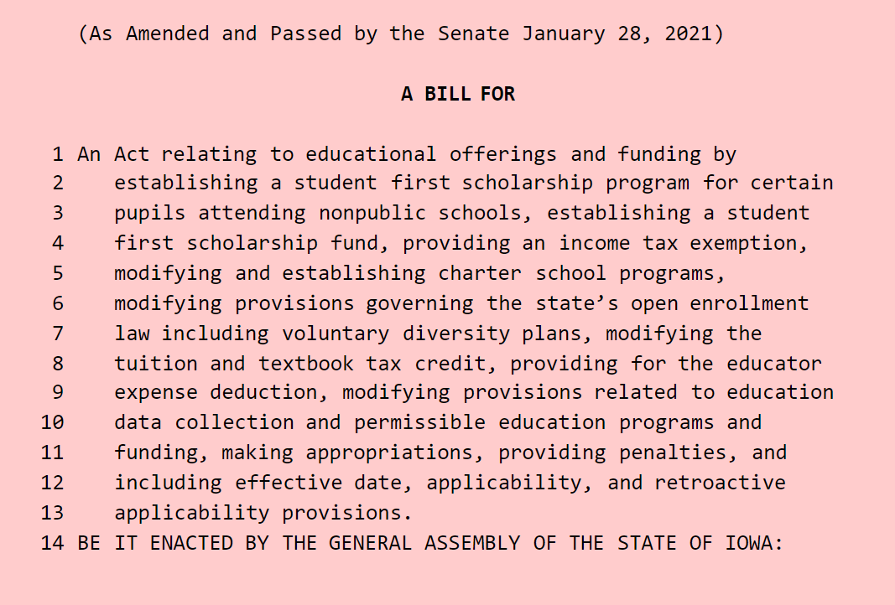
Governor’s Proposal SF 159
Jan. 11: First day of 2021 Session
Jan. 12: Governor’s Condition of the State – first mention of school choice
Jan. 20: SSB 1065 introduced
Jan 25: Education Subcommittee, Committee approved (new # SF 159), Jan. 26: through W&M Subcommittee and Committee
Jan. 27: Approps subcommittee and Committee
Jan. 28 debated in the Senate and approved, sent to the House

Slide 12
Governor’s Proposal SF 159
House breaks up the Governor’s proposal into several bills
  HSB 243 Students First Scholarship Program (Vouchers) which did not advance out of the Education Committee
  HF 228 Diversity Plans
  HF 813 Charter Schools
  HF 847 Education Flexibility and Open Enrollment

Slide 13
HF 228 Diversity Plan Open Enrollment
Bans the ability of five districts with voluntary diversity plans (Davenport, Des Moines, Postville, Waterloo and West Liberty) from regulating open enrollment out of the district based on their plans, which currently review socioeconomic status (income) or English-language learner classification as metrics to consider.
None of these districts uses race as a metric, which was banned as a sole measure of consideration by a Supreme Court decision in 2007, but could have been used as a partial measure.
For the transition year, there is no deadline in the statute for families to request open enrollment out of one of these five districts.
For the 2022-23 school year, the March 1 2022 open enrollment deadline will apply.
Does not mandate that receiving districts must take the student.
Does not prohibit using a plan to regulate open enrollment within the district, but likely will eliminate that, as parents will request a certain building and if denied, request open enrollment out of the district.

Slide 14
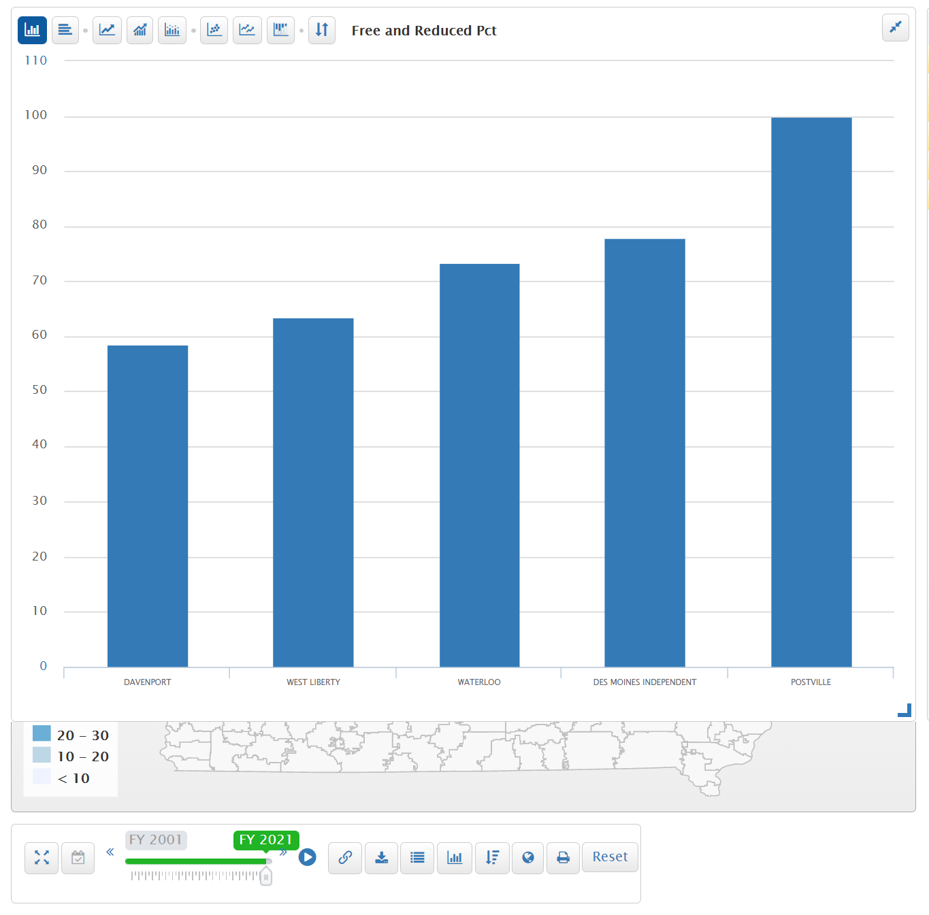
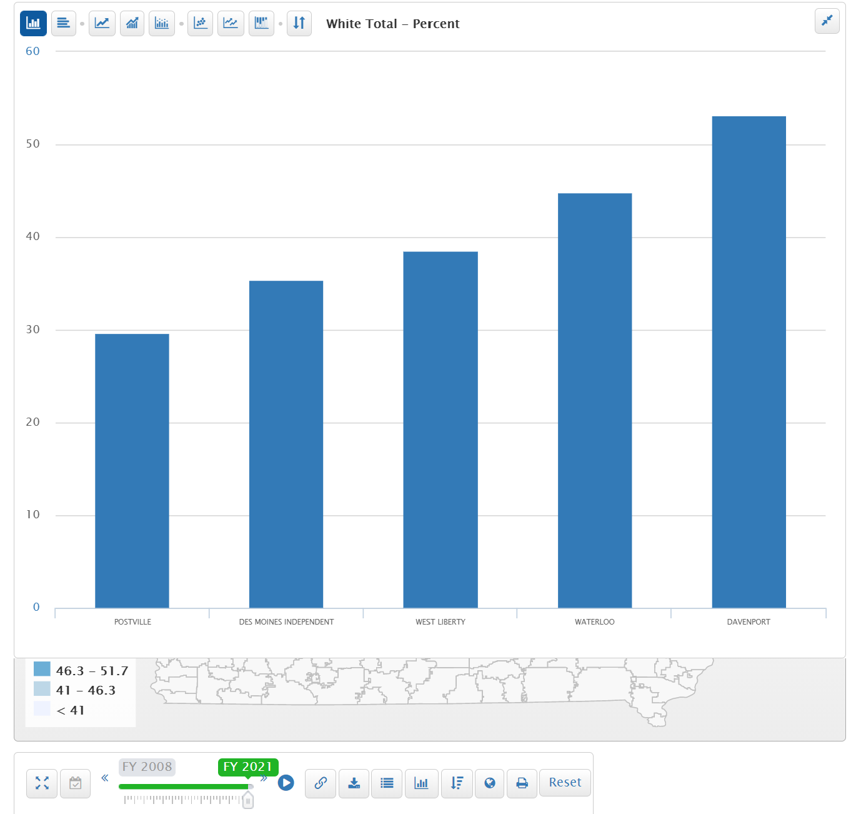
Diversity plan districts level of poverty: FRPL range from 68% in Davenport to 100% in Postville.
Diversity plan districts level of minority: Davenport is the only district with majority white at 53.1%. (Des Moines at 35.4% and Postville at 29.6%)

Slide 15
HF 228 Diversity Plan Open Enrollment
The goals of the diversity plans are to preserve a mix of diversity and prevent segregation of schools (minority and poverty concentration).
Solid research base that shows a concentration of poverty which hits a tipping point at 50-60% and segregated schools negatively impacts student achievement, economic growth and workforce diversity for such communities.
See the UEN Issue Brief explaining the issue and showing data on poverty, minority, open enrollment and certified enrollment for these districts and for similar districts without voluntary diversity plans. This Brief was shared with subcommittee members in the House and posted to the comments section of the legislative website.
The provisions of this bill are included as Division III in SF 159 Governor’s School Choice Omnibus Bill, as approved in the Senate Thursday, Jan. 28.
House passed it 2/2/21. Senate passed it 4/5/21. Governor signed it 5/10/21

Slide 16
HF 813 Charter Schools Signed May 19
The purpose of a charter school shall be to accomplish the following:
a. Improve student learning, well-being, and postsecondary success.
b. Increase learning opportunities for students in areas of need in this state, including but not limited to science, technology, engineering, and math (STEM), and science, technology, engineering, arts, and math (STEAM).
c. Increase opportunities for work-based learning, early literacy intervention, and serving at-risk populations.
d. Accelerating student learning to prevent learning loss during the COVID-19 pandemic and other significant disruptions to student learning.
e. Encourage the use of evidence-based practices in innovative environments.
f. Require the measurement and evaluation of program implementation and learning outcomes.
g. Establish models of success for Iowa schools.
h. Create new professional opportunities for teachers and other educators.
i. Investigate and establish different organizational structures for schools to use to implement a multi-tiered system of supports for students.
j. Allow greater flexibility to meet the education needs of a diverse student population and changing workforce needs.
k. Allow for the flexible allocation of resources through implementation of specialized school budgets for the benefit of the schools served.
l. Allow greater flexibility for districts and schools to focus on closing gaps in student opportunity and achievement for all students from preschool through postsecondary preparation.
4. The state board of education shall be the only authorizer of charter schools under this chapter.

Slide 17
HF 813 Charter Schools
Requirements (here are a few):
  Includes length of time for a charter, various requirements on teachers, on non-discrimination, on operating as a non-religious school, on testing, instructional days and other matters.
  Requires that performance evaluation measures, compensation and dispute resolutions methods for staff and for the educational provider be in the charter application.
  Requires charter schools to specify what statutes and administrative rules with which it does not attend to comply and for the DE to assist in which statutes and rules can be waived.
  Requires the budget be published online.
  Requires that charter schools give the school district the necessary documentation for Medicaid claiming.

Slide 18
HF 813 Charter Schools
Appropriations and funding:
  District of residence pays to charter school the SCPP for the previous year, TLC per pupil, ELL weighting generated by an ELL student enrolled in the charter school, and the actual costs of special education. The Charter is required to pay PSEO costs. There is a standing appropriation for the DE to pay the costs of any students enrolled in the charter school not on the district of residence prior enrollment count (Kindergarten, home school or private school, or students new to the district since prior Oct. 1)
Adds students enrolled in charter school to the calculation of a district’s actual enrollment.
SBRC requests: allows a school district to request modified supplemental amount from the SBRC for the opening or closing of a charter school, including if a charter goes bankrupt or charter is revoked and students return to the public school, allows the school district to ask the SBRC for spending authority to provide education for those students.
Requires the State Board to develop a protocol for charter school closings, including notice and transition

Slide 19
Charter Schools HF 813
Requires charter school board to determine the appropriate placement of a student on the sex offender registry and requires notice of such consideration on the board’s tentative agenda. If the student is denied enrollment, the district of residence is responsible for determining the appropriate placement.
Good cause open enrollment: adds permanent closure of a charter school authorized under the new chapter to good cause criteria for open enrollment requests after March 1
See ISFIS Analysis of NAPCS Report linked here, which includes additional analysis about the impact of charter schools across the country.

Slide 20
Charter School Amendments in HF 847
Requires charter to have administrators with an administrator’s license, a teacher’s license or a new Charter Administrator license created by BOEE
Makes the governing board subject to public records law
Requires the charter school to notify the resident district that a student will be attending the charter school by March 1 of the school year preceding the school year of enrollment
Requires charter schools to submit an annual report to the state board
HF 813 Signed by the Governor on May 19
HF 847 Signed by the Governor on May 20

Slide 21
Charter Schools Next Steps
State BOE and BOEE will have to develop rules, criteria, performance framework, licensure, etc., so lots of steps before a charter school will be in place, including written and public testimony to each of the following:
  DE and BOEE Public Hearings
  State BOE and BOEE official board action
  Legislative Rules Review Committee
There will be pressured from the Governor to get this work done this fall, so charters can emerge, be approved, and allow enrollment by March 1, 2022 (we think)
Local school charters, developed early in the process, could be seen as minimizing the evidence of need for outside charters in the community (we think)

Slide 22
HF 847 Education Flexibility/STO/Open Enrollment/Masks
The process: mask mandate introduced around noon Wednesday, May 19, signed by the Governor just after midnight. The enrolled bill was not yet available to the public days later. No opportunity for input or preparation. Confusion about CDC rule on busses. DE directed schools to consult their attorneys. Effective on enactment (12:30 am on May 20)
Prohibited schools, cities and counties from requiring a mask mandate unless state or feds mandate it.
Rep. Holt: “hundreds if not thousands of email from parents. . .” shows that advocacy/pressure may actually work.
Is it fair to say that Iowa is not a local control state?

Slide 23
HF 847 Education Flexibility
Flexible Student and School Support Program (FS3) allowing schools to implement evidence-based practices for innovate ways to improve student learning, well-being and post-secondary success.
  Allows DE Director to grant participation for up to a three-year period.
  Allows waiver of from one or more of the requirements of Iowa Code 256.11 subsections 3, 4, 5 (all of the offer and teach requirements), 6 paragraph b or c (PE requirements), or the minimum school calendar requirements in section 279.10, subsection 1 (start date no earlier than Aug. 23, and 180 days or 1,080 hours)
  Specifies the application and program requirements
  States that the program does not exempt the school from federal law or any other requirements of state law not specifically exempted by the director.
  Requires an annual report filed by each school to the DE.
  Allows but does not require use of the flex account to fund the FS3
ISFIS Special Topic Webinar June 10: Flexibility Options

Slide 24
HF 847 TLC, TSS, Tax Credits and Transportation Assistance
Flex Account: Adds TLC funds as transferable to the flex account if all requirements of chapter 284 are met.
TSS Balances: Requires TSS funds received for any years prior up to and including 2020-21 school year, that are unexpended and unobligated at the conclusion of the 2020-21 fiscal year, be paid to teachers before July 1, 2023. The district is required to pay out all but 5% of the funds received in FY 2022. This provision sunsets July 1, 2023
Tax Credits: Allows homeschoolers to use the Tuition & Textbook credit Doubles the credit; 25% of the first $1,000 $2,000. Allows teachers to take a state tax credit similar to the federal credit for expenses but not to exceed $250 $500. Apply retroactively to Jan. 1, 2021 tax year and estimated at $12 million. STO tax credit increases from 65% to 75% retroactive to tax year beginning Jan. 1, 2021 and increases from $15 million to $20 by January 1, 2022 ($3.1 million.)

Slide 25
Categorical Fund Balances
https://educateiowa.gov/documents/categorical-funding/2021/03/fy20-carryforward-categorical-funding
FY 2021 won’t be known until next spring (although you’ll know your own)

Slide 26
Flex Account Implications (HSAP, TLC, PK, PD and Discontinued)
Payout Implications (TSS)

Slide 27
HF 847 Open Enrollment Provisions
  Open Enrollment Transportation: Requires the DE and the State BOE to determine the eligibility of transportation assistance for open enrollment to at least 200% of the FPL.
  Adds changes in the custody/residence of the child and a school is in need of significant improvement as good cause for missing open enrollment deadlines. Defines schools in need of significant improvement based on DE’s designation of priority school for two or more years or identified by ESSA for two or more years.
  Makes the open enrollment deadline for pre-K students needing special education as Sept. 1.
Makes denials related to the inability of a school to adequately address repeated acts of harassment of the student or the consistent failure of the resident district to reasonably respond to a student’s failure to meet basic academic standards after parent notice appealable to State Board
Requires State BOE to adopt rules to set criteria

Slide 28
HF 847 Open Enrollment Provisions
Adds more conditions under which an open enrolled students can participate immediately in varsity sports (these provisions are effective on enactment):
  If a school board or superintendent makes a decision that results in discontinuation or suspension of a varsity athletic activity in the district of residence
  If the boards of both districts agree to waive the waiting period
  If the district of residence had a voluntary diversity plan in effect on Jan. 1, 2021
  Requires students to fulfill academic ineligibility requirements imposed by the resident district before participating in the receiving district’s varsity programs.
  NOTE: Governor’s most recent public health emergency proclamation states that all students will be presumed academically eligible for varsity competition this Fall
Creates a COVID varsity participation exception – if a student was enrolled in a school on July 1, 2020, open enrolled to another, and enrolls back to original school by July 1, 2021, they can participate in sports immediately. This provision applies retroactively to 2020-21 school year and for the 2021-22 school year.

Slide 29
HF 847 Education Practices
Pledge: requires public school boards to administer the Pledge of Allegiance in grades 1-12 each school day. Each classroom in which the pledge is recited is required to display a flag during the recitation. Prohibits the school from compelling a student against the student’s or parents’ objections from reciting the pledge. This provision is effective July 1, 2021
School Board Power and Duties: states that the school board is responsible for overseeing the improvement of student outcomes, including but not limited to student academic achievement and skill proficiency.

Slide 30
HF 847 Operational Sharing
Weighting: Adds work-based learning coordinators and special education directors to positions generating operational weighting at 3 students.
Defines Work-based learning coordinator: “an appropriately trained individual responsible for facilitating authentic, engaging work-based learning experiences for learners and educators in partnership with employers and others to enhance learning by connecting the content and skills that are necessary for future careers.”
Reduces weighting for positions for school budget years beginning FY 2022-2024 (lowers the 5’s to 4 and lowers the 3’s to 2).
Timeline: get sharing in place to count enrollment for supplementary weighting by Oct. 1, 2021 to void losing funds if already at the 21 max or any count, really.
ISFIS Memo on Operational Sharing posted on ISFIS web site will be updated soon with the new requirements and weightings https://www.iowaschoolfinance.com/reorganizing_sharing

Slide 31
HF 847 Education Provisions
Approved in the House 53:35, in the Senate 29:17, Signed by the Governor May 19.
Although some expanded flexibility for school districts, primarily open enrollment expansion, tax credits supporting nonpublic options, and mandates, some from the Governor’s original school choice proposals and others from the House and Senate.

Slide 32
HF 868 Accountability and Administrative Measures & Fees
As of today (June 3) not yet signed by the Governor
Difference of opinion on how far this departs from current law
The normal subcommittee, committee and debate processes in both chambers would have clarified and allowed both learning and input, but alas
Amendment to HF 868 Education Appropriations with no opportunity for stakeholder input:

Slide 33
HF 868 Accountability and Administrative Measures & Fees
Requires the DE to develop and make available on the DE's internet site general guidance for parents, guardians, and community members who have concerns about school districts or school governing boards. Here’s a link to the formal written complaint process on DE’s website FYI https://educateiowa.gov/pk-12/special-education/dispute-resolution/formal-written-complaint-dispute-resolution
Requires DE to develop and distribute to school districts standards of practice for equity coordinators employed by school districts and a training program on free speech under the first amendment to be used by school districts.

Slide 34
Accountability and Administrative Measures & Fees
LSA NOBA citation: “CODE: Strikes and replaces the State Board and DE accreditation, monitoring, and enforcement process for school districts and nonpublic schools seeking accreditation and provides for reporting requirements.
DETAIL: DE currently has an accreditation, monitoring, and enforcement process for school districts and nonpublic schools seeking accreditation. The changes reflect the current practices of the DE and allows for additional enforcement mechanisms.
FISCAL IMPACT: DE does not anticipate a fiscal impact or the need for additional FTE positions to meet the provisions of this Division.”

Slide 35
What’s Different in the Accreditation Language?
Adds monitoring and enforcement to the title (rather than just accreditation)
Phase I shall include but not be limited to one or more desk audits, one or more remote or on-site visits
Recommendations of site visit can not exceed steps to get to minimum compliance (current process is about school improvement so this could be freeing for school districts who don’t appreciate state suggestions for improvement)

Slide 36
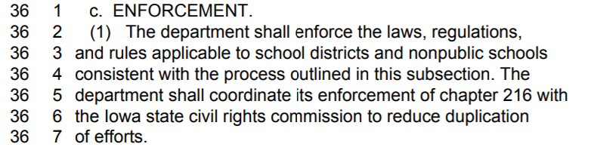
What’s Different in the Accreditation Language?
Enforcement (not specific to just Phase II – could apply to Phase I) :

Slide 37
Penalties
Senate responds with compromise language that is in the final bill:
If noncompliance is not corrected, the DE Director shall recommend and the state board shall may do one of the following
  recommend federal funding conditions
  withhold state funds
Director has a longer list of enforcement mechanisms and shall exercise discretion to ensure that the actions are proportionate to the noncompliance.
  Advise about availability of technical assistance
  Set a date and require completion of corrective action
  Recommend a Phase II visit
  Refer conduct to the AG and refer financial concerns to Auditor
  Recommend removal of accreditation to the State Board
  Take any other enforcement mechanism available to the Director
  Requires DE focus of enforcement activities on all of the following:
    Improving educational results for children, families, and students.
    Ensuring that public agencies and their governing boards meet requirements of state and federal laws.

Slide 38
Scope of Accreditation is Expanded
Data Collection is Limited
Requires DE to enforce compliance (removes the requirement that the state BOE act first although that is preserved for Phase II)
Expands noncompliance formerly w/state education standards, now also includes fiscal, board policy, state and federal laws, rules and regulation, HF 744, HF 802 specifically
DE is prohibited from collecting information they are not specifically authorized to collect (already current law, just not in the accreditation chapter)

Slide 39
BOEE Administrative Fees
Permits BOEE to establish and collect fees from administrators who, having been notified of a sanction by the BOEE, choose to pursue the matter in a hearing and subsequently sanction the administrator
Lists the costs for which fees can be assessed (processing complaint, holding hearing, personal service by a sheriff, legal notice, transcription or court reporter fee, and other fees)

Slide 40
Petition for Public Hearing
Final Compromise Language is better (slightly)
5% 10% of those voting in the last school election or 500, whichever is less, petition signatures
Place the item on the next regular board meeting or at a special board meeting (within 30 days)
Requires meeting notice to include brief description of the proposal (in the petition)
Requires the board meeting to include sufficient time to receive public comment on the proposal. Board must allow each interested member of the public time to comment, but may limit the amount of time for each person if the same amount of time is applied to each speaker and the limit is necessary due to the amount of people wishing to speak.
If it’s about curriculum, the district may suspend use of the curriculum
Requires information in student handbook about the DE’s website for complaints
Requires districts to provide training for equity coordinators

Slide 41
Transitional Accreditation
School districts and accredited nonpublic schools currently accredited on the effective date of this division remain accredited until the state BOE adopts rules, and DE implements such rules, to administer the accreditation process
HF 868 Education Appropriations was approved in the House 53-34, in the Senate 27-17, sending it to the Governor, where it awaits her signature.

Slide 42
Other Policy Bills

Slide 43
HF 260 Child Care Numbers
Increases the number of children receiving child care at any one time in a child care home
  If not registered, 5 or fewer children unless at least one is a school-aged child, then it increases to 6 children.
  If registered, increases from 6 to 7 children.
Signed by the Governor 4/12/2021

Slide 44
HF 308 Proficiency for Concurrent Enrollment Courses
If a student is not proficient in reading and math based on achievement scores, which is a prerequisite for enrolling in liberal arts concurrent enrollment courses, the bill allows demonstration of proficiency through alternative measures jointly agreed upon by the school board and the eligible postsecondary institution.
Still allows the school board to establish alternative but equivalent measures including but not limited to another administration of the state test, portfolios of student work, students performance rubric or end-of-course assessments. Iowa Code 261E.3 (2) (b)
Specifies that the state test administered in the school year beginning July 1, 2019 is considered the latest available score.
Effective on enactment.
Signed by the Governor 3/08/2021

Slide 45
HF 315 At-Risk Children
Allows AEAs to use certain funds related to early childhood programs for other child development programs. House approved 93-0 (2/16) Senate Agreed 44-0.
Signed by the Governor 4/30/2021

Slide 46
HF 317 Education Funding Requests for Children in Facilities
Changes the methodology used by schools to calculate funding requests to DE for providing education services to children in foster care, juvenile detention or residential treatment facilities.
Uses the number of days children are enrolled in the district (conforms to current practice).
House approved the bill 93-0 (2/10) Senate Agreed 44-0; Governor signed it 4/30/2021

Slide 47
HF 380 Distracted Driving
Requires that driver’s education classes include provisions on distracted driving.
House approved the bill 94-0 (2/10) Senate Agreed 44-0; Governor signed it 5/20/2021

Slide 48
HF 388 CDCC Services
Strikes certain outdated duties of the Child Development Coordinating Council on inventories of services for at-risk children and on the development of regional councils.
House approved 94-0 (2/10) Senate agreed 44-0; Governor signed it 5/20/2021

Slide 49
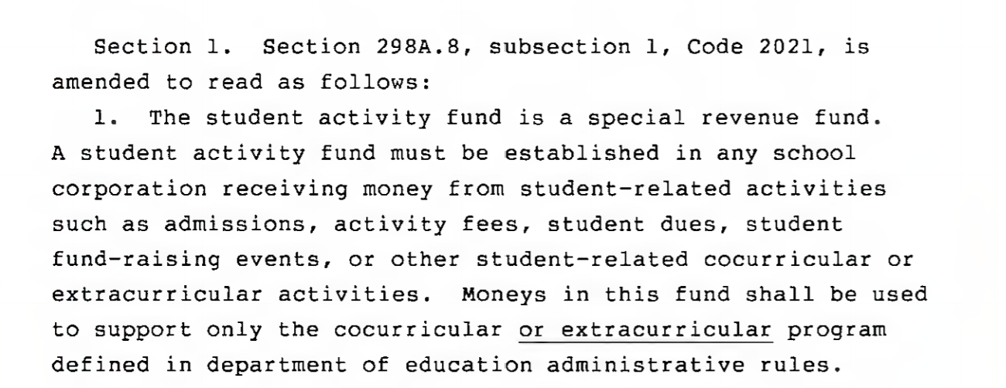
HF 602 Student Activity Fund Transfers:

Slide 50
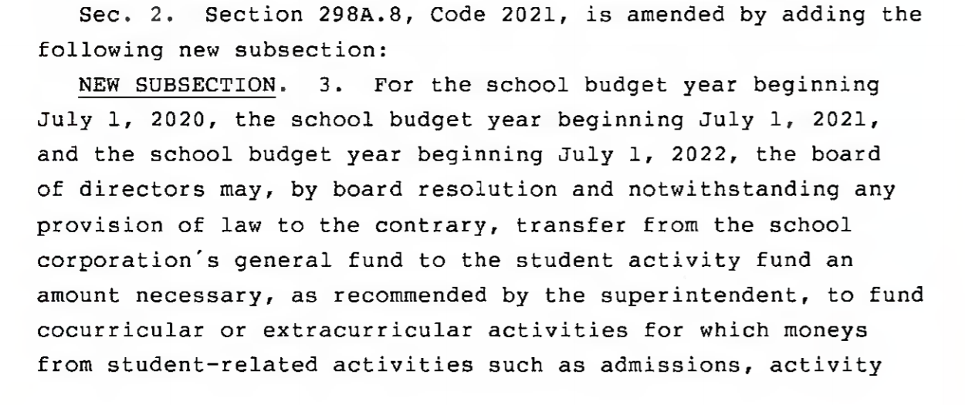
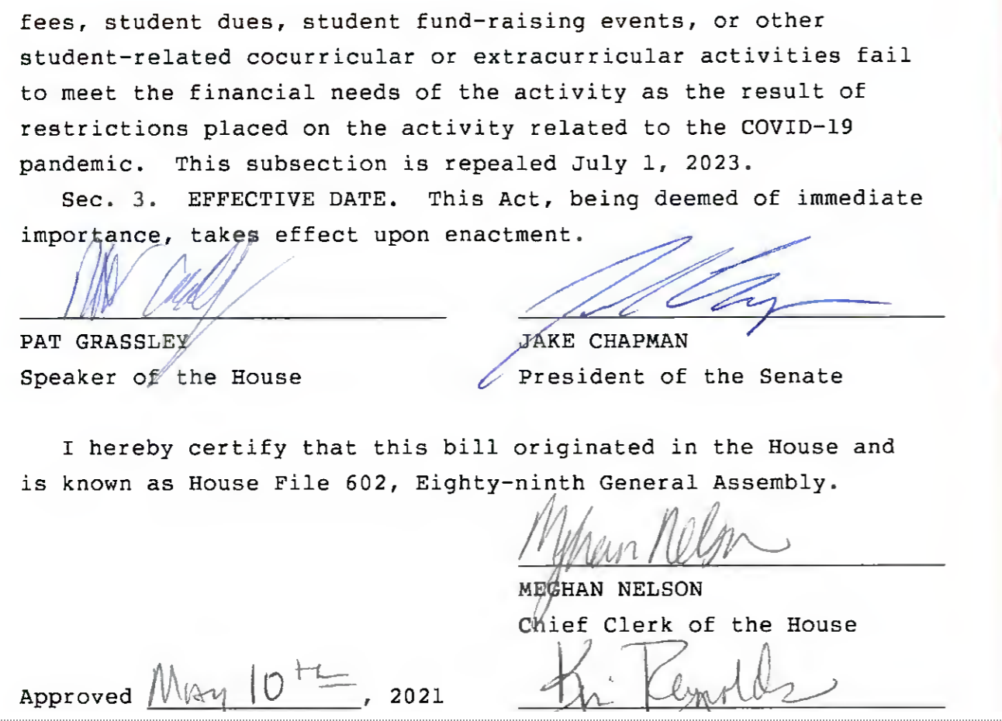
1) Applies to FY 2021, FY 22 and FY 23
2) Board resolution required
3) GF Transfer to SAF
4) Amount necessary to fund activities when normal receipts failed to meet the revenue necessary
5) as result of COVID-19 restrictions
6) Effective on Enactment

Slide 51
HF 602 Student Activity Fund Transfers
Signed by the Governor 5/10/2021
we’ll cover more in the June 10 Special Topic Webinar
Sample Board Resolution - Authorizing Transfer of General Fund to Student Activities Fund - used to authorize the transfer of expenses remaining due to COVID-19 pandemic activities. - posted June 2021

Slide 52
HF 605 ELL Tiered Weighting
Divides students with limited English proficiency into two categories for purposes of generating ELL supplementary weighting;
  Intensive which generates a weighting of .26 and
  Intermediate which generates a weighting of .21
  Currently .22 weighting for students served in ELL programs.
  Both categories are based on test scores related to ELL proficiency. About 80% of students are in the intermediate category.
Signed by the Governor 4/30/2021

Slide 53
HF 675 Substitute Authorization
Directs BOEE to update substitute requirements, allowing an AA degree or completion of 60 credit hours of college for up to 10 days in a 30-day period in one teaching position (except for Drivers’ education).
Allows for continuing beyond the 10 days within a 30-day period if school asks BOEE for an extension and documents the need and benefits to the educational program.
BOEE is required to reply either way in writing.
Effective July 1, 2021 (Note: Governor’s recent emergency declaration continues substitute flexibility – likely at least until June 27)
House approved is 93-0, Senate approved is 46-0, the Governor signed it in May 19

Slide 54
HF 722 Teach Iowa Loans
Essential closes the loop on the Teacher Shortage Forgivable Loan Repayment Fund and the Teacher Shortage Loan Forgiveness Repayment Fund, requiring transfer or payment to the Teach Iowa Scholar Fund
Governor signed it 5/20/2021

Slide 55
HF 744 Protecting Free Speech
First half of the bill is about Universities.
School provisions also protect student and employee intellectual freedoms in public schools.
  Requires the school board to establish and publicize policies that protect students and faculty from discrimination based on speech.
  Prohibits retaliation against a person who files a complaint for a violation of this section and provides whistle-blower protections if the complainant is an employee.
  Allows disciplinary action by the BOEE against school employees for discriminatory practices.
  Requires school boards to incorporate provisions in relation to student publications and to protect school employees who act to protect the rights of students involved with the school newspaper.
The House approved the bill 93:0, Senate approved it 46-0. Signed by the Governor 5/20/2021

Slide 56
HF 756 Firearms Provisions
The bill makes several changes to firearms licensure and penalties, but impact on schools is likely limited to an expansion of the group of individuals allowed to carry a firearm on school grounds
It is assumed that any property and employee liability insurance claims arising out of the expansion of the group of persons allowed to carry a firearm on school grounds will likely be covered by existing school liability insurance policies. The cost of any subsequent rate increases is not possible to determine at this time, but may have a fiscal impact on Management Fund rates down the road.
The House approved the bill 60:37, Senate approved it 31:17, Signed by the Governor 4/21/2021

Slide 57
HF 770 Teacher Professional Development
Requires the BOEE to allow that half of the CEU’s needed for licensure renewal by an educator can be done through an individualized PD plan or by completing courses offered by a PD program approved by the BOEE or an AEA.
House approved 92-0, Senate 46-0, Governor signed it on May 19.

Slide 58
HF 793 JROTC Credit
exempts a student in Junior ROTC from PE requirements and requires schools to award 1/8 unit of credit for PE for each semester the student is in Junior ROTC.
House approved 92-0, Senate 46-0, Governor signed it on May 20.

Slide 59
HF 802 Diversity Training and Curriculum Limitations
Limits staff training “specifically defined” concepts, including the following list, followed by the definitions of race and sex stereotyping directly from the bill language:
  (1) one race or sex is inherently superior to another race or sex.
  (2) USA and the state of Iowa are fundamentally or systemically racist or sexist.
  (3) an individual, by virtue of the individual’s race or sex, is inherently racist, sexist, or oppressive, whether consciously or unconsciously.
  (4) an individual should be discriminated against or receive adverse treatment solely or partly because of the individual’s race or sex.
  (5) members of one race or sex cannot and should not attempt to treat others without respect to race or sex.
  (6) an individual’s moral character is necessarily determined by the individual’s race or sex.
  (7) an individual, by virtue of the individual’s race or sex, bears responsibility for actions committed in the past by other members of the same race or sex.
  (8) any individual should feel discomfort, guilt, anguish, or any other form of psychological distress on account of that individual’s race or sex.
  (9) meritocracy or traits such as a hard work ethic are racist or sexist, or were created by a particular race to oppress another race.
  (10) Any other form of race or sex scapegoating or any other form of race or sex stereotyping.
  b. “Race or sex scapegoating” means assigning fault, blame, or bias to a race or sex, or to members of a race or sex because of their race or sex, or claiming that, consciously or unconsciously, and by virtue of persons’ race or sex, members of any race are inherently racist or are inherently inclined to oppress others, or that members of a sex are inherently sexist or inclined to oppress others.
  c. “Race or sex stereotyping” means ascribing character traits, values, moral and ethical codes, privileges, status, or beliefs to a race or sex, or to an individual because of the individual’s race or sex.

Slide 60
HF 802 Diversity Training
School Provisions
Allows school districts to continue training that fosters a workplace and learning environment that is respectful of all employees and students.
Requires the superintendent to ensure that any curriculum or mandatory staff or student training provided by an employee of the school district or by a contractor hired by the school district does not teach, advocate, encourage, promote, or act upon specific stereotyping and scapegoating toward others on the basis of demographic group membership or identity.
States that this subsection shall not be construed as preventing an employee or contractor who teaches any curriculum or who provides mandatory training from responding to questions regarding specifically defined concepts raised by participants in the training.
Also states that the bill is not to be construed to inhibit or violate first amendment rights of students or staff, not to prevent districts from promoting racial, cultural, ethnic, intellectual or academic diversity or inclusiveness, provided such efforts are consistent with the provisions of this bill, does not prohibit discussing these subjects as a part of a larger course of academic instruction, does not create any right or benefit allowing suit of the state, and does not prohibit a court or agency from ordering an action containing discussion of these specifically defined concepts as remedial action due to a finding of discrimination.

Slide 61
HF 802 Diversity Training
School Provisions (Continued)
is not to be construed as prohibiting use of curriculum that teaches the topics of sexism, slavery, racial oppression, racial segregation, or racial discrimination, including topics relating to the enactment and enforcement of laws resulting in sexism, racial oppression, segregation, and discrimination.
Requires the school board to have rules (policies or regulations) incorporating all of the provisions of this bill, made available to staff and students.
Provides whistle-blower protections to employees/officials acting to protect a student under this section.
The bill states that the unfunded mandate statute does not apply to this bill.
The bill is effective July 1, 2021.
The Senate approved the bill, 30:18. The House approved it 53:35. It is not yet signed by the Governor.

Slide 62
HF 848 Broadband Grant Policy
Creates tiers of internet speed, provides for incentives for the expansion of high-speed internet across the state and defines areas of need.
see HF 867 Administration and Regulation Appropriations bill for funding, $100 million for FY 2022
House approved 92-0, Senate 46-0, Governor signed it on May 20.

Slide 63
SF 130 School Board Member
Income Limit (temporary)
Allows a school board member to earn more than the $6,000 limit in the conflict of interest statute if working in the district as a substitute teacher, bus driver or food/nutrition work during the 2020-21 school year.
Signed by the Governor 3/8/2021

Slide 64
SF 160 In-Person Learning Option and Metrics for Waiver
Notwithstands (sets aside and supersedes)
  2020 legislation (SF 2310 RTL Plans and primarily in person learning)
  Or any law to the contrary
Although SF 2310 allows hybrid option to count for days/hours of instruction, districts will still have to offer the full-time parent option
Full time is defined in Iowa Code 279.10 as 180 days or 1,080 hours. Must provide the equivalent of that option to parents.

Slide 65
In-Person Learning Provisions
Requires schools to offer parents an option for in-person instruction beginning no later than the second Monday following the effective date of this Act.
  requires schools offer parents the ability to select full time in-person instruction for their student unless this requirement is explicitly waived for one or more school districts or accredited nonpublic schools in a Governor’s Public Health Disaster Emergency proclamation.
  requires schools not already offering the full time option on the effective date of this act to provide parents notice of the opportunity to select full-time in-person instruction and allow the parent at least 5 days to decide their selection if the school will still offer other instructional options.

Slide 66
Expanded Metrics for DE Waiver
In addition to DE metrics on COVID incidence, added that DE shall consider, in addition to any other factors or information, data regarding the number of teachers employed by the school district or school who are quarantining due to exposure to COVID-19, as well as the scarcity of substitute teachers, food service workers, and school bus drivers.
Signed by the Governor 1/29/21

Slide 67
SF 260 Medicaid Billing Documentation
Requires a receiving district providing special education to an open enrolled student to provide Medicaid billing documentation to the resident district.
Signed by the Governor 4/30/2021

Slide 68
SF 285 Opportunity Scholarships
Allows deferring or suspending participation in All Iowa Opportunity Scholarships based on military service or other obligations that meet conditions set by the College Student Aid Commission by rule.
Signed by the Governor 3/8/2021

Slide 69
SF 289 School Powers
Raises the threshold for AEA leases needing state approval to the competitive bid threshold in Iowa Code 26.3.
Makes changes to the school board president elections (organizational meeting held not less than year nor more than 13 months of prior organization meeting)
Strikes requirements that school boards report dues paid to IASB to the DE but requires IASB to report to the DE.
Makes changes related to the sale of school buildings and property, including allowing fund from the proceeds of property sales deposited into any account following a public hearing which is appropriately noticed and published.
Strikes newspaper reporting requirements for loans for equipment purchases.
Eliminates a PK duplicative reporting requirement
Raises the threshold for disposition of property according to board policy from $5,000 to $25,000.
Eliminates Iowa Code 279.44 energy audits.
The Senate passed the bill 48-0. The House approved the bill 93:0. It was signed by the Governor 3/22/2021

Slide 70
SF 466 Providers for Concussion Management
Adds occupational therapists to the list of possible providers for purposes regarding concussion and brain injury policies for extracurricular interscholastic activities.
Signed by the Governor 4/30/2021

Slide 71
SF 517 Academic Credit for Pages
Requires high schools to give ½ unit of social studies credit to legislative pages. Exempts the pages from PE requirements.
House approved 82-9, Senate 44-1, Governor signed it on May 19.

Slide 72
SF 532 SPR for Behavior Analysts and Mental Health Professionals
Requires BOEE to develop a statement of professional recognition for Behavior Analysts licensed under Chapter 154D, by Aug. 1, 2021
Requires BOEE to do the same for Mental Health Professionals defined in Iowa Code 228.1 by Jan. 1, 2022
Signed by the Governor 5/10/21

Slide 73
SF 546 Home School Matters and Drivers’ Education
Mostly changes provisions related to home school, but includes ability for any parent to teach their child to drive, not just home school parents
Signed by the Governor 5/10/21

Slide 74
SF 568 Election Changes
Makes many changes about elections, absentee ballots, time frame for voting, etc.
Original bill would have required schools (and any other local government) with a ballot initiative at a special election to mail notice to all addresses with a registered voter. That provision was eliminated in the final negotiations.
Not yet signed by the Governor

Slide 75
What Didn’t happen?
SF 467 Online Learning/Snow Days: The online learning provisions are moving forward through rule. There is no mandate to offer parents virtual option in the 2021-22 school year. Authority for 5 virtual snow days dies in the House Education Committee.
HF 532 Qualified Instructional Supplement: House and Senate Leadership couldn’t come to agreement. Dies on Senate Calendar (the PK on-time funding provisions were amended on to HF 868 which we’ll cover in the next legislative webinar.)
HF 318 PK for young 5-year olds Pilot Project: Dies on Senate Calendar
SF 183 Construction Manager At-Risk: Dies on House Calendar
And another almost 2,000 bills, all of which remain alive for the 2022 Session, including HSB 243 Vouchers (or SF 159 School Choice): Dies in House Education Committee

Slide 76
ECS Resources
Traditional private school choice policies continue to garner attention nationally and at the state level. The education landscape continues to shift in concert with expansions of choice or choice-related policies during the pandemic.
For more research on private school choice see the ECS School Choice Key Issues page and their latest 50-State Comparison on Private School Choice Programs.

Slide 77


Slide 78
Map of the Week (MOW)
Find your Legislators
https://gis.legis.iowa.gov/FYL/index.html

Slide 79
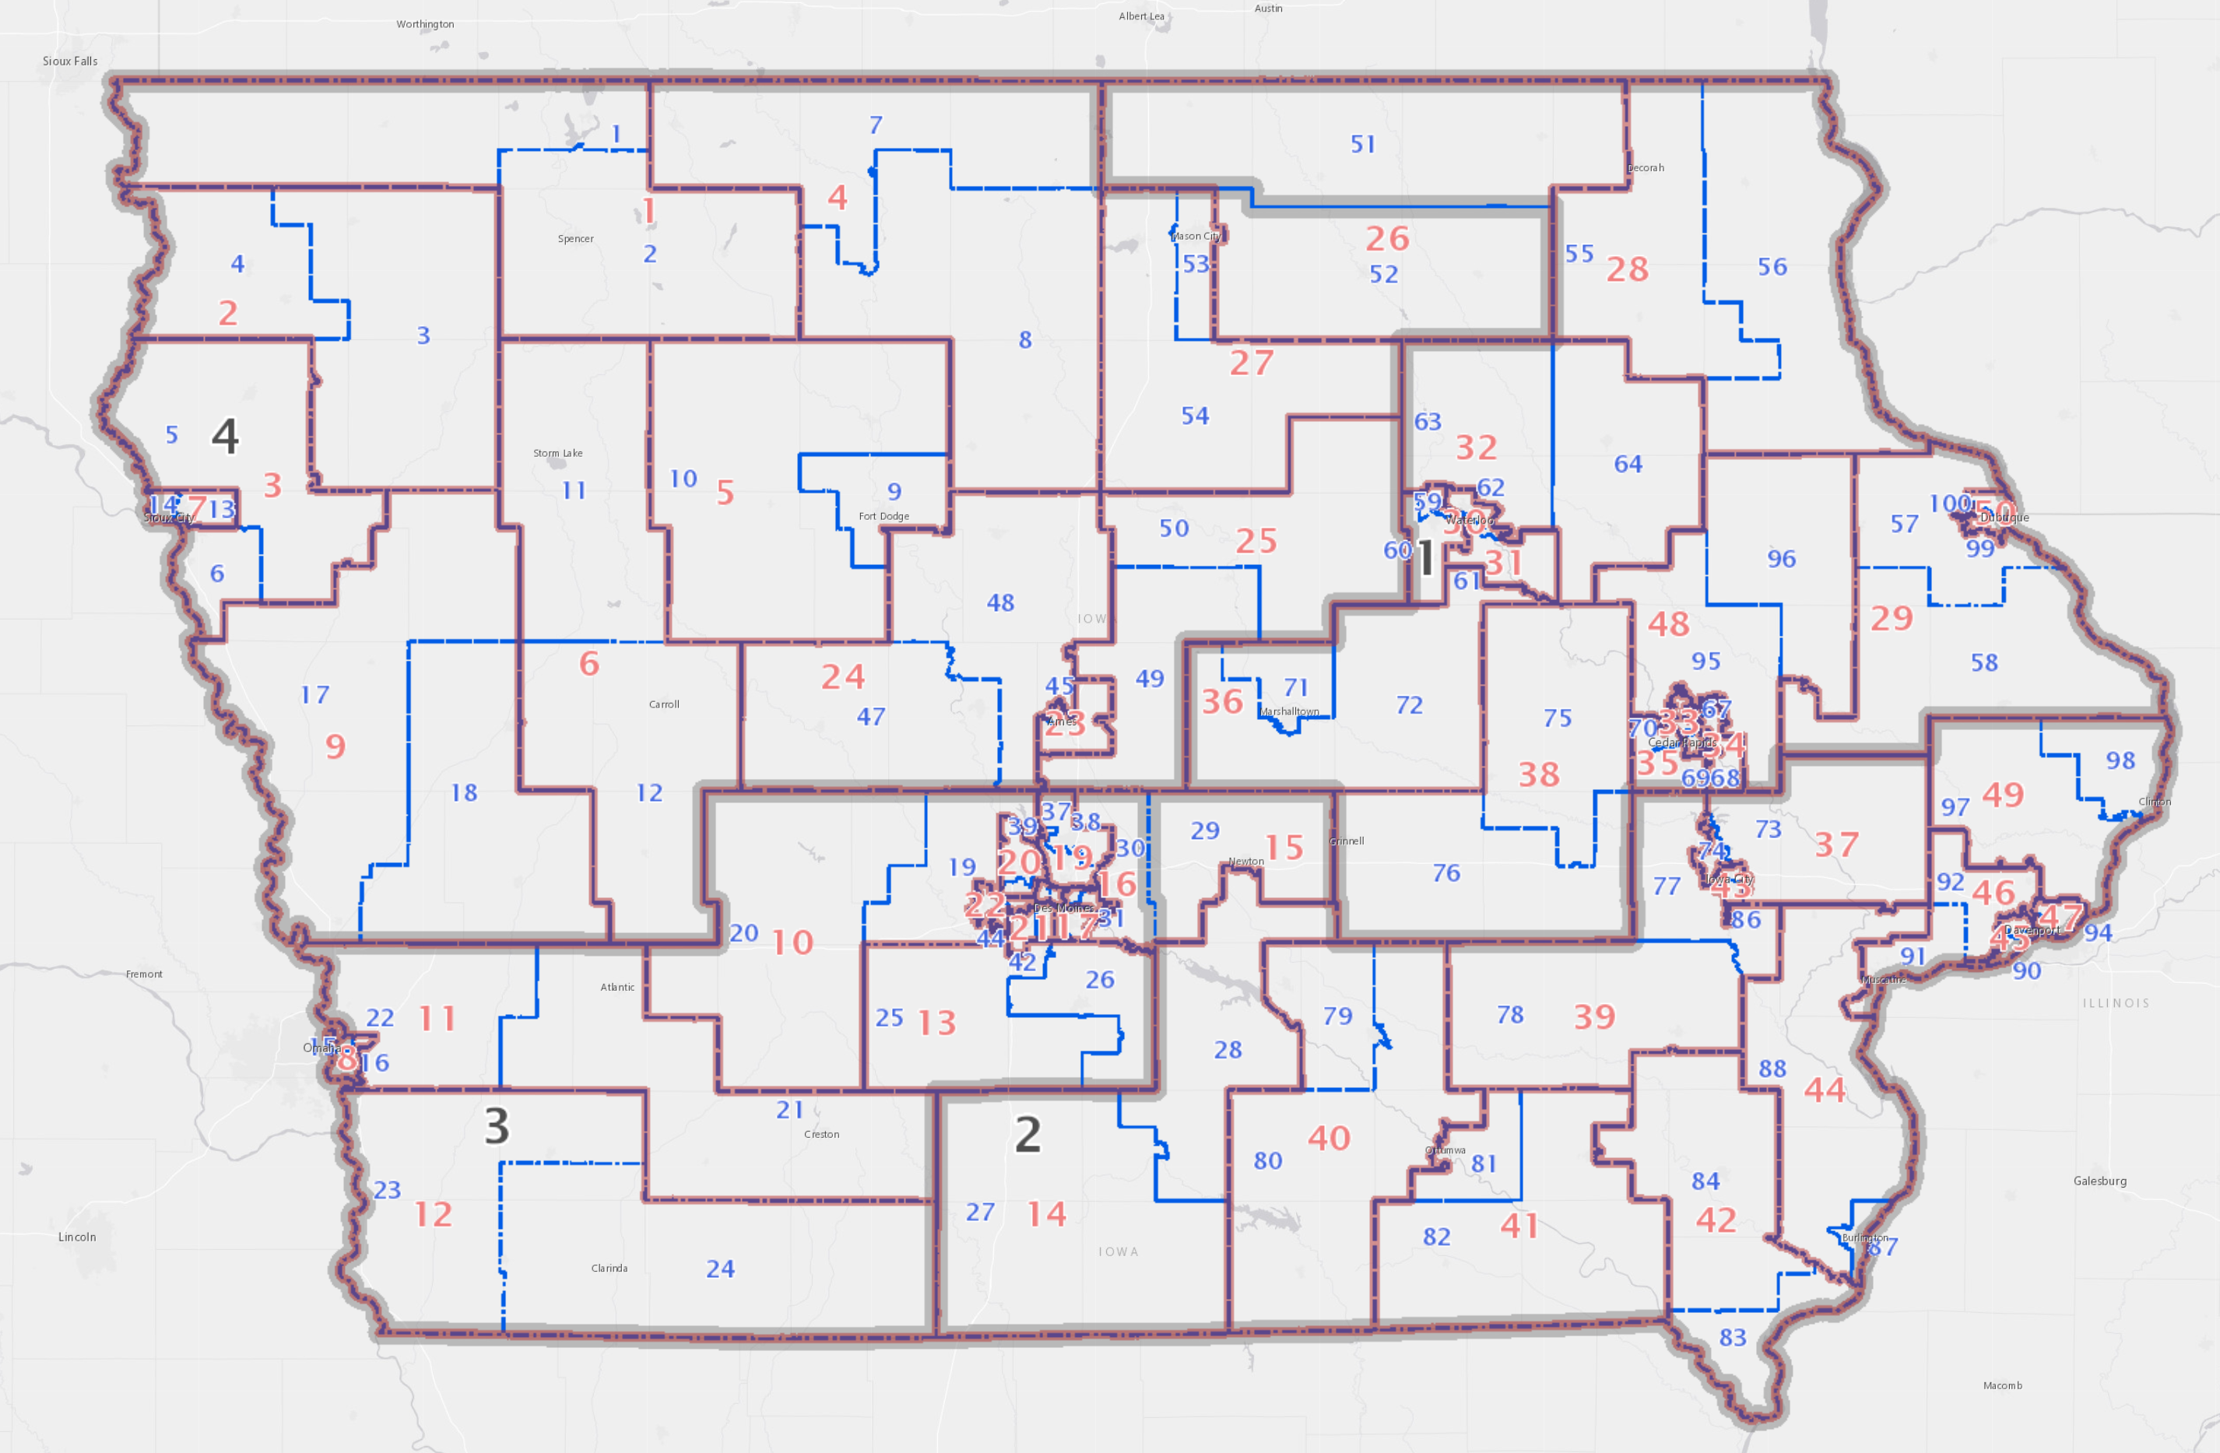
Click on Oskaloosa
House District 79

Slide 80
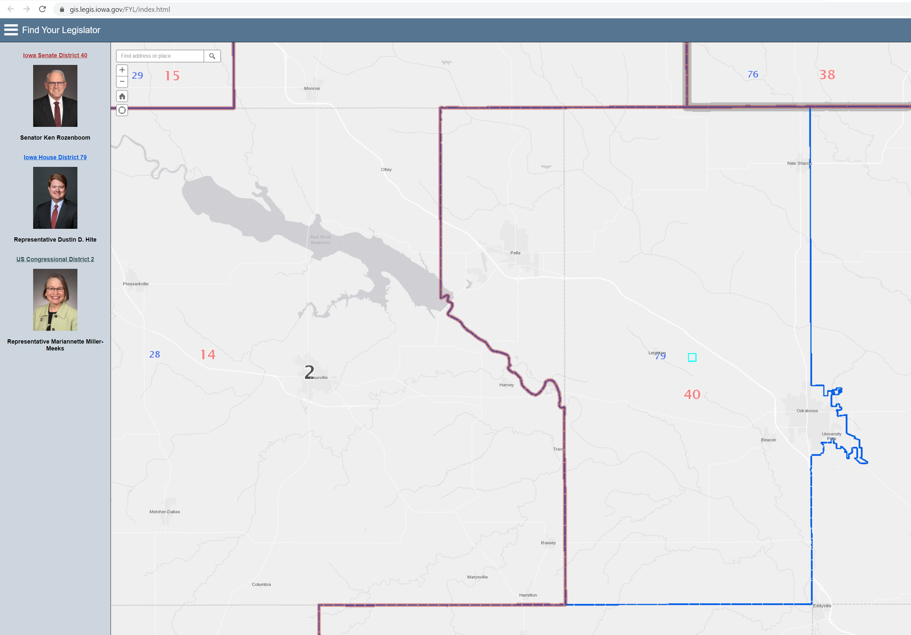
Get live links to your Rep, Sen, and Congressional Rep.

Slide 81
Pending Dates and Deadlines
        DE Deadlines Calendar (from Calendar tab on DE home page) and from the DE’s School Leader Update and School Business Alert
Date | Deadline
June 15 | Nonpublic transportation reimbursement claims due
June 17 | SBRC meeting
June 20 | Governor’s Final Action Deadline to sign or veto
June 23 | SRI Certification
June 24 | Assessment Accountability Certification Deadline
June 30 | Last day to pay PSEO postsecondary institution End of Fiscal Year 2021
July 1 | Beginning of Fiscal Year 2022

Slide 82

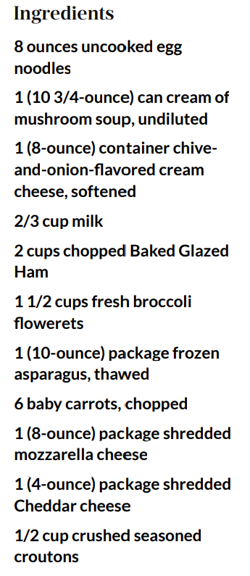
https://www.southernliving.com/recipes/ham-noodle-casserole
Instructions
Step 1 Cook pasta according to package directions; drain.
Step 2 Stir together soup, cream cheese, and milk in a large bowl. Stir in pasta, ham, and next 3 ingredients. Spoon half of ham mixture into 2 lightly greased 8-inch square baking dishes.
Step 3 Combine cheeses. Sprinkle half of cheese mixture over casseroles. Spoon remaining ham mixture over cheeses.
Step 4 Combine remaining cheese mixture with croutons. Sprinkle over casseroles. Wrap one casserole in heavy-duty aluminum foil, and freeze up to 1 month.
Step 5 Bake other casserole at 400° for 30 minutes or until lightly browned.

Slide 83
Larry Sigel, ISFIS – Partner
Cell: 515-490-9951
larry@iowaschoolfinance.com
Margaret Buckton , ISFIS – Partner
UEN Executive Director,
RSAI Professional Advocate
Cell: 515-201-3755
margaret@iowaschoolfinance.com
We are here to help!
Jen Albers
Office: 515-251-5970 Ext. 4
jen@iowaschoolfinance.com
ISFIS, Inc., 1201 63rd Street, Des Moines, IA, 50311, (515) 251-5970, www.IowaSchoolFinance.com

