Slide 1

June 17, 2021
ISFIS Special Topic
Webinar
2021 Legislative Session #2
Larry Sigel & Margaret Buckton
© Iowa School Finance Information Services, 2021

Slide 2
Webinar Resources
PPT is linked on the ISFIS webinar webpage
Use the slides and information as you see fit
OK to share with others in your district
Let us know if others in your district need an invite to attend the webinars

Slide 3

Connect with ISFIS
Are you connected with ISFIS on Social Media?
Follow us on Twitter: @ISFISInc
Like us on Facebook:
https://www.facebook.com/isfisinc/
Link to us on LinkedIn:
https://www.linkedin.com/company/iowa-school-finance-information-services
If you or anyone at your district needs access to the ISFIS subscriber content on the website, email jen@iowaschoolfinance.com
Please check with others at your district to make sure they’re getting our emails & invites!

Slide 4
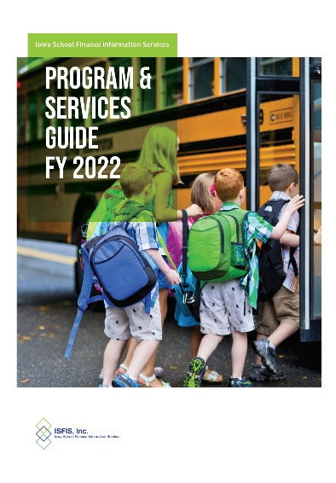
ISFIS Renewal for 2021-22
We thank you for your 2020-21
ISFIS Subscription and ask you to consider
renewal for 2021-22.
Check out our new FY 2022 ISFIS Program & Services Guide (included in the mailing to Supts & SBOs, and on our website).
We offer a 5% discount for renewal subscriptions paid before July 15th.
If you are leaving your position at year-end, setup your replacement for success by renewing with ISFIS before your depart.
Let us know if you have any questions about our programs or services
or how ISFIS can help your district.

Slide 5
ISFIS Webinars
View Accompanying PPT View Recording (50 minutes) | SPECIAL TOPIC WEBINAR - 2021 LEGISLATIVE SESSION RECAP June 3, 2021 This Special Topic Webinar recapped the legislative actions that took place at the Iowa Statehouse during the 2021 legislative session as part 1 of a 2-part series. In part 1, learn the details of school choice legislation, charter schools, the new flexible student and school support (FS3) program, changes to open enrollment, changes to Iowa School Accreditation law, Diversity Training requirements and Free Speech Protections.
View Accompanying PPT View Recording (44 minutes) | SPECIAL TOPIC WEBINAR - UNDERSTANDING FLEX FUNDS June 10, 2021 at 3pm In this Special Topic Webinar, Margaret and Larry will do a deeper dive into expanded school district funding flexibility over the last four years, including recent updates to the flexibility accounts, school board process, and short- and long-term considerations for sustainability.
Register Here | SPECIAL TOPIC WEBINAR - OPERATIONAL SHARING July 8, 2021 at 2pm In this Special Topic Webinar, Larry and Margaret will review the basics of the operational sharing incentives, including timeline, positions eligible (including recent additions from the 2021 Legislative Session), weightings associated with each position and requirement for eligibility.
Register Here | SPECIAL TOPIC WEBINAR - EXPLAINING ASSESSMENTS TO YOUR BOARD July 15, 2021 at 2pm In just one webinar, learn terminology to help explain the complicated system of assessments to your school board and stakeholders, including required assessments and best practice, how best to use data and information to guide instructional improvement, student achievement and program evaluation.
Register Here | SPECIAL TOPIC WEBINAR - FEDERAL FUNDS July 22, 2021 at 2pm In this Special Topic Webinar, Margaret and Larry will do a deeper dive into the federal funds available to Iowa schools, eligibility and formula distributions, allocations, guidance available, considerations and lots of room for Q&A.
Let us know if there’s an issue or content that you’d like to see us cover in a future Special Topic Webinar. Find Registration, Recordings and Links to Materials:
https://www.iowaschoolfinance.com/webinars

Slide 6
2021 Legislative Session Webinar Agenda
2021 Session Spending Bills
2021 Tax Changes
ISFIS Tool on C&I Backfill Impact
MOW MOW MOW Map of the Week
Timeline for Implementation: Rules
DE Guidance on Open Enrollment
Dates, Deadlines, and Recipe of the Week

Slide 7

2021 Spending (Appropriations) Bills

Slide 8
$$$$$
SF 269 SSA
HF 868 Education Appropriations
HF 813 Charter Schools
SF 615 Standings Appropriations

Slide 9
SF 269 SSA

Slide 10
SF 269 Fiscal Impact
Sets a 2.40% State percent of growth rate to be applied to the State cost per pupil (SCPP) for FY 2022 for an SSA of $169 per pupil.
Sets a 2.40% State percent of growth rate to be applied to each of the State categorical cost per pupil amounts for FY 2022.
An additional increase of $10 to the FY 2022 regular program SCPP separate from the SSA.
SCPP is $7,227 for 2021-22 (Addition of $179 to $7,048)
Additional property tax replacement funding based on the per pupil increase that results from the FY 2022 SSA increase. Freezes the additional levy portion of the FY 2022 SCPP at $750 per pupil, regardless of the per pupil increase for FY 2022.
Amends the FY 2022 General Fund appropriation to the Transportation Equity Program to equal the amount necessary to make all transportation equity aid payments.

Slide 11
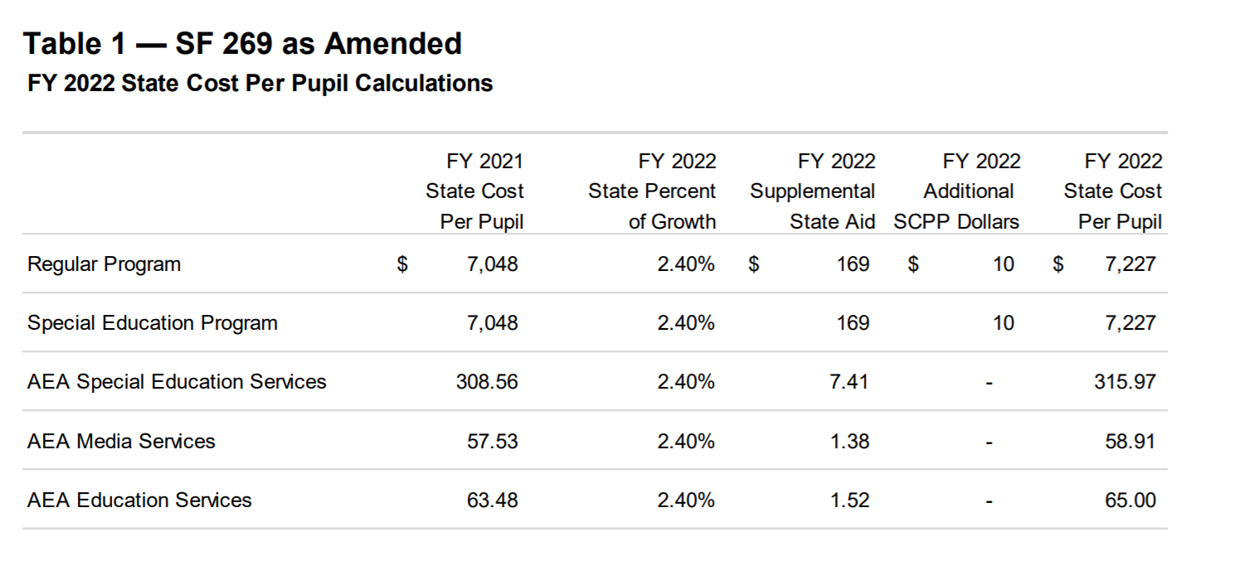

Slide 12
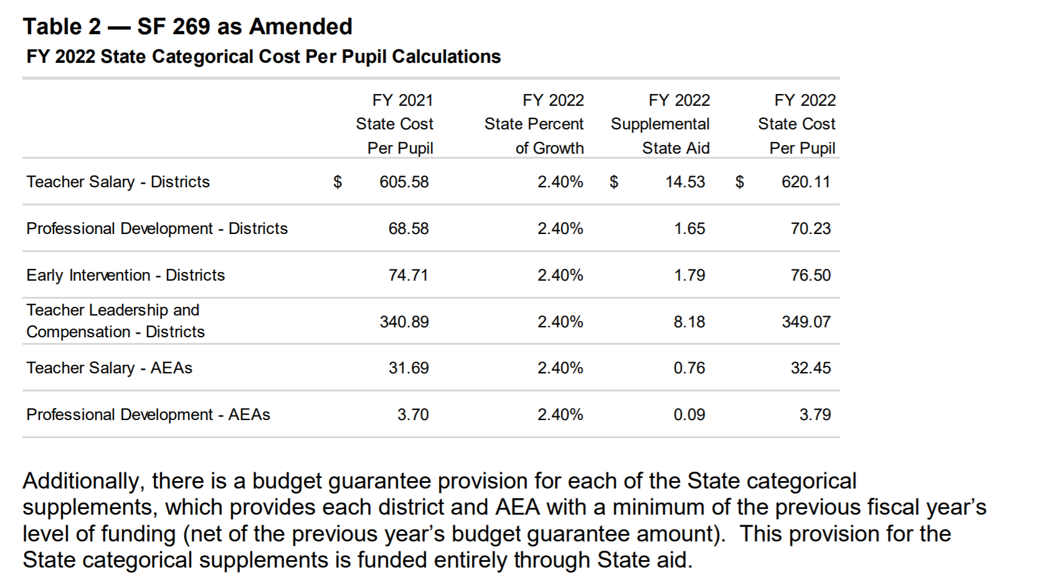

Slide 13
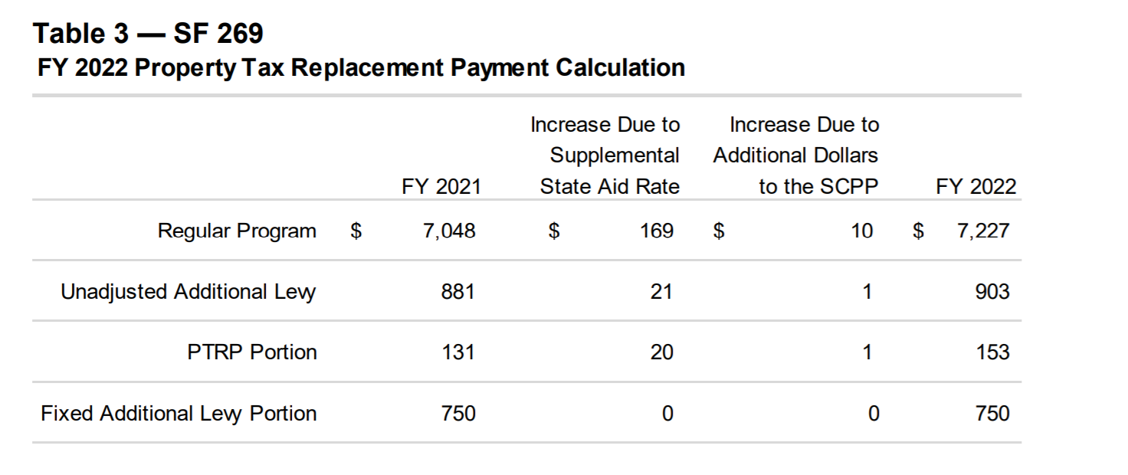
$750 per pupil in fixed levy will drop when Tax Omnibus Bill is implemented in FY 2023. It raises the Foundation Threshold from 87.5% to 88.4% in FY 2023. That will compress the Fixed Additional Levy by bringing up the bottom.

Slide 14
Financing the General Fund
Property Poorest
Average Valuation
Property Richest
Increase in Foundation Pct from 87.5% to 88.4% is effected for FY 2023
Per Pupil
$7,227
$7,227
$7,227
Prop Tax Replacement→
$153
$153
$153
Additional Levy→
$685
$685
$685
88.4%→
--------------------------------------------------------
$452
$4,451
State Aid→
$5,519
State Aid
Property Taxes
$6,347
$1,948
Uniform Levy→
$880

Slide 15
How much state money?
The total State aid from the General Fund (reflecting the total school aid funding level for school districts and AEAs generated through the school aid formula) is estimated to be $3.418 billion, an increase of $36.5 million (1.08%) compared to FY 2021. (AEAs were cut the usual $15 million in the Standings bill, which lowers the state aid impact to net $21.5 million)
The additional increase in the FY 2022 SCPP of $10 for a total of $5.8 million, which is included in the total State aid estimate.
The FY 2022 General Fund appropriation of $27.5 million to the Transportation Equity Fund is not included in the total State aid estimate, but adds another $700K+ to the bottom line.
HF 532 Supplemental COVID funding didn’t happen. . . Remains in the House Education Committee for discussion next Session.
$36.5 M
-15.0 M
+ 5.8 M
+ 0.8 M
_______
$28.1 Million total public school funding

Slide 16
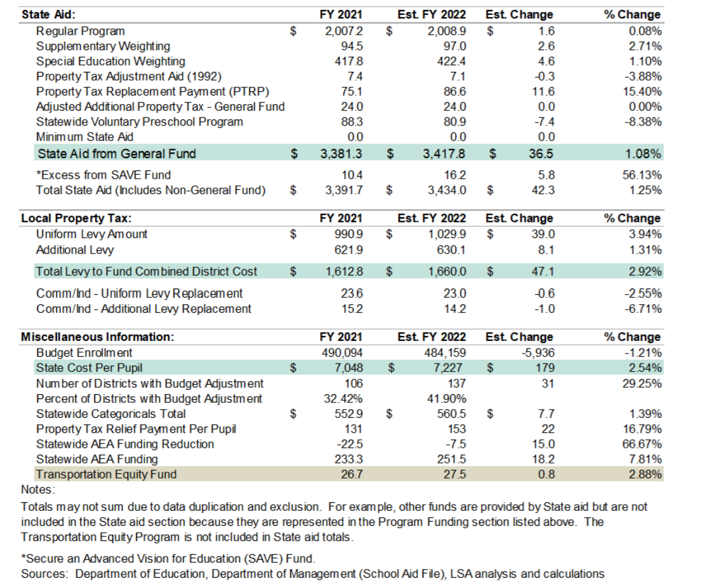
Fiscal Note to SF 159
1
1. The largest increase in state aid is PTRP
2. PK down $7.4 million
3. BEDS Pandemic = loss of 6,000 students.. Leaves 137 districts on BG.
4. FN shows AEA’s $15M, but that’s cut later in SF 615.
2
3
4

Slide 17
Next Year Impact?
Enrollment likely to rebound. Will cost the state more if all 6,000 students return.
Tax Omnibus raises foundation threshold. Estimated cost over $60 million. That bill also reduces state general fund revenue.
There is still significant federal pandemic funds.
Extraordinary advocacy will be required to nudge the 2022 Session to increase the SSA beyond their current trend.

Slide 18
HF 868 Education Appropriations

Slide 19
HF 868 NOBA
General Fund FY 2022: Appropriates a total of $972.4 million from the General Fund and 11,776.7 full-time equivalent (FTE) positions for FY 2022 to the Department for the Blind, the College Student Aid Commission, the Department of Education, and the Board of Regents.
Increase of $26.4 million and a decrease of 46.4 FTE positions compared to estimated FY 2021.

Slide 20
Prior Appropriations for FY 2022
In addition to the appropriations in this Bill, the tracking document includes the following funding provided in SF 2360 (Classroom Environment and Therapeutic Classrooms Act) during the 2020 Session:
$500,000 to DE for developing standards and guidance on behavior in the classroom, restraint of a student, least restrictive environment, and research-based intervention strategies.
$500,000 to DE for reimbursement to school district claims for therapeutic classroom transportation.

Slide 21
Appropriations to DE
An increase of $13.6 million from the General Fund compared to estimated FY 2021. The increases include:
$544,000 for Early Childhood Iowa (ECI) General Aid (School Ready Grant)
$200,000 for Nonpublic Textbook Services
$2.0 million for the Iowa Jobs for America's Graduates (iJAG) Program
$250,000 for the Iowa Reading Research Center
$1.1 million for Children's Mental Health Training $6.5 million for General Aid for Community Colleges
$1.6 million for the Therapeutic Classroom Incentive Fund
$500,000 for Classroom Environment Professional Development
$500,000 for Therapeutic Classroom Transportation
$300,000 for Iowa Vocational Rehabilitation Services
$100,000 for Iowa PBS

Slide 22
Policy Language impacting PK-12
Requires DE to provide reading assessments for PK-6th grade to detect students not proficient in reading. allows DE to charge school districts for the cost of the assessment, which school districts may pay out of Early Intervention funds.
Specifies the funds provided for in the Children's Mental Health School-Based Training and Support appropriation will be allocated to AEAs for school-based children's mental health services including mental health awareness training for educators.
Requires UNI to work with community colleges to develop programs for community college instructors and the development of Science, Technology, Engineering, and Mathematics (STEM) curricula.

Slide 23
Policy Language impacting PK-12
Allows any unexpended funds appropriated to the Department of Education for the Summer Joint Enrollment Program for FY 2022 from the General Fund to remain available for expenditure in FY 2023.
Allows any unobligated and unexpended funds appropriated to the AEAs for creating a clearinghouse of mental health resources for use by schools and community providers to remain available and be used for mental health awareness training for educators and for providing mental health services and support for students.

Slide 24
Reports
Requires DE to submit a written report by Jan. 15, 2022, to the General Assembly describing the DE’s antibullying programming and current and projected expenditures for antibullying programming for FY 2022.
Requires the Iowa Reading Research Center to submit a report to the General Assembly and Legislative Services Agency (LSA) detailing the expenditures of the FY 2022 advanced dyslexia specialist endorsement appropriation.
Requires DE, in collaboration with the statewide not-for-profit health care organization receiving moneys for the children's grief and loss rural pilot program, to prepare a report detailing the expenditure of moneys used for the purposes of the program and its outcomes to the General Assembly by September 30, 2022. Requires organizations receiving a distribution of the General Fund appropriation for Best Buddies Iowa to annually report student identifying data to the DE for students participating in the Program.

Slide 25
Studies/Task Forces
Establishes a Task Force on growing a diverse prekindergarten through grade 12 teacher base in Iowa. The task force will be convened by the DE, in consultation with Iowa Jobs for America's Graduates (iJAG).Requires the Task Force on Growing a Diverse PreK-12 Teacher Base in Iowa to submit a report regarding its findings and recommendations, including any proposed legislative or administrative rule changes, to the Governor, the General Assembly, and the State BOE by Dec. 15, 2021.
Requires the Legislative Council to establish an interim study committee to examine the Board of Regents' administrative costs, staffing allocations and levels, and the graduation and student retention rates for each academic program at each Regent institution.

Slide 26
Other Policy Language in HF 868
See part I of this webinar series for details about Accreditation changes and public hearings.
Specifies that Division IV of the Bill that permits the School Budget Review Committee (SBRC) to provide a modified supplemental amount in FY 2022 for preschool programs that meet enrollment eligibility requirements based on funds made available to the SBRC takes effect upon enactment.
Specifies that Division V of the Bill that allows a student of a school district or accredited nonpublic school to be counted as attending an hour of instruction during the school day when that student attended the public funeral service of a member of the Iowa State Patrol on Friday, April 16, 2021, takes effect upon enactment, retroactive to April 16, 2021.

Slide 27
Other Policy Language in HF 868
Requires DE to develop and make available on their website general guidance for parents, guardians, and community members who have concerns about school districts or school governing boards.
Allows BOEE to establish, collect, and refund fees from an administrator for administrative costs of processing complaints and conducting hearings if the administrator is the respondent in a complaint for violation of the code of professional conduct and ethics, if the final Board action results in a sanction against the administrator.
Requires DE to develop and distribute to school districts standards of practice for equity coordinators employed by school districts and a training program on free speech under the First Amendment to the US Constitution to be used by school districts.
Requires a school board to provide training on free speech under the First Amendment to the US Constitution to any equity coordinator employed by the school district.
Adds a mental health professional who holds a statement of recognition issued by the BOEE to operational sharing positions for weighting of 3 (lowers to 2 in FY 2022-23 as part of HF 847 – see webinar part 1)

Slide 28
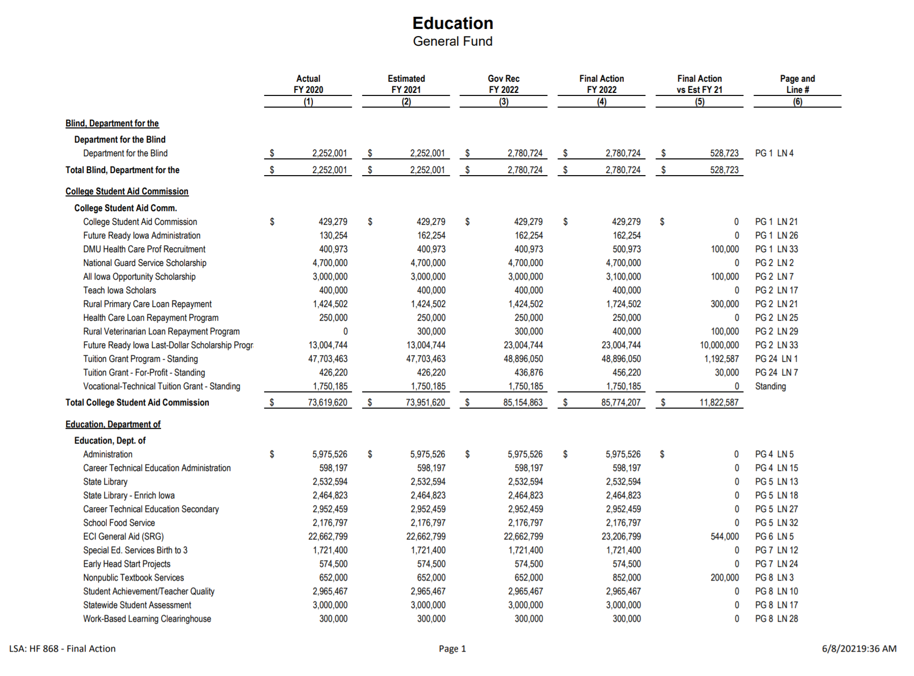

Slide 29
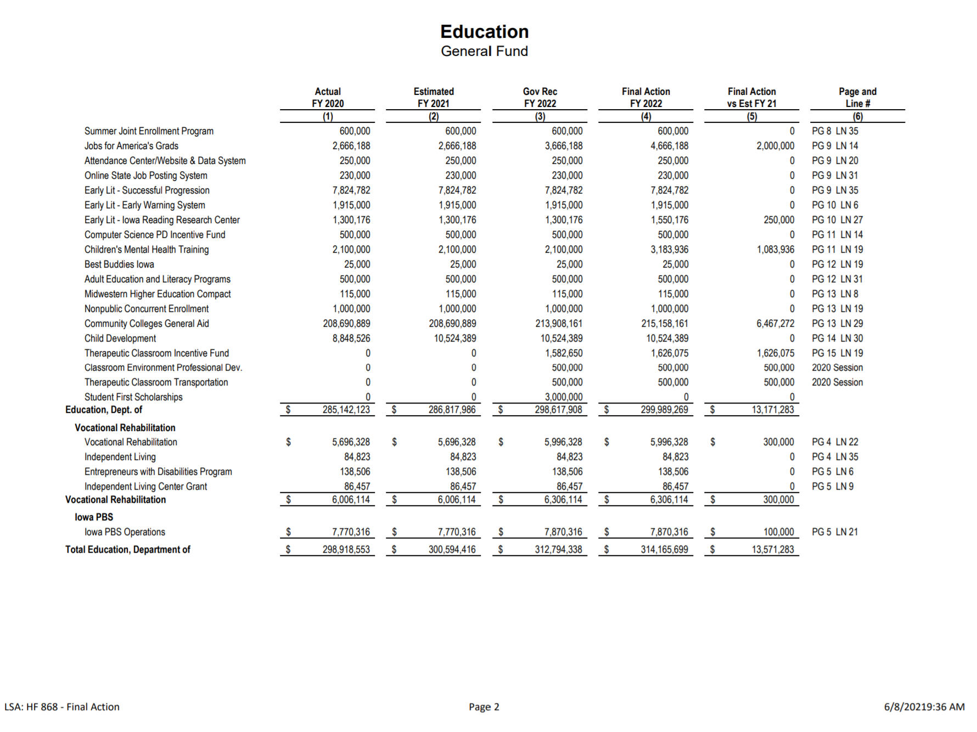

Slide 30
HF 813 Charter Schools

Slide 31
Charter Schools
All of the policy language was covered in the Part 1 webinar
Rules/Applications will have to be completed. If ready for enrollment by March 1 for the 2022-23 school year, could hit the 2022-23 budget.
Charter School Funding: includes a standing unlimited appropriation/funding for any student not included in the prior year’s enrollment count including students attending nonpublic schools, home schools, or students entering kindergarten.

Slide 32
Charter Schools Fiscal Note Comments
Federal fiscal and nonfiscal reporting requires inclusion of data for public charter schools. If a charter school is independent from a school district, determinations will be needed regarding eligibility and allocation methods used for federal funds.
There may be double counting of students for State funding. For the initial year of funding for a charter school, State funding is based on estimated enrollment. The potential students included in the charter school estimate may not actually attend the charter school and would in turn be funded at the school where they are actually enrolled. A reconciliation, based on actual enrollment, is to be completed during the subsequent payment to the charter school.
It is unclear if the initial year of funding will be provided to the charter school through advance funding by DOM, be provided through payments from the student’s district of residence (like open enrollment typically paid in February and July), or be provided through some other means.
It is unknown the number of students who would be included in the General Fund standing unlimited appropriation for initial year enrollment in a charter school. Therefore, the appropriation cannot be estimated at this time.

Slide 33
SF 615 Standing Appropriations
NOBA

Slide 34
Repeat/Usual Standings Limitations
Limits the FY 2022 General Fund appropriation to DE for nonpublic school transportation to $9.0 million.
Requires the appropriation to be prorated if the claims exceed the appropriation.
Reduces the FY 2022 State school aid funding to AEAs by $15.0 million.

Slide 35
Repeat/Usual Standings limitations
Suspends the General Fund standing appropriation of $14.8 million to DE for the Instructional Support Program for FY 2022.
DETAIL: Although no State funding will be provided for the Instructional Support Program, school districts may use local property tax and income surtax to fund their portion of the Program.
In FY 2021, 325 school districts implemented the Program and generated $246,150,998 in local taxes ($93,082,602 in income surtax and $153,068,396 in property taxes).
ISP has not been funded by the State since FY 2006.

Slide 36
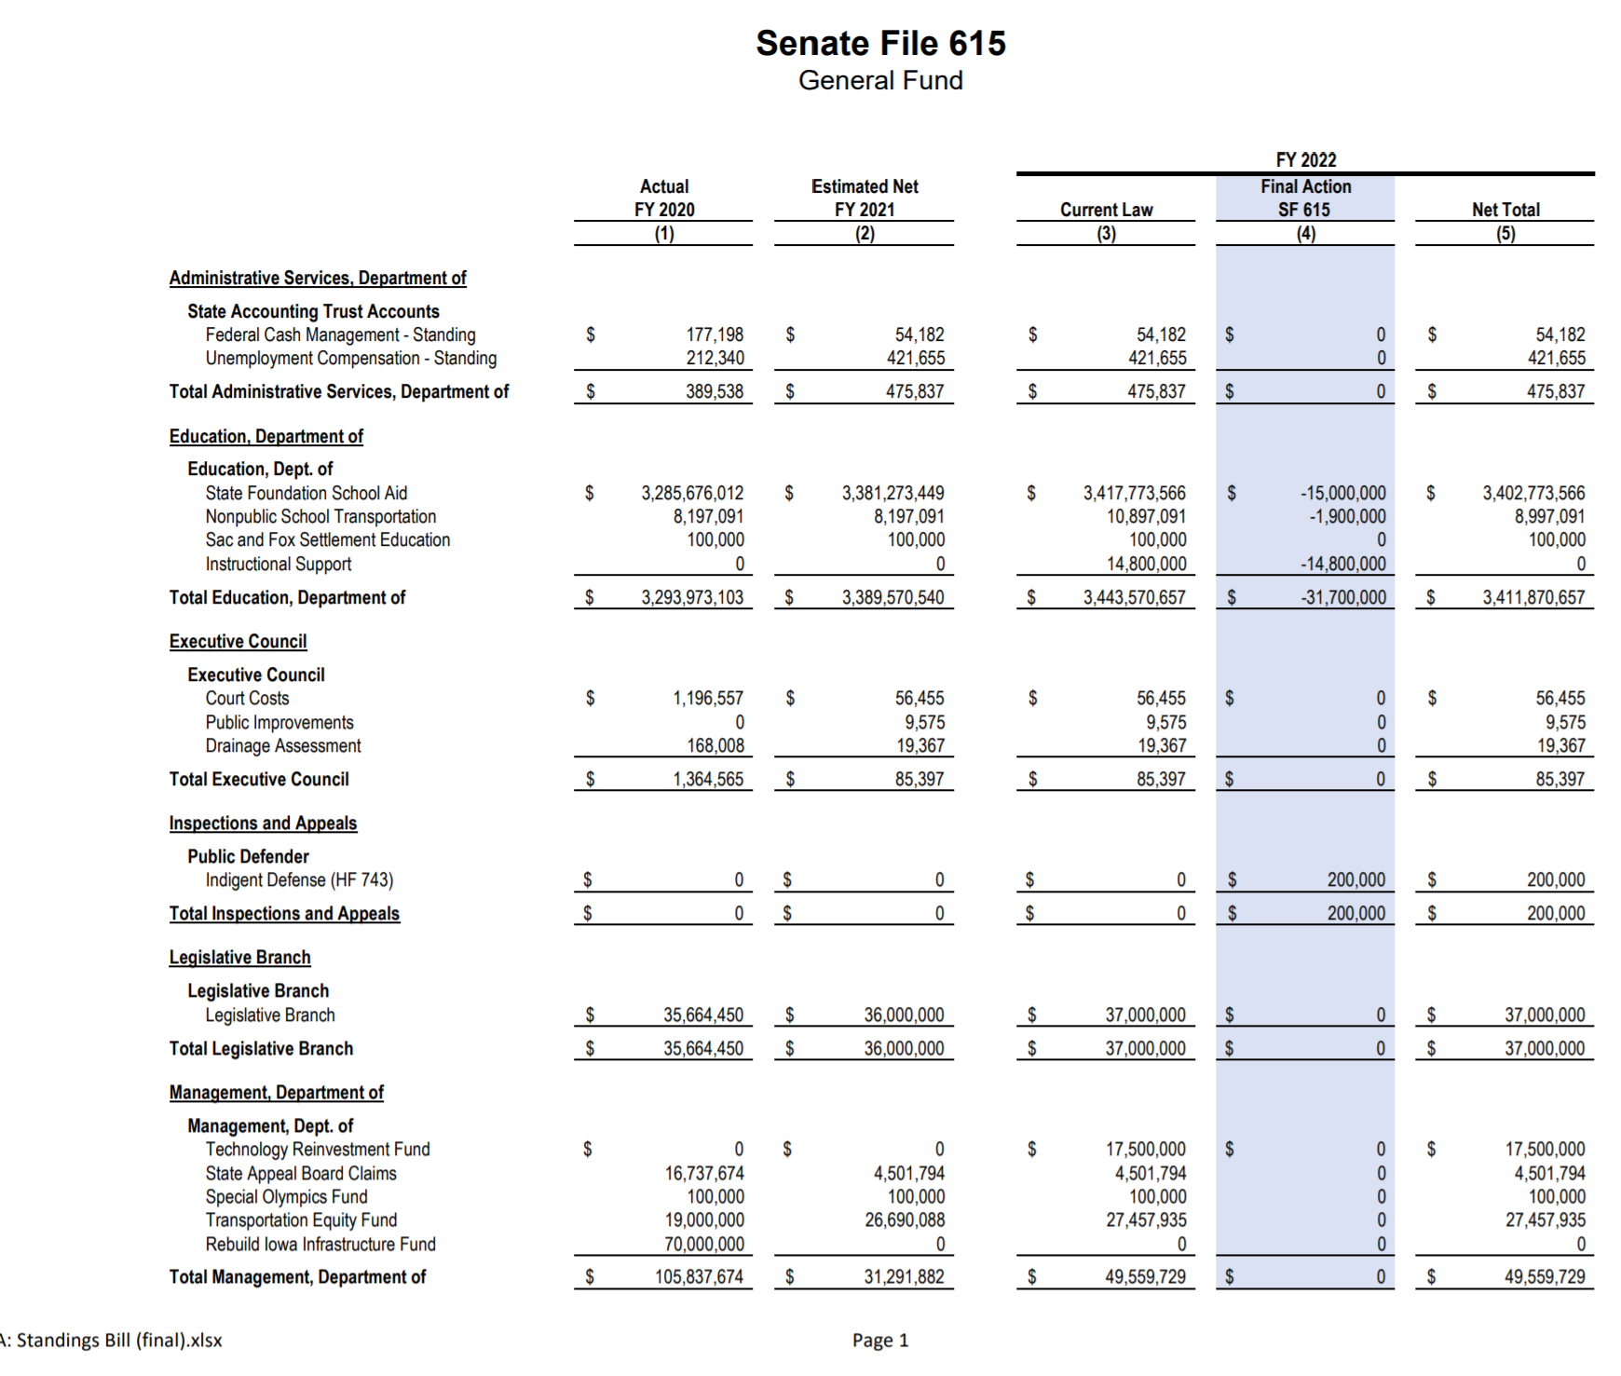
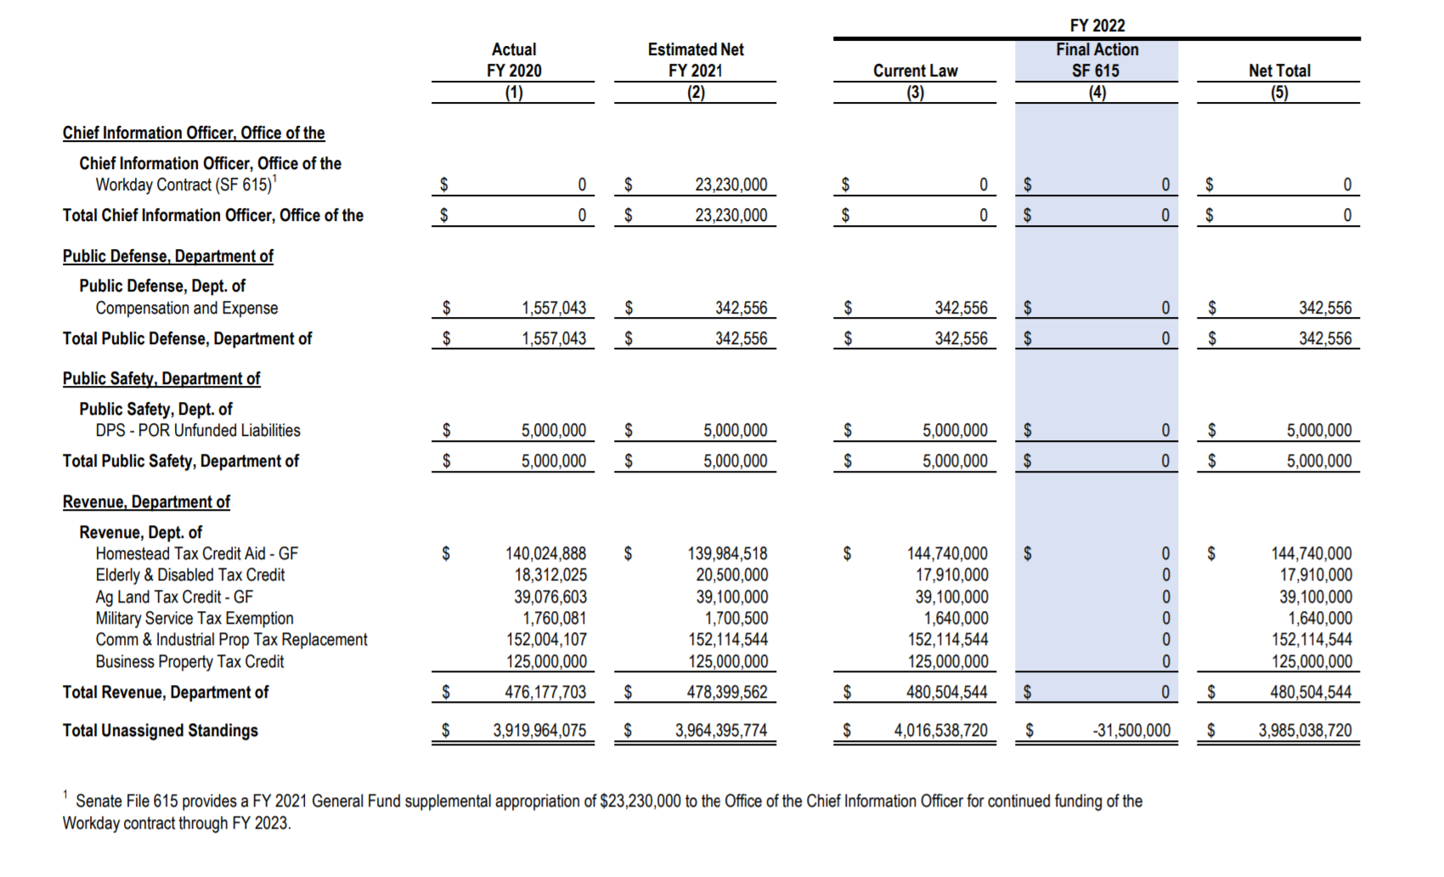
Note school aid change
from FY 20 to FY 21 :
$3,285,676,012 FY 2020
$3,381,273,449 FY 2021
= $95.6 million increase
Change from FY 21 to FY 22:
$3,381,273,449 FY 2021
$3,402,773,556
= $21.5 million increase

Slide 37
HF 867 Broadband Funding
NOBA

Slide 38
HF 867 Administration and Regulation Appropriations bill
Appropriates $100 Million to the Office of the Chief Information Officer (OCIO) from the General Fund to the OCIO for broadband grants.
This is an increase of $95.0 million compared to estimated net FY 2021.

Slide 39
SF 619 Tax Omnibus
Division I — Contingent Income Tax System Triggers: amends the 2018 Iowa Acts by striking the two conditions necessary for the trigger to occur and specifies that the 2018 Income tax cuts take effect Jan. 1, 2023 (moves up one year based on current REC projections, this change would have been effective Jan. 1, 2021 regardless).
Reductions by fiscal year:
  • FY 2023 = $154.6 million
  • FY 2024 = $160.2 million
  • FY 2025 = $30.1 million per tax year
The reduction in State income tax liability will reduce the amount raised by income surtax for schools by 3.0% of State income tax reduction. (note: schools must set the income surtax rate in whole numbers and often adjust the mix of property tax and income surtax to raise the needed revenue for ISL or PPEL.)

Slide 40
SF 619 Tax Omnibus
Division II — Early Childhood and Child and Dependent Care Tax Credits: increases the maximum net income amount used in determining eligibility for the Early Childhood Development (ECD) and Child and Dependent Care (CDC) Tax Credits, from $45K to $90K, retroactive to Jan. 1, 2021.
May impact demand for before and after school care??

Slide 41
SF 619 Tax Omnibus
Division V — Inheritance Tax: Phases out remaining Inheritance Tax (there is none in Iowa for lineal descendants, so this applies to others)
DOR estimates the 5-year phase out will reduce Iowa General Fund revenue by :
      • FY 2021 = $0.5 million
      • FY 2022 = $15.1 million
      • FY 2023 = $34.1 million
      • FY 2024 = $54.5 million
      • FY 2025 = $76.6 million
      • FY 2026 = $99.7 million
      • FY 2027 = $107.4 million

Slide 42
SF 619 Tax Omnibus
Division VIII — Telehealth Parity: requires Iowa health carriers to reimburse health care professionals or facilities for health care services for mental health conditions, illnesses, injuries, or diseases provided to a covered person by telehealth on the same basis and at the same rate as the health carrier would apply to the same mental health care services provided to a covered person by the health care professional or facility in person.
Effective upon enactment and retroactive to Jan. 1, 2021.
Fiscal Impact: the cost of those covered by Iowa’s State health care plan is estimated to be $2.6 million for the first year of implementation. Cost for Medicaid covered services can’t be determined at this time.

Slide 43
SF 619 Tax Omnibus
Division XIII - Workforce Housing Tax Credits: increases the max amount of tax credits allowed under the Workforce Housing Tax Incentives Program and increases the set-aside amount reserved for small cities.
Currently, the Program is limited to $25.0 million per year, and the small city set-aside is $10.0 million. The Bill increases the tax credit maximum to $40.0 million for FY 2022, and $35.0 million for FY 2023 and after. The small city set-aside is increased to $12.0 million for FY 2022, and $17.5 million for FY 2023 and after.
Note: Work with local economic development to anticipate change in enrollment down the road related to housing availability.

Slide 44
SF 619 Tax Omnibus
Division XXV — Mental Health and Disability Services (MHDS) Funding: creates a new Mental Health and Disability Services Regional Services Fund and establishes a General Fund standing appropriation to DHS for distribution to the MHDS Regions performance-based contracts and the following per capita amounts:
    • $15.86 for FY 2022.
    • $38.00 for FY 2023.
    • $40.00 for FY 2024.
    • $42.00 for FY 2025.
    • Beginning in FY 2026 and beyond, the previous year’s appropriation is multiplied by a growth factor indexed to sales tax growth for the preceding fiscal year, not to exceed 1.5%
The current MHDS system is a regional system managed by the counties, with State oversight. Counties finance a portion of the system with a county property tax levy that is capped at a per capita dollar amount for each of the 14 MHDS Regions, totaling $116.8 million for FY 2021. The State finances the majority of the services provided through the Medicaid Program. For a complete funding history of the MHDS system back to 1995, please see the related Issue Review.

Slide 45
Division XXV CMHF continued
Eliminates the MHDS property tax levy over a two-year period, with all county levies reduced to no more than $21.14 per capita for FY 2022 and reduced to $0 beginning in FY 2023.
Per Capita State Appropriations. Creates a new Mental Health and Disability Services Regional Services Fund and establishes a General Fund standing appropriation to DHS for distribution to the MHDS Regions performance-based contracts and the following per capita amounts:
    • $15.86 for FY 2022.
    • $38.00 for FY 2023.
    • $40.00 for FY 2024.
    • $42.00 for FY 2025.
• Beginning in FY 2026 and beyond, the previous year’s appropriation is multiplied by a growth factor indexed to sales tax growth for the preceding fiscal year, not to exceed 1.5%.
• Limits ending balances and creates a MHDS Regional Incentive Fund to provide additional funding to the MHDS Regions and specifies the criteria in which an MHDS Region may apply for funding. Appropriates $3.0 million to the MHDS Regional Incentive Fund for FY 2022 which grows over time.

Slide 46
Division XXVI — Property Tax Replacement Payments
Background: 2013 Session established a set commercial and industrial taxable value rollback of 90% and established a standing appropriation designed to reimburse local governments for the property tax revenue loss resulting from the taxable value reduction.
Since FY 2017, the annual backfill appropriation has been limited to $152.1 million.
Beginning with the FY 2023 payment, the bills phases out the General Fund standing appropriation for C&I property tax replacement for cities and counties in four or seven years, depending on how the tax base of the city or county grew relative to the rest of the State since FY 2014
School district backfill payments will be eliminated after FY 2022. Taxing authorities that are not schools, cities, or counties will have their backfill payment phased out over seven years.

Slide 47
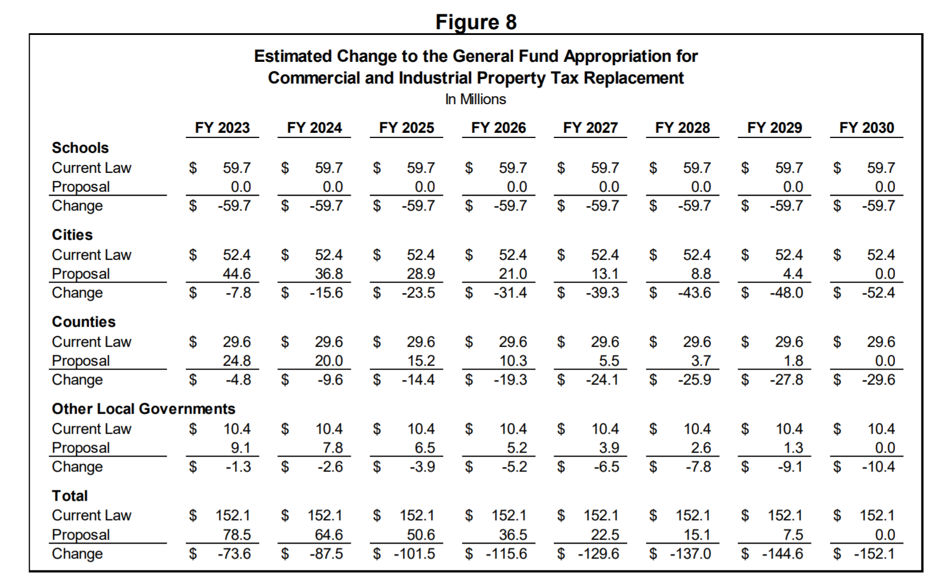

Slide 48
School C&I Replacement Impact
The revenue reduction for individual school district levies, totaling $59.7 million per year starting FY 2023, is estimated to be:
      General fund levy = $-41.8 million
      Instructional support levy = $-3.6 million
      Management levy = $-4.0 million
      Amana library levy = $-0.0 million
      Voted PPEL = $-3.8 million
      Regular PPEL = $-1.3 million
      Public Education and Recreation Levy (PERL) = $-0.1 million
      Debt service levy = $-5.0 million

Slide 49
Division XXVII — School Foundation Percentage
Beginning in FY 2023, the school foundation aid level increases from 87.5% to 88.4% to offset the revenue from the elimination of the C&I property tax replacement backfill payments.

Slide 50
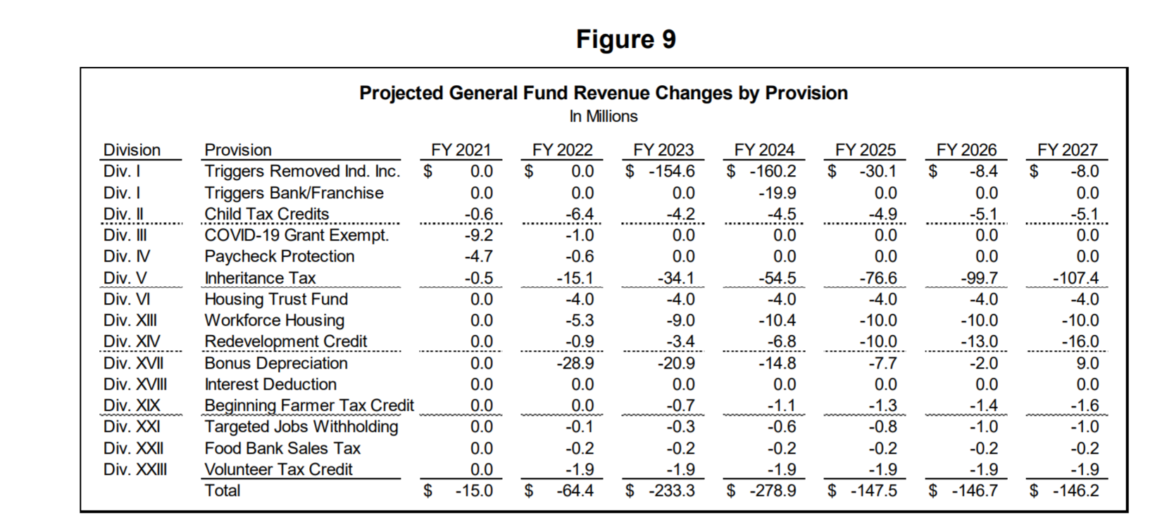
Fiscal Impact — State General Fund Revenue
https://www.legis.iowa.gov/docs/publications/FN/1221012.pdf

Slide 51
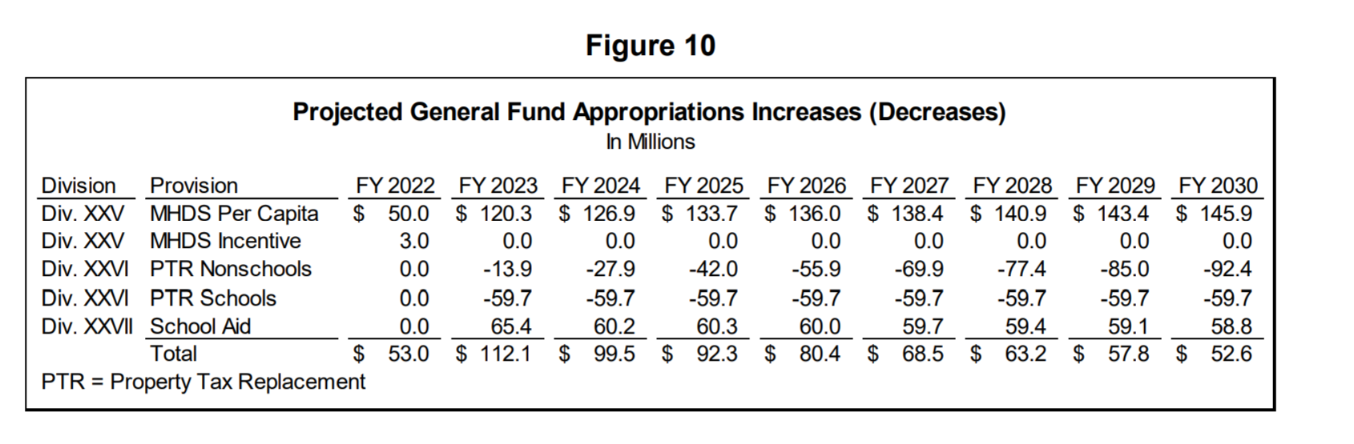
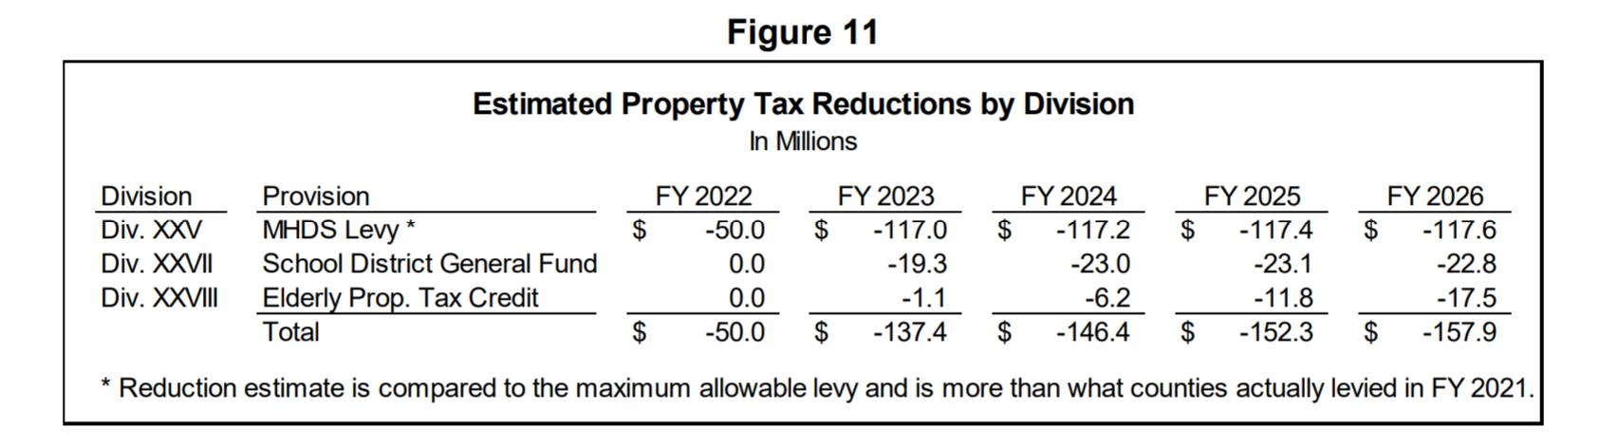
Fiscal Impact —Approp’s & Property Tax Relief
https://www.legis.iowa.gov/docs/publications/FN/1221012.pdf

Slide 52
ISFIS Tool: C&I Potential for Impact
  For illustration purposes, but it doesn’t hit until FY 2023. We don’t know enrollment, property valuation growth or SSA yet. Calculations are based on FY 2022.
  Spreadsheet posted here:
https://www.iowaschoolfinance.com/system/files/members/Public/ISFIS%20Special%20Topic%20Webinar%202021.06.17%20-%20Foundation%20Increase%20Backfill%20Elim%206.15.21.xlsx

Slide 53
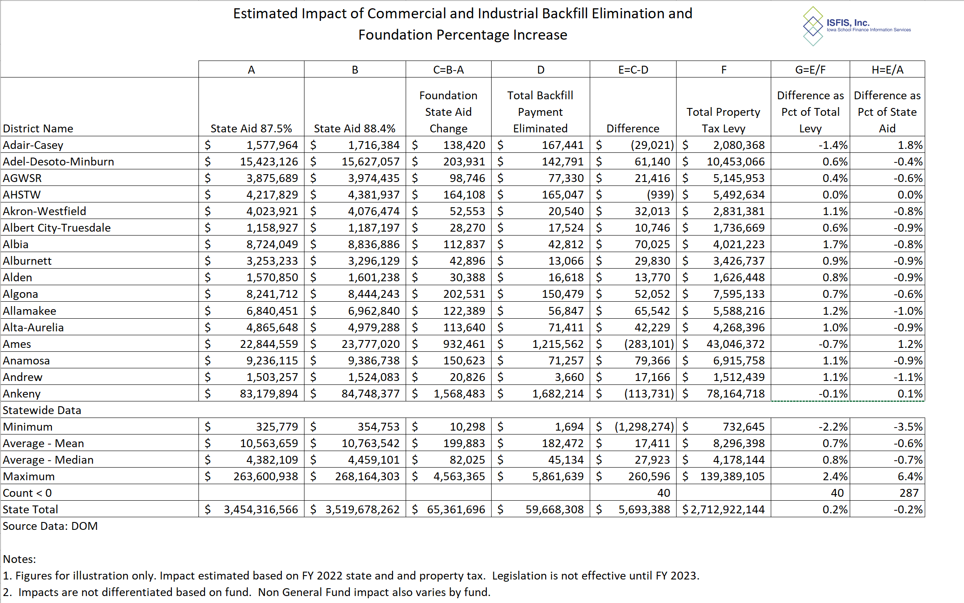

Slide 54
Map of the Week (MOW)
C&I Valuation History
ISFIS Mapping Tool
https://www.iowaschoolfinance.com/interactive_map

Slide 55
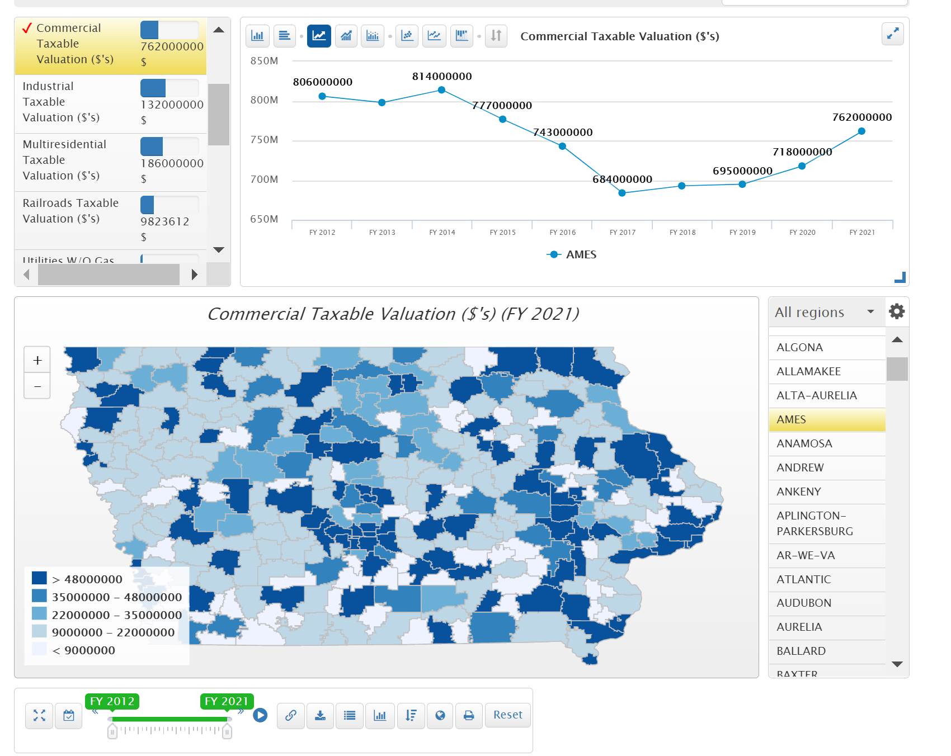

Slide 56
Timeline for Implementation

Slide 57
Policies Requiring
Administrative Rules
New Certifications: BOEE is required to create SPR for MH Professionals by Jan. 1, 2022 and Behavior Analysts by Aug. 1, 2021. Likely won’t be able to create the sharing arrangement prior to the Oct. 1 BEDS.
Charter Schools: Both BOEE (admin license) and State BOE (Application, oversight, criteria, closure, etc.) must create rules before applications are out there to get a charter started. The earliest, if rules move along fast, would be for application before March 1, 2022 for students to attend a charter school in the 2022-23 school year.
FS3 (Flexible Student and School Support Program) requires the State BOE to establish the program (typically done by rule, but could be faster if done through resolution and delegation to DE Director.)
Open Enrollment Good Cause: State board shall adopt by rule the criteria for determining a resident district’s consistent failure to reasonably respond to a student’s failure to meet basic academic standards. (New good cause open enrollment – exempt from March 1 application deadline.)

Slide 58

https://educateiowa.gov/sites/files/ed/documents/2021-06-16_HF228and847.pdf

Slide 59
FAQ
Guidance is organized into frequently asked questions by title.
First half deals with students open enrolling out of districts with diversity plans, which have no deadline for the 2021-22 school year.
The rest of the FAQ is about changes in HF 847 which impact the entire state.

Slide 60
FAQ
13. HOW WILL FUNDING WORK? Funding is the same as any other open enrollment. If the application is filed on or before October 1st, the resident district will be responsible for paying the open enrollment costs or actual cost of the special education program. After October 1st, the resident district will not be required to pay until the 2022-23 school year.
ARE STUDENTS ELIGIBLE FOR TRANSPORTATION ASSISTANCE? It depends. A student is eligible if the household meets the eligibility guidelines (which were increased to 200% of the federal poverty level, which is higher than the FRPL ceiling of 185%.)

Slide 61
FAQ
16. WHAT REASONS HAVE BEEN ADDED AS GOOD CAUSES TO APPLY FOR OPEN ENROLLMENT AFTER THE MARCH 1ST APPLICATION DEADLINE?
The following situations were added to Iowa Code section 282.18, subsection 4 as good cause to apply after the March 1st deadline:
● A child’s change in residence from the residence of one parent or guardian to the residence of a different parent or guardian in a different school district,
● Initial placement of a prekindergarten student in special education programming requiring specially designed instruction,
● A student’s assigned school building in the district of residence is designated under the priority category on the Iowa School Performance Profile for two or more of the immediately preceding years, OR
● The school is designated as in need of comprehensive support under the Every Student Succeeds Act for two or more of the immediately preceding school years.

Slide 62
FAQ
The FAQ also includes questions about PK open enrollment and other changes in HF 847 regarding athletic eligibility that would allow students to participate in athletics immediately upon open enrolling into a district.
However,
24. IF A STUDENT IS ACADEMICALLY INELIGIBLE IN THEIR RESIDENT DISTRICT . . . The student shall be ineligible in the receiving district for the remaining period of ineligibility declared by the resident district.

Slide 63
Pending Dates and Deadlines
        DE Deadlines Calendar (from Calendar tab on DE home page) and from the DE’s School Leader Update and School Business Alert
Date | Deadline
June 20 | Governor’s Final Action Deadline to sign or veto (She’s done)
June 23 | SRI Certification
June 24 | Assessment Accountability Certification Deadline
June 30 | Last day to pay PSEO postsecondary institution End of Fiscal Year 2021
July 1 | Beginning of Fiscal Year 2022
July 15 | Last day to bill for second semester special ed tuition and second semester tuition
Aug 1 | Foster care claim certification deadline, Sped claims due (foster care, district court placed, nonpublic, and high cost) and Juvenile Home program claims due
Aug 5 | State Board of Education Meeting (might be some rules proposals going on)

Slide 64

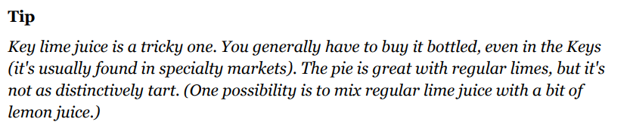
https://cooking.nytimes.com/recipes/1014850-key-lime-pie
Key Lime Pie
from NYTimes Cooking
INGREDIENTS
6 large egg yolks
2 14-ounce cans sweetened condensed milk
1 cup freshly squeezed or bottled Key lime juice
1 tablespoon finely grated lime zest
One prepared 9-inch graham cracker crust, refrigerated
2 to 3 cups lightly sweetened whipped cream, for topping
PREPARATION
In a mixing bowl, beat yolks until thick, about 3 minutes. Add condensed milk, lime juice and lime zest. Beat again until well blended, about 1 minute.
Pour into pie shell, filling it to the brim and mounding slightly on top. Cover with plastic wrap, stretching wrap tightly across surface. Freeze until firm, at least three hours.
Just before serving, remove from freezer and discard plastic wrap. Allow to rest for 5 minutes, then spread with whipped cream and serve.

Slide 65
Larry Sigel, ISFIS – Partner
Cell: 515-490-9951
larry@iowaschoolfinance.com
Margaret Buckton , ISFIS – Partner
UEN Executive Director,
RSAI Professional Advocate
Cell: 515-201-3755
margaret@iowaschoolfinance.com
We are here to help!
Jen Albers
Office: 515-251-5970 Ext. 4
jen@iowaschoolfinance.com
ISFIS, Inc., 1201 63rd Street, Des Moines, IA, 50311, (515) 251-5970, www.IowaSchoolFinance.com

