Slide 1

June 5, 2025
Special Topic Webinar
2025 Legislative Session
Appropriations, School Funding and Property Tax Proposals
Larry Sigel, Margaret Buckton, and
Ken Sturgis
© Iowa School Finance Information Services, 2025

Slide 2
SitRep Resources
PPT is linked on the ISFIS webinar webpage
Use the slides and information as you see fit
OK to share with others in your district
Let us know if others in your district need an invite to attend the webinars
If you are not an ISFIS Subscriber and interested in learning more, contact jen@iowaschoolfinance.com

Slide 3
SitRep Reminders
Feel free to pose questions via the question pane.
Questions are private (to ISFIS staff only) not public.
We’ll do our best to get back to you during or shortly after the webinar.

Slide 4

Connect with ISFIS
Are you connected with ISFIS on Social Media?
Like us on Facebook:
https://www.facebook.com/isfisinc/
Link to us on LinkedIn:
https://www.linkedin.com/company/iowa-school-finance-information-services
If you or anyone at your district needs access to the ISFIS subscriber content on the website, especially if there are new people, email jen@iowaschoolfinance.com
Please check with others at your district to make sure they’re getting our emails & invites!

Slide 5


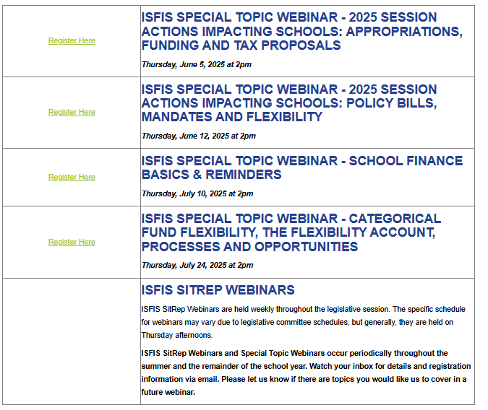
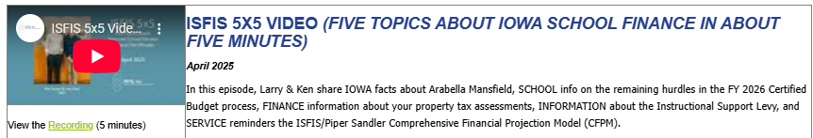
Special Topic Webinars and Recordings
SitReps take a Summer Break
ISFIS 5X5 Videos
Let us know if there’s an issue or content that you’d like to see us cover in a Webinar.
Find Registration, Recordings and Links to Materials:
https://www.iowaschoolfinance.com/webinars

Slide 6
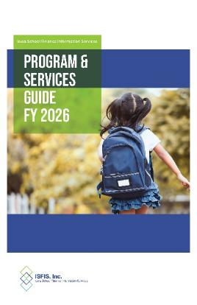
ISFIS Renewal for 2025-26
We thank you for your 2024-25
ISFIS Subscription and have sent out invoices for 2025-26 renewal.
Our FY 2026 ISFIS Program & Services Guide was included in the mailing to all Supts & SBOs, as well as posted on our website.
We offer a 5% discount for renewal subscriptions paid before July 15th.
If you are leaving your position at year-end, set up your replacement for success by renewing with ISFIS before your depart.
Let us know if you have any questions about our programs or services
or how ISFIS can help your district.

Slide 7
Agenda
Condition of State General Fund Revenues
Projections for Budget Surplus, Taxpayer Relief Fund, CRF and EEF, etc.
SSA plus other $$$ in SF 167 (RPDC, DCPP Equity, Transportation Equity and Operational Sharing Weighting)
Preliminary Aid and Levy & Tax Certification
SF 647 Education Appropriations
Standings Appropriations ($$ for PK-12 and ESAs)
HF 787 TSS Plus (CFPM Reminders and TSS $)
SF 660 Sports Wagering (includes Education Support Personnel Supplement)
Note on Federal Funds and Allocations Resources
Property Tax Reform – Proposals, Data and Advocacy Information
Tax Foundation Study of Iowa Property Taxes – some takeaways
MOW MOW MOW Map of the Week
Dates, Deadlines and Recipe of the Week

Slide 8

State of Iowa Year to Date General Fund Revenues
https://www.legis.iowa.gov/publications/fiscal/dailyReceipts
Monthly Revenue Memo
https://www.legis.iowa.gov/docs/publications/MM/1529317.pdf

Slide 9
State of Iowa Cash
General Fund Receipts
Category | Cash Receipts through 6/04/2025 | Cash Receipts through 5/14/2025 | March REC Estimate for FY 2025
Income & Misc. Tax* | -11.6 | -9.31% | -7.1%
Sales Tax | +1.28% | +0.62% | +2.5%
Corporate Income Tax | -10.70% | -11.19% | -11.9%
Refunds | +3.32% | +10.07% | -6.2%
Net Receipts | -8.02% | -7.98% | -6.1%
*Personal Income Tax and Miscellaneous Tax added together.

Slide 10
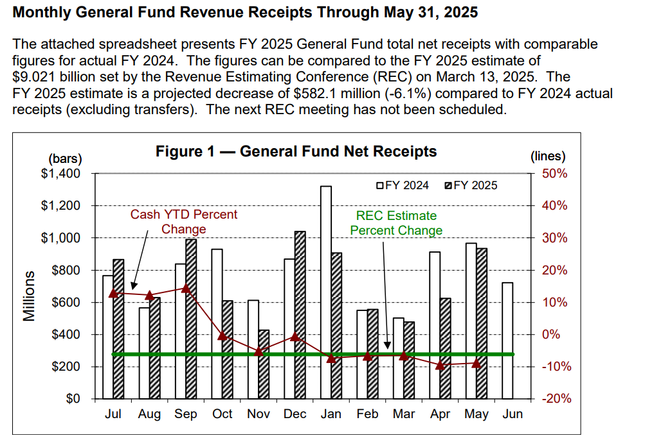
https://www.legis.iowa.gov/docs/publications/MM/1529317.pdf

Slide 11
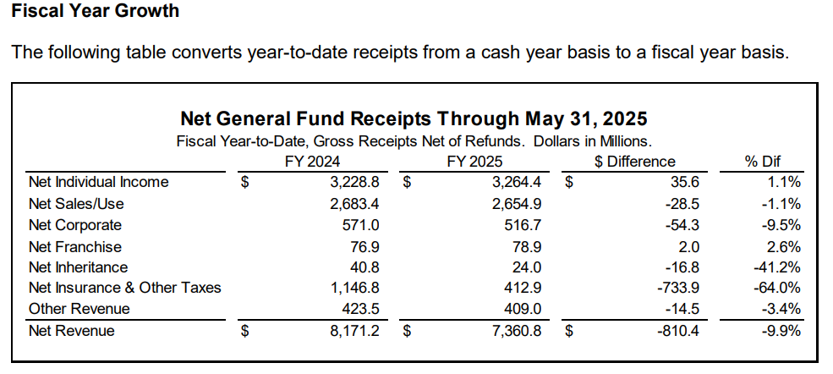

Slide 12
Considerations to Think About
LSA reported:
Deposits motor fuel tax combined w/personal income tax and sales/use tax revenue in a suspense account, which later is taken out.
Personal income tax changed to 3.8% flat rate effective for TY 2025 and exempted all retirement income effective Jan. 1, 2023.
DOR created a new revenue classification for the Pass-Through Entity Tax (PTET), enacted in 2023 Iowa Acts, which created retroactive income tax credits.
May’s monthly due date for tax filings in 2024 fell on a weekday. May’s monthly due date in 2025 fell on a weekend, pushing receipts to June 2, 2025. This weakened General Fund monthly totals for May 2025 compared to May 2024.
These factors impact month-to-month and year-to-year comparisons.
Without adjusting for the above items of impact, May 2025 net General Fund revenue was $32.5 million (-3.4%) below the May 2024 net revenue level.

Slide 13
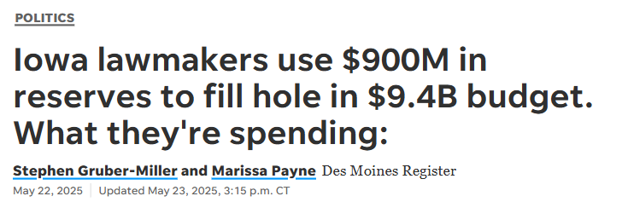
Projections for Budget Surplus, Taxpayer Relief Fund, Cash Reserve Fund and Economic Emergency Fund.
Des Moines Register May 23, 2025
.

Slide 14
FY 2026 State Budget
Republicans, who hold legislative majorities, passed the state budget before adjourning the 2025 legislative session early in the morning on May 15.
The $9.42 billion state budget for fiscal year 2026, which begins July 1, represents an increase of $478.9 million, or 5.3%, over this year’s $8.95 billion in spending.
Des Moines Register May 23, 2025

Slide 15
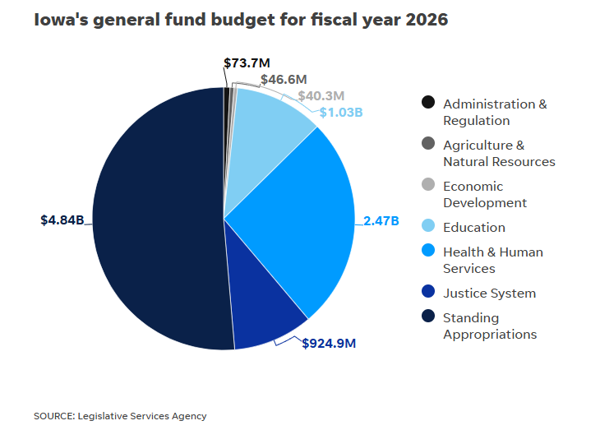
(Includes $3.9 State Aid for schools plus ESAs)

Slide 16
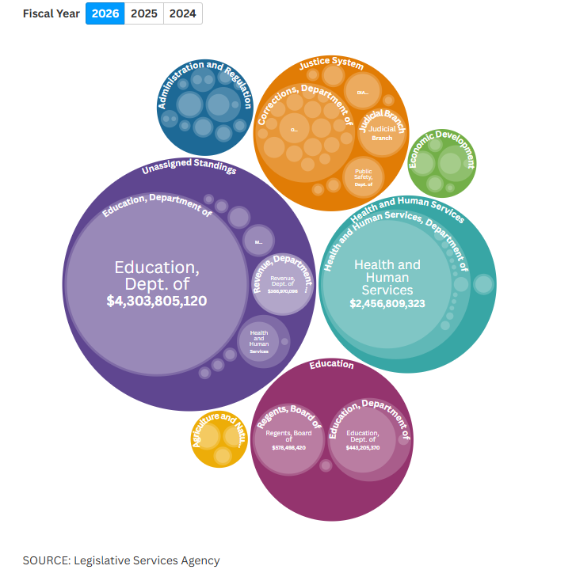
Education in two buckets:
Standings ($3.9B of $4.3B)
Education $70M out of $443 to DE)

Slide 17
Revenues Down/Spending Up
Iowa is only expected to take in about $8.51 billion in FY 2026, largely because of the effects of a GOP-backed 3.8% flat income tax rate that began Jan. 1.
To fill the hole, the budget uses $463.6 million from the state’s Taxpayer Relief Fund, which will reduce the fund from $4.03 billion at the end of the current fiscal year to $3.65 billion at the end of next year.
The state’s budget surplus also is expected to fall by $463.6 million by the end of next year, from $2.08 billion to $1.61 billion.
Des Moines Register May 23, 2025

Slide 18
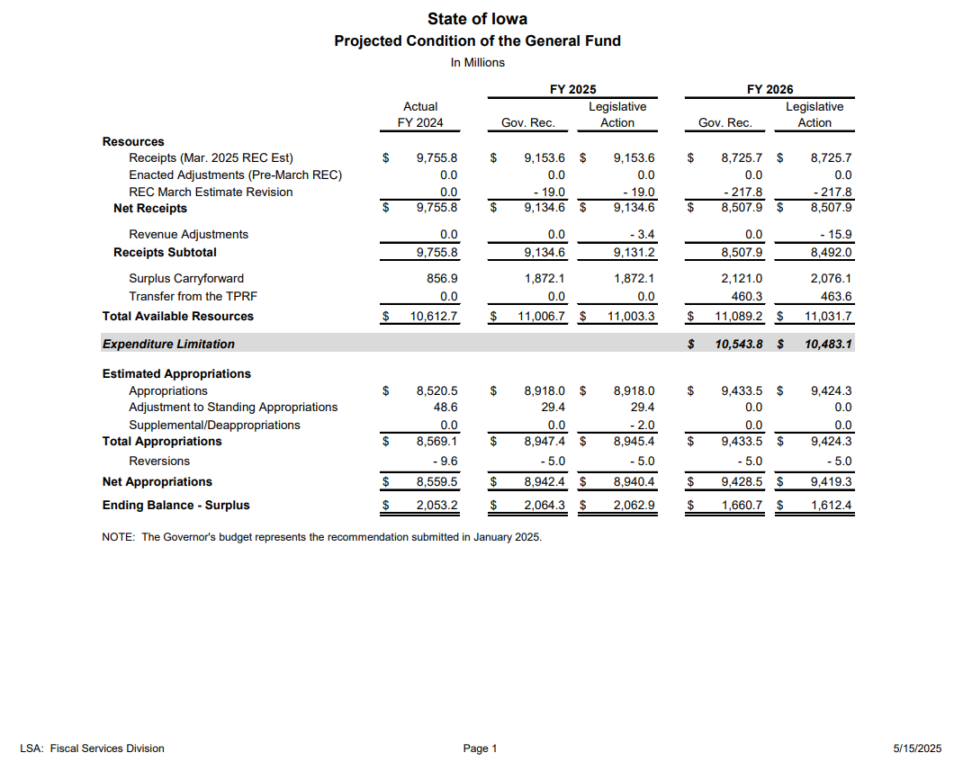
https://www.legis.iowa.gov/docs/publications/EOS/1527948.pdf

Slide 19
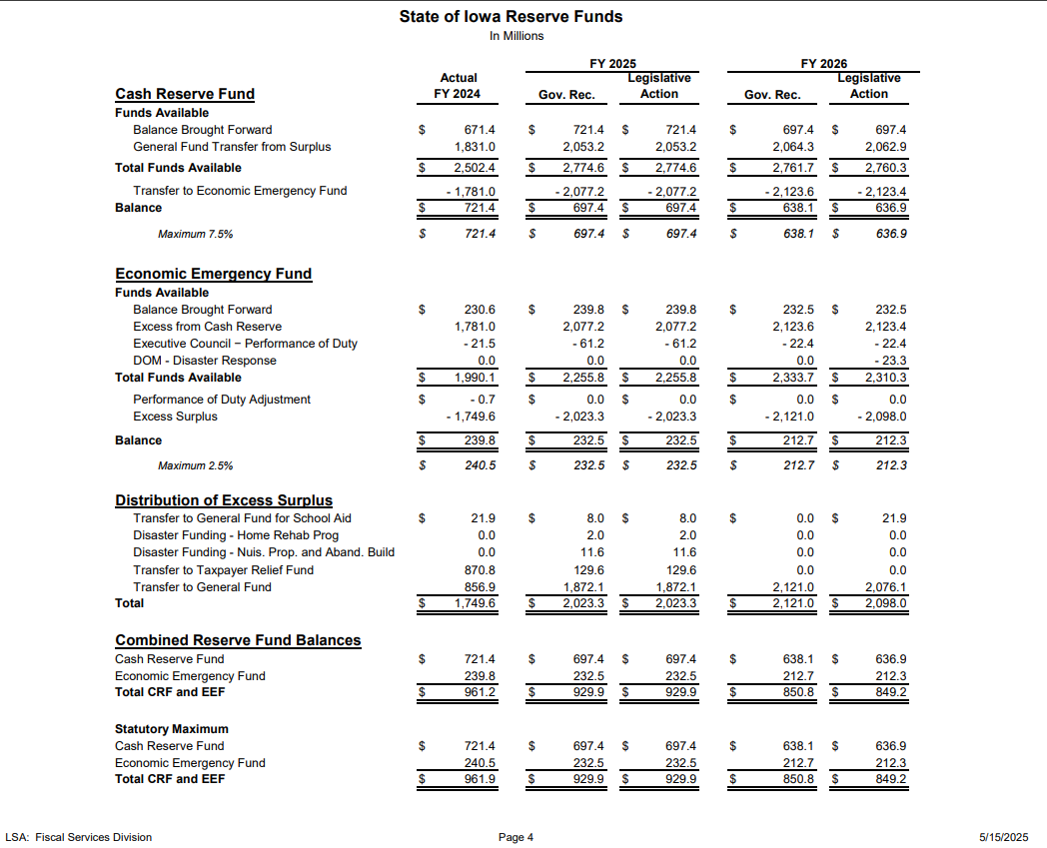

Slide 20
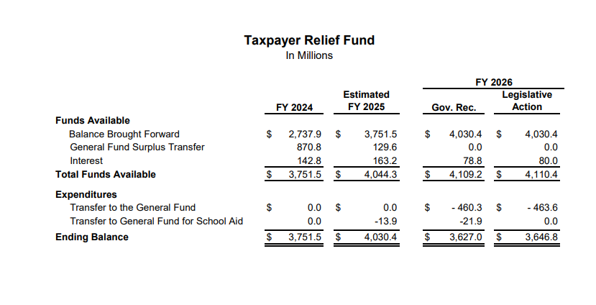

Slide 21
State Cash Position FY 2026 - FY 2025
Budget Surplus $1,612.4M $2,062.9
TRF $3,646.8M $4,030.4
EEF $ 636.9M $ 697.4
CRF $ 212.3M $ 232.5
Total $6,320.7M $7,023.2
Net Fund Balance Change 2026-2025 $-914.8

Slide 22
SF 167 SSA ++
Source: SF 167 Fiscal Note https://www.legis.iowa.gov/docs/publications/FN/1525877.pdf

Slide 23
SF 167 SSA (Signed 5/14)
Sets a 2% growth rate applied to the SCPP for FY 2026, for an SSA increase of $157 per pupil.
Establishes a 2% growth rate applied to State categorical PP amounts for FY 2026
Sets Transportation Equity increase at 5%.
Provides additional property tax replacement funding based on the per pupil increase for FY 2026. Freezes the additional levy portion at $685 per pupil.
Specifies the Iowa Code requiring SSA be enacted within 30 days of submission of the Governor’s budget (or mid-February this Session) does not apply.

Slide 24
Other $$ in SF 167
Provides an additional increase of $5 to the FY 2026 regular program SCPP, separate from the SSA.
  $1.5 million for additional support for pupils
  $1.4 million property tax reduction for those with a higher DCPP
Operational Sharing: increases the maximum amount of additional weighting from 21 to 25 pupils beginning FY 2026
  estimated to increase supplementary weighting by a total of approximately 129 pupils for 46 school districts at a total annual cost of $1.0 million beginning with FY 2026 and ending after FY 2035 (sunsets per Iowa Code)
  appropriation of $942,000 state funding plus $91,000 local property tax through the school aid formula.

Slide 25
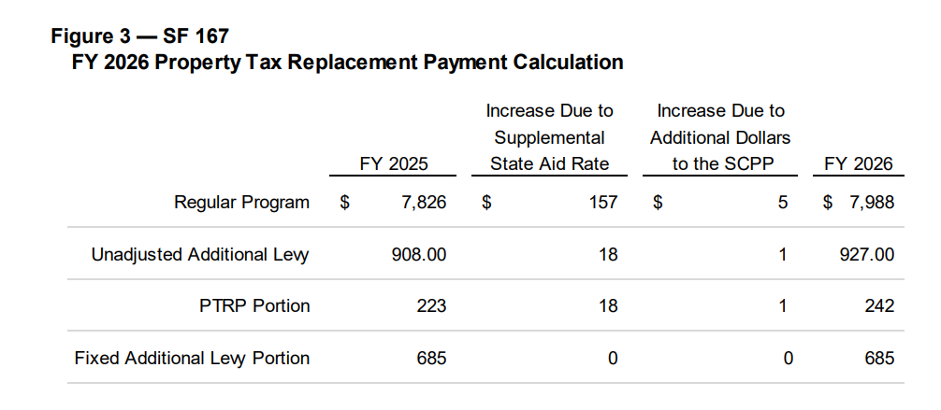
$7,988 PP includes the $5 PP equity payment (for districts at state minimum, this is new spending authority. For districts above the state minimum, it offsets property tax authority.)
PTRP absorbs the property tax relief share of the 2% growth. $137.3 million in PTRP funding, an increase of $10.5 million (8.29%) compared to estimated FY25.

Slide 26
Categorical Funds Per Pupil
$747.5 million for the State categorical supplements for school districts and AEAs, an increase of $59.3 million (8.61%) compared to estimated FY 2025:
  • $468.9 million for the TSS at the district and AEA levels, which is an increase of $49 M, or 12%, to fund higher teacher pay minimums plus 2% increase on the state TSS per pupil.
  • $39.4 million for the professional development supplement.
  • $42.8 million for the early intervention supplement.
  • $196.3 million for the Teacher Leadership and Compensation supplement.

Slide 27
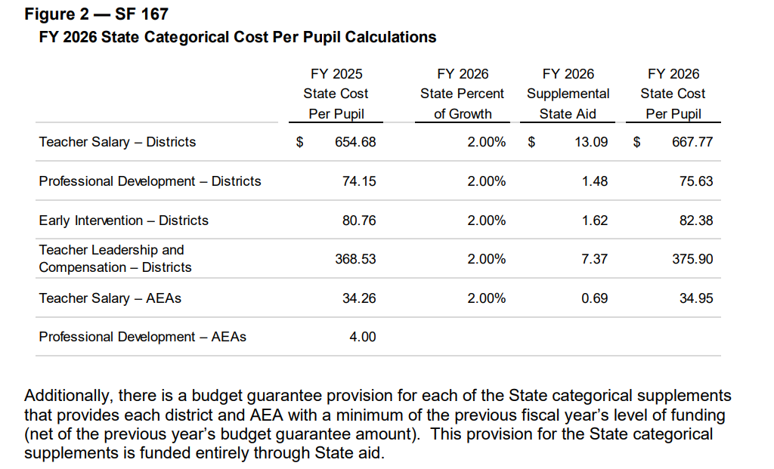
Sum of PP Categoricals ($1,202) X ESA resident enrollment stays with districts
157 districts are eligible for Budget Guarantee, for a total of $24.3 million.

Slide 28
Transportation Equity Program
Iowa Code § 257.16C establishes the Transportation Equity Program.
Provides additional funding to school districts for public school transportation costs that exceed a statewide adjusted average cost per pupil. Unless otherwise provided, the appropriation increases at the categorical State percent of growth.
Transportation equity payments buy down transportation costs to the statewide average cost per pupil, if there’s enough money. If there is more than enough, school districts with transportation costs per pupil below the statewide average get some, apportioned on enrollment.
SF 167 provides for a growth of 5% ($32.7 million total, which is a $1.6 million increase)

Slide 29
How Much Money is this?
Total property tax funds generated through the school aid formula are estimated to be $1,803.3 million, an increase of $56.8 million (3.25%) compared to estimated FY 2025.
Total State aid from the General Fund (school aid for school districts and AEAs generated through the school aid formula) is estimated to be $3,940.4 million, an increase of $ 152.8 ** million (4.03%) compared to estimated FY 2025. Figure 4 also includes the FY 2026 General Fund appropriation of $32.7 million to the Transportation Equity Fund, which is not included in the total State aid estimate.
  **overstates AEA appropriation by $25 million later reduced in Standings. After adjusting for the AEA cut, the percentage increase of State Aid is 3.4%
  further adjusted for TSS increase of $49 million for mandated salaries, the general fund increase for schools from State Aid is 2.1%.
Fiscal Note: https://www.legis.iowa.gov/docs/publications/FN/1525877.pdf

Slide 30
CPI-U Link to Arbitrator Limitations
https://eab.iowa.gov/public-collective-bargaining/impasse-mediation#consumer-price-index-cpi-for-midwest-region

Slide 31
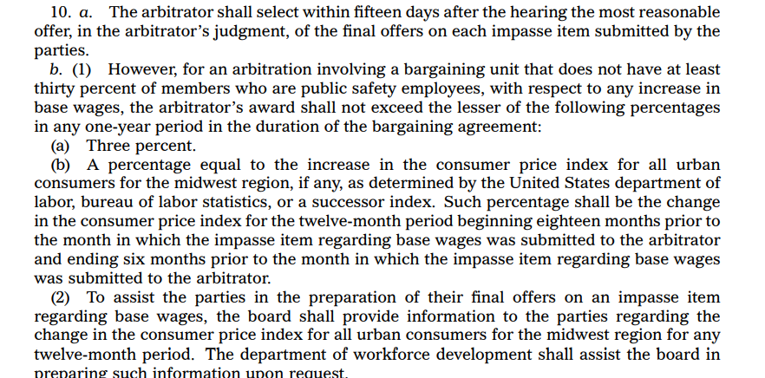
CPI-U Arbitration Limits
Limitations in Iowa Code 20.22
https://www.legis.iowa.gov/docs/code/2025/20.22.pdf
Award shall not exceed the lesser of 3% or CPI-U

Slide 32
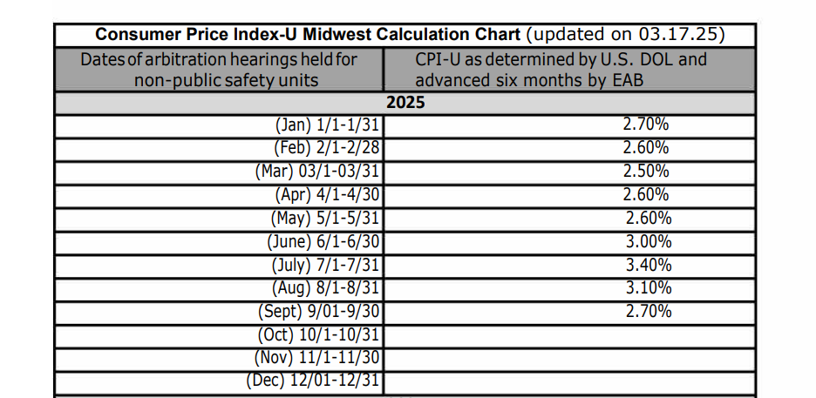
June – August awards limited to 3%
Others are limited to CPI-U calculation

Slide 33
Preliminary FY 2026 Aid and Levy and Tax Certification

Slide 34
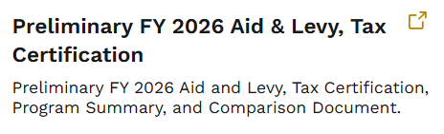
First thing.
Y’all should have received an email from John Parker on June 3. Time to look at our A&Ls
They are NOT updated in the DOM system. You have to download the spreadsheet.
https://dom.iowa.gov/
local-government/
school-resources

Slide 35
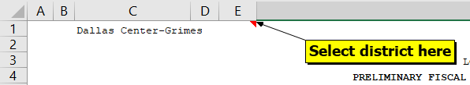
First thing.
Once you open the spreadsheet select your district.
This will populate everything. From there you can review the Preliminary Aid and levy and compare to what was input in the DOM system.

Slide 36
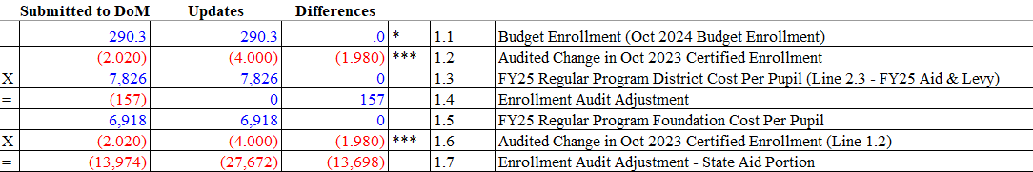
From there, compare
Compare the differences between your submitted budget, to the preliminary version
Double check all changes, there will be one line explanations, make sure you understand what is happening to your budget.

Slide 37
Notes
The preliminary version includes the TSS amounts that were sent out on April 2 (and includes the $13.42 increase due to SSA).
If your rate increased, its ok! Generally districts are not allowed to increase their levy after the budget is submitted, however, any levy increases that are caused by law changes, formula adjustments, updated by DOM in the system, are ok.

Slide 38
Notes
If your levy rate decreased due to law changes (say you submitted 2.25% SSA), you can’t make changes to increase your levy back to the original amount.
If you want to further decrease your levy, the easiest way is to reduce your cash or management levy.
Verify your Debt Service Levy covers any General Obligation Debt (and only GO Debt)

Slide 39
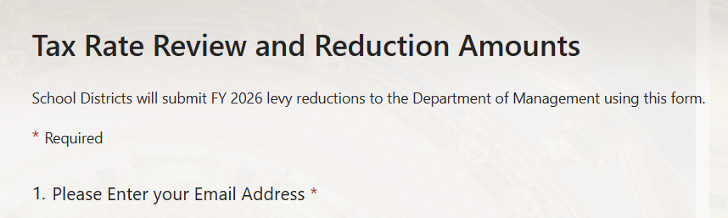
Finalizing it
Once you are done with your comparison, please complete the form with the link that Mr. Parker sent out with the email.
If you want to reduce, it will ask you for a dollar or levy target.

Slide 40
SF 647 Education Appropriations

Slide 41
SF 647 Ed Appropriations
General Fund FY 2026: Appropriates a total of $1.033 billion from the General Fund and 11,061.6 full-time equivalent (FTE) positions for FY 2026 to the Department for the Blind, the DE, and the Board of Regents. This is an increase of $14.1 million and 7.0 FTE positions compared to estimated FY 2025.
Standing Appropriation FY 2026: Includes a standing appropriation from the General Fund estimated at $750,000 for Therapeutic Classroom Services, which does not appear in this Bill. This is for students in Therapeutic Classrooms that do not have IEPs.

Slide 42
SF 647 Education Appropriations
Department of Education: Appropriates $451.4 million from the General Fund and 420.6 FTE positions. This is an increase of $8.5 million (1.9%) compared to estimated FY 2025. The General Fund changes include:
An increase of $152,000 for the DE Administration.
An increase of $300,000 for Jobs for America's Grads.
An increase of $7.5 million for General Aid for Community Colleges.
An increase of $342,000 for the Iowa School for the Deaf.
An increase of $98,000 for the Education Services for the Blind and Visually Impaired.
A new appropriation of $265,000 for the Online State Job Posting System.
A decrease of $5.0 million for the Division of Special Education ($5 M is appropriated in SF 660)
An increase of $299,000 for the Teach Iowa Scholars.
A new appropriation of $8.0 million for the Health Care Professional Incentive Program.
A new appropriation of $50,000 for the Court Reporter Equipment Grant Program.
An increase of $1.1 million for the Tuition Grant Program — Standing.
An increase of $2,000 for the Tuition Grant Program For-Profit.
An increase of $49,000 for Iowa PBS Operations.

Slide 43
SF 647 Studies and Intent Language
Requires Approp to DE for Early Head Start project be used for implementation and expansion of EHS pilot projects addressing the comprehensive cognitive, social, emotional and developmental needs of children from 0-3 years of age, including prenatal support for qualified families. Requires projects to promote healthy prenatal outcomes and healthy family functioning and to strengthen the development of infants and toddlers in low-income families.
Requires the DE to provide reading assessments for PK-6 to identify students not proficient in reading. Allows DE to charge school districts for the cost of the assessment, which school districts may pay out of Early Intervention funds. The fee is determined by dividing the actual remaining costs to purchase the statewide license for the school year by the number of pupils assessed under the system in the current fiscal year. School districts are permitted to use the early intervention allocation and the successful progression for early readers to pay for the early warning assessment system fee.

Slide 44
SF 647 Studies and Intent Language
Prohibits the Iowa Reading Research Center from spending more than $250,000 for the establishment and continuing oversight of the advanced dyslexia specialist endorsement. For FY 2026, requires the Center to submit a report to the General Assembly detailing the expenditures of moneys used for these purposes.
Requires that $200,000 of the appropriation for children's mental health school-based training and support be used to implement a Children's Grief and Loss Rural Pilot Program to serve Iowa children in rural school districts or accredited nonpublic schools. The Program must be administered by, and $200,000 must be allocated to, an existing statewide not-for-profit health care organization that currently provides grief and loss services to children.

Slide 45
SF 647 Studies and Intent Language
Requires DE to establish criteria for the distribution of moneys appropriated to Best Buddies Iowa and organizations receiving funds to report to DE annually student identifying data.
Specifies that use of funds for the STEM Collaborative Initiative include activities directly related to the recruitment of K-12 math and science teachers and for ongoing math and science programming for students in K-12.

Slide 46
SF 647 Other Requirements
Programs for At-Risk Children: Limits the standing appropriation under Iowa Code § 279.51 for at-risk children to $10.5 million. Requires appropriated funds to be prorated among the programs specified under Iowa Code § 279.51.
Student Achievement and Teacher Quality Program: Maintains the required allocations to the Student Achievement and Teacher Quality Program for FY 2026.
At-Risk Grants: Establishes a contingent effective date of July 1, 2025, for the limit on the standing appropriation under Iowa Code § 279.51 for at-risk children if SF 445 Preschool, Approved Programs, Standards, and Curricula Bill or any other successor legislation is not enacted. (SF 455 Governor’s Childcare Continuum bill was not approved by the House.)

Slide 47
Info and Next Steps
NOBA has the detail and appropriations tracking for every line-item
https://www.legis.iowa.gov/docs/publications/NOBA/1527436.pdf
Not yet signed by the Governor.

Slide 48
SF 659 Standings Appropriations

Slide 49
Standings Appropriations
SF 659 NOBA Link
Limits the FY 2026 General Fund appropriation to the DE for nonpublic school transportation to $9.0 million. Requires the appropriation to be prorated if claims exceed the funds. (SQ funding)
Suspends the General Fund standing appropriation of $14.8 million to the DE for the Instructional Support Program for FY 2026 (results in zero state funding, SQ amount)
Transfers $21.9 million from the Taxpayer Relief Fund to the General Fund in FY 2025 to pay FY 2026 State school foundation aid as described in Iowa Code § 257.16.

Slide 50
Standings Appropriations
SF 659
Reduces the standing unlimited FY 2026 State school aid funding for school districts for special education support services (previously AEA funding) by $25.0 million.
Specifies that the $7 million statutory reduction comes out of the school district share of special education support services dollars and prorates based on what districts would otherwise have received.
Combined reduction including statutory decrease of $7 million is $32.5 million, same as FY 2025, but comes out of the school district amounts rather than the AEA.
Adopts corrective provisions for the Governor’s cell phone bill (exempts charter schools.)

Slide 51
DHHS Investigation of
Employee Student Abuse
New IC § 232E.2 Investigation of alleged student abuse by school employees
Requires HHS to administer and provide for the investigation of reports of alleged student abuse by school employees
Requires HHS to notify school boards or nonpublic school authorities and the BOEE if, during a child abuse intake, the HHS receives a report from an identifiable source and determines the report is an allegation of student abuse by a school employee.
Requires the school board/authority to place an employee on administrative leave and prohibit them from entering school property if subject of an ongoing student abuse investigation.
Requires HHS to refer the matter to/cooperate with appropriate law enforcement, notify the board/authority, notify BOEE if the employee is licensed, certified, authorized or holds an active statement of recognition, if the HHS determines the alleged student abuse is a criminal act.
Requires HHS to commence an investigation within 24 hours and complete it within 30 business days of receiving a report of alleged student abuse.

Slide 52
DHS Investigation of
Employee Student Abuse
Requires HHS to submit a written investigation report to the board/authority and BOEE if the employee if appropriate, upon completion of an investigation.
Requires HHS to adopt administrative rules, in consultation with DE, regarding the intake and investigation processes, reports, case and investigation record retention and dissemination, and case disposition.
Requires HHS to maintain information and data regarding student abuse reports, investigations, and dispositions separate from information and data regarding child abuse reports, assessments and dispositions under IC § 232.
Requires a school district or nonpublic school to cooperate with HHS during an investigation of student abuse involving a school employee.
Requires a school district or nonpublic school to terminate employment of a school employee if an HHS investigation report indicated the school employee committed student abuse.

Slide 53
MSA for Extraordinary
Open Enrollment In
Applies to school district with more than 45% open enrolled into the district.
Allows MSA request for 50% of authority that would be generated if those students were resident students for 1) DCPP minus SCPP, 2) PD supplement, 3) EICS per pupil.
Does not include TSS. Also, TLC is required to be paid by the resident district to the receiving district per current law.
Requires the school board to hold a public hearing, which must be published in the newspaper between 10-20 days before the hearing, before filing a request for MSA.
Does not apply if a majority of students open enrolled into the district’s online instruction from a private provider under IC § 256.43 (2)
Prohibits the district’s combined property tax rate for a year in which this MSA is received from exceeding the prior year’s tax rate.
Applies to school budget years beginning on or after July 1, 2025.

Slide 54
HF 787 Education Omnibus: TSS, TeachIowa Job Site, Returning Retiree Min Salary, Out-of-state Risk Pool, Intern Student Teaching Flexibility

Slide 55
HF 787 TSS Provisions
Requires TSS calculations necessary to meet new teacher pay minimums of $50,000 for beginning up to 12-year-experience and $62,000 for teachers with 12 years or more of experience.
Includes employer share of FICA and IPERS
Allows for experience error correction from prior year’s BEDs report
Provides that growth from SSA be applied to the state TSS per pupil and added to district TSS per pupil amounts (2% SSA = $13 PP growth added to district per pupil TSS amount.)
TSS provisions are effective on enactment (Governor has not yet signed it)

Slide 56
What will be my TSS Amounts?
You can double check your TSS amounts in two ways
  Aid and Levy Comparison tab on the FY2026 Preliminary Aid and Levy Spreadsheet (Row 66-73 or Aid & Levy 4.15-4.22)
  The Attached PDF that John Parker sent out on April 2. Be sure to use the column that has 2% SSA, and add 13.42 to the 0% Per Pupil Amounts

Slide 57
How do I use it?
TSS has to be spent on teacher salaries but as long as you meet the salary minimums and spend it all down you don’t have to
  Divide it equally (yes, some teachers can get $0 TSS)
  Put it in the teacher’s contract
You can do it, you just don’t have to.
Creates opportunity for making ends meet. See May 8 ISFIS SitRep Webinar for some ideas.
HF2612 Implementation FAQ

Slide 58
HF 787 Other Provisions
Resurrects the TeachIowa Job posting site
Creates a new Risk Pool for high cost out-of-state special education placements (off top of state aid)
Sets a minimum $50K pay for full-time retired teachers returning to the classroom
Provides for student teaching flexibility for Intern Teachers.
These provisions are all effective 07/01/2025

Slide 59
SF 660 Sports Wagering Receipts Fund

Slide 60
Sports Wagering Receipts Fund Appropriations SF 660
Appropriates $14 million to DE for distribution to school districts for education support personnel supplemental salary.
Funding is miscellaneous income for school districts.
Requires school districts to report to the DE, on or before July 1, 2025, information related to education support personnel employed by the school district in order to receive the funds.
Distributes the $14 million on a per pupil basis.
Specifies education support personnel are “any regular and part-time employees of the school district who are not salaried.”
Note: Does not require that funding be distributed equally or to all employees that meet the definition, which means there is local discretion to determine distribution of supplemental funds to staff. Does require that it be supplemental income.
This section is effective on enactment.

Slide 61
Sports Wagering Receipts Fund Appropriations SF 660
Appropriates $5,000,000 million from the SWRF in FY 2026 to the DE’s Division of Special Education. (This is in addition to the GF appropriation in SF 647)

Slide 62
Federal Funds and Allocations Information

Slide 63
Federal Funds Murky
Federal budget discussions are ongoing.
Iowa Capital Dispatch reported June 3, Senators from both parties grilled Education Sec. McMahon
  Proposes $12 B cuts to Education (IA about 1%???)
  Questions specifically about GEAR-UP and TRIO programs for low-income first-in-family college goers
  Proposes less funding and likely less directives and mandates, but it’s murky.

Slide 64
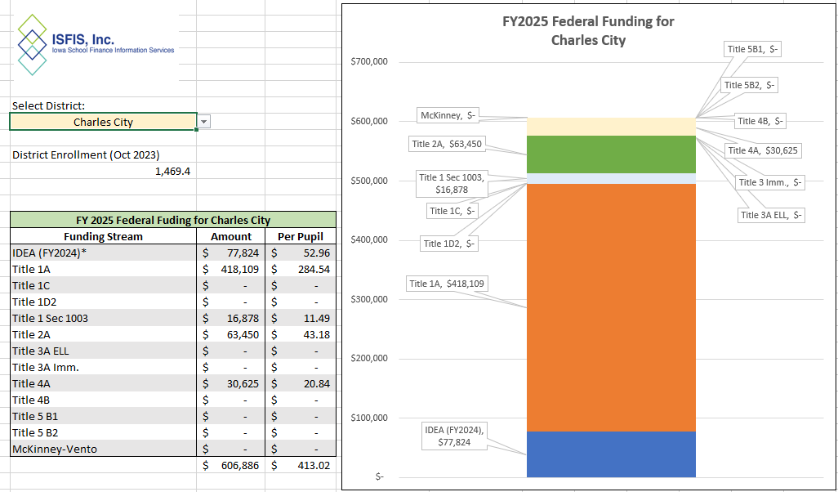
Information to Help
ISFIS tool on historical federal funds
https://www.iowaschoolfinance.com/system/files/members/Public/ISFIS%20FY2025_Federal%20Allocation-rc2.xlsx

Slide 65
Information to Help
DE Allocations Summaries https://educate.iowa.gov/pk-12/operation-support/business-finance/financial-management/allocation-summaries
ISFIS Flexibility Account Memo (if caught midyear and need to continue to pay contracted staff, this is a good source of one-time support) https://www.iowaschoolfinance.com/flexibilityaccount
See the May School Business Alert Newsletter for more flexibly account info

Slide 66
SF 651 Property Tax
Overhaul
Dies on Senate Calendar
Alive for consideration in 2026

Slide 67
Class of Property Discussion
~What has been the historical trend of taxes paid by class of property on percentage basis?
Source: Department of Management

Slide 68
PTR Round III SF 651
SF 651 phases our rollbacks over 10 years.
Homestead exemption of 25% but not to exceed $125,000
Rate reductions (would have been) effective July 1, 2026.
Limits City/County Valuation growth, but allows more if inflation (CPI-U) is higher. Defines new construction and adds value of new construction above the 2% limit. Senate Amendments changes some terms in new valuations and CPI-U growth limitations. This has less impact on schools.

Slide 69
PTR Round III SF 651
Impact on school bonding/infrastructure capacity:
Limits PPEL/Debt levy rates to 70% of existing rates beginning July 1, 2026.
  BPPEL set at 24 cents per $1,000
  VPPEL set at $1.18 per $1,000
  Bond issue thresholds: $1.89 and $2.84
  Removes the blackout period or moratorium on votes from earlier versions.
  Specifies that levies approved before July 1, 2026 are subject to these rates.
Allows board resolution by April 30 preceding the budget year if debt obligation is due or refunded or refinanced. Required any refund or refinance in the year beginning July 1, 2025, could not exceed 70% of the original levy rate. (IC §76.2 also allows levy above the rate limitation in law to make payments on debt.)
SF 651 uses PTER diversion to help pay for state cost of 100% Foundation Threshold, so it’s a shift from PTR to PTR. Prior versions would have kept the PTR Fund revenue in SAVE for school infrastructure.

Slide 70
Initial Look at Data
(Piper Sandler modeling)
Mix of valuation contribution by class:
Class | Current Contribution | Proposed Contribution
Residential | 57% | 63% | by FY 2035
Agricultural | 14% | 12%
Commercial | 23% | 20%

Slide 71
PPEL and Debt Capacity Impacts
(Piper Sandler Modeling Draft)
3 districts are eventually held harmless (at some point when rollback is phased in)
13 districts lose between 0-10%
185 districts lose between 10-20%
122 districts lose between 20-30%
2 districts lose more than 30%

Slide 72
SF 651 More Details
Eliminates wind rollback (taxed on 0-25% of net acquisition cost for 6 years, then at 30% going forward.) Will jump to 100%.
Adds Education Services and Media Services amounts to combined district cost (becomes state aid with 100% of foundation threshold)
Lowers school formula levies:
  Regular foundation base set at 100%
  Special education foundation base set at 100%
  Reorg incentives (lowers the three thresholds to 70% of existing levels)
  Sets uniform foundation levy at $4.48662 per $1,000 taxable valuation

Slide 73
SF 651 Same Management Fund Ideas
Management Fund
  Requires districts report to SBRC if ending balance exceeds 100% FY 2025 total expenditures by Nov. 15, 2025.
  Requires SBRC to review and determine appropriateness of establishing Management Fund unexpended fund balance limitations for fiscal years beginning on or after July 1, 2027. Requires SBRC to make recommendations to GA by Feb. 1, 2026.
  Limits Management Fund Taxing Authority based on unspent balances beginning July 1, 2027.

Slide 74
SF 651 More Details
(Phases down management fund carry forward balance limitation on budget year levy)
Fiscal Year | Maximum Allowable Fund Balance (% of Prior 3-Year Avg. Expenditures)
2027-28 | 180%
2028-29 | 175%
2029-30 | 170%
2020-31 | 165%
2031-32+ | 160%
To calculate the maximum for FY 2028, take the average expenditures of FY2024, FY2025, and FY2026, multiply by 180%, and subtract 2026 unexpended fund balance

Slide 75
How much MF Ending Balance is Justified?
Cash flow and balance aspects both at play
Property, Casualty & Loss Premiums due July 1 (and districts may not know them at budget publication deadline)
Local Government Risk Pool Premiums due by July 31
Equipment Maintenance Insurance Program (Break-Fix)
Reserve of Deductibles (higher wind and hail deductibles now required)
Planning ahead for early retirement plan and actual early retirement expenditures
Planning ahead for possible litigation judgement/claims (any examples of significant judgments ordered? Court Costs?)
Increased premiums due to bad workers comp experience?
Do refunds paid by insurance impact ending balance?

Slide 76

Interim, then 2026 Session
Look for information to share with legislators at teachable moments.
  Any hail damage or storms this summer? Send them a note.
  Voters approve PPEL or bond issue? Send them a note.
  Share successes and talk about what students need.
  Continue to push on the State’s inability to adequately fund education now.
Advocate with balanced tone, some pluses and minuses, avoid “fear mongering”, and share the facts (Never was a fiscal note, so ask them how they know what any proposal will mean for taxpayers or local governments.)
Watch for resources from advocacy groups.
Get your property tax ducks in a row

Slide 77

If you’re not in Iowa LGRP, consider it now for FY 2026 – It’s not to late to participate for this coming school year. Reach out to Jen Albers.

Slide 78

More than 75 categories and 500 types of electronic equipment are allowable under the plan
Now’s the time to consider for
FY 2026.
ISFIS Special Topic Webinar April 2022
View the Webinar Recording
View the Accompanying PPT
Video Produced by SU Insurance Company
Contact Melissa Kauffman, Jester Insurance, (515) 350-7664, mkauffman@jesterinsurance.com

Slide 79
Tax Foundation Study of Iowa Property Taxes: Some Takeaways
https://taxfoundation.org/wp-content/uploads/2025/03/Iowa2025_3-24-1.pdf

Slide 80

Commissioned by Iowa Taxpayers Association
Shows some Iowa comparisons to other places
Has some good recommendations
Seems to observe more about city and county property taxes than school property taxes
Dr. Abir Mandal was at a Taxpayer Association of Central Iowa (TACI) meeting on May 14 and Shared some recommendations:

Slide 81
Big Picture Overview
Reforming the property tax is not easy. Some superficially appealing solutions are likely to backfire on homeowners in the long run, while meaningful reform and relief will involve revisiting a tangle of existing provisions that aren’t fully working as intended.
This publication considers the legitimate place of property taxes as a source of local revenue, surveys Iowa’s existing property tax system, puts Iowa tax burdens in a regional and national context, and compares and contrasts the leading approaches to providing property tax relief, culminating in recommendations for delivering effective, sustainable, and non-distortionary property tax relief.
With a well-designed package of property tax reform, Iowa would round out its tax overhaul with a flourish—and give homeowners, farmers, and businesses a much-needed win.

Slide 82
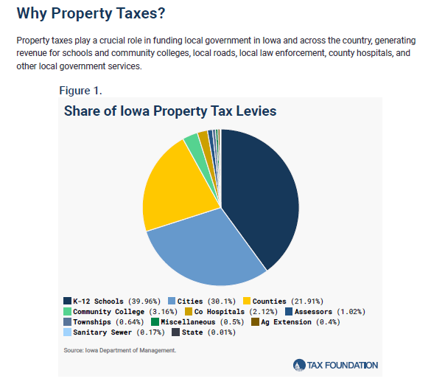
1. Property taxes do less economic harm than alternative ways to raise the same amount of revenue (more economically efficient than alternatives.) Property taxes are better for economic growth than are sales taxes or, especially, income taxes.
2. Property taxes have less of an effect on decision-making—including location decisions—than most other taxes, making them less distortionary than alternatives. There’s broad consensus it’s better to leave most individual and business decisions to the market/private realm.
3. Property taxes roughly align with the benefits that property owners receive from local services, making them more equitable than the alternatives.
4. Property taxes are highly transparent and correlate strongly with services that enhance property value and utility, making them unusually sensitive to local preferences on government size and scope.
“Nevertheless, taxes are virtually no one’s idea of a popular tax—unless you manage to only survey economists. It’s worth asking why public finance experts appreciate the property tax when so many taxpayers viscerally dislike it, as it can help inform options for property tax relief. The basic case for property taxes rests on the following premises, which are well-supported by the economic literature:”

Slide 83
Inflation vs. Property Tax Growth
Property taxes comprise roughly a quarter of Iowa’s total tax burden. Between 2018 and 2024, taxable assessed values have grown from $160 billion to $202 billion, an increase of nearly 27% over six years, or an average annual growth rate of approximately 4.44%. And the increase would have been much higher absent Iowa’s rollback system, which discounts the market value for tax purposes. Actual home prices in Iowa increased by 52% in nominal terms since 2018, while nationally, home prices soared by 69%.
Over the same period, taxes levied on these properties increased from $4.91 billion to $5.99 billion (not including special districts and assessments), a growth of 21.97%, at an average of 3.66%.
Notably, adjusting for inflation, this represents a decline in property tax collections: on an inflation-adjusted basis, Iowa would expect to have collected about $6.25 billion in 2024 to remain level with 2018. It did not. And if that were the end of the story, Iowans would have reason to cheer.
Tax growth varied widely, from negative in a few counties to nearly doubling in others, indicating diverse local policies or economic conditions.

Slide 84
Property taxes are good?
Property taxes also better align with benefits received than other broad-based taxes. Whereas federal and state taxes fund many programs that provide no direct benefit to those remitting the taxes (which is simply the reality, and not a judgment on the value of those expenditures), most local government expenditures— roads, schools, police, emergency services, parks, waste management, etc.—have a direct bearing on the quality of life of property owners, and often enhance the value of property.2
Businesses do not have children, but benefit from good schools, as do childless homeowners who not only enjoy the broad social benefits of a jurisdiction with a quality education system, but also see their home appreciate in value because it is in a good school district. The value of your home is a far better proxy for the benefits you receive from local government than your income or how much you consume.
1 See, e.g., Jens Arnold, Bert Brys, Christopher Heady, Åsa Johansson, Cyrille Schwellnus, and Laura Vartia, “Tax Policy for Economic Recovery and Growth,” Economic Journal 121:550 (2011): F59-F80; Santiago Acosta-Ormaechea and Jiae Yoo, “Tax Composition and Growth: A Broad Cross-Country Perspective,” IMF Working Paper, October 2012; Dagney Faulk, Nalitra Thaiprasert, and Michael Hicks, “The Economic Effects of Replacing the Property Tax with a Sales or Income Tax: A Computable General Equilibrium Approach,” Ball State University, Department of Economics, Working Papers, June 2010; and Stephen T. Mark, Therese J. McGuire, and Leslie E. Papke, “The Influence of Taxes on Employment and Population Growth: Evidence From the Washington, D.C. Metropolitan Area,” National Tax Journal 53:1 (2000): 119.
2 See generally, Joan Youngman, A Good Tax: Legal and Policy Issues for the Property Tax in the United States (Cambridge, MA: Lincoln Institute of Land Policy, 2016).

Slide 85
Takeaways:
A well-designed levy limit shouldn’t force tax cuts on local governments, but it shouldn’t prevent them, either. To encourage localities not to treat increases as use-it-or-lose-it, moreover (and therefore always use it), lawmakers may wish to allow some portion of unused increases to be “banked.”
“Lawmakers may want to recession-proof their levy limits by ensuring that a temporary decline in property values does not suppress tax revenues even after the housing market has recovered. . . In other states, levy limits tend to look back to the prior year’s allowable limit, not prior year tax collections as such.”
Simple and reasonable caps – CPI + #%
Voters should be allowed to authorize higher levies
Transparency – Iowa needs a better taxpayer statement

Slide 86
%
MOW MOW MOW
Maps of the Week
Total PPEL Tax Rate FY 2024
State Cell Phone Restrictions

Slide 87
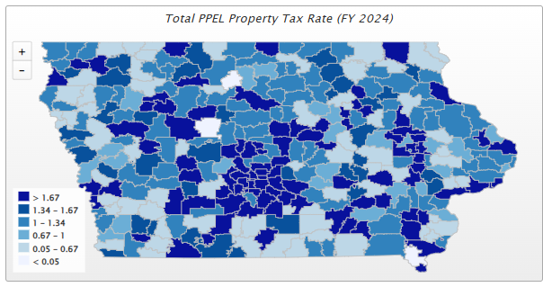

Slide 88
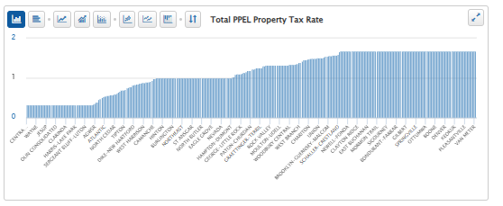
Those below max would have potential of voter approval to increase rate to new maximum (as proposed)
70% reduction in PPEL:
  $1.67 lowered to $1.18
  $1.00 lowered to $0.70
  $0.33 lowered to $0.23

Slide 89
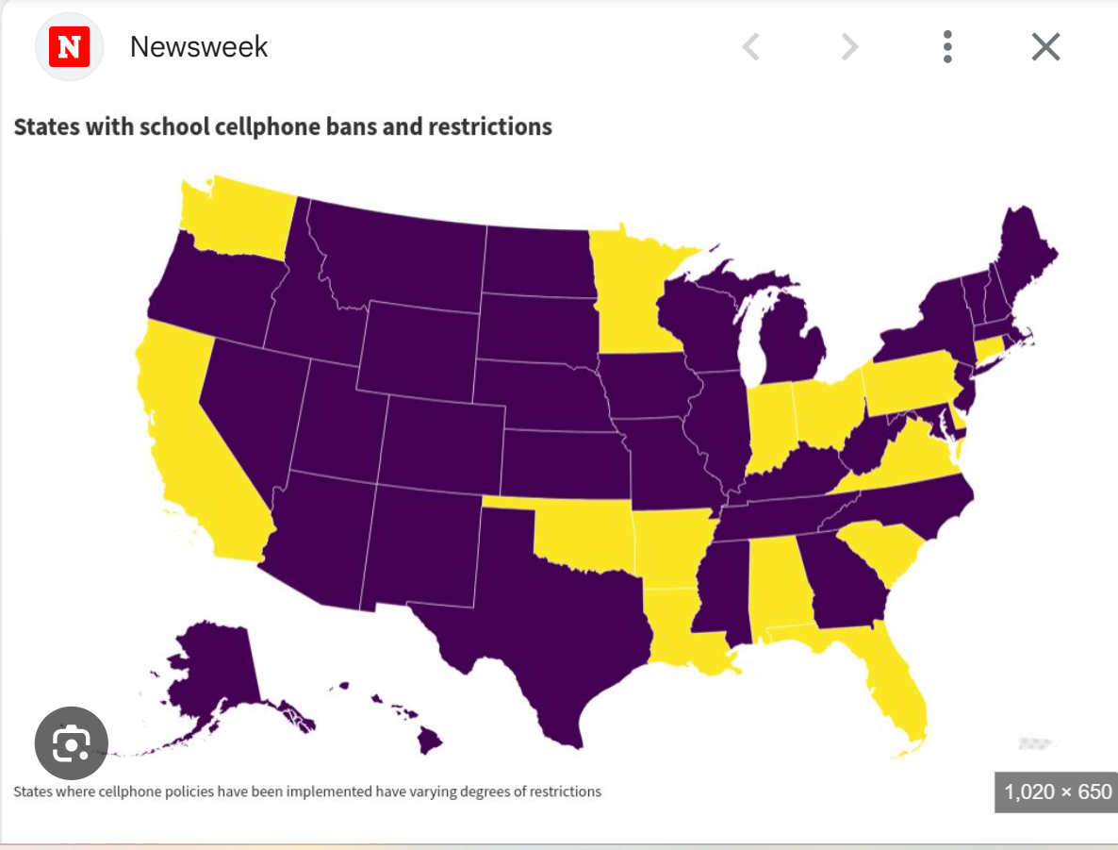
Sept. 2024, 15 states
https://www.newsweek.com/map-shows-states-school-cellphone-bans-1958547

Slide 90
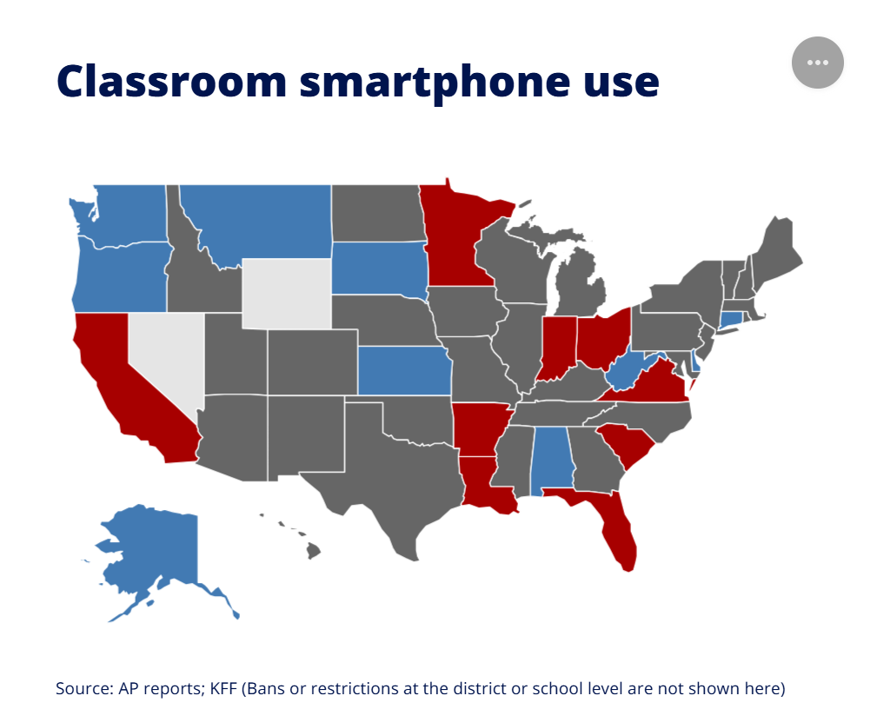
Fox reports on May 21, 2025 https://www.livenowfox.com/news/states-banned-cell-phones-schools
State Ban
State Restriction
Pilot Project
No State Law

Slide 91


Pending Dates and Deadlines
        DE Deadlines Calendar (tab on DE home page) and from the DE’s Superintendent & Ed Leader Update and School Business Alert
Date | Deadline
June 15 | 30-day Deadline for Governor’s Signature of 2025 Legislation
June 16 | Private school transportation reimbursement is certified by the DE and starts the process to reimburse the districts
June 24 | Spring SRI certification deadline
June 25 | Continuum care grant application deadline due to DAS. https://www.iowagrants.gov/viewStorefrontOpportunity.do?OIDString=1742847843596%7COpportunity
June 30 | Last day to pay Post Secondary Enrollment Options tuition to eligible institutions USDA Community Eligibility Provision “Intent to implement” due (check SBA) Spring Basic Educational Data Survey Due
July 1 | Education Support Personnel Data due to DE for district to qualify for part of $14M supplemental pay
July 1 | Due Date for Special Education contract with AEA HAPPY NEW FISCAL YEAR!
https://educate.iowa.gov/pk-12/accreditation-program-approval/notice-deadline-calendar

Slide 92

https://www.nytimes.com/2025/05/31/dining/pickle-lemonade.html
Pickle Lemonade?
Pickle Lemonade!
7 large organic lemons (see Tip), at room temperature
⅔ cup granulated sugar
3 cups chilled, filtered water
1 to 1¼ cups dill pickle juice (see Tip), plus pickle spears for garnish
Ice, for serving
Tips Because conventional lemons are often sprayed with pesticides, this recipe calls for organic lemons. If using conventional lemons, be sure to wash the fruit thoroughly.
When choosing pickles for this recipe, look for refrigerated dill-flavored ones like Grillo’s, for brighter flavors. Sweet bread and butter pickles, or other pickles that use too much garlic or other seasonings, might overpower the balance of acidity (lemon), sweetness (sugar) and saltiness (pickle brine). Depending on your pickle choice, you may need to adjust the sugar and lemon ratios.
Step 1:Thinly slice 1 lemon, discard the seeds, and set aside for garnish. Roll the remaining lemons firmly on counter top before juicing in order to extract as much juice as possible. Quarter the lemons, then squeeze enough to get 1 cup of lemon juice. Add the squeezed lemon peels and any unsqueezed lemon quarters to a large jar, such as an 8-cup Mason jar, a wide pitcher or even a large bowl.
Step 2: Add sugar to the lemon peel pieces in the jar and, using a wooden spoon or a muddler, muddle together until the sugar has mostly dissolved, 1 to 2 minutes.
Step 3: Add lemon juice to the jar, cover and shake vigorously (or stir, if your vessel doesn’t have a lid) to ensure the sugar dissolves. Add water and then pickle juice to taste. Shake or stir to mix; strain using a fine-mesh strainer. (To store, refrigerate up to 3 days.)
Step 4: To serve, pour into glasses over plenty of ice. Garnish with a lemon slice and a pickle spear.

Slide 93




Larry Sigel
Cell: 515-490-9951
larry@iowaschoolfinance.com
Jen Albers
515-251-5970 ext. 4
jen@iowaschoolfinance.com
Ken Sturgis
515-251-5970 ext. 6
ken@iowaschoolfinance.com
Margaret Buckton
515-201-3755
margaret@iowaschoolfinance.com
ISFIS, Inc., 1201 63rd Street, Des Moines, IA, 50311, (515) 251-5970, www.IowaSchoolFinance.com

