Slide 1

December 2, 2021
Special Topic Webinar
Best Practices in Search, Hire and Support of New Administrators
Margaret Buckton ISFIS
Trent Grundmeyer, Grundmeyer Leader Search
© Iowa School Finance Information Services, 2021

Slide 2

Grundmeyer Leader Services
Hiring Best Practices

Slide 3
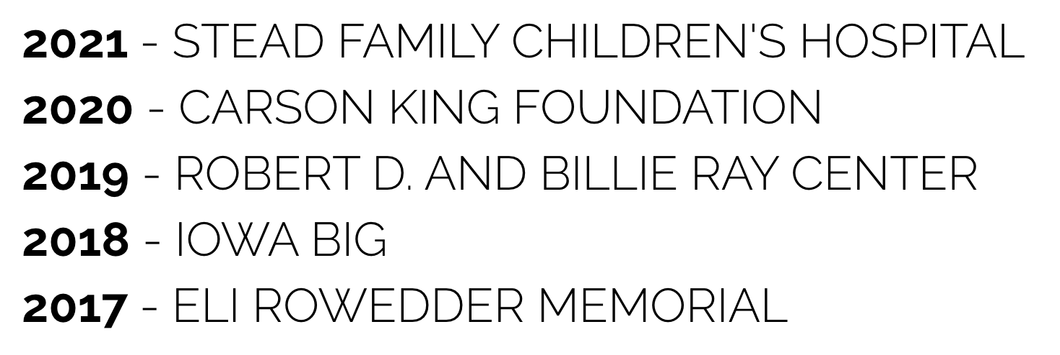
Giving back to education
"Thank you so much for the extremely generous donation! We appreciate the support as we continue to help serve those in need around the state."
-Carson King

Slide 4
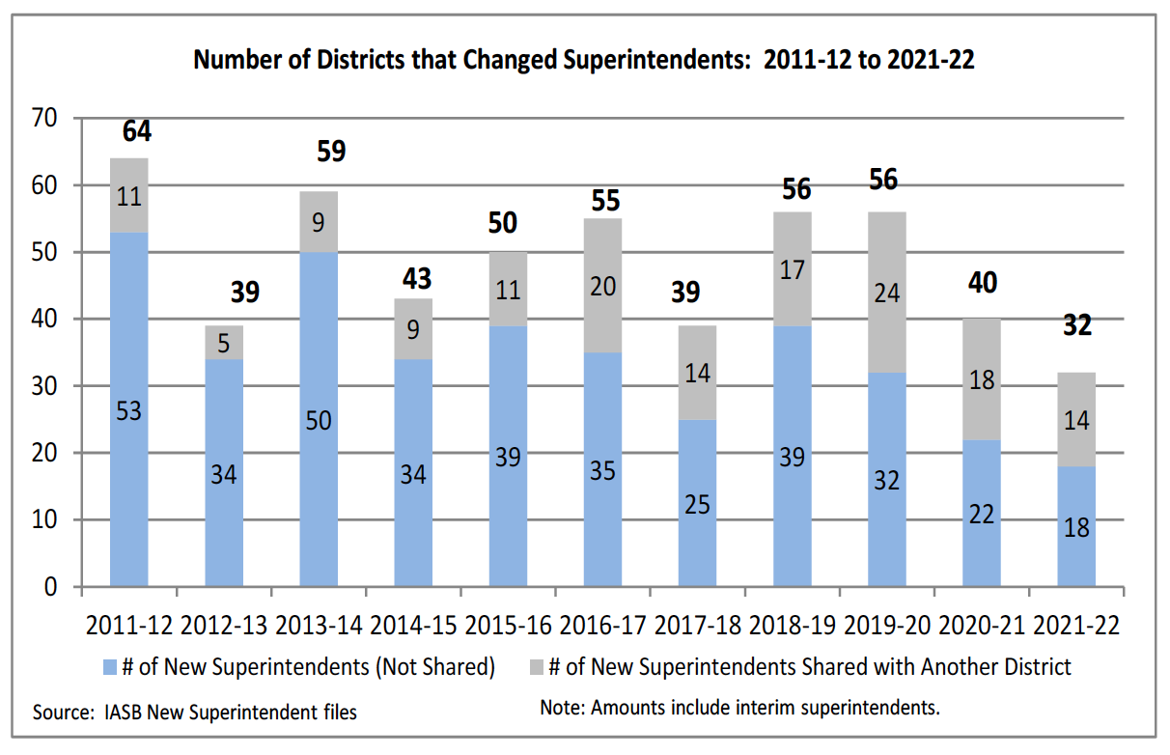

Slide 5

Lots of opportunities with GLS
Active
Searches:

Slide 6

Out of state hires
8%

Slide 7

Female candidates hired
31%

Slide 8
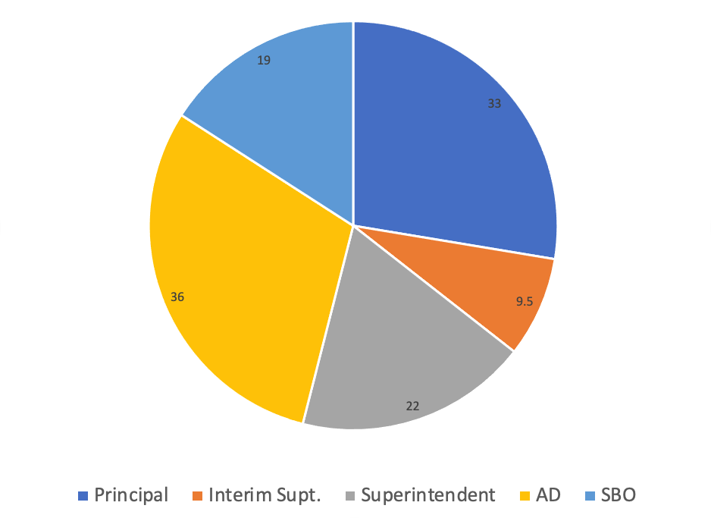
Average Number of Apps

Slide 9
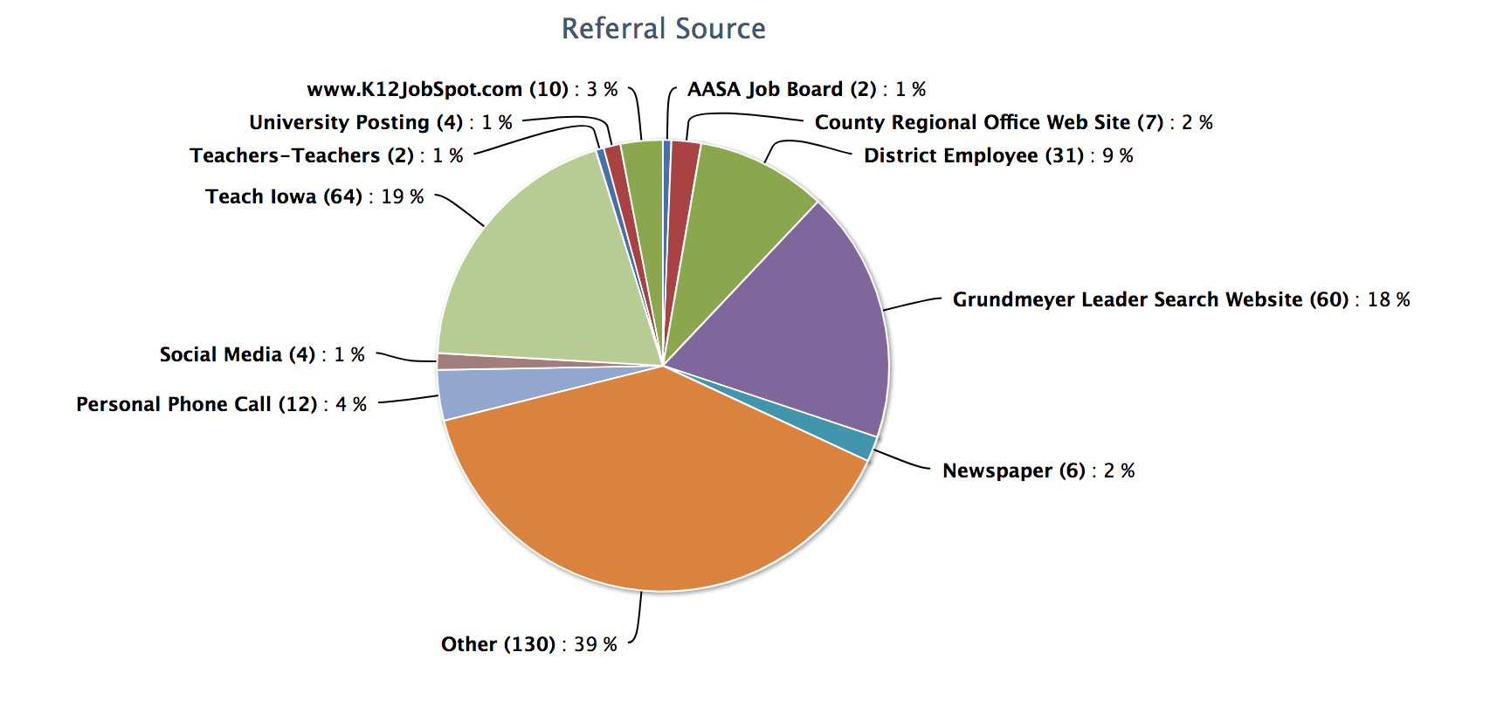
Referral Sources Overview

Slide 10
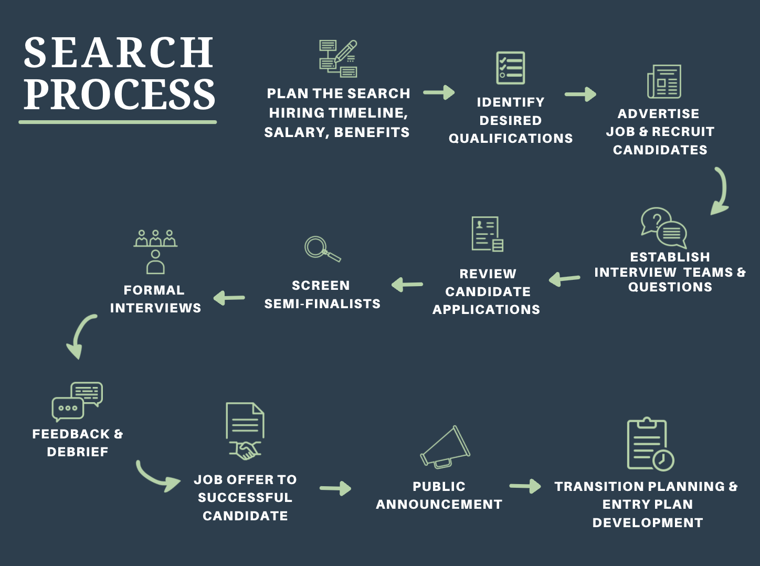

Slide 11
Considering a Job…
Your family
Your current situation/satisfaction
Your skills, experiences and qualifications
The opportunity:
  Job posting
  Job description
  District finances (IASB/ISFIS)
  District website
  Iowa Report Card
  Personal calls and homework

Slide 12
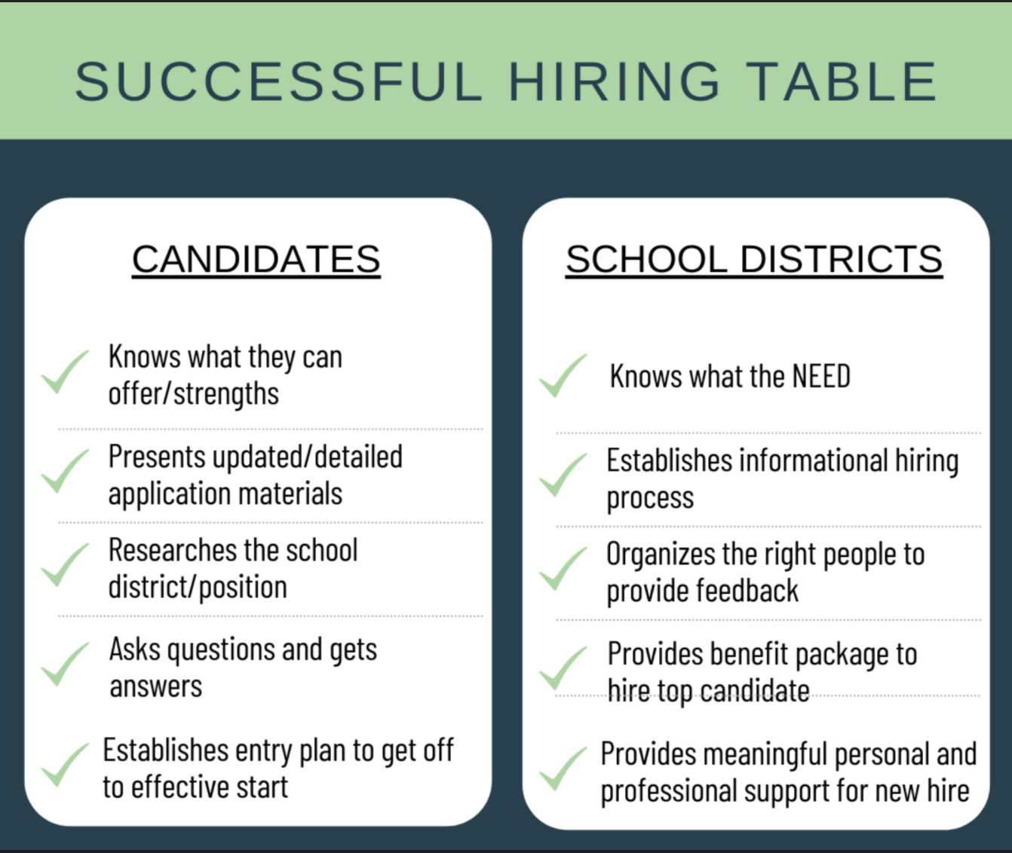

Slide 13
PLAN
1
Solidify timeline for the hire
Narrow the benefits package (data provided)
Send out stakeholder survey for general feedback
Identify “desired qualifications” (FIT) for the position
Solidify the formal interview process

Slide 14





STAKEHOLDER SURVEY REPORT

Slide 15
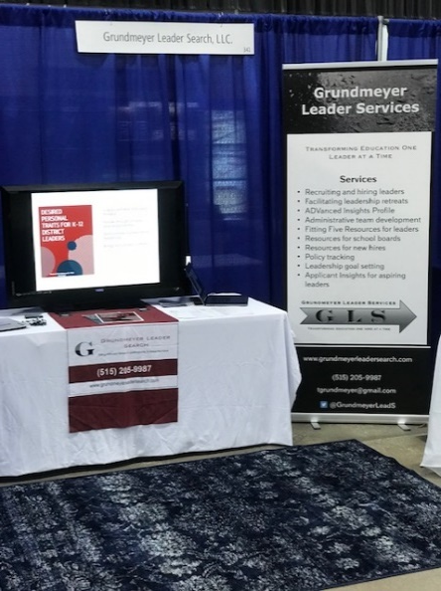
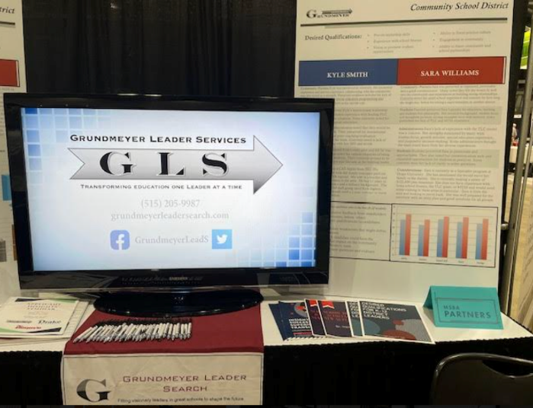
RECRUIT
2
www.teachiowa.gov
Superintendent Programs
National Posting Boards
  K-12 Job Spot
  Handshake
  AASA Job Bulletin
SAI Contacts
Grundmeyer Leader Search Website
GLS candidate pools
Social Media
Personal calls and emails
Notes:
Where have you posted the position? How have you recruited for the position?

Slide 16
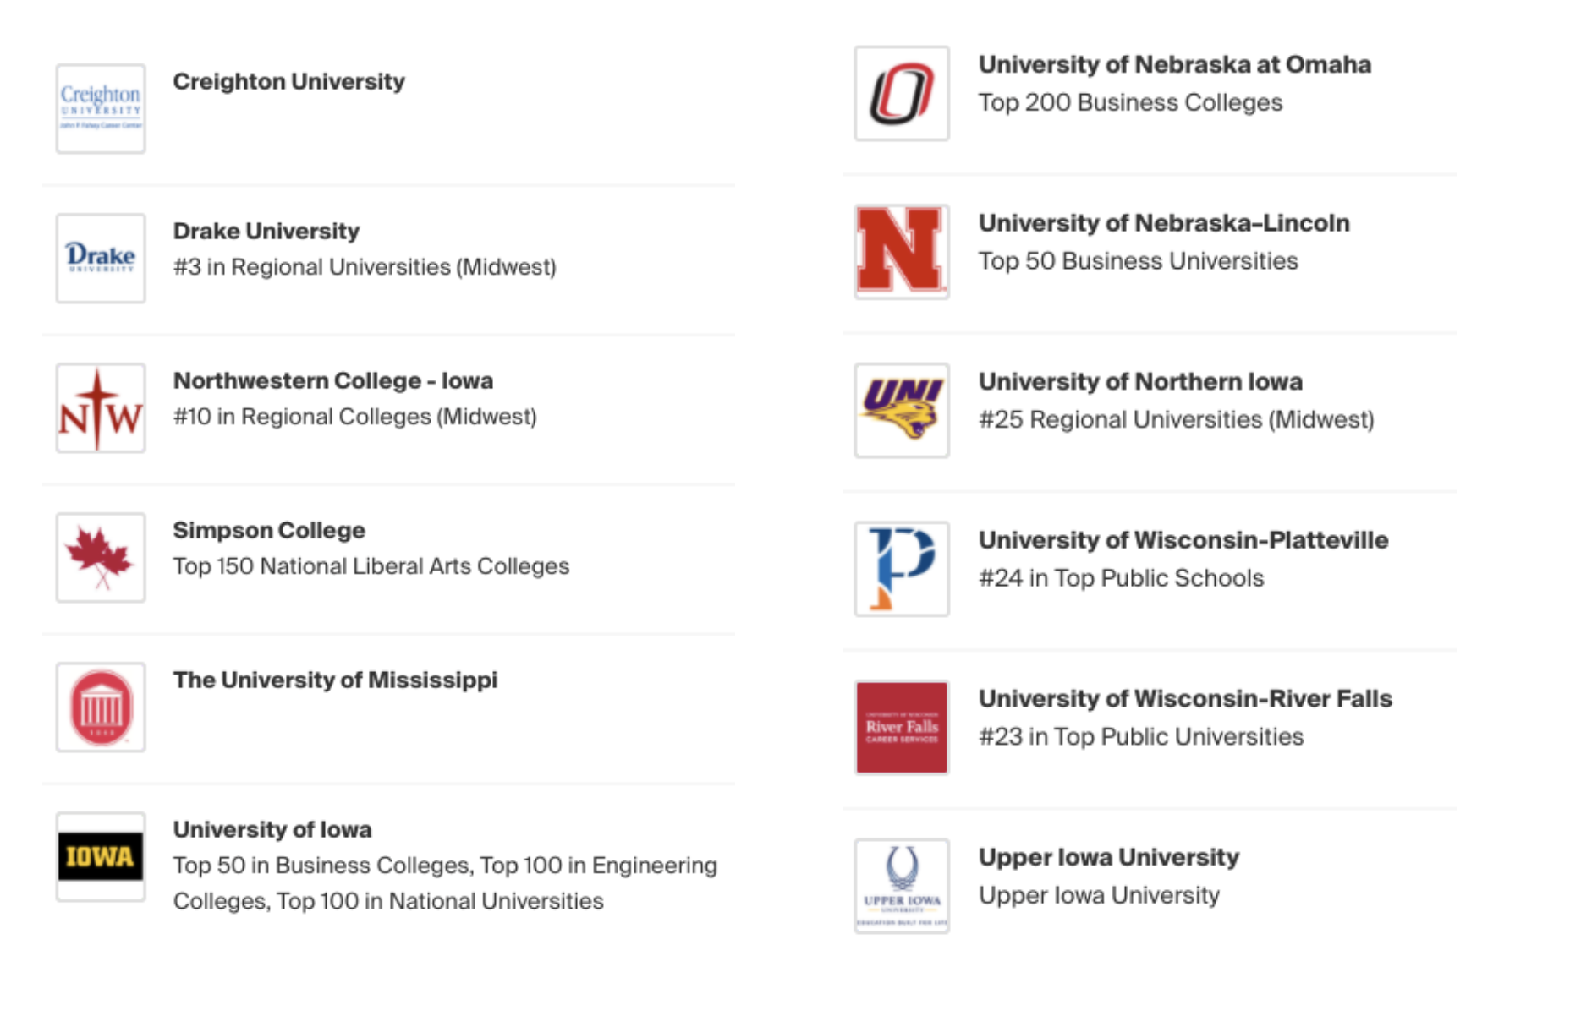
Recruiting a Diverse Candidate Pool

Slide 17

Candidate Information to the School Board
Resume
Cover Letter
EMAIL
Candidate
Applications
Candidate
Narratives
Disclosures
EMAIL
Social Media
State Licensure
MEETING
Reference
Summaries

Slide 18
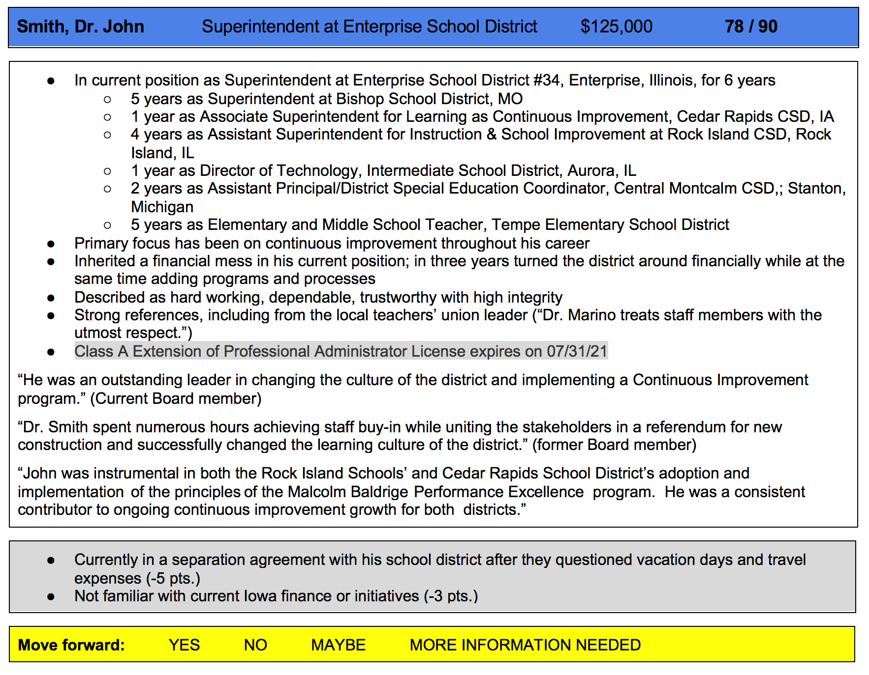
Candidate Feedback & Ranking

Slide 19

Google & Social Media Check

Slide 20
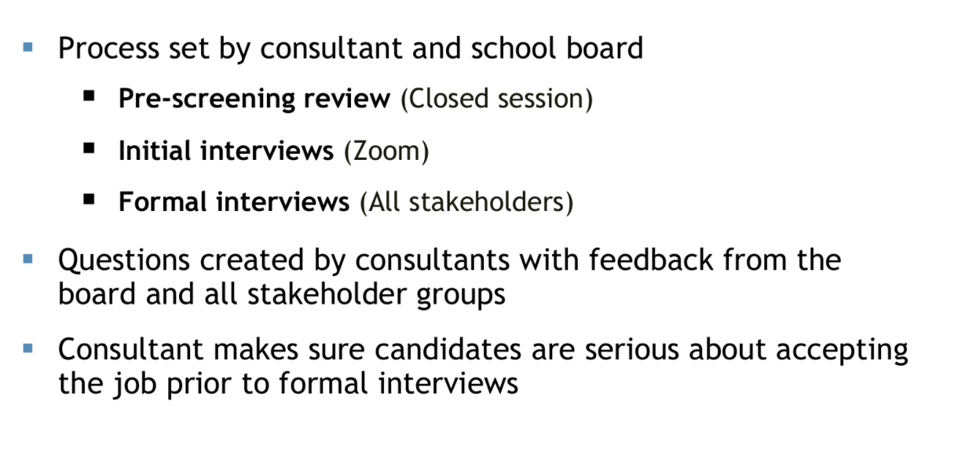
Screen
3
Notes:
What process do you want to use to get buy-in and feedback in the hiring process?

Slide 21
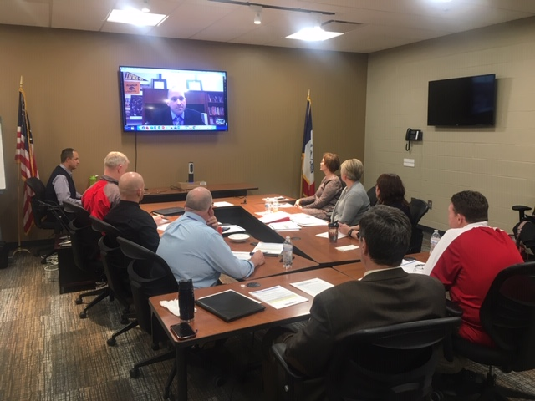

Slide 22
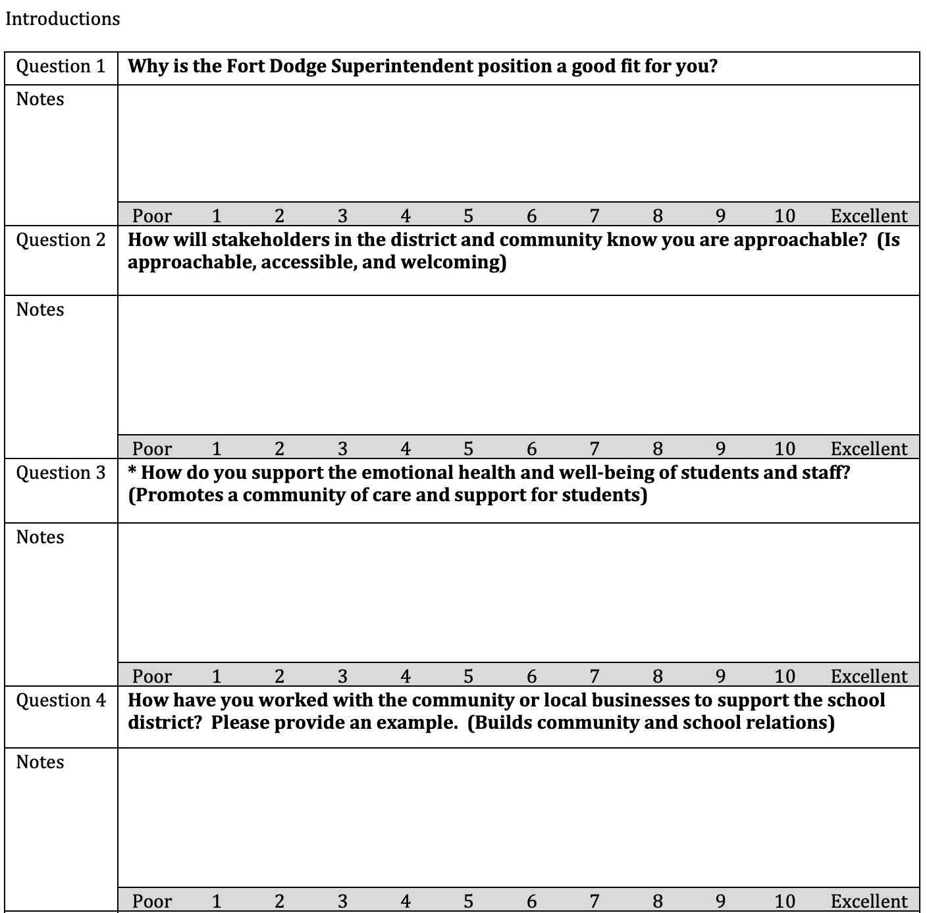
Screening Interview
Process

Slide 23
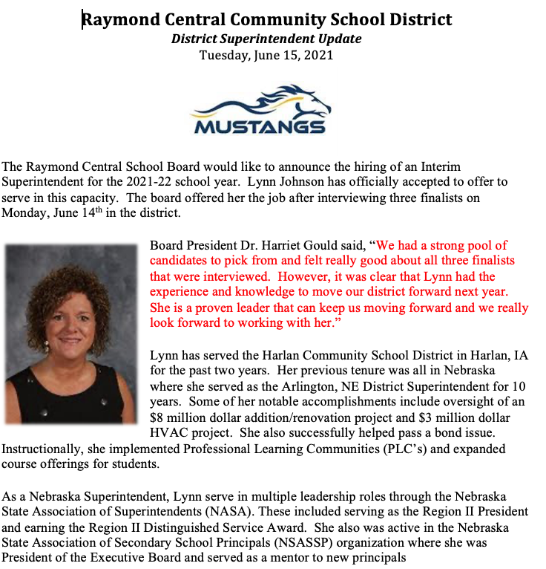
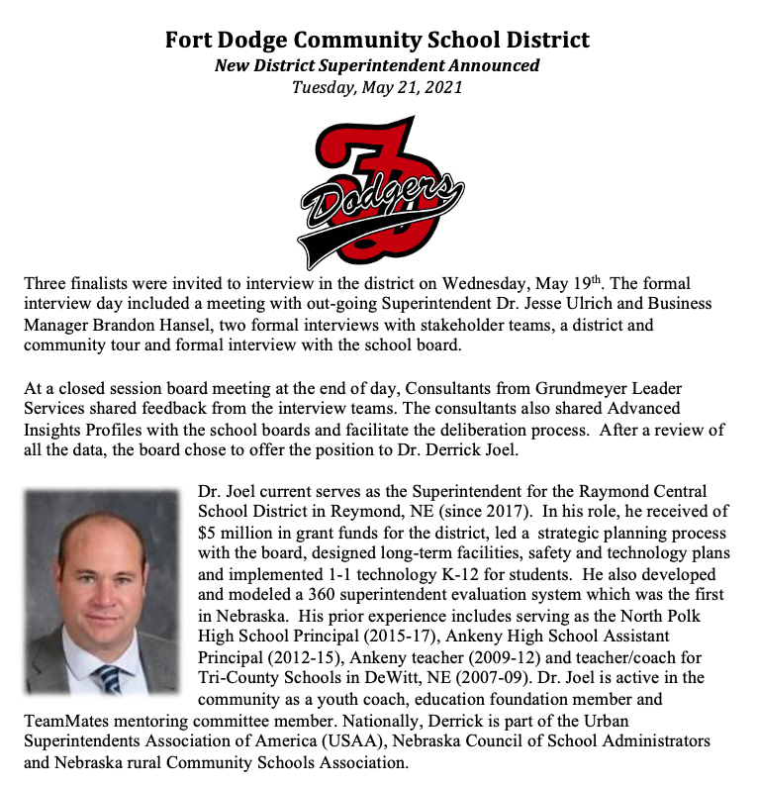
Finalist Announcement

Slide 24
Hire
4
Consider feedback from stakeholder groups
Negotiations between board president and candidate or board president to candidate through consultant
Background check and board approval conducted before announcement is made.
Announcement will be timely, unified, and consistent to all outlets

Slide 25
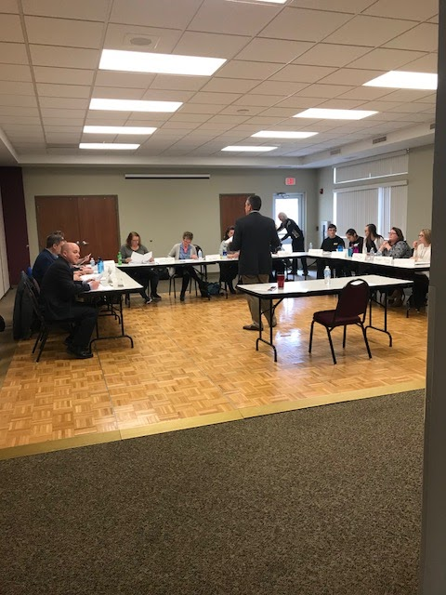
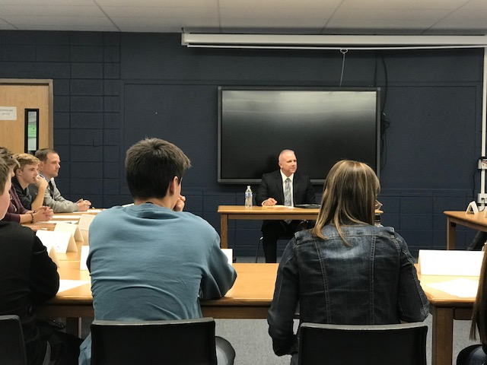
Mixed Interviews Teams
We facilitate the day, so the board can focus on the candidates!

Slide 26
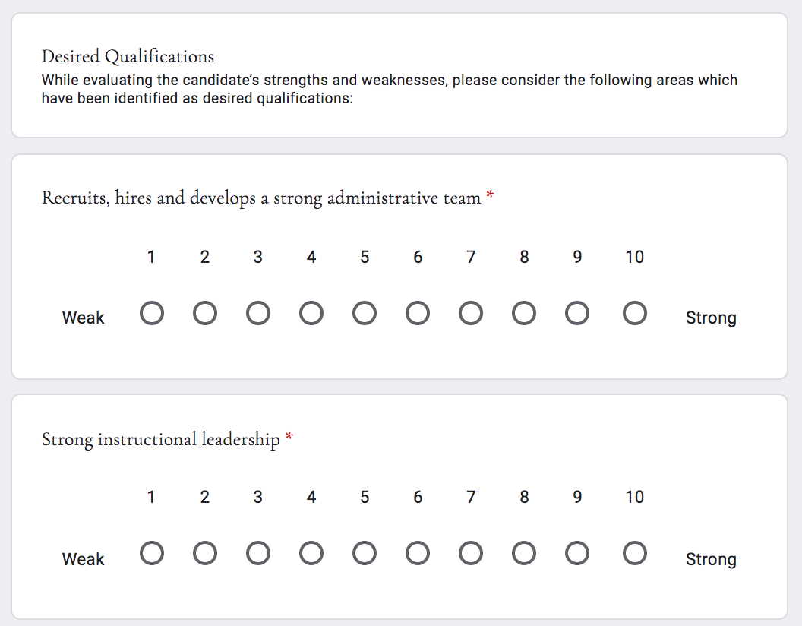

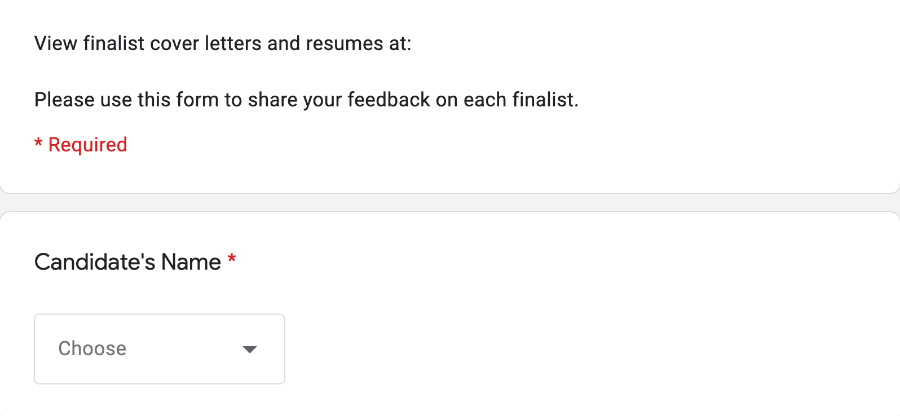
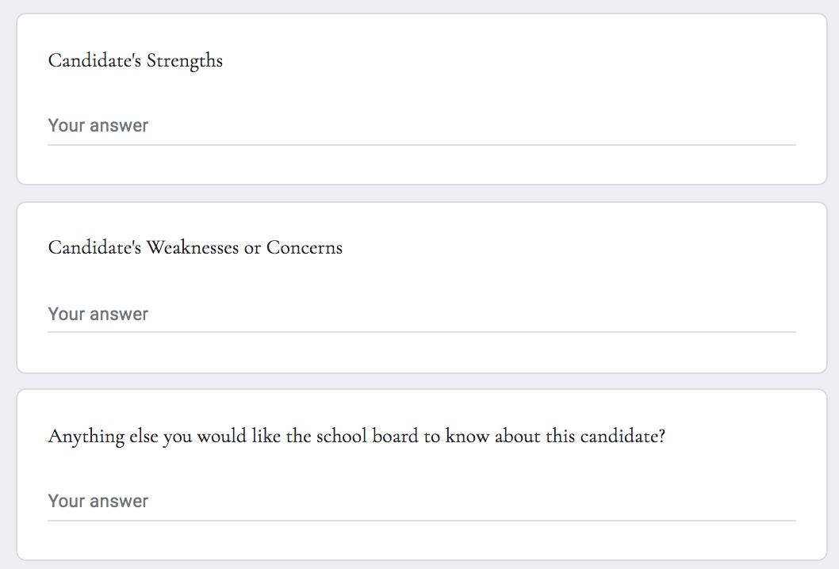
Interview teams provide feedback to the board

Slide 27
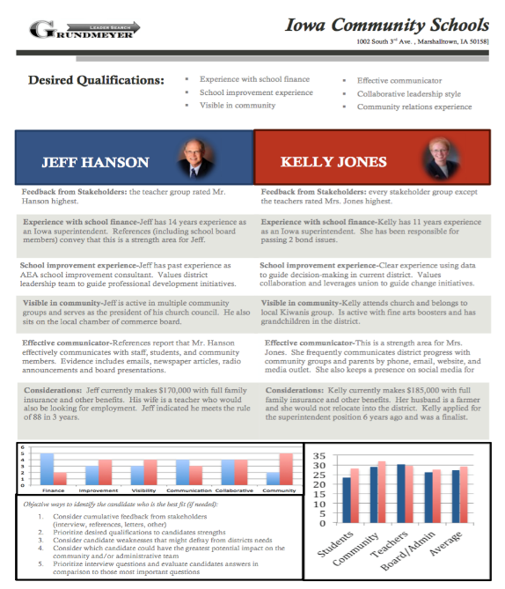
The Art of Hiring

Slide 28
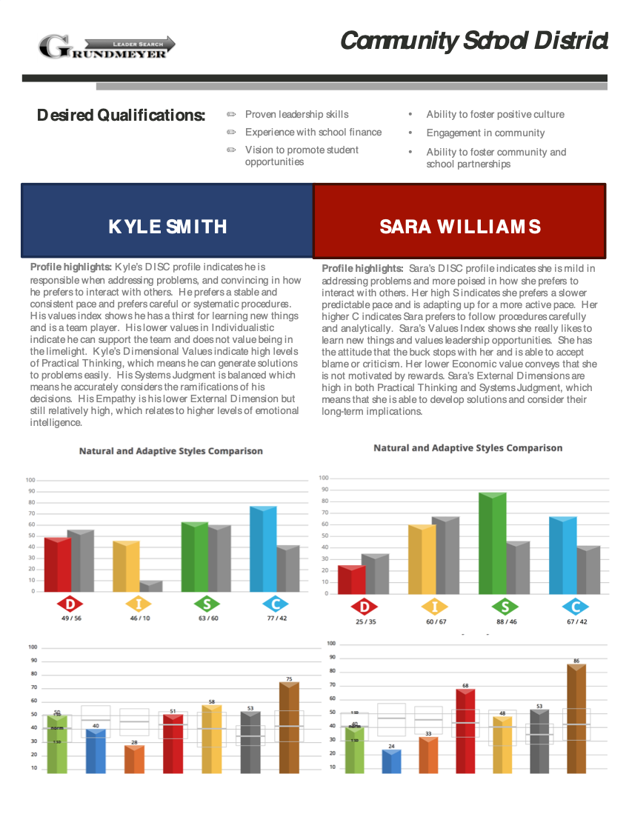
The Science of Hiring

Slide 29
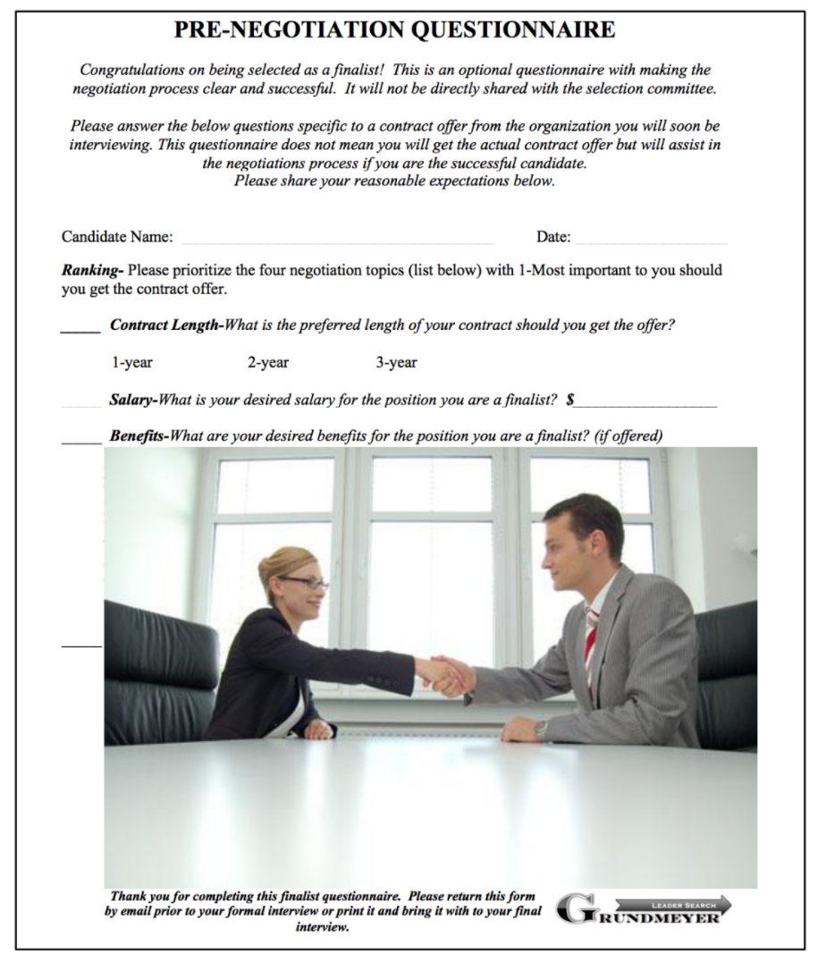

Contract
Negotiations

Slide 30
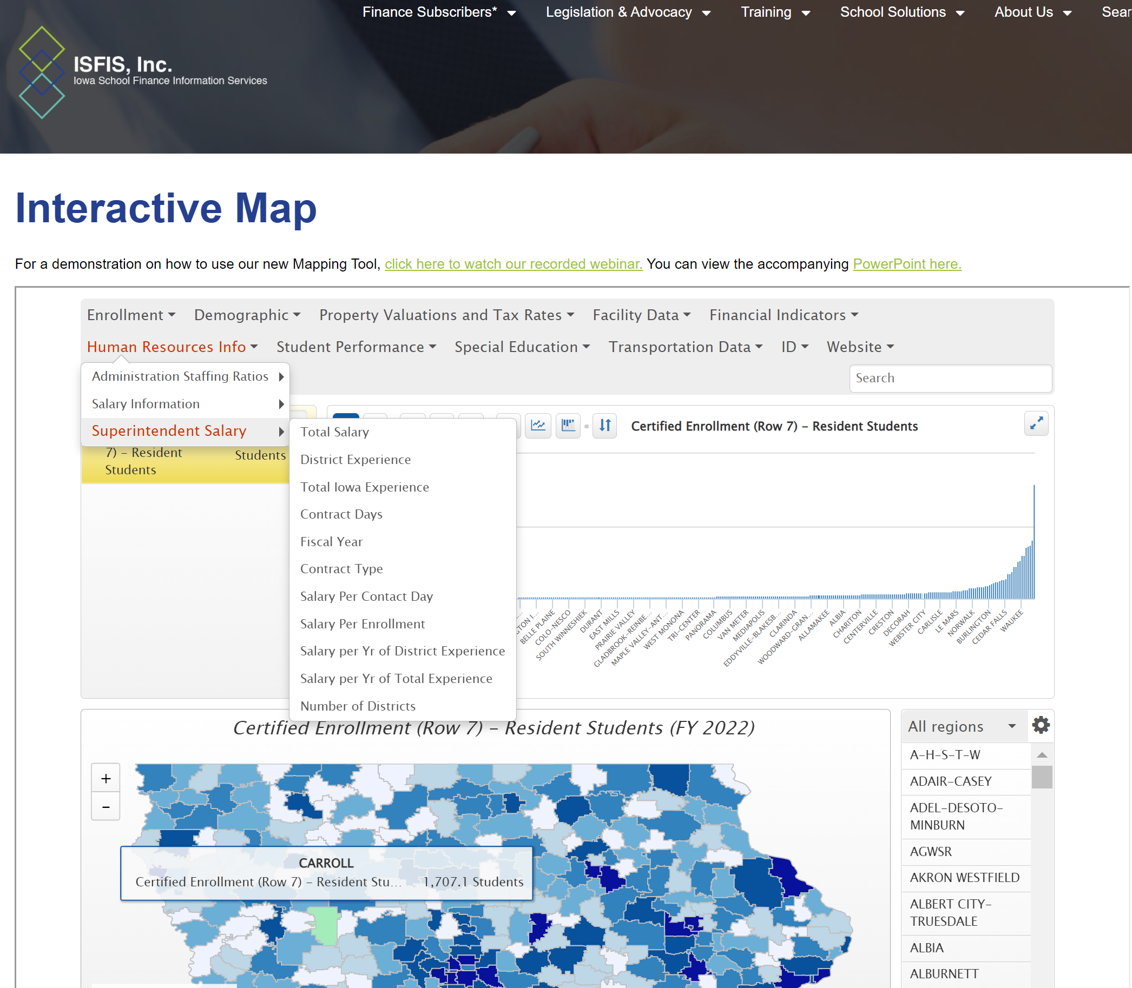
Comparison Data: Admin Salaries Plus Plus

Slide 31
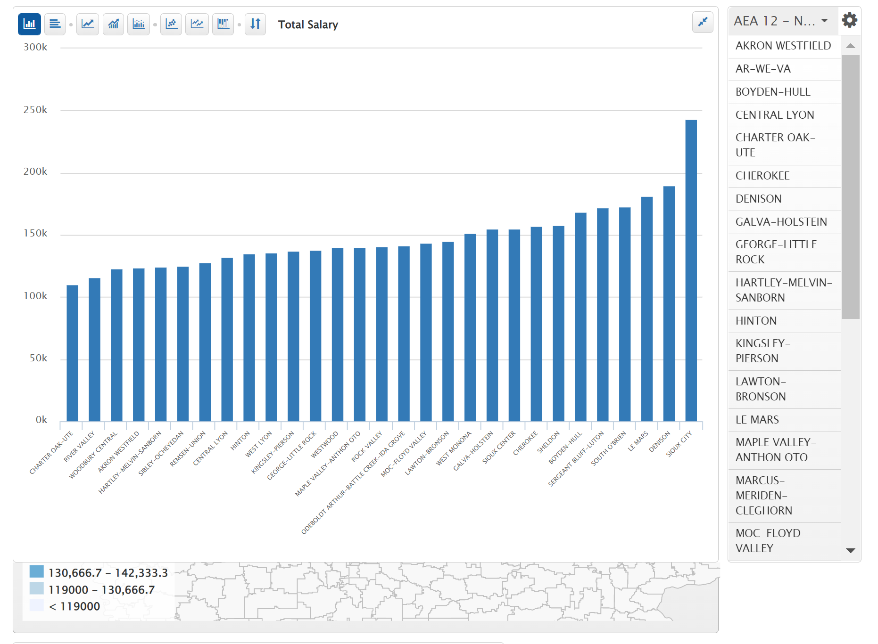
Superintendent Total Salary
NW AEA

Slide 32
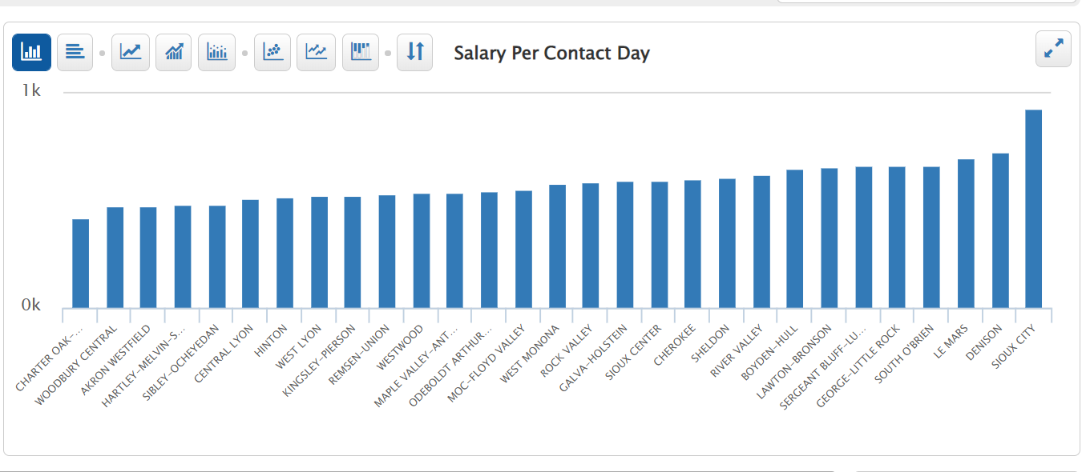
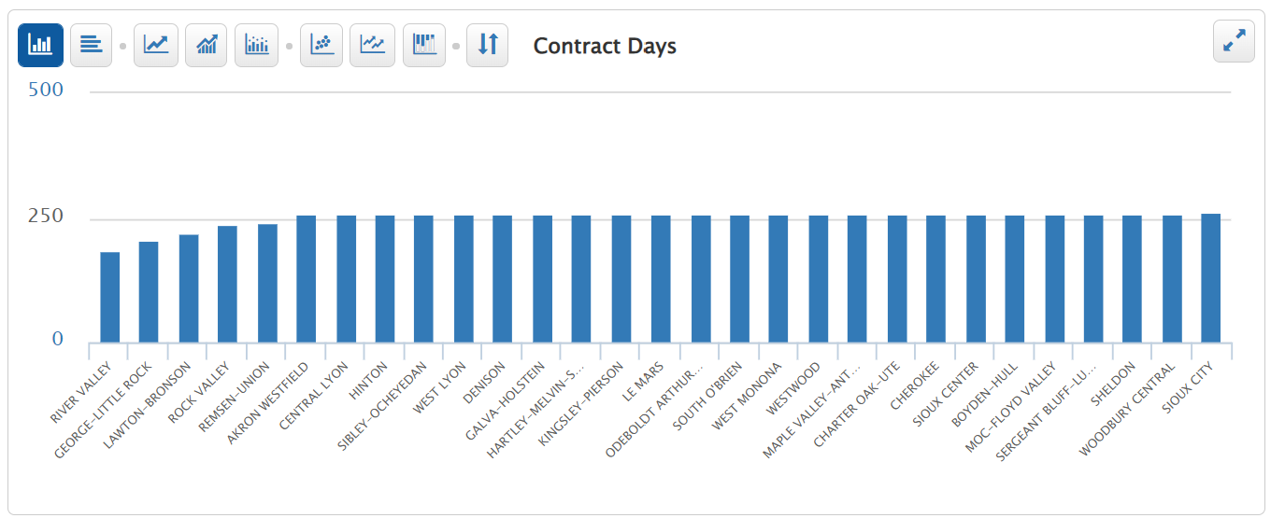

Slide 33
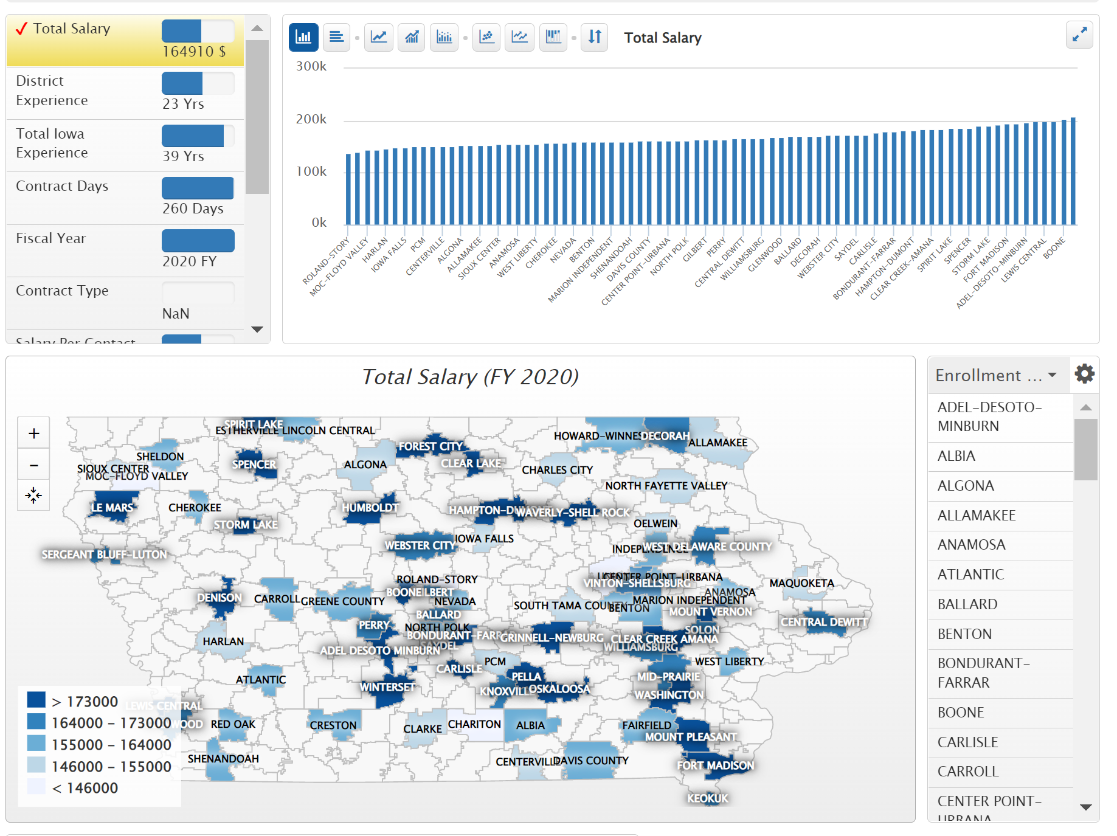
Enrollment Group 1,000-2,499

Slide 34
Prepare
5
Consultants take feedback from stakeholders in working with new superintendent to create an entry plan.
The board provides priorities for the new superintendent.
An entry plan ensures the new superintendent gets off to a good start in their new district.
The entry plan can be used to set first year goals for your new leader.

Slide 35
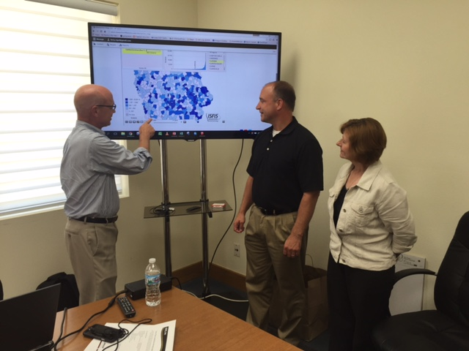

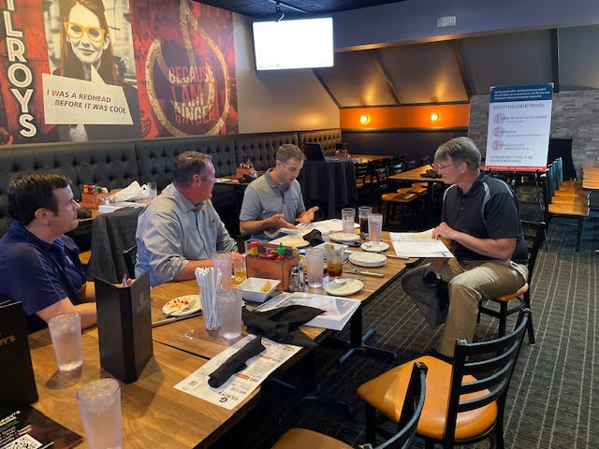

GLS preparing you for success

Slide 36


Slide 37
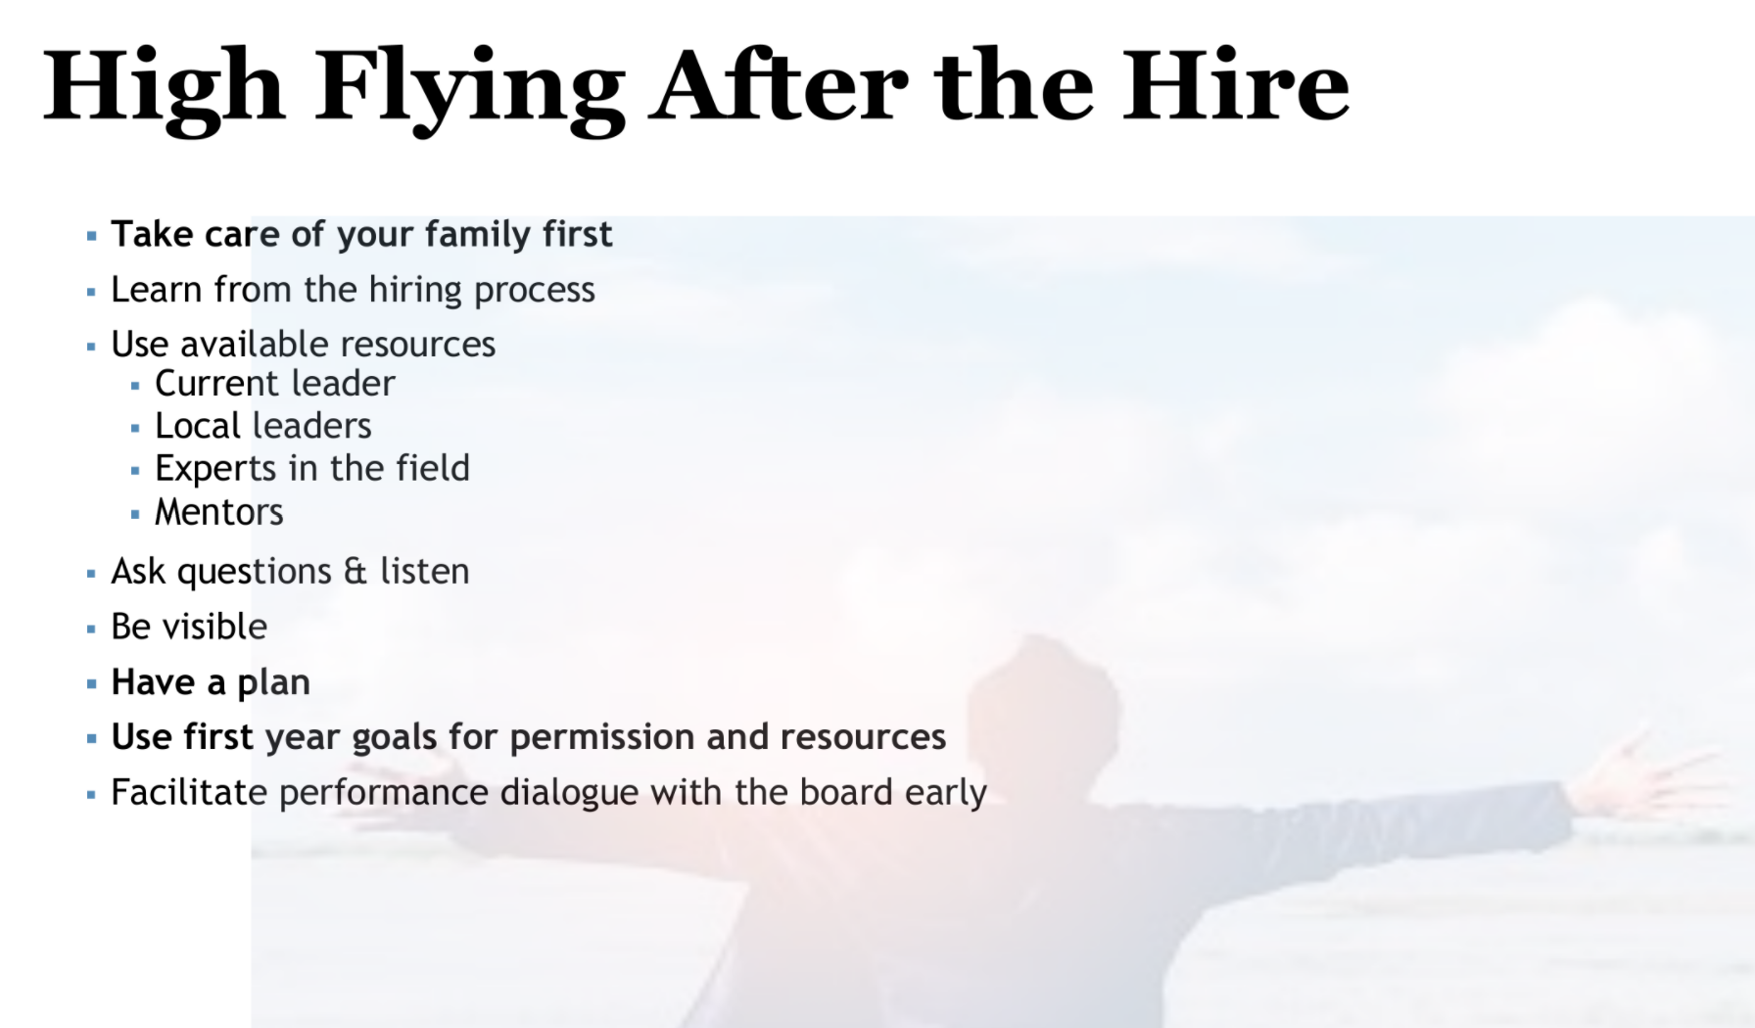

Slide 38
GUARANTEE OF SERVICES
In the event that a successful candidate cannot be hired for unforeseen reasons or because one of the finalists turns down an offer, the search firm will continue the search for up to 2 calendar years or until a successful hire is made without any additional costs.
- Grundmeyer Leader Services

Slide 39

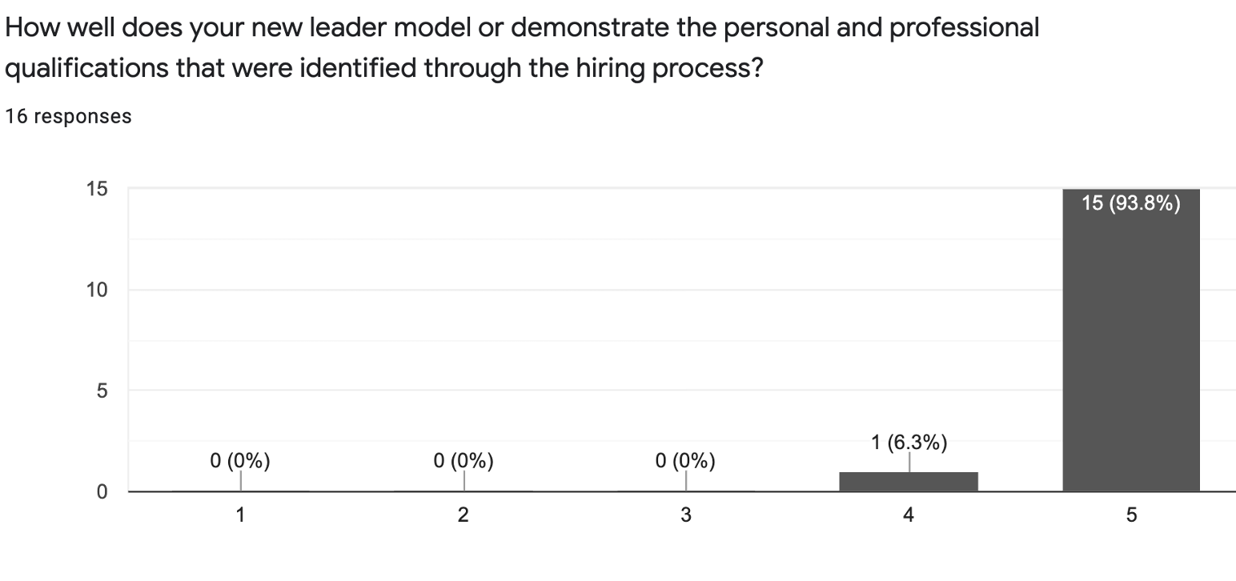

Slide 40
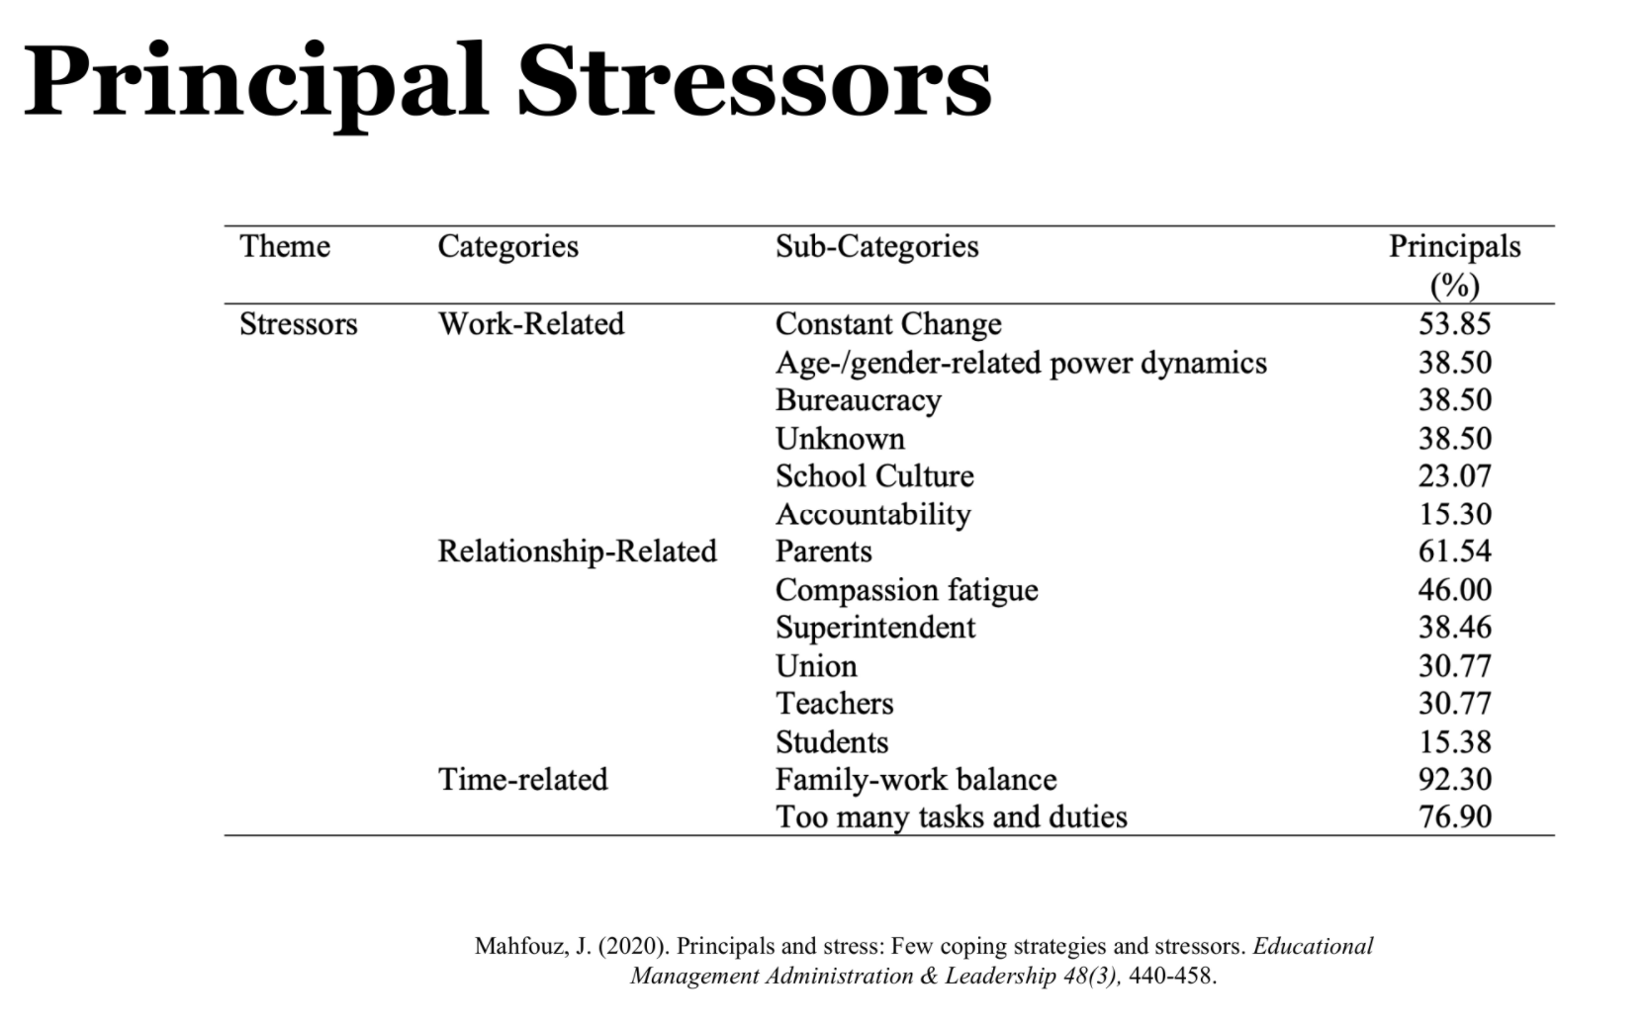

Slide 41
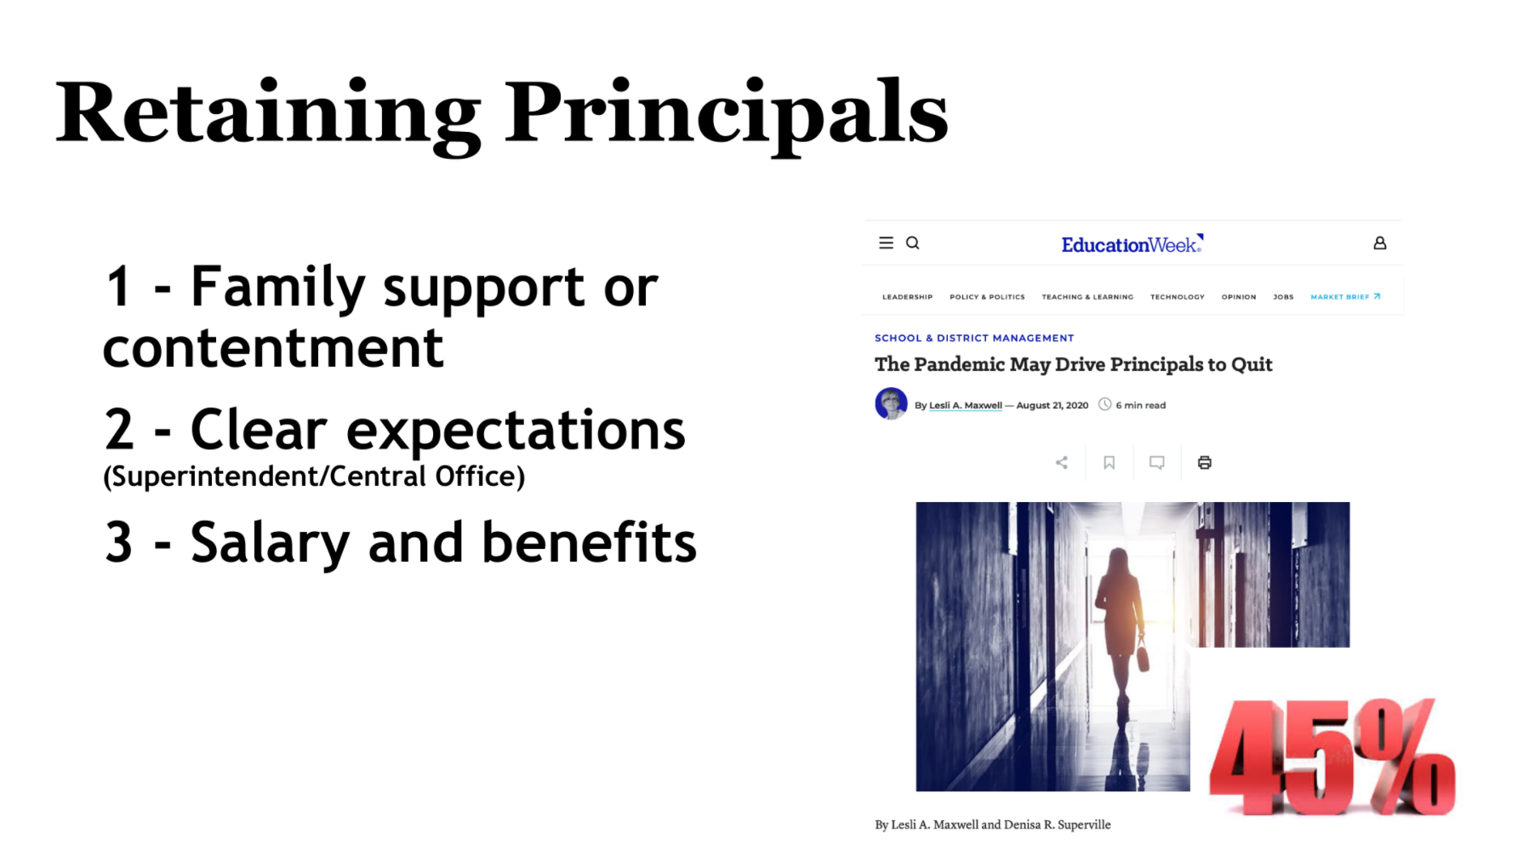

Slide 42
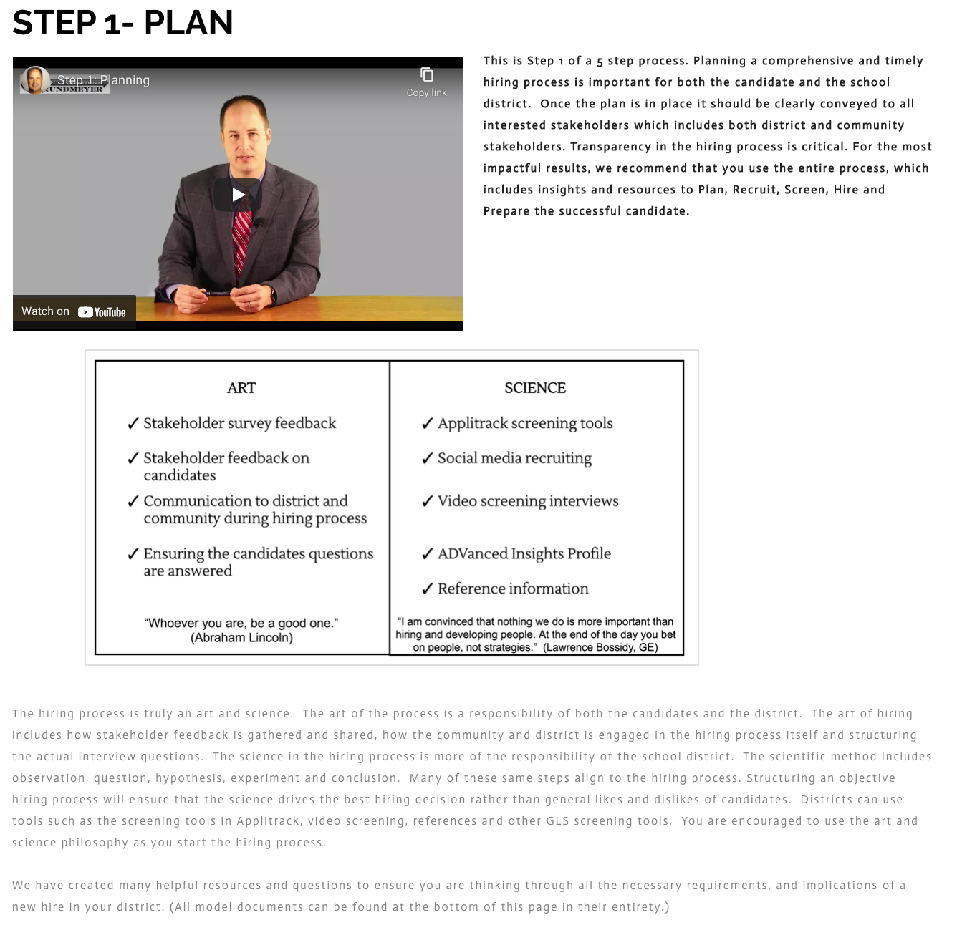
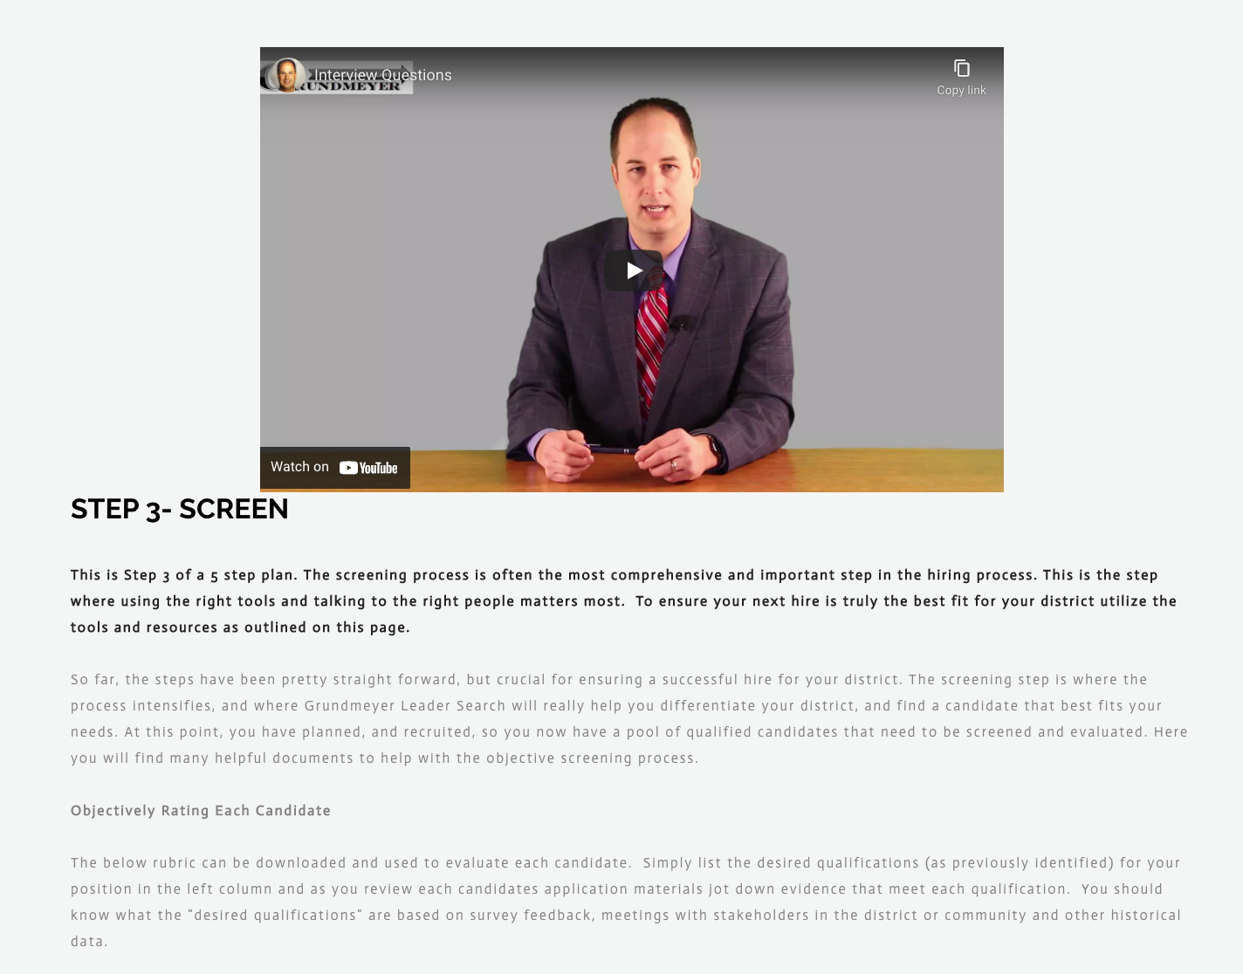

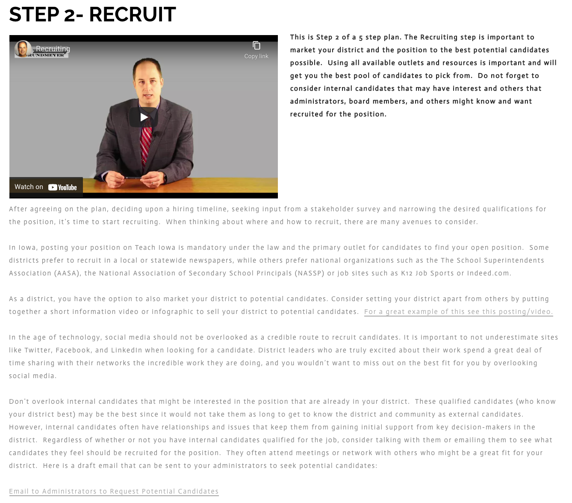
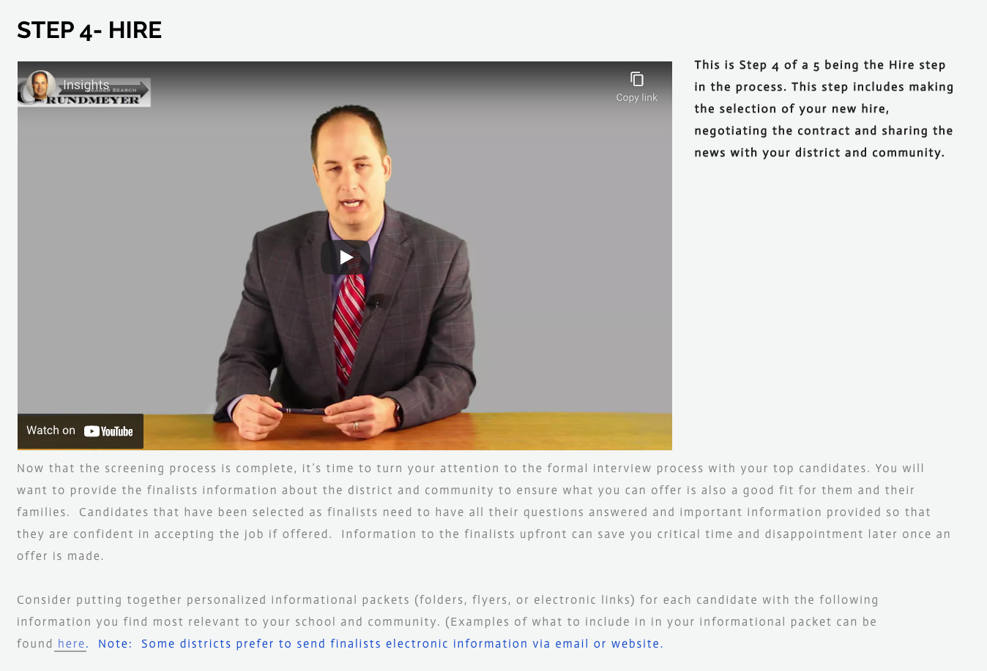

Slide 43

@GrundmeyerLeadS

Slide 44
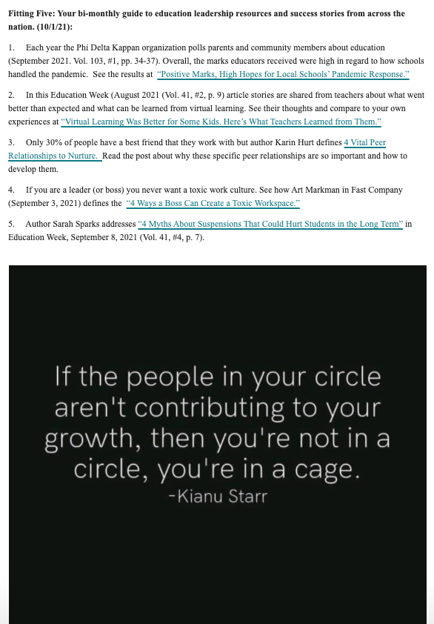
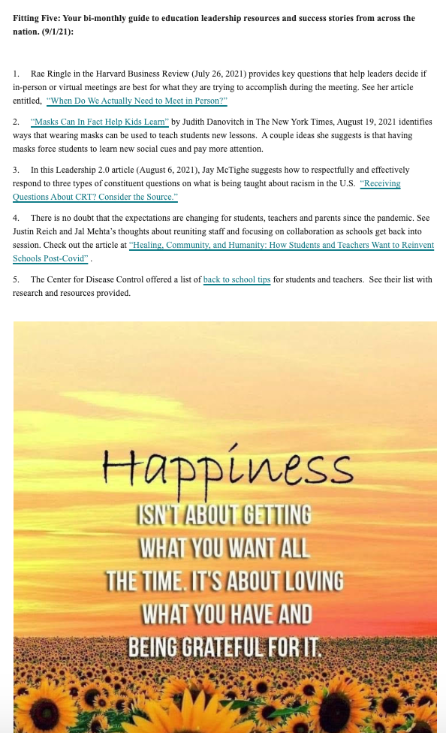
GLS Fitting 5 Resources

Slide 45

December January
July

Slide 46
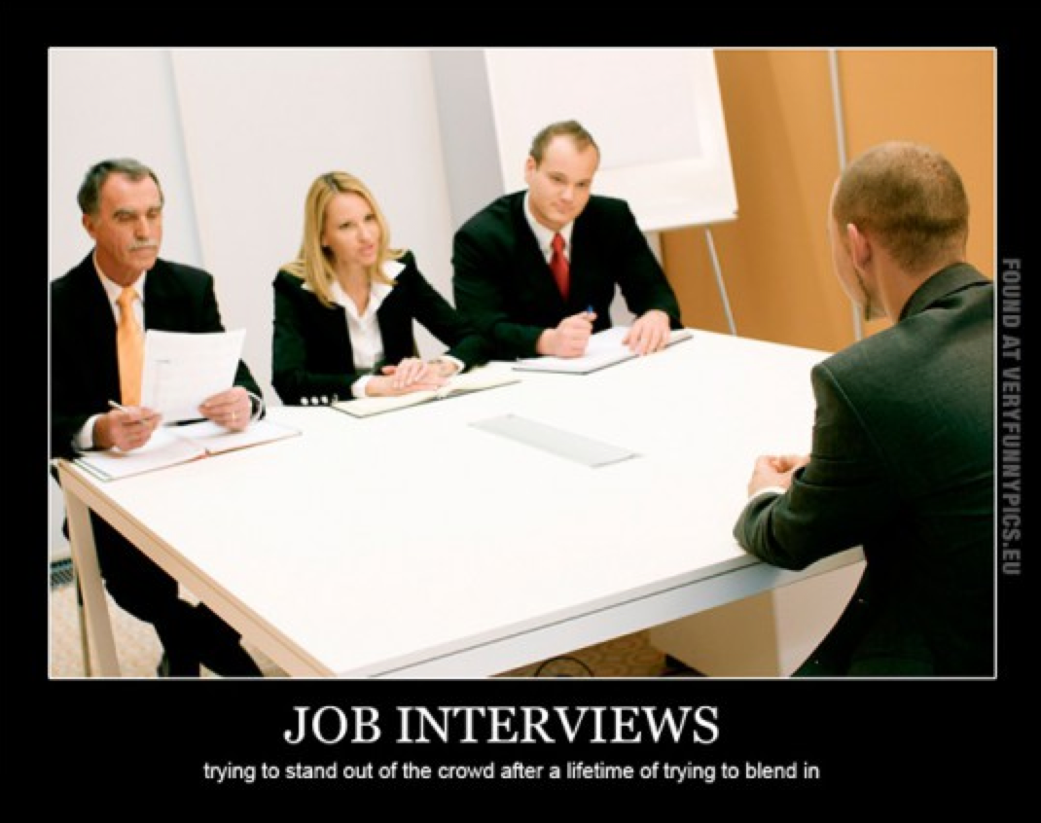

Slide 47
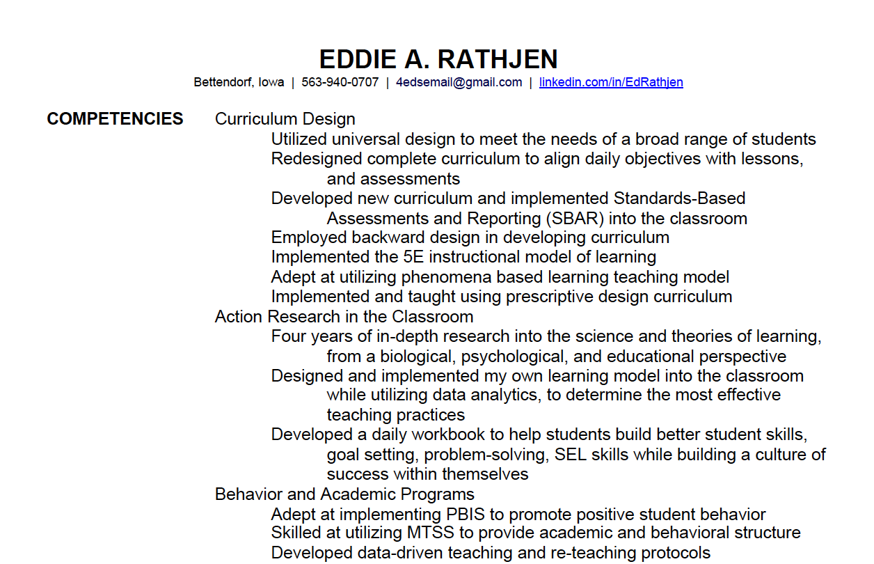
Sample resume that improved!

Slide 48
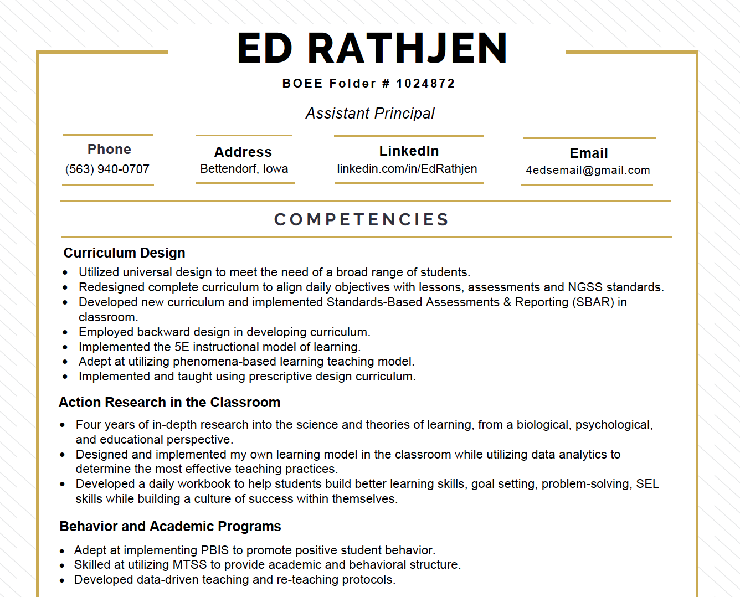

Slide 49


Slide 50

Questions?
Do not hesitate to contact us if you have any questions or comments!
Iowa School Finance Information Services
1201 63rd Street
Des Moines, IA 50311
Office: 515-251-5970
www.iowaschoolfinance.com
Larry Sigel, Partner
larry.sigel@gmail.com
515-490-9951 (cell)
© ISFIS 2021
Margaret Buckton, Partner
margaret@iowaschoolfinance.com
515-201-3755 (cell)

