Slide 1

School Finance for the General Public
Ken Sturgis
FY 2026
© Iowa School Finance Information Services, 2025

Slide 2
School Finance Overview
Segregated funding sources
General Fund
  State Budget Limitation & Spending Authority
  Who Pays?
  Accounting for Spending Authority And Fund Balance
  Expenditures
Other (Non-General) Funds
Oversight

Slide 3

Segregated Funding Sources

Slide 4
School Finance Overview
School districts have restricted funding sources (not all funds can be spent on anything the district decides)
  State and federal law specifies what are allowable expenditures–even from within the General Fund
  Administrative Rules, legal rulings, and court precedent can further clarify state Code
These rules create “weird” results: A school could have the money to buy a building, but not have enough money for salaries

Slide 5
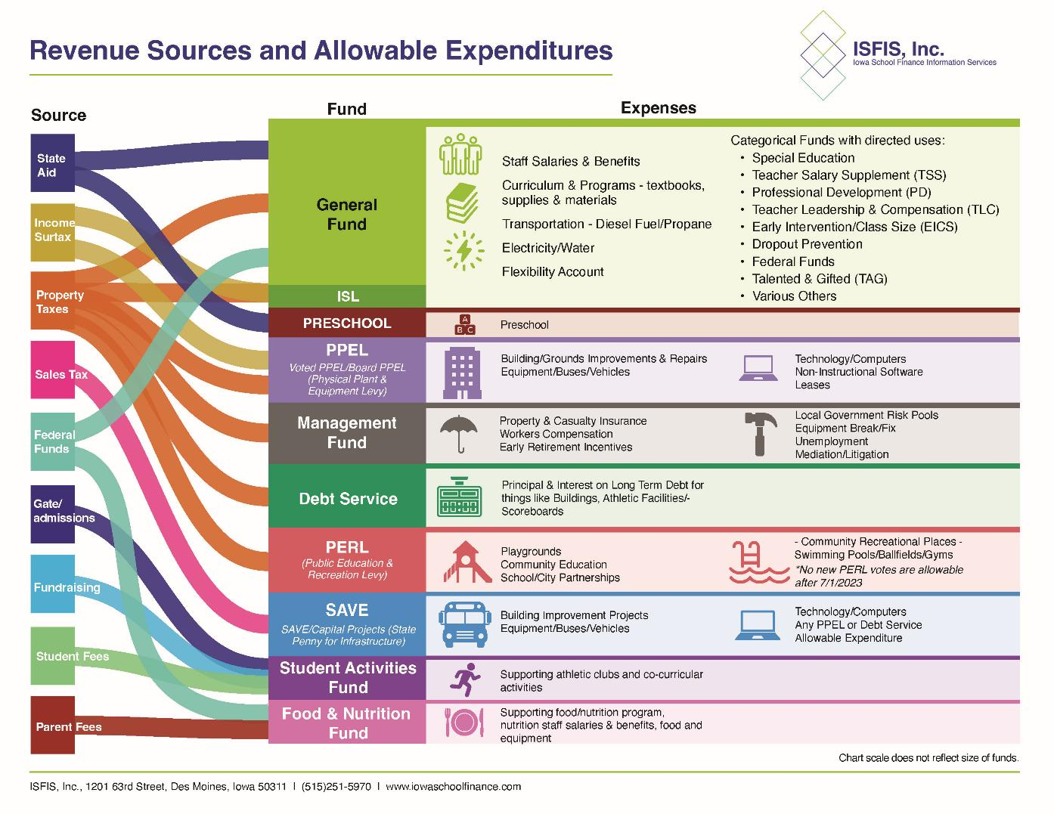
Notes:
Reminder: these are not to scale

Slide 6
FY 2025: “General” Fund

Slide 7
General Fund: Budget Limitation & Spending Authority

Slide 8
Focus
Focus primarily on General Fund. Why?
  That’s where we pay for educational program.
  Largest portion of a school’s expenditures.
  Biggest risk.

Slide 9
General Fund: Basics
Funding and budget is student driven, amount per student set by legislature
Schools are budget limited, not rate limited.
  Doubling property value = rate falls, not more $ to spend for your general fund
Tax rate driven primarily by the formula (and legislature) than by district actions

Slide 10
General Fund: Basics
State controls maximum amount of district spending though spending authority.
You can have plenty of cash, but you can’t legally spend it if you don’t have the Spending Authority
Why? Equity – basic principle is that every child should receive the same amount of funding – no matter where they live in Iowa

Slide 11

Spending Authority Calculation: Students
X DCPP ($$) =
Basic formula: # of students x a cost per student = total current year Spending Authority.
# of students is a year behind – always use prior year count – headcount in October is the number used for next year’s budget.
Some students (special education or English language learners) get additional weighting and count as more than one

Slide 12
Spending Authority Calculation: DCPP
X DCPP ($$) =
DCPP: District Cost per Pupil
Cost per pupil is set by the Iowa Legislature by setting State Supplementary Assistance Rate (currently known as SSA).
Spending Authority is then funded by a combination of State Aid and Property Taxes.

Slide 14
Spending Authority
Schools must track these separately
  Cash
  Spending Authority
Focus more on Spending Authority than fund balance (cash in the bank). Why?
  Negative Fund Balance can be solved locally.
  Negative Spending Authority can get you closed.

Slide 15
General Fund: Who Pays?

Slide 16
Funding Sources – State Average
FY 2022
(impacted by Covid $)
FY 2025
(“Normal”)

Slide 17
Who Pays?
So how do we pay for the Spending Authority in the General Fund? Four sources:
  Property Tax Replacement Payment funds a fixed amount of the Additional Levy with state funds.
  Additional Levy – property tax levy that funds the last 11.6% of the cost per pupil* (no rate limit – adjusts automatically to fund as much as needed).
  State Supplemental Aid – backfills up to 88.4% of the cost per pupil
  Uniform Levy - $5.40 property tax levy (first layer).

Slide 18
FY26 Financing the General Fund
Property Poorest*
Average Valuation
Property Richest
Per Pupil
$7,988
$7,988
$7,988
Prop Tax Replacement→
$242
$242
$242
Additional Levy→
$685
$685
$685
88.4%→
State Aid→
$6,032
$4,669
State Aid
Uniform Levy
Additional Levy
$7,061
$2,392
Uniform Levy→
$1,029

Slide 19
FY26 Financing the General Fund
Property Poorest*
Property Richest
Per Pupil
$7,988
$7,988
Prop Tax Replacement→
$242
Tax Rate Comparison
$242
Additional Levy→
$685
$3.59
$0.52
$685
88.4%→
State Aid→
$6,032
State Aid
Uniform Levy
Additional Levy
$7,061
Uniform Levy→
$1,029
$5.40
$5.40

Slide 20
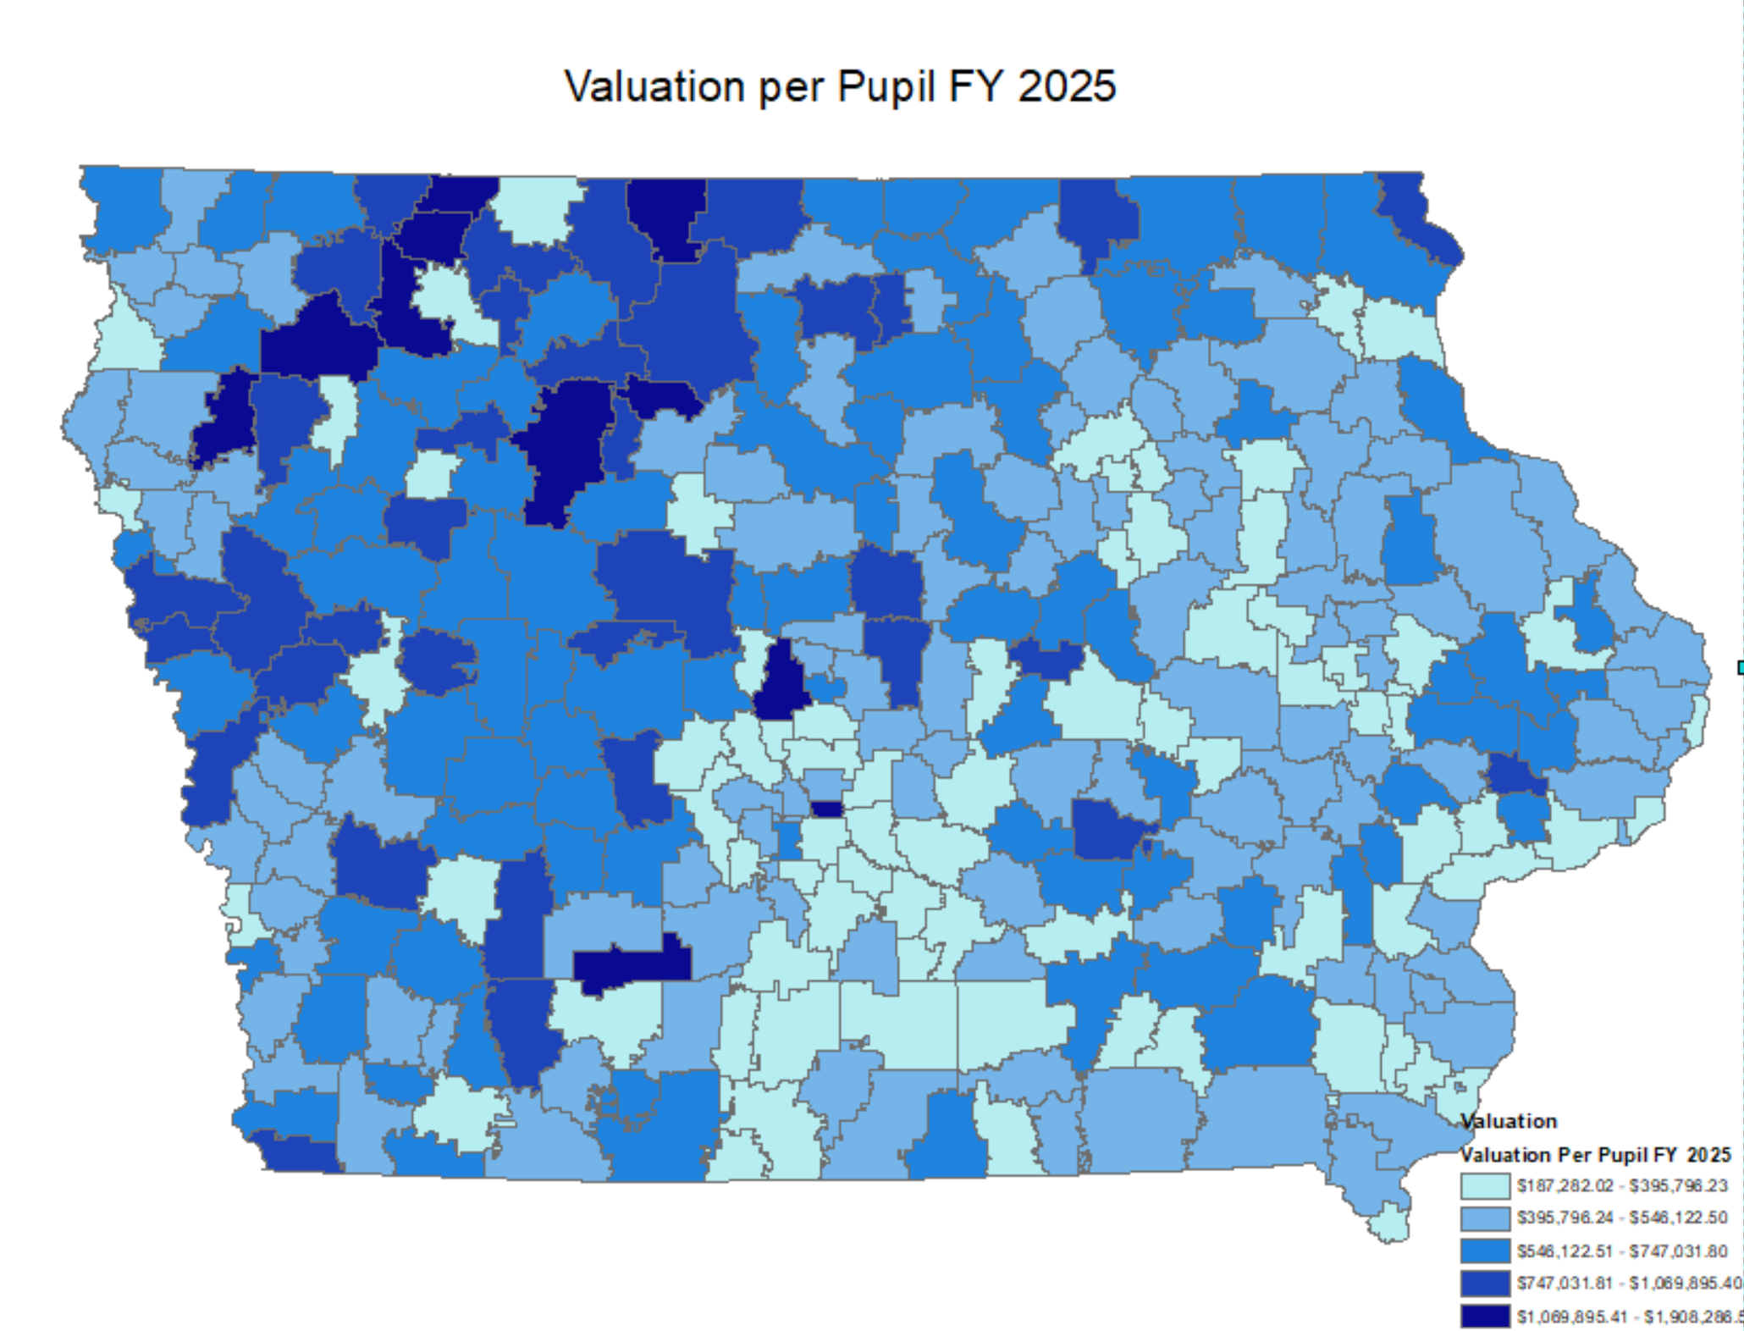
Property Valuation Characteristics

Slide 21
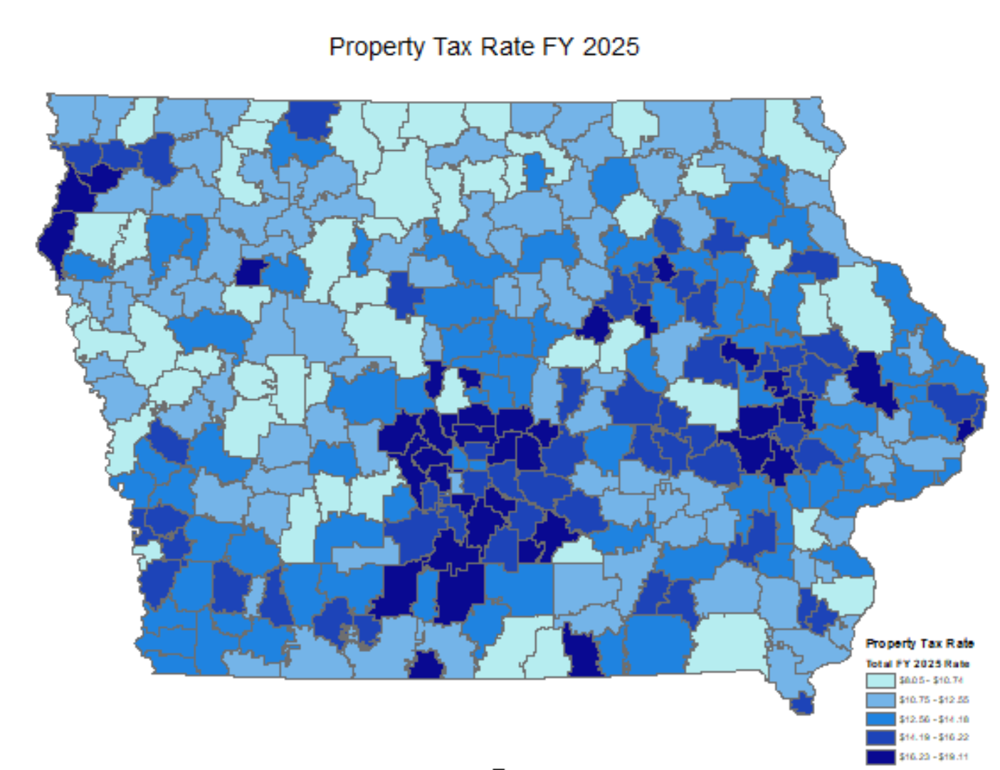
Impact Property Tax Rates

Slide 22
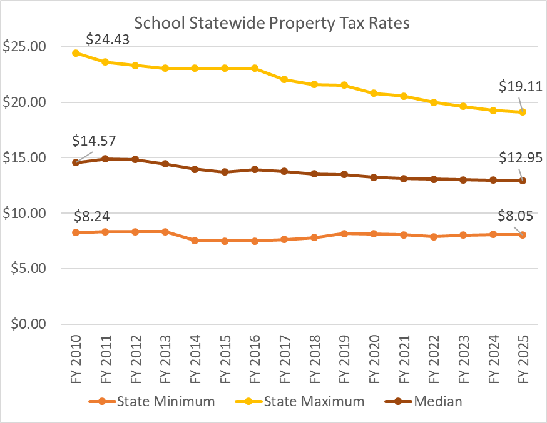
Historical Property Tax Data
Measure | Change FY10 – FY25
Maximum | -21.8%
Median | -11.1%
Minimum | -2.3%

Slide 23
General Fund: Accounting for Spending Authority And Fund Balance

Slide 24
Spending Authority Calculation
Limit on spending is the amount of Spending Authority a district has, not the amount of Cash or Fund Balance.
Total Spending Authority for a year is:
Current Year Spending Authority
+ Previous Years’ Unused Spending Authority
= Total Spending Authority

Slide 25
Spending Auth. Vs Fund Balance
“If we get state aid and property taxes in the amount of our spending authority every year, why isn’t our Unspent Authorized Budget equal to our Fund Balance?”
Great question – because there are situations that generate cash and not spending authority and circumstances that generate spending authority and not cash.

Slide 26
Spending Authority Calculation
So what’s the big deal with Spending Authority?
  It is illegal for a school district to exceed it’s total Spending Authority.
  Workout Plan, then Phase II Financial Viability Audit.
  The State Board of Education has the ability to close a school district for lack of compliance with state/federal law and/or for financial unviability (not necessarily educational reasons).

Slide 27
General Fund: Expenditures

Slide 28
General Fund: Expenditures
Where does the money go?
80% of the district’s funds go to pay for staff.
  Remainder is spent on curriculum, utilities, supplies, professional development and costs of transportation (fuel and salaries, usually not buses).
  Funds are to be used for the educational program not school facilities.

Slide 29
Other Funds
(Non General Fund)

Slide 30
Transition to Non-General Fund
Step across the great divide.
Most of the following funding sources cannot be used in General Fund and vice versa.
Might have money in one of these sources but cannot use to offset a General Fund shortfall.

Slide 31
Non-General Fund Summary
PPEL: Physical Plant and Equipment Levy
Debt Service: Making Bond Issue Payments
Sales Tax: 1 Cent State Wide

Slide 32
Physical Plant and Equipment Levy
Used for buildings, buses (purchase and major repair), equipment and technology (no staff)
Two levies:
  Board-approved $0.33 cents per thousand – exclusively property tax.
  Voter-approved – maximum equivalent of $1.34 per thousand of property tax. May be funded by property tax or income surtax or a combination. Maximum 10 years – 50% + 1 vote.
  Can borrow against property tax portion of voter-approved. Cannot borrow against the board-approved PPEL levy.

Slide 33
Debt Service
For buildings/grounds only
Voters approved borrowing against future property taxes (bond issue)
60% + 1 to approve
All property tax – maximum* $4.05 per thousand
20 year maximum duration
Until State Penny, was the primary way to build schools in Iowa

Slide 34
Sales Tax
Started out as local option sales tax in 1998. By 2007 voters in all counties had passed it. Became “State Penny for School Infrastructure” July 1, 2008.
Distributed on a per pupil basis
Requires a district vote on a Revenue Purpose Statement (RPS).
Can be used for buildings/grounds, PPEL purposes and PERL purposes (still depends on RPS language in your district) – cannot be used for staff costs.
Increased portion to property tax relief => maximum 1% of growth rate yearly until reaches 30% of total receipts (doesn’t keep up with construction inflation).
Expires 1/1/2051.

Slide 35
Property Values Matter
Example Levy | Property Poorest (Per Student) | Property Richest (Per Student)
PPEL ($0.33) | $63 | $432
PPEL ($1.34) | $255 | $1,752
Debt Service ($4.05) | $772 | $5,296
SAVE (State Penny) | $1,367 | $1,367
Districts with lower property values per pupil do not generate as much at a rate as district’s with higher property per student

Slide 36
Oversight

Slide 37
Layers of Oversight
There is a lot of oversight on school spending and performance
  Annual reports filed annually and audited by independent auditors (they look at expenditures, processes, etc.)
  Certified Annual Report (a district’s accounting information) is submitted to the DE
  School Budget Review Committee reviews issues with spending authority or other non-compliance
  State Auditor

Slide 38
Wrap Up

Slide 39
Key Points
Schools have segregated funds, they don’t have full control over how they spend money
Schools are budget limited and that is set by the legislature every year
Budget: Enrollment x District cost per pupil
On average general fund funding is 58% state aid, and 32% local taxes, 10% Federal and other
It is illegal for a school to spend beyond the legislature's set spending authority.
There are layers of oversight

Slide 40



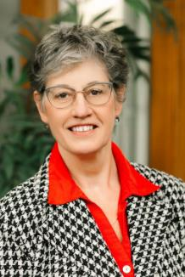
Larry Sigel
Cell: 515-490-9951
larry@iowaschoolfinance.com
Jen Albers
515-251-5970 ext. 4
jen@iowaschoolfinance.com
Ken Sturgis
515-251-5970 ext. 6
ken@iowaschoolfinance.com
Margaret Buckton
515-201-3755
margaret@iowaschoolfinance.com
ISFIS, Inc., 1201 63rd Street, Des Moines, IA, 50311, (515) 251-5970, www.IowaSchoolFinance.com

