Slide 1
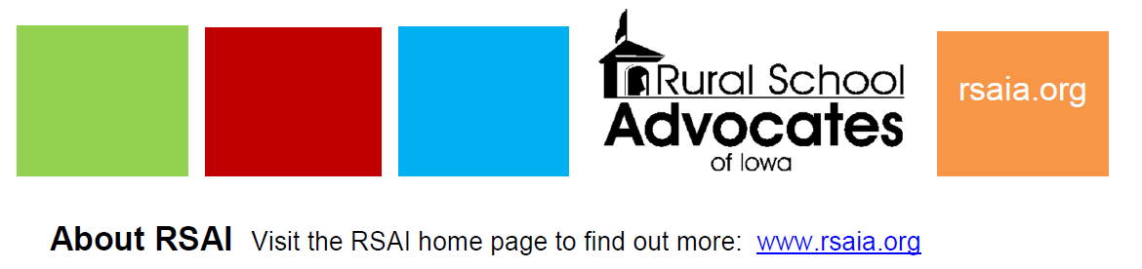
The Condition of Iowa’s Rural Schools
Zoominar with Iowa Rural Development Council
Sept. 25, 2026
View the IRDC Zoominar Recording by entering the Passcode of: 3$9S6Znp

Slide 2
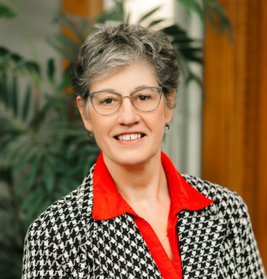
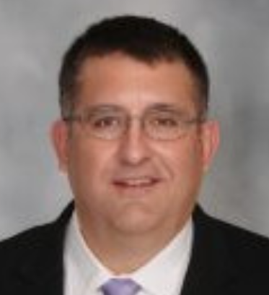

Your Panel Today
Margaret Buckton,
Professional Advocate for Rural School Advocates of Iowa (since 2013), and
Partner at Iowa School Finance Information Services (ISFIS)
Bio: https://www.iowaschoolfinance.com/Margaret
Ron Lorenz, Superintendent at Red Oak CSD since 2020-21 school year.
Email: lorenzr@redoakschools.org
LinkedIn: https://www.linkedin.com/in/ron-lorenz-033a7620
Caleb Bonjour, Superintendent at Gladbrook Reinbeck CSD since 2023-24 school year.
Email: caleb.bonjour@gr-rebels.net
Article: https://www.gladbrook-reinbeck.k12.ia.us/article/1107275
LinkedIn: https://www.linkedin.com/in/caleb-bonjour-01381192/

Slide 3
Public Schools Are Economic Development
Financial Contribution to the Local Economy
Workforce Development
Entertainment and Community Connection
School/ Community Interdependence

Slide 4
Public Schools Are Economic Development:
Financial Contribution to the Local Economy: Rural schools are among the largest, if not the largest employer, providing payroll and benefits in many Iowa rural communities. They purchase goods and services from the community/region. Employees spend their paychecks in the community.

Slide 5
Public Schools Are Economic Development:
Workforce development
  Connect students to local businesses and careers.
  Supply the community with a labor pool (spouse and family of the school employee.)
  Provide a range of jobs from part-time hourly to full time, plus supplemental work.
  Provide preschools and some even provide childcare and before and after school care, keeping students safe and learning while parents are working.

Slide 6
Public Schools Are Economic Development:
Entertainment and Community Connection
  Athletics to fine arts
  Convening space for local conversations
  Shelter when there is a flood or disaster, becoming the distribution center for resources
  The gathering place
  Opportunity for volunteerism and connection to community after retirement.

Slide 7
Public Schools Are Economic Development:
School/ Community Interdependence
  Shared ownership and impacts re housing, healthcare, transportation, jobs, and amenities.
  Identified community challenges impact all of us.

Slide 8
A little history – what’s been happening with Rural Schools
Enrollment
Funding
Teacher Pay
School Choice
Mandates

Slide 9
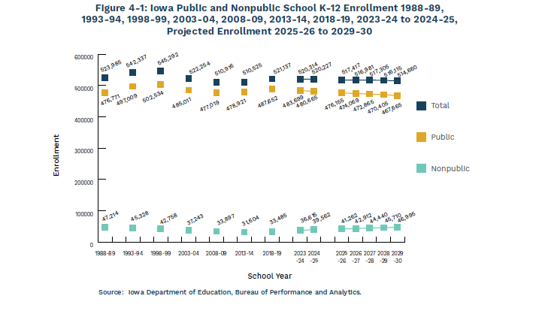
Projections for continued enrollment decline
1988-89
2025-26
25-26 Actuals vs. prior year projections:
510,425 (-7.0K)
467,935 (- 8.2K)
42,495 (+ 1.2K)

Slide 10
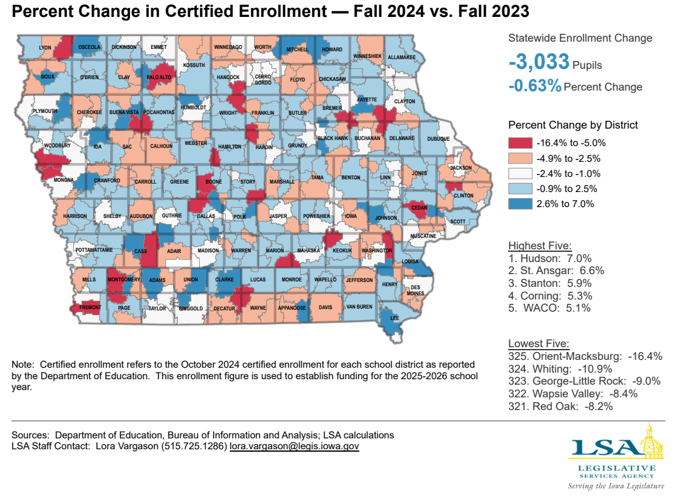
https://www.legis.iowa.gov/docs/publications/FCTA/1529472.pdf

Slide 11
Since 1990, there are 106 fewer school districts. Notice the low funding valleys that precipitate the consolidation/closing of schools.

Slide 12
National Education Association Rankings & Estimates https://www.nea.org/research-publications

Slide 13
Local Story: Enrollment Decline and Funding

Slide 14
A little history – what’s been happening with Rural Schools
Enrollment
Funding
Teacher Pay & Shortages
School Choice
Mandates

Slide 15
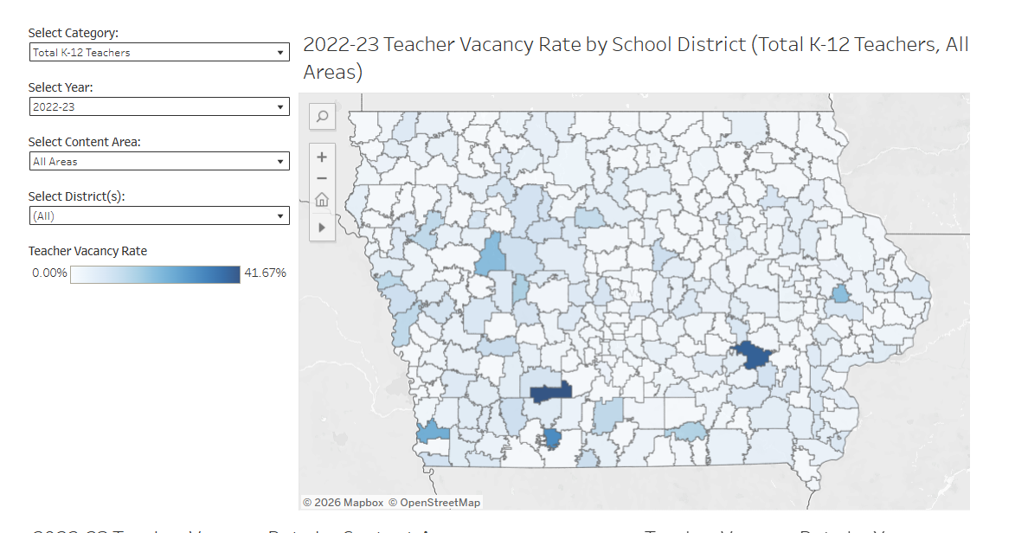
DE’s Teacher Pipeline Dashboard maps vacancy percentages for school districts. This is a map of total K-12 teachers. Orient Macksburg was the highest vacancy rate at 42%.
Source: https://educate.iowa.gov/pk-12/educator-quality/practitioner-preparation/teacher-shortage-areas/teacher-pipeline-dashboard

Slide 16
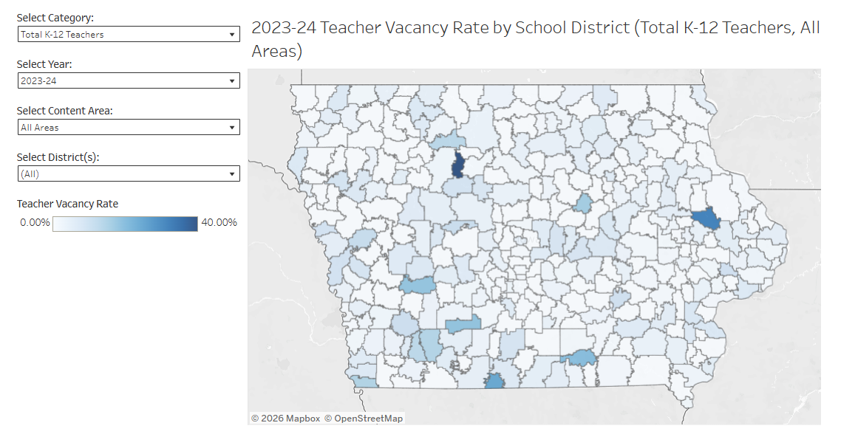
DE’s Teacher Pipeline Dashboard maps vacancy percentages for school districts. This is a map of total K-12 teachers. Gilmore City-Bradgate had the highest percentage of vacancy at 40%.
Source: https://educate.iowa.gov/pk-12/educator-quality/practitioner-preparation/teacher-shortage-areas/teacher-pipeline-dashboard

Slide 17
Teacher Salary Minimums increased 2024 and 2025
Iowa starting teacher pay is now a minimum of $50,000
Teachers with 12+ years experience also make at least $62,000.
Goal was to get Iowa near the top nationally in teacher pay.
Funded with Teacher Salary Supplement, a per student amount, enough to get districts what they needed to pay the costs of meeting the minimums. (TSS ranges from $726 to $3,373 in FY27)
Additional policy changes in how AEAs are funded and what services they may and must provide. Chaos in the AEA restructuring resulted in fewer AEA staff, many of whom were hired as teachers in public schools.

Slide 18
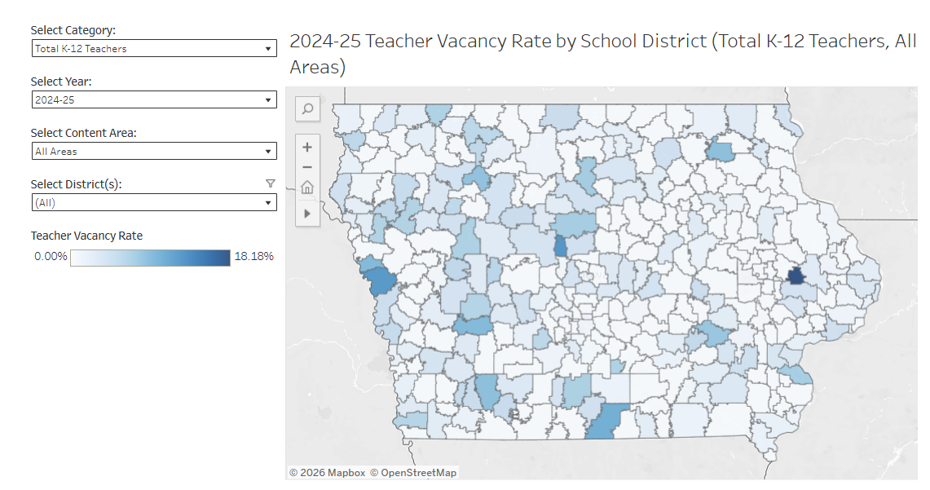
Vacancy rates dropped in 2024-25. However, still some outliers in rural districts. Olin has 18% vacancy. West Monona was unable to fill 12% of teaching jobs. Wayne had a 10% vacancy.

Slide 19
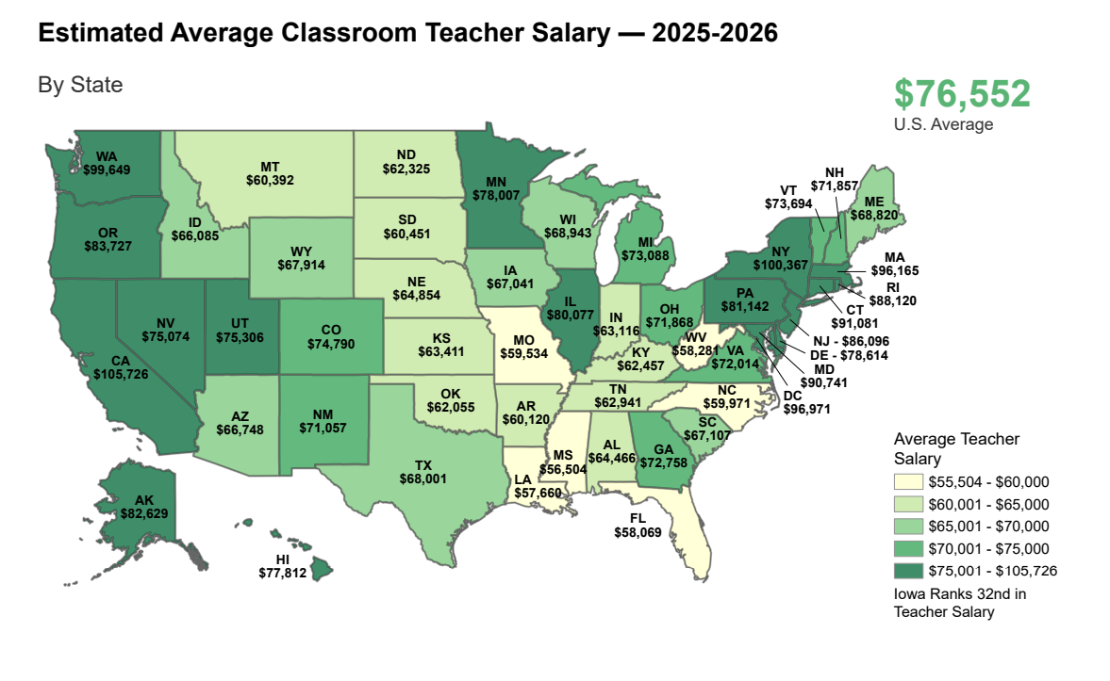
Source: LSA FactBook
https://www.legis.iowa.gov/docs/publications/FCTA/1607808.pdf

Slide 20
Local Story: Teacher Shortage

Slide 21
A little history – what’s been happening with Rural Schools
Enrollment
Funding
Teacher Pay & Shortages
School Choice
Mandates

Slide 22
School Choice Expansion
Education Savings Accounts for Accredited nonpublic schools.
  All enrolled private school students are eligible for the $8,148 ESA (no income/means testing)
  42,495 private school enrollment in 2025-26 (5.9K more than before ESAs began, or 16% increase)
  Mostly in urban/suburban areas and some NW and NE Iowa spots
  Most rural areas do not have private schools – why care?
  The state funding for ESAs is equivalent to about 8% SSA. Remember the chart on school closures following low funding increases? That 8% increase per pupil ($380 million) would have made a big difference, especially in rural areas with declining enrollment.
Charter Schools – 17 now authorized by Iowa State Board of Education. There are a few on-line options which attract serve rural students.
Home School – loosed regulations in 2026 Session, hard to measure with no oversight

Slide 23

Has SSA (per pupil funding) Kept Up With The Economy?
Chart includes an additional 1% SSA in FY2025 and FY2026 to simulate the increase in TSS. The gap between SSA and wages and CPI is about 13-25%, depending on the timeline.
13.8%

Slide 24
Poverty – changing needs of students
When school choice options increase, concentration of poverty in public schools increases
That’s not the only reason –poverty has increased in rural areas that have little school choice options
In 2001, about 27% of students were eligible for Free/Reduced Price Lunch (FRPL).
In 2026, there were 42.2% of students eligible for Free/Reduced Price Lunch (FRPL). 197,491 students, many of whom are in rural school districts.

Slide 25
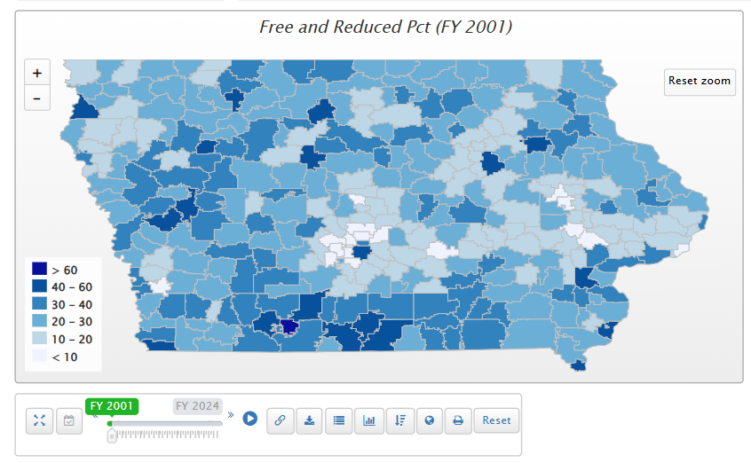
In 2001, only Diagonal school district is above 60% FRPL eligibility.

Slide 26
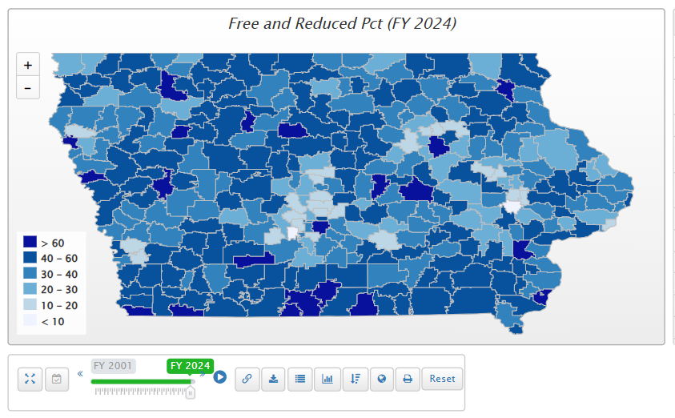
16 school district in 2024 are above 60% FPRL. 13 of those 16 school districts are rural.

Slide 27
Poverty and Education
Iowa’s funding for at-risk (.48%) and dropout prevention (2.5-5%) combined are well short of the national average 29% weighting for low-income students (AIR, Study of a new Method of Funding for Public Schools in Nevada, Sept. 2012).
Since Iowa spends over $4,000 less per student than the national average (NEA Rankings & Estimates FY 2026), the weighting per low-income Iowa student, applied to a lower base, is inadequate to provide needed supports.
Students from low-income families are more likely to begin school academically behind, exhibit nonproficient literacy skills, especially in early elementary, and fall further behind over summer breaks, unless schools have the resources, staff and programs to meet their needs.
Concentrated poverty impacts student learning when not addressed. The McCourt School of Public Policy, Georgetown, FutureEd, State Education Funding; The Poverty Equation, March 2020, states, “What’s more, when poverty is concentrated in a school—that is, when a significant portion of students in a school come from low-income households—the impact on performance is compounded. A body of research suggests that there is a ‘tipping point,’ somewhere between 50 to 60 percent of a school’s students living in poverty, where performance for all students there drastically declines.”

Slide 28
Local Story - Poverty

Slide 29
Accreditation and Unfunded Mandates – 10 years of more work
Curriculum/Instructional Changes: Computer science, financial literacy, civics test for graduation, work-based learning, literacy state initiative and math counts state initiative, technology time limits in K-5, Talented and Gifted plans and acceleration
Policy mandates: cell-phone restrictions, classroom removals, chronic absenteeism plans, technology limits in K-5, radon testing, employee misconduct reporting and background checks, seizure disorder training, special education training

Slide 30
Items per legislative session
64 items, 2017–2026 · 60 new requirements and 4 providing relief
60
new requirements
4
relief or flexibility bills
27
items in 2025 & 2026 alone
Counts bills, not workload: a single-line requirement weighs the same here as an omnibus.
https://www.iowaschoolfinance.com/system/files/members/Public/Unfunded%20Mandates%202017%20to%202026.pdf
Notes:
Source: ISFIS, State-Imposed Mandates Affecting Iowa Schools, legislative sessions 2017–2026, compiled August 2026. The 2020 session was cut short by the pandemic.

Slide 31
Local Story – Unfunded Mandates

Slide 32
Other Financial Limitations 2026
2026 Property Tax Reform bill
  Limited school districts to no more than 35% carry forward of spending authority into FY 2027 (larger balances were typically in smaller rural districts).
  Scooped SAVE (State penny sales tax for school infrastructure) $39 million in FY27, scales up to $122 million in FY 2031.
School Funding: state used $42 million to pay for budget guarantee, which otherwise would have allowed school district to use property taxes to slow the financial impact of declining enrollment. (That $42 million could have delivered a higher SSA rate giving more funding to school districts instead)
Hourly Staff Pay: $14 million from FY26 was cut in half, providing just $7 million for FY27.

Slide 33
Iowa and Other State Expenditure Comparisons
$94.5 million
$1.96 billion

Slide 34
Amendment #1 on the ballot
Requires a supermajority (2/3) of senators and representatives in Iowa to increase corporate or individual income taxes to solve a future budget problem
  17 Senators would be able to halt an income tax reconsideration.
  Would leave sales taxes, property taxes, fees and/or severe state budget cuts to response to a recession or other budget need.
  For rural families, sales taxes and property taxes are more regressive (they pay a larger share of their income on those taxes than rich people do.)
  Education is closing in on 50% of the state budget. Schools will have to be on the chopping block (as will health care, water quality, etc.)
  Google “Colorado and TABOR” experience (Tax Payer Bill of Rights) to see the impacts – dropped from the middle of the pack to 48th in teacher Pay

Slide 35
Some Legislative Actions to Help Rural Schools
TSS to increase teacher pay – more funding for smaller and rural school districts per pupil. Very appreciated, however, it’s based on enrollment. If enrollment goes down more than funding percentage goes up, TSS goes down. (If SSA doesn’t grow the TSS pot, salaries will fall behind quickly)
Transportation equity funding – schools with transportation costs per pupil above the state average receive reimbursement for their higher costs (they can now buy text books, pay for a counselor or a librarian or add a CTE program). Total of $33.3 million.
Operational Sharing – school districts can share certain positions, like superintendents, curriculum directors, school resource officers, etc., and generate extra funding to help cover their costs. FY26, a total weighting equivalent to 4,310 students, or $34.4 million, was generated through operational sharing for 301 school districts. (Only 24 districts didn’t receive operational sharing funding)
Flexibility Account Options – since one size doesn’t fit all, categorical carry forward funds (PD, PK, TLC and Class Size) can be redirected by school board action to other priorities.

Slide 36
Strengths of Iowa’s Rural Schools

Slide 37

NREA Annual Report “Why rural Matters” ranks states by the condition of their rural schools, with #1 having the most significant needs.
This report placed Iowa among the top third of states in outcomes for rural students
https://nrea.net/wp-content/uploads/2026/05/WRMReport2025-State-by-State-5-28-26.pdf

Slide 38
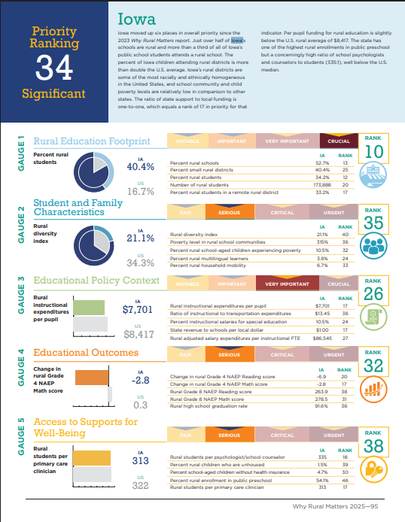
NREA Ranking
Iowa is doing pretty well, ranking 16th in nation in the quality of rural education.
40.4% of Iowa students are served in rural districts
State revenue to schools per local dollar $1.00 Iowa ranks 17th (33 other states have a better ratio of local to state dollars)
Iowa is in the Top third of states for better outcomes in test scores for rural students.
Only 5 states have better rural student access to PK than Iowa.

Slide 39
Rural School Programs
We know you and your family – students don’t “fall through the cracks”.
Great staff, committed to students and communities, finding creative solutions and working with communities to bring opportunities to students.
Universal Preschool (only 5 states have better PK access for students)
Graduation Rate: over 100 rural school districts in Iowa had ZERO dropouts in FY 2025 according to DE website.
Shared Programming (CTE Academies, Concurrent Enrollment/College Credit, Shared teachers, Shared Courses, Work-based learning and Internships)
Iowa ranks #1 in the nation in college credit earned per capita in High School.

Slide 40
Local Story: collaboration

Slide 41
Local Story: Grow your own programs

Slide 42
Conclusion
We are hopeful because rural schools have the commitment to serve students and we have a lot going for us (and for them.)
The state has to own the responsibility to adequately fund education.
Lester Thurow, Economics and Management Professor, at MIT, in his book Zero-sum Solution, 1985:
“Social welfare programs may be a matter of ethics and generosity, but education and training are not. I am willing to pay for, indeed insist upon, the education of my neighbor’s children, not because I am generous, but because I cannot afford to live with them uneducated.”

Slide 43
Questions
Margaret Buckton,
Professional Advocate for Rural School Advocates of Iowa (since 2013), and
Partner at Iowa School Finance Information Services (ISFIS)
Bio: https://www.iowaschoolfinance.com/Margaret
Ron Lorenz, Superintendent at Red Oak CSD since 2020-21 school year.
Email: lorenzr@redoakschools.org
LinkedIn: https://www.linkedin.com/in/ron-lorenz-033a7620
Caleb Bonjour, Superintendent at Gladbrook Reinbeck CSD since 2023-24 school year.
Email: caleb.bonjour@gr-rebels.net
Article: https://www.gladbrook-reinbeck.k12.ia.us/article/1107275
LinkedIn: https://www.linkedin.com/in/caleb-bonjour-01381192/

Slide 44
This Presentation and Recording will be posted on the RSAI website if you’d like to share it with others.

