Slide 1

School Finance Basics
Margaret Buckton, ISFIS/UEN
Larry Sigel, ISFIS
© Iowa School Finance Information Services, 2019

Slide 2
Urban Education Network Districts
Enroll 34.0% of Iowa's 504,063 PK-12 students
Enroll 57.6% of Iowa's PK-12 students of color, including 74.2% of African American students and 52.2% of Iowa’s PK-12 Hispanic Students
Enroll 60.6% of Iowa's limited English speaking students
Serve 43.7% of Iowa's K-12 low-income students (UEN enrollment of Free and Reduced Lunch eligible students is 55.0% of total UEN enrollment compared to the statewide average of 42.9%.)
Employ 33.4% of Iowa's PK-12 certified staff
Employ 26.2% of Iowa’s school principals with an average contract length of 14.2 days more than the state average contract length.

Slide 3
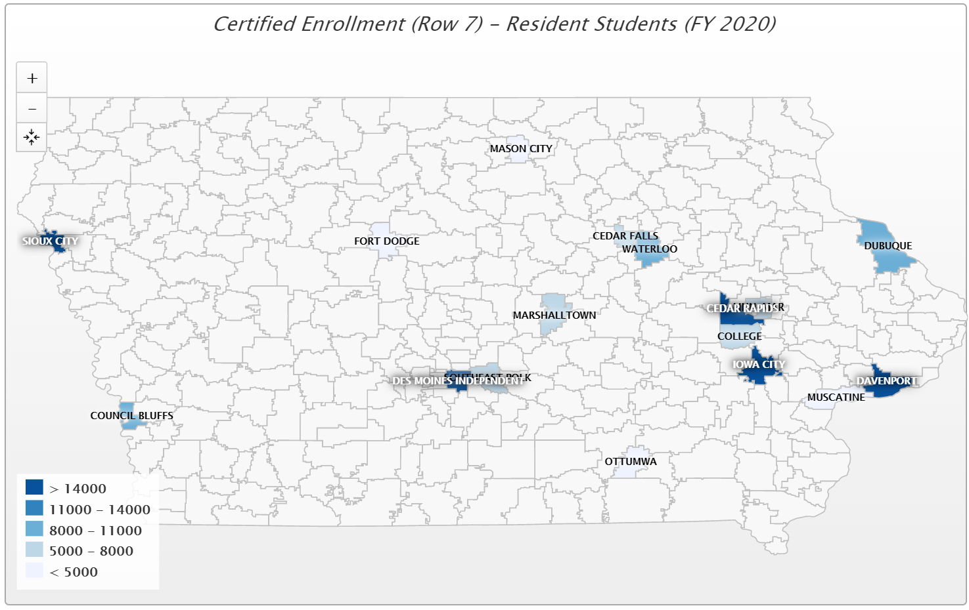

Slide 4
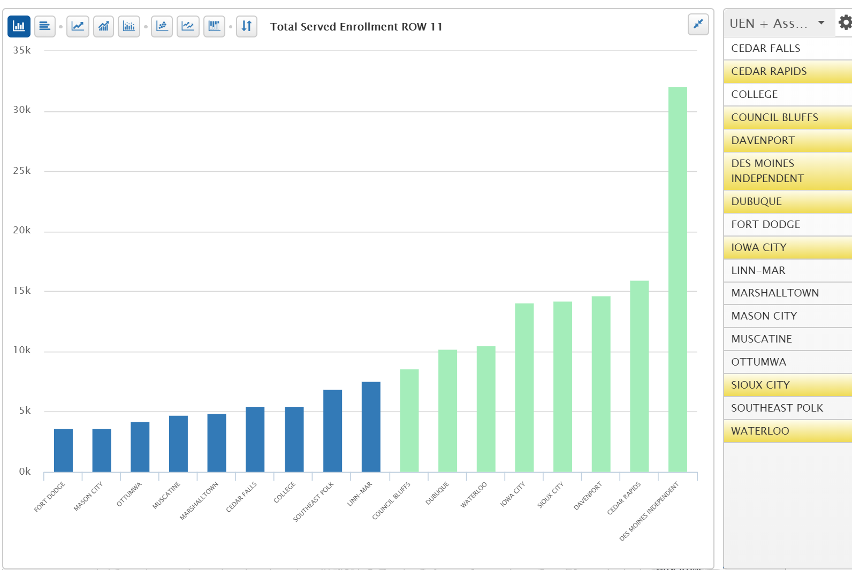
Eight Charter UEN Members
Nine Associate UEN Members

Slide 5
Overview: School Finance
Basics for UEN Districts
Funds & Revenues
Spending Authority
Expenditures
Other Funds
Financial Health Indicators
Financial Policies
District Specific Data
Board Role in Financial Oversight
2

Slide 6
Funding Sources
School districts have restricted funding sources - not all funds can be spent on anything the district decides.
  State and federal law specifies what are allowable expenditures – even from within the General Fund.
  Administrative Rules can further clarify state Code.
However, Home Rule statute gives some enhanced local authority

Slide 7
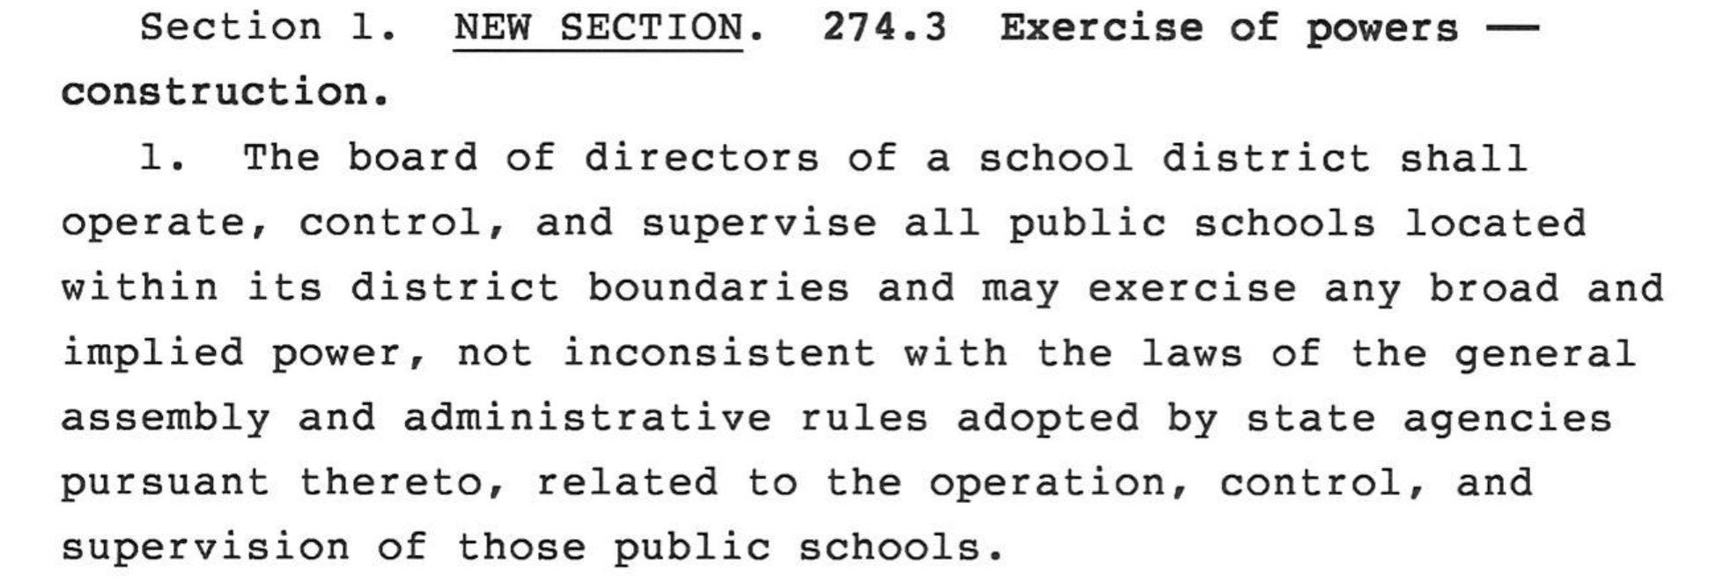
Home Rule
Legislature gave school districts “Statutory Home Rule” in HF 573 in 2017 Legislative Session

Slide 8
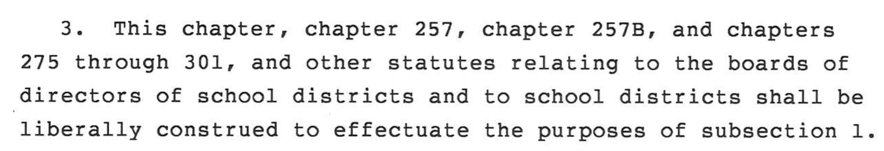
Home Rule
Home Rule statue still prohibits districts from:
  Levy a tax not authorized
  Charge fee not authorized
  Adopt/enforce a policy hindering law enforcement agency
Also, interpretation of Code (DE, Courts, Auditor, etc.) was given direction to be flexible:

Slide 9
Funding Sources
Funds
Activity
Nutrition
Trust & Agency
Other
Funds
General Fund
Management
PPEL
Capital Projects
Debt Service
PERL
Child Care

Slide 10
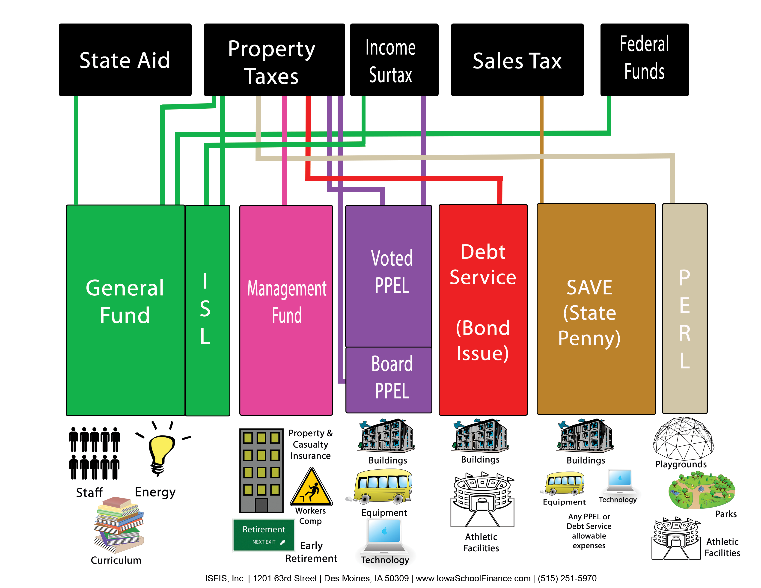

Slide 11
General Fund
Basic Principles:
  Student driven, amount per student set by legislature.
  Schools are budget limited, not rate limited. Doubling property value = property tax rate falls – no more $’s to spend.
  Tax rate driven by formula more than district actions.
  District can only spend funds on allowable purposes.

Slide 12
Funding Sources

Slide 13
General Fund
Very important concept: Spending Authority
State controls maximum amount of district spending
Why? Equity – basic principle is that every child should receive the same amount of funding – no matter where they live

Slide 14
General Fund
Restriction of Spending Authority only applies to the General Fund – all other funds allow spending if you have the cash to spend
District must account for two things in their General Fund:
  Fund Balance (cash)
  Spending Authority (credit card limit)

Slide 15
General Fund
Limit on spending is the amount of Spending Authority a district has not the amount of cash or fund balance
Total Spending Authority for a year is:
  Current year Spending Authority
  + Previous year’s surplus Spending Authority
  = Total Spending Authority

Slide 16
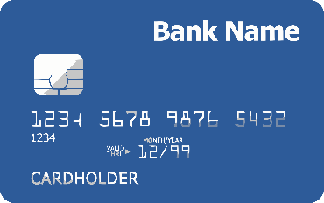
General Fund
Where does Spending Authority come from?
  Basic formula: # of children x a cost per child = total current year Spending Authority.
    # of children is a year behind – always use prior year count – this October’s number = the number used for next year’s budget
    Cost per child is set by the Iowa Legislature by setting State Supplementary Assistance Rate (formerly Allowable Growth)
    Spending Authority is then funded by a combination of State Aid and Property Taxes

Slide 17
General Fund
Reconciling two concepts: Fund Balance and Unspent Budget Authority
  Fund Balance – if the district ceased to exist at the conclusion of the fiscal year – and took in all funds it was owed and paid all bills it owed – what would be left over
  Corollary to Fund Balance from Spending Authority perspective: Unspent Budget Authority (Unspent Balance)

Slide 18
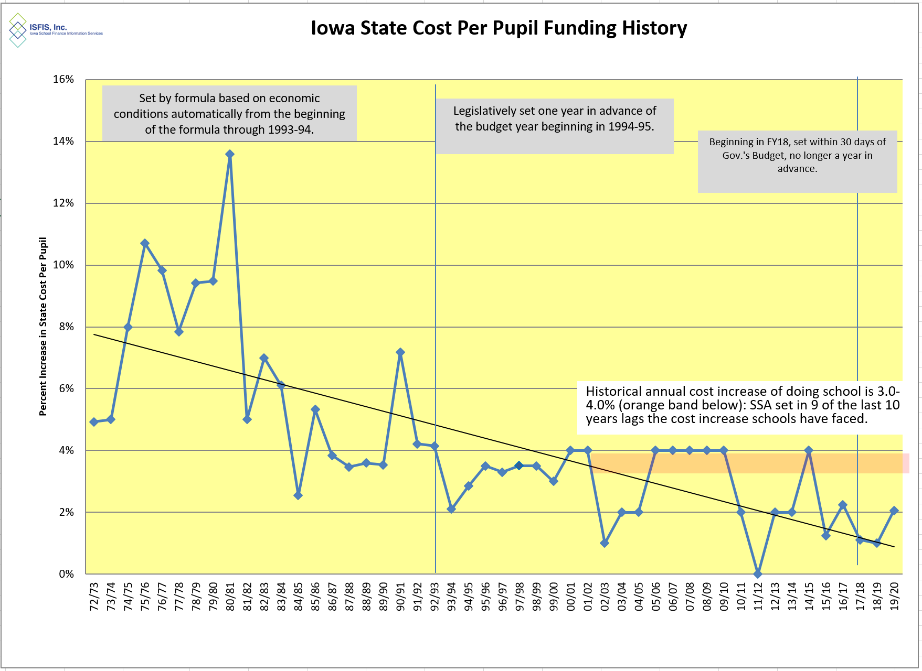
Adequacy
There is a cumulative impact to low funding and several years with no time for planning. HF 306 set 2.06% for 2019-20 school year. In 9 of the last 10 years, the increase in the cost per pupil has fallen short of cost increases schools typically experience.

Slide 19
Permutations of Spending Authority and Fund Balance
Understanding Fund Balance and
Unspent Budget Authority
Ending Fund Balance
Negative
Positive
Unspent
Negative
Situation 1
Situation 2
Budget
Authority
Positive
Situation 3
Situation 4

Slide 20
Student-driven Formula
Enrollment Driven for Regular Program
Categorical funding for certain programs within General Fund (mostly per student)
Weighting of some students differently based on costs of educating them.
Weightings add students to the number that is multiplied by the per pupil spending authority = more funding

Slide 21
Special Education Weighting
Counts students at a value greater than 1 then multiply by credit card limit to provide additional funds
  Special Education at three weightings:
    0.72
    1.21
    2.74
  Weightings driven by services specified in the Individual Education Plan, IEP, developed w/parents, educators, AEA oversight
All weightings in addition to 1.0 for regular education
May apply to SBRC for additional costs above the weightings

Slide 22
Data from SBRC https://educateiowa.gov/pk-12/school-business-and-finance/financial-management/school-budget-review-committee/school-0

Slide 23
English Language Learners
English Language Learner (ELL) at weighting of 0.22 (up to 5 years with state funding)
All weightings in addition to 1.0 for regular education
  May apply to SBRC for additional costs above the weightings (within the 5 years) or additional time beyond the 5 years.
  FY 2018 total of $14.6 million authority statewide was claimed by 107 districts. Of that, $8.3 million is in 15 UEN districts.

Slide 24
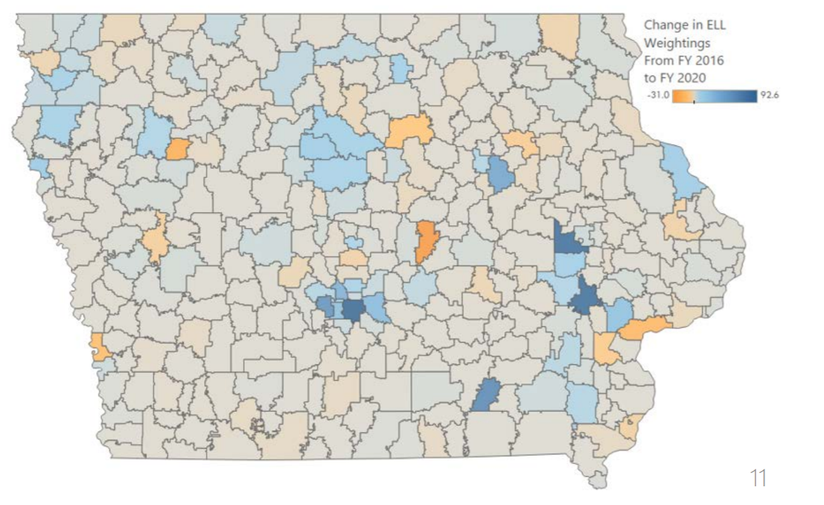
Since FY 2016, statewide ELL weightings have increased by 678 (16.6%). Weightings were last adjusted in FY 2004.
LSA Presentation to School Finance Interim Committee Dec. 13, 2019 https://www.legis.iowa.gov/docs/publications/SD/1125535.pdf

Slide 25
General Fund
So what’s the big deal with Spending Authority?
  It is illegal for a school district to exceed it’s total spending authority
  Sole measure: negative Unspent Authorized Budget
  Phase II Financial Viability Audit
  The State Board of Education has the ability to close a school district for no other reason than financial unviability (not educational reasons)

Slide 26
General Fund
So how do we pay for the Spending Authority in the General Fund?
Three sources:
  Uniform Levy - $5.40 property tax levy (first layer)
  State Supplemental Aid – backfills up to 87.5% of the cost per pupil (credit card limit)
  Additional Levy – property tax levy that funds the last 12.5% of the cost per pupil (no rate limit – adjusts automatically to fund as much as needed)

Slide 27
Financing the General Fund
FY 2020
Per Pupil
$6,880
$6,880
$6,880
Prop Tax Replacement→
$114
$114
$114
Additional Levy→
$750
$750
$750
87.5%→
------------------------------------------------
$85
$4,090
State Aid→
$4,869
$5,805
$1,800
Uniform Levy→
$1,021
Property Poorest
Average Valuation
Property Richest

Slide 28
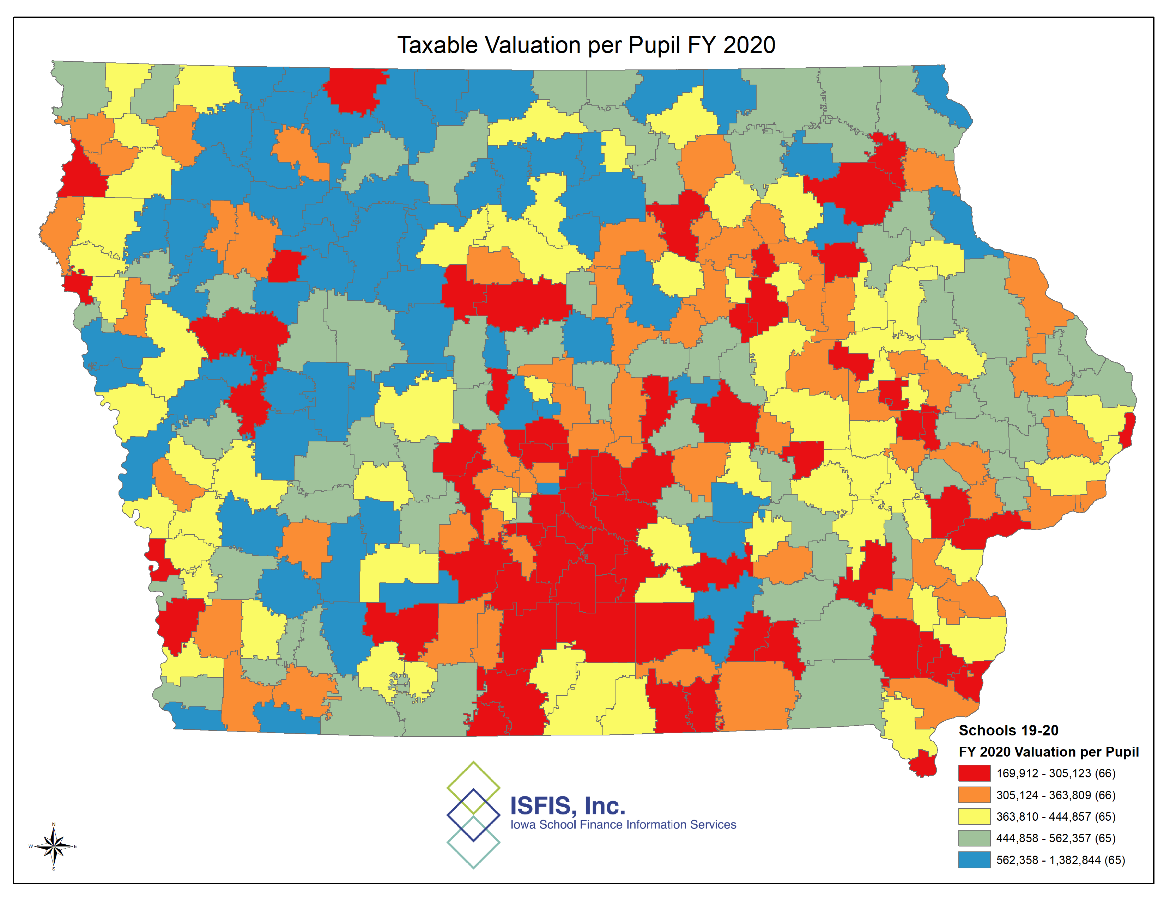
Property Valuation Characteristics…

Slide 29
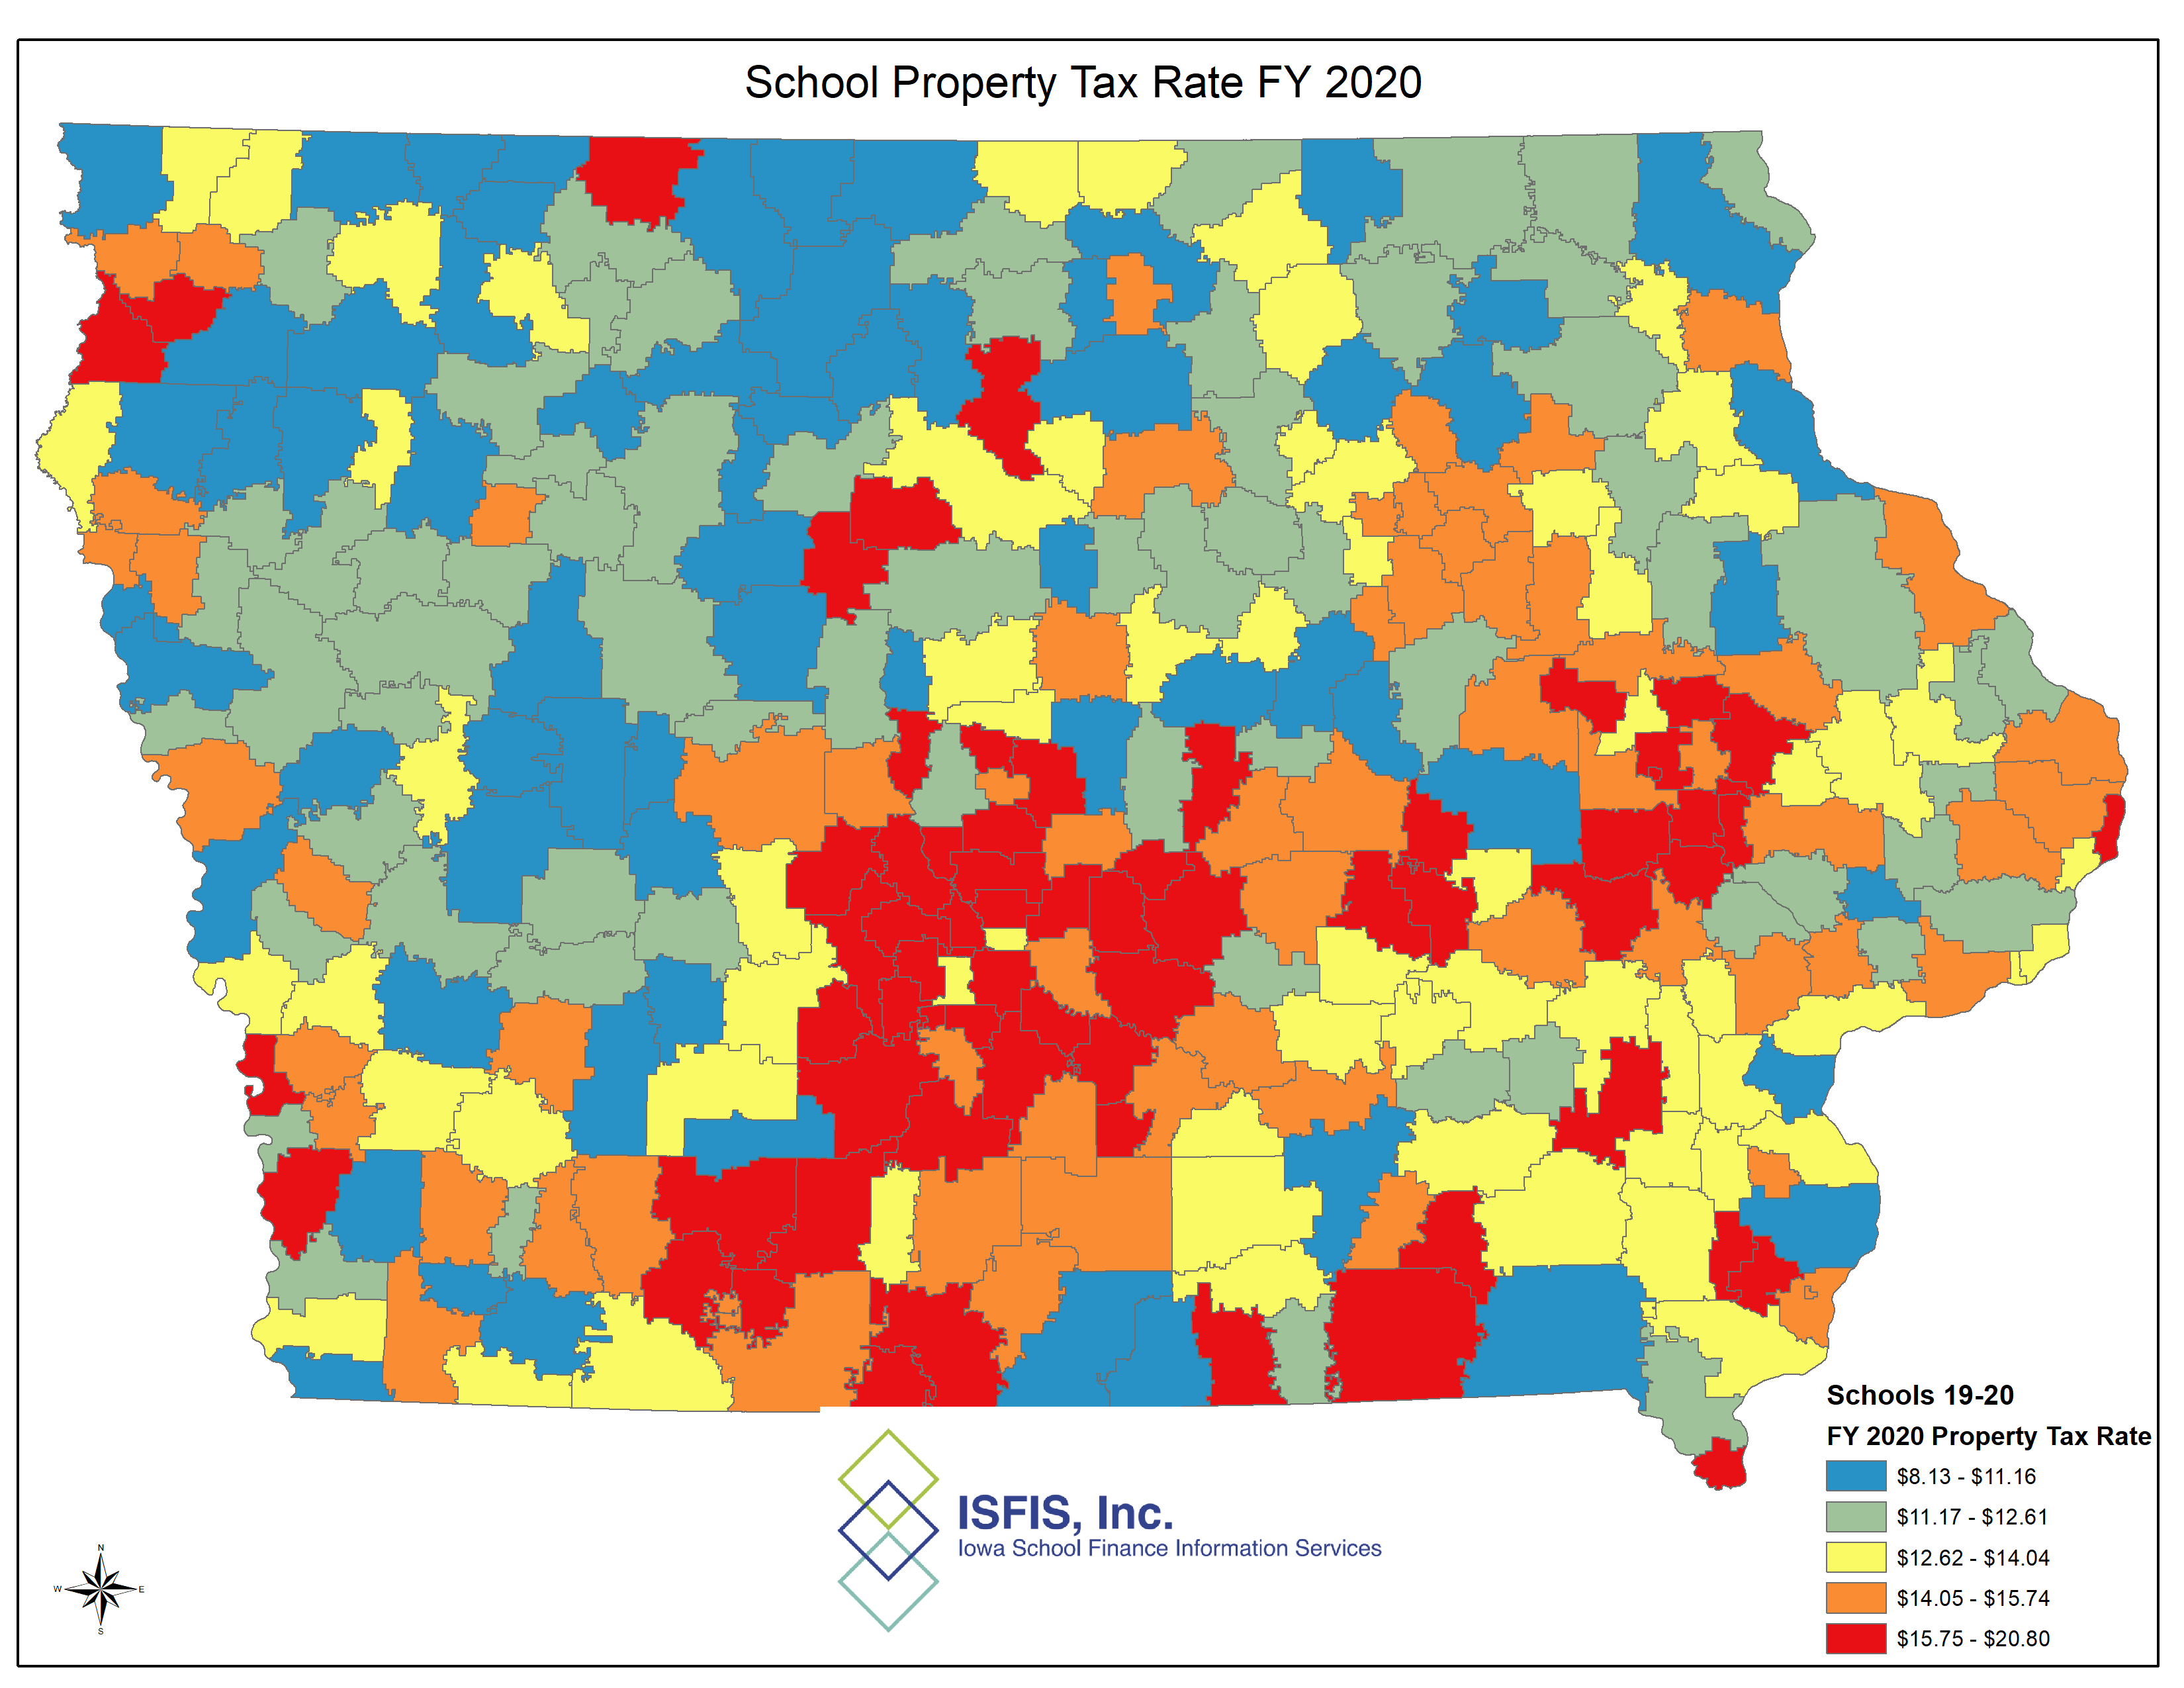
…Impact Property Tax Rates

Slide 30
School Property Tax Rates FY 2020
Minimum $ 8.13/$1,000
Mean $13.51/$1,000
Median $13.22/$1,000
Maximum $20.80/$1,000

Slide 31
Optional Sources of Authority in the General Fund
Instructional Support Levy (ISL)
  First question: How much do we want to increase (up to 10% of credit card limit)?
  How do we fund it (property taxes or income surtax)?
  Voter approval – up to 10 years
  Board approval – up to 5 years

Slide 32
Optional Sources of Authority in the General Fund
Dropout Prevention
  Maximum 5% of Regular Program District Cost (2.5% min / 5.0% max)
  Used for services to dropouts or student defined as at-risk and for generic prevention
  Effectively funded by all property tax

Slide 33
Budget Guarantee
Mechanism to postpone the impact of enrollment changes by one year
If this year’s Regular Program District Cost (Kids x Credit Card Limit) is less than 101% of last year’s RPDC, the district receives and amount of spending authority equal to get the district to 1% growth
Amount is all property tax
Because the following year’s calculation does not contain any budget guarantee authority, the loss the following year is equal to what would have been for the current year

Slide 34
On Time Funding
Because enrollment figure for budgets is always a year behind, what happens when more K-12 kids show up this year than last?
District’s are eligible to receive spending authority for those pupils (but not PK)
Provides an extra year of spending authority for those pupils that were new this year
Also can receive authority for students new to the district but open-enrolled out before attending school in your district

Slide 35
General Fund
Where does the money go?
  80% of the district’s funds go to pay for staff
  Remainder is spent on curriculum, utilities, professional development, and costs of transportation (fuel and salaries, usually not buses)
  Funds are to be used for the educational program, not physical infrastructure.

Slide 36
Cash Reserve Levy
Only for the General Fund!
All property tax
No rate limit on the levy – but a district cannot levy the Cash Reserve Levy if fund balance exceeds 20%
Cash Reserve Levy does not create spending authority, it only gives the funds to spend it (i.e., you cannot just levy your way out of a spending authority problem)

Slide 37
Transition to Non General Fund Sources
Step across the great divide
Most of the following funding sources cannot be used in General Fund and vice versa
Might have money in one of these sources but cannot use to offset a General Fund shortfall

Slide 38
Funds Outside the General Fund
Management – Risk management: Property insurance, Unemployment, Worker’s Comp, Early Retirement, Risk Pools. Set annually as part of Certified Budget. All property tax.
PPEL – Facilities/Equipment: Buildings, buses, tech, energy conservation. Board approved set annually as part of Certified Budget - $0.33/thousand all property tax. Voter approved (10 years), simple majority (50%) – max $1.34/thousand can be all property tax or a mix with income surtax.
Sales Tax (SAVE) – Facilities/Equipment: any PPEL or Debt Service purpose. Revenue Purpose Statement required, simple majority (50%). Borrowing or unattached athletic facilities subject to reverse referendum.
Debt Service – Facilities: Buildings – project based. Voter approved (20 years), super majority (60%) – max $4.05/thousand all property tax.
PERL – recreation/community education. Voter approved (no end date), simple majority (50%) – max $0.135/thousand all property tax.

Slide 39
Financial Health
Focus primarily on General Fund
Why?
  Pays for educational program
  Largest portion of school expenditures
  Biggest risk
Focus more on Spending Authority than Fund Balance – why?
Simple, Negative Spending Authority can get you closed – Negative Fund Balance can be solved locally

Slide 40
Non-General Fund Key Measures
For all funds outside of the General Fund the Fund Balance (Fund Equity) is the way relative health is measured
  Beginning Fund Balance
  + Current year revenues
  - Current year expenditures
  = Ending Fund Balance
We find it most meaningful to express on a percentage basis (i.e., what percentage is surplus?)
Key issues – what is the trend? (up, down, stable), for PPEL/Sales Tax what obligations do we have in the future (facilities plan), how much of our borrowing capacity has been committed? When are any bonds paid off?

Slide 41
General Fund Key Measures
Unspent Budget Authority – by far most important measure
  Look at trend
  Usually measured on a percentage basis
  Impact by reducing (or shifting) expenditures (not Special Ed)
Solvency Ratio – Fund Balance (cash) expressed on a percentage basis
  Look at trend
  Impact by reducing expenditures, increasing Cash Reserve Levy
Other key indicators
  Salary + Benefits cost
    As a percent of GF expenditures
    Class size
    Staffing Ratios
  Other expenditures – one time vs. ongoing (e.g., curriculum vs. electricity)
Do you have board policies on these that set goal amounts/percentages?

Slide 42
Total Property Tax Rate
Total Property Tax Rate
 | General Fund Rate
+ | PPEL Rate
+ | Management Rate
+ | Debt Service Rate
+ | PERL Rate
= | Total Property Tax Rate
Here is the most common way a district sets the annual property tax rate:
  General Fund – most of the rate is set by formula, however the Cash Reserve Levy is adjustable (if balance maximum does not exceed the limit)
  Management Fund – set by Certified Budget – adjustable based on uses as set by Board
  PPEL, Debt Service, PERL are usually not adjusted
Other less common ways:
  If income surtax funds either ISL or PPEL, those may be adjustable (more income surtax = less property tax), less commonly used, but may apply
  Can use Sales Tax to “buy down” Debt Service outstanding debt, or use funds to offset what would have been purchased with PPEL property taxes

Slide 43
Vacation Analogy
How do you know what route to take if you don’t have a destination?
School finance corollary:
  If the board doesn’t communicate via policy where you want your Spending Authority and Fund Balance to be, how can your district administrators and staff figure out what budget to recommend, what to levy and what to spend?

Slide 44
Big Picture
What is the purpose of setting financial goals?
  Ultimately the board sets expectations – the “what” and the “why”
  The administration provides the “how” (or range of “hows”)
  Facilitates longer term planning.
  Stability and predictability are key features of any finance system.

Slide 45
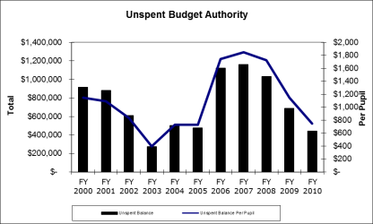
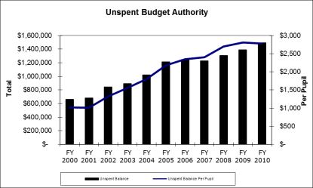
Stability and Predictability
Consider these two districts:
What do you think happens during these times?

Slide 46
Preferred Financial Goal Components
Goal v. absolute requirement
Range v. point estimate
Description of why important
Reporting/Accountability component

Slide 47
District Specific Data

Slide 48
ISFIS Financial Analysis Comparison Tool (FACT) Snapshot

Slide 49
Board Roles and Responsibilities in School Finance

Slide 50
Board Roles in School finance
Compliance with state law
  approve paid bills list (various processes depending on size of the district and volume of bills paid)
  pass board resolutions for increased spending authority requests as directed by DE
  delegation to sec/treasurer and superintendent, etc. for e.g., board policy may direct district staff to always apply for additional spending authority
  appear before the SBRC if required for workout plan or for unique and unusual requests of additional spending authority.

Slide 51
Board Roles in School finance
Approve Certified Budget by April 15 deadline
  Big picture question: What good for whom at what cost?
  Public Hearing Required, but there may be other board opportunities or directives for public input
  Tax rates – all politics is local
  How big to build the budget – maximum spending authority vs. striving for exact amount to be spent
  Amendments by May 31

Slide 52
Board Roles in School finance
Receive and Review the Audit
  Annual audit of all district finances
  Look for areas of noncompliance but also, look at suggestions of the auditor
  The auditor works for the board, so always hear directly from the auditor
  The only stupid question is the one never asked.

Slide 53
Other Considerations
Open meetings and public records – for example, is your paid bills list public, posted on the internet, searchable? Or simply available at the district office?
Conflict of interest – even the perception of conflict can be problematic in urban districts. Know when there is potential for conflict, declare it and determine if board member should abstain from voting or even step aside from all conversation
Board meeting nuts and bolts – for example, do you approve your paid bills list as a formality within the consent agenda? Do board members set aside items they have questions about or may have conflicts within?

Slide 54
Sample Board Policies
(rates/amounts in red are examples only)

Slide 55
Sample Unspent Budget Authority Policy
The unspent budget authority is the remaining legal spending authority at the end of the fiscal year. The district’s unspent budget authority at June 30 shall be no less than 5 percent with target of 7.5 percent and a maximum of 10 percent of its general fund budget (spending) authority. Maintaining an adequate unspent budget authority provides legal authority to spend the undesignated, unreserved fund balance. A report on meeting this target will be made annually to the Board.

Slide 56
Sample General Fund Balance Policy
“The District’s goal for its assigned and unassigned general fund balance at June 30 is a minimum of 15 percent of that year’s revenue. The District may certify annually a cash reserve levy if needed to reach and/or sustain the desired fund balance. A fund balance of a minimum of 15 percent enables the District to achieve the highest possible credit ratings from rating agencies. Higher credit ratings are directly related to lower interest rates on long-term debt issued by the District. Sufficient fund balances also eliminate short-term borrowings and related interest expense in the general fund and protect the District if the State of Iowa reduces funding mid-year. A report on meeting this target will be made annually to the Board.”

Slide 57
Modified Supplemental Amount
The district shall solicit from the School Budget Review Committee additional Modified Supplemental Amount (MSA) where it may be available for items such as special education deficit, increasing enrollment, English as Language Learner, and any other lawful purposes. Any award of MSA may be levied as a cash reserve levy, in full, in the next available budget year. For recurring program deficits that are predictable and estimable, the district may levy in advance for the immediately succeeding year as part of the general cash reserve levy.

Slide 58
What are the Benefits of Board Financial Policies?
Sets clear and identifiable goals.
Promotes stability.
Allows the administration to know the budget parameters and develop plans/options.
Rating agencies are requiring local policies, and having them may help reduce interest rate on borrowing.
Helps board members communicate with patrons about why the district is taking the action.
Going through the conversation educates board members.

Slide 59
Resources
ISFIS FACT Snapshot https://www.iowaschoolfinance.com/FACT (or email and we will send you your district-specific page)
ISFIS Building Blocks Virtual Training Modules https://www.iowaschoolfinance.com/board_building_blocks
ISFIS Mapping Tool https://www.iowaschoolfinance.com/interactive_map
ISFIS Supplemental Policy Services provides sample school board policies and searchable online hosting of your school board policy manual
ISFIS Comprehensive Financial Projection Model provides 5-year projection tool for school business office. Can model tax rate, expenditure and authority changes based on budget decisions. Included free with ISFIS subscription

Slide 60

Questions?
Do not hesitate to contact us if you have any questions or comments!
Iowa School Finance Information Services
1201 63rd Street
Des Moines, IA 50311
Office: 515-251-5970
www.iowaschoolfinance.com
© ISFIS 2019
Margaret Buckton, UEN Professional Advocate
margaret@iowaschoolfinance.com
515-201-3755 (cell)
Larry Sigel, Partner
larry@iowaschoolfinance.com
515-490-9951 (cell)

